Slide 1
Lesson 10: Rebellion and Complaining

Slide 2
 | Date |  | Topic
1 | Sunday | February 21 | The Birth of Moses
2 | Wednesday | February 24 | The Preparation of Moses
3 | Sunday | February 28 | The Burning Bush
4 | Wednesday | March 3 | Return to Egypt
5 | Sunday | March 7 | The Plagues
6 | Wednesday | March 10 | From Egypt to Sinai
7 | Sunday | March 14 | Mount Sinai
8 | Wednesday | March 17 | The Golden Calf
9 | Sunday | March 21 | Renewing the Covenant
10 | Wednesday | March 24 | Rebellion and Complaining
11 | Sunday | March 28 | Failing to Enter the Land
12 | Wednesday | March 31 | Preparing the Next Generation
13 | Sunday | April 4 | The Death of Moses

Slide 3
Complaints Before Sinai
Who is the target of these complaints?
“Your grumblings are not against us but against the LORD” (16:8)
Exodus 2:14: Moses killed the Egyptian
“Who made you a prince or a judge over us?”
Exodus 5:21: First demand to Pharaoh backfires
“May the Lord … judge you, for you have made us odious in Pharaoh’s sight”
Exodus 14:10-13: Trapped by the Red Sea
“… you have taken us away to die in the wilderness?”
Exodus 15:24: Three days out and no water
“the people grumbled at Moses… what shall we drink?”
Exodus 16: Grumbling about food
“you have brought us out … to kill the whole assembly with hunger”
Exodus 17: Quarreling about water
“why have you brought us up … to kill us … with thirst?”
What is the motivation behind these complaints?
Any serious threat to replace Moses?
Any punishment from the LORD?

Slide 4
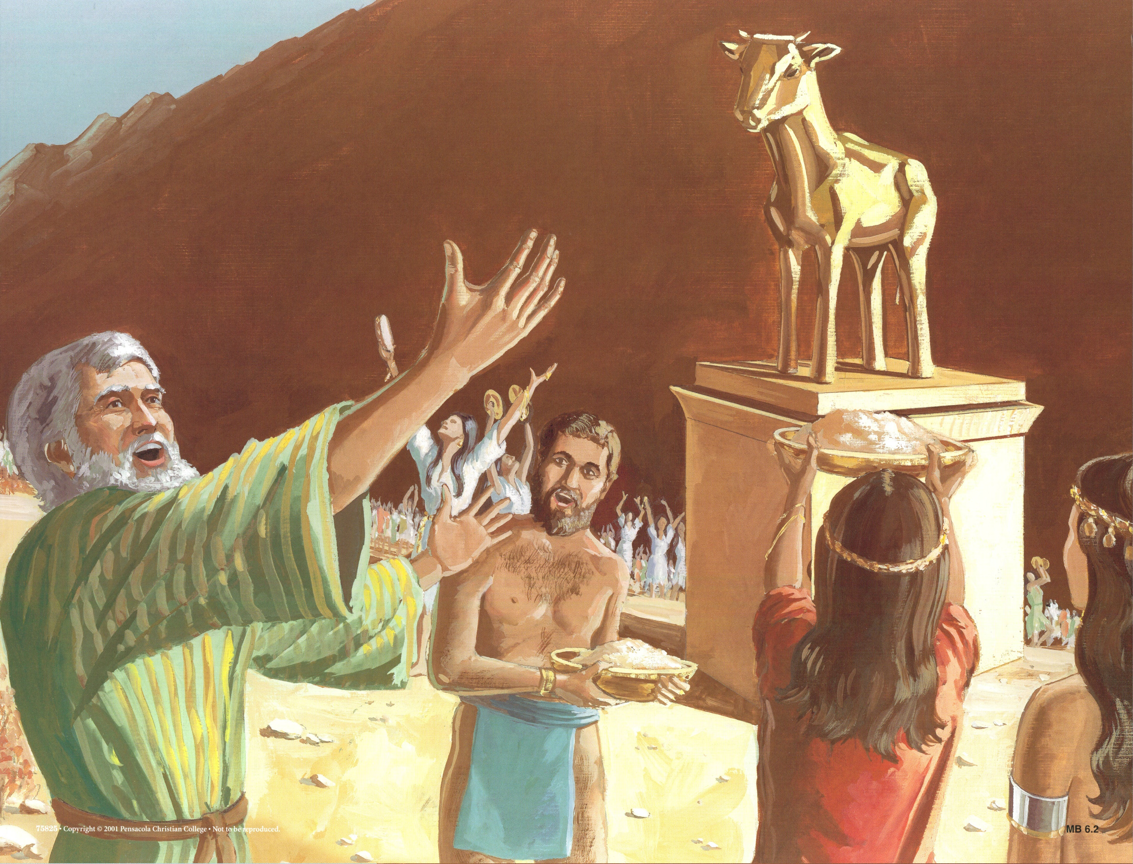
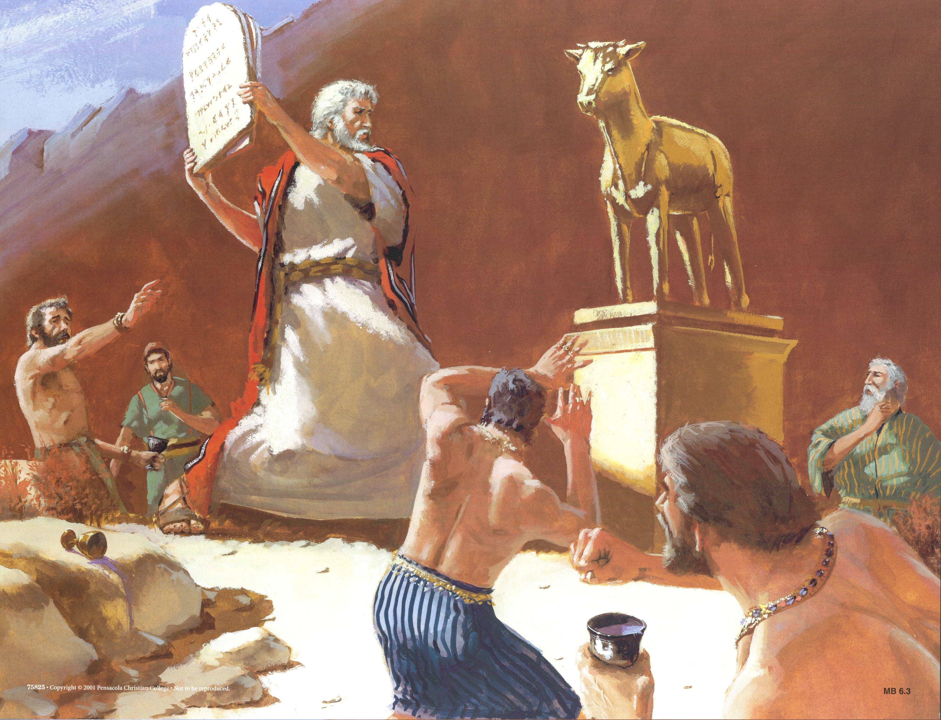
The Golden Calf
The People Sin (32:1-6)
The LORD Reacts (32:7-10)
Moses Intercedes (32:11-14)
Moses is Angry (32:15-20)
Moses Deals with Aaron (32:21-24)
Moses Takes Control (32:25-29)
Moses Makes Atonement (32:30-35)
The Lord Distances (33:1-12)
Moses Intercedes Again (33:13-23)
The Covenant is Renewed (34)
What were the motivations behind this rebellion?

Slide 5
Numbers 11
“Greedy desires” (not fear of death) behind this complaint
Complaints punished with fire (1-3)
People cry out to Moses, who prays to the Lord
“Who will give us meat?” (4-9)
Moses is frustrated (10-15): “Please kill me at once”
The Lord’s response
Appoint 70 elders to ease Moses’ burden (16-17; 24-25)
At tent of meeting, portion of Spirit transferred
Eldad & Medad were in the camp (26-27)
“Are you jealous for my sake?” (28-30)
So much meat you’ll be sick of meat (18-20)
Moses wonders how (21-23)
Three feet of quail from the sea (31-32)
A severe plague on the people (33-35)
Is Moses determined to concentrate all authority in himself?

Slide 6
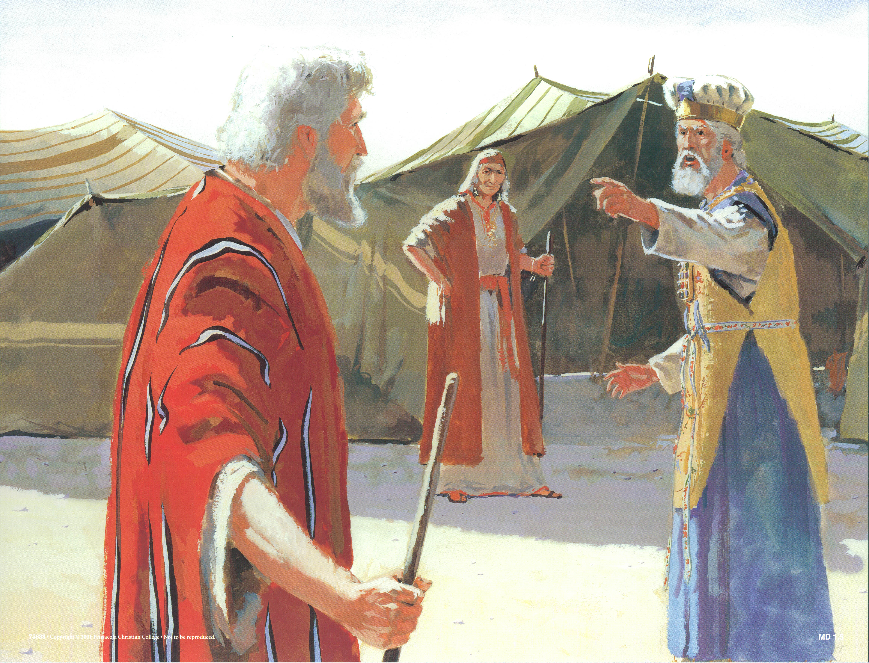
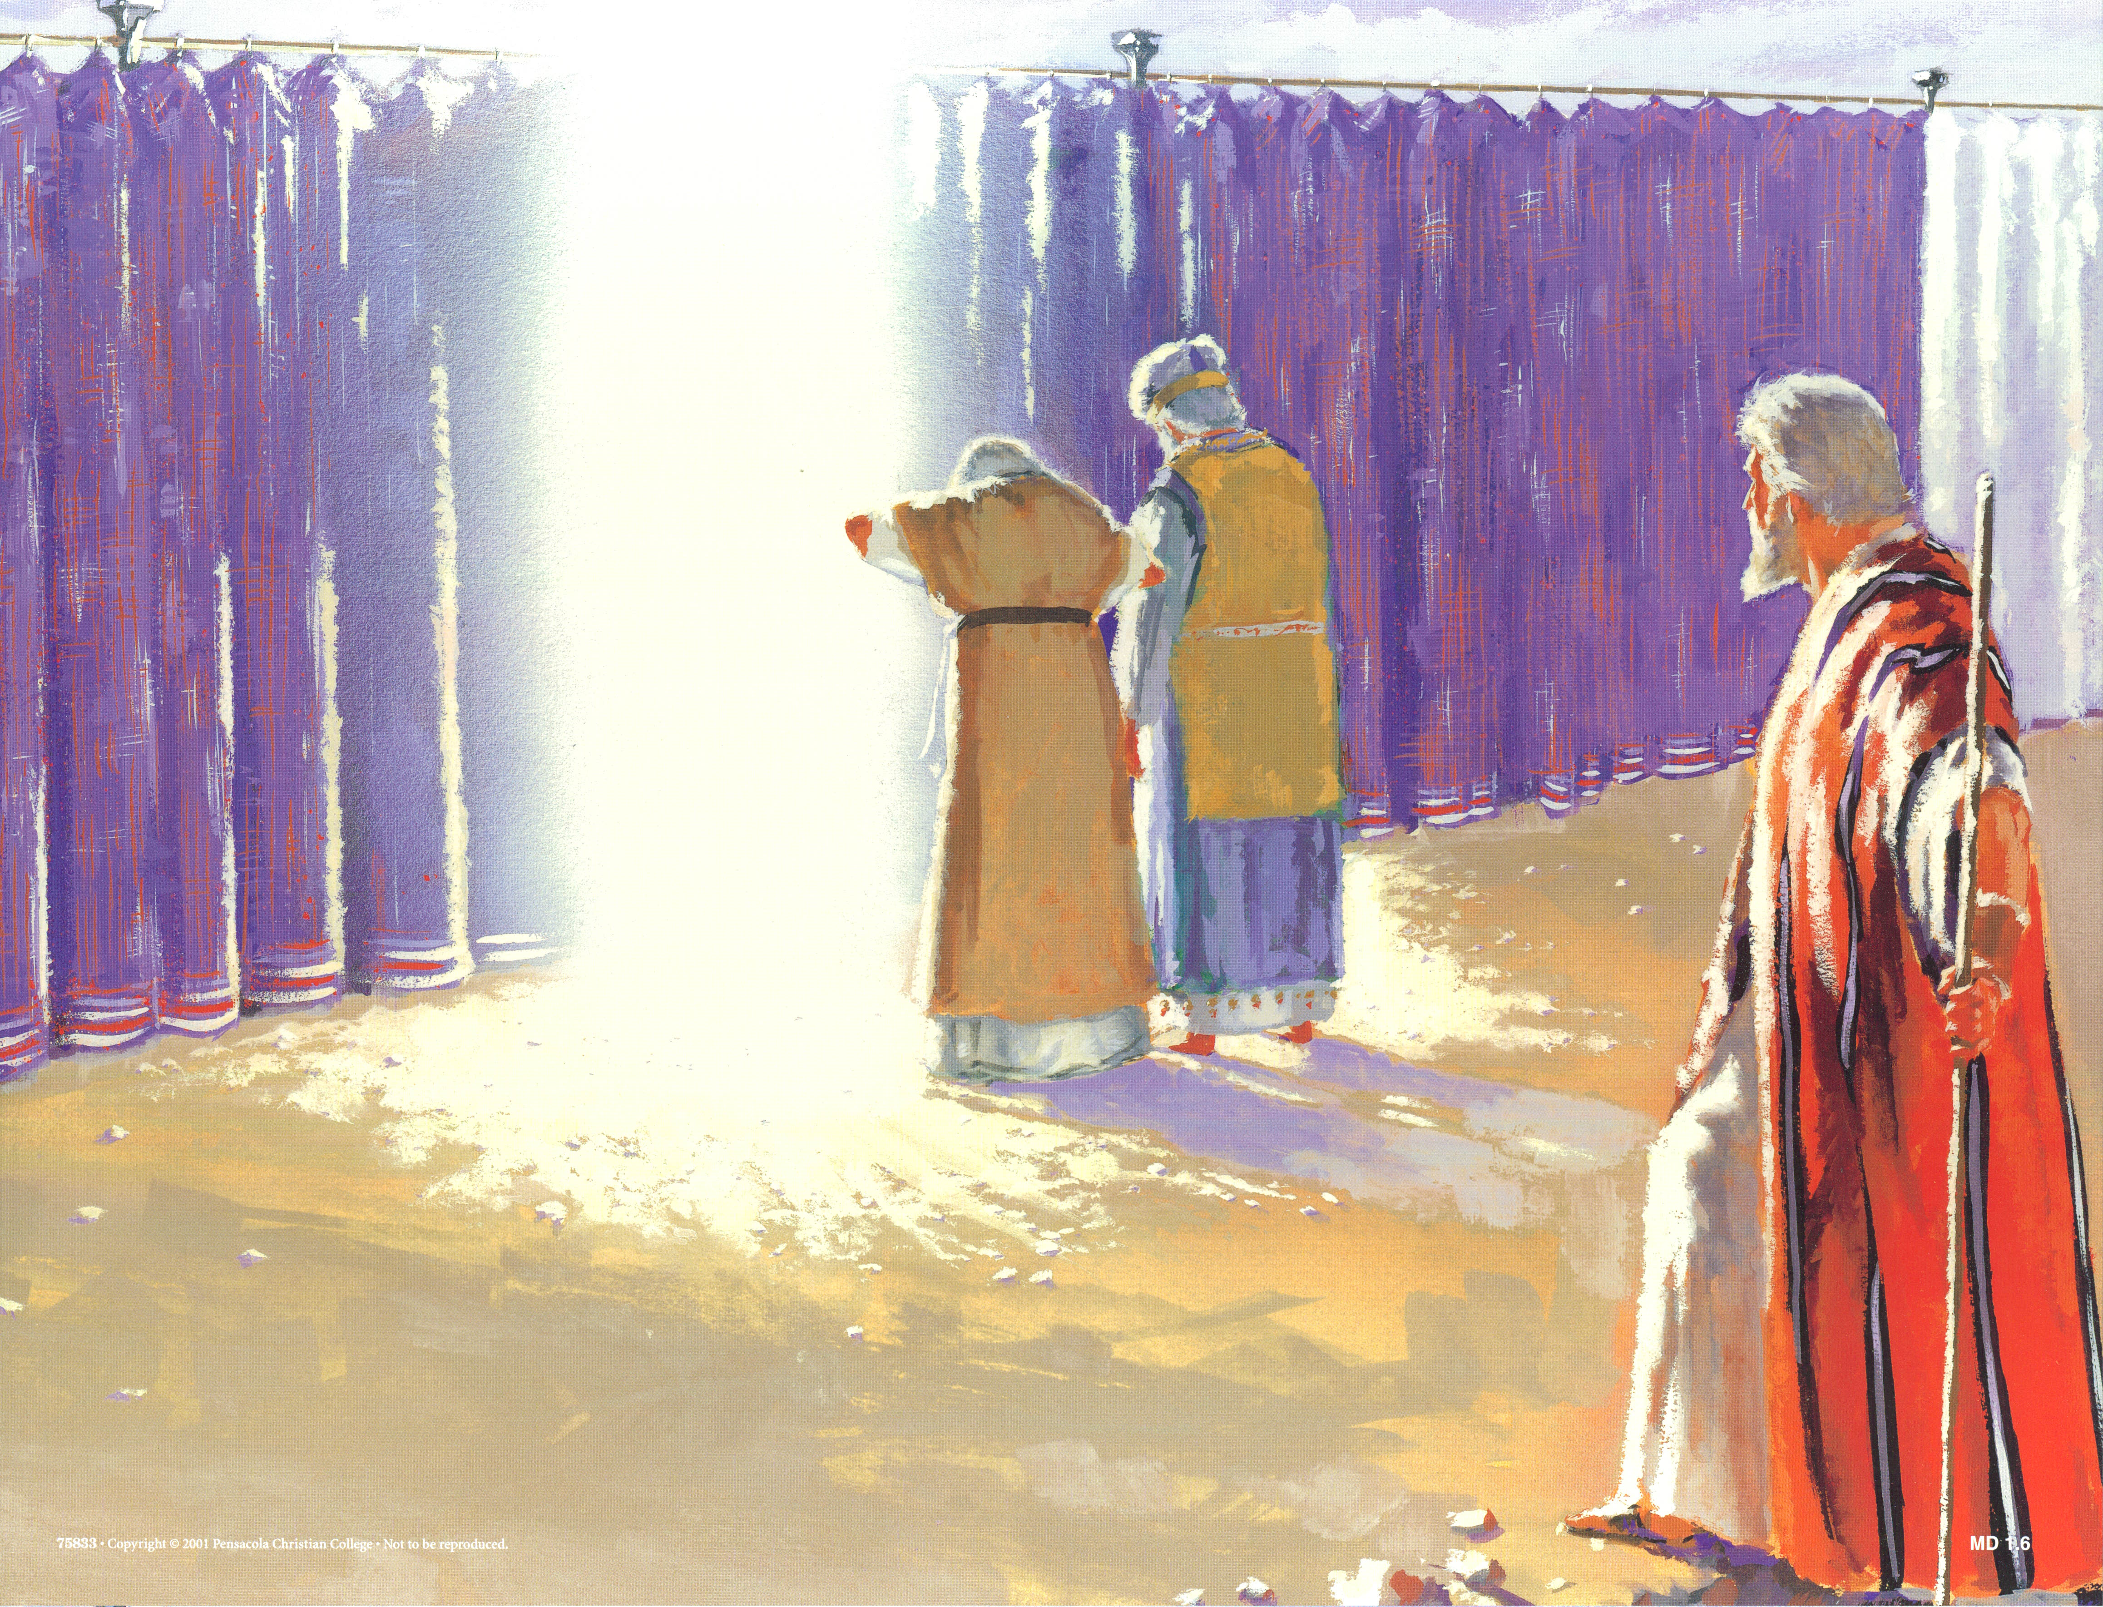
Murmuring from Miriam & Aaron (Numbers 12)
“Hear now My words: If there is a prophet among you, I, the LORD, shall make Myself known to him in a vision. I shall speak with him in a dream. Not so, with My servant Moses, He is faithful in all My household; With him I speak mouth to mouth, Even openly, and not in dark sayings, And he beholds the form of the LORD. Why then were you not afraid To speak against My servant, against Moses?"
Spoke against his marriage to a Cushite woman (1)
“Has the Lord spoken only through Moses? Has he not spoken through us as well?” (2)
Moses was more humble than any on the face of the earth (3)
The LORD summons them to tent of meeting and calls Aaron & Miriam

Slide 7
Murmuring from Miriam & Aaron (Numbers 12)
Miriam struck with leprosy (10)
Aaron begs Moses not to account their sin to them (11-12)
Moses prays for healing for Miriam (13)
The LORD requires a seven-day period of punishment (14)
The LORD underscores the special role of Moses
Rebellion against Moses from family and about family
Moses intercedes even for those who rebel against him

Slide 8
Meanwhile … Kadesh-Barnea (Numbers 13-14)
The people refuse to take the promised land, and are condemned to wander for 40 years in the wilderness, until that generation dies

Slide 9
Korah’s Rebellion (Numbers 16)
Korah + two other Levites + 250 chosen men of renown
Gone far enough; all are holy; why do you exalt yourselves?
Bring your censers tomorrow, and the LORD will show who is His
Moses reasons with Korah (8-11)
Moses attempts to reason with the others (12-14)
The LORD is ready to consume them instantly, but M&A intercede
People are warned to move away ; earth swallows up Korah + leaders
Fire consumers the 250 others; altar is plated with their censers
People grumble the next day, the LORD starts instant consumption
M&A use censer to stop the plague … not before 14.7K are killed

Slide 10
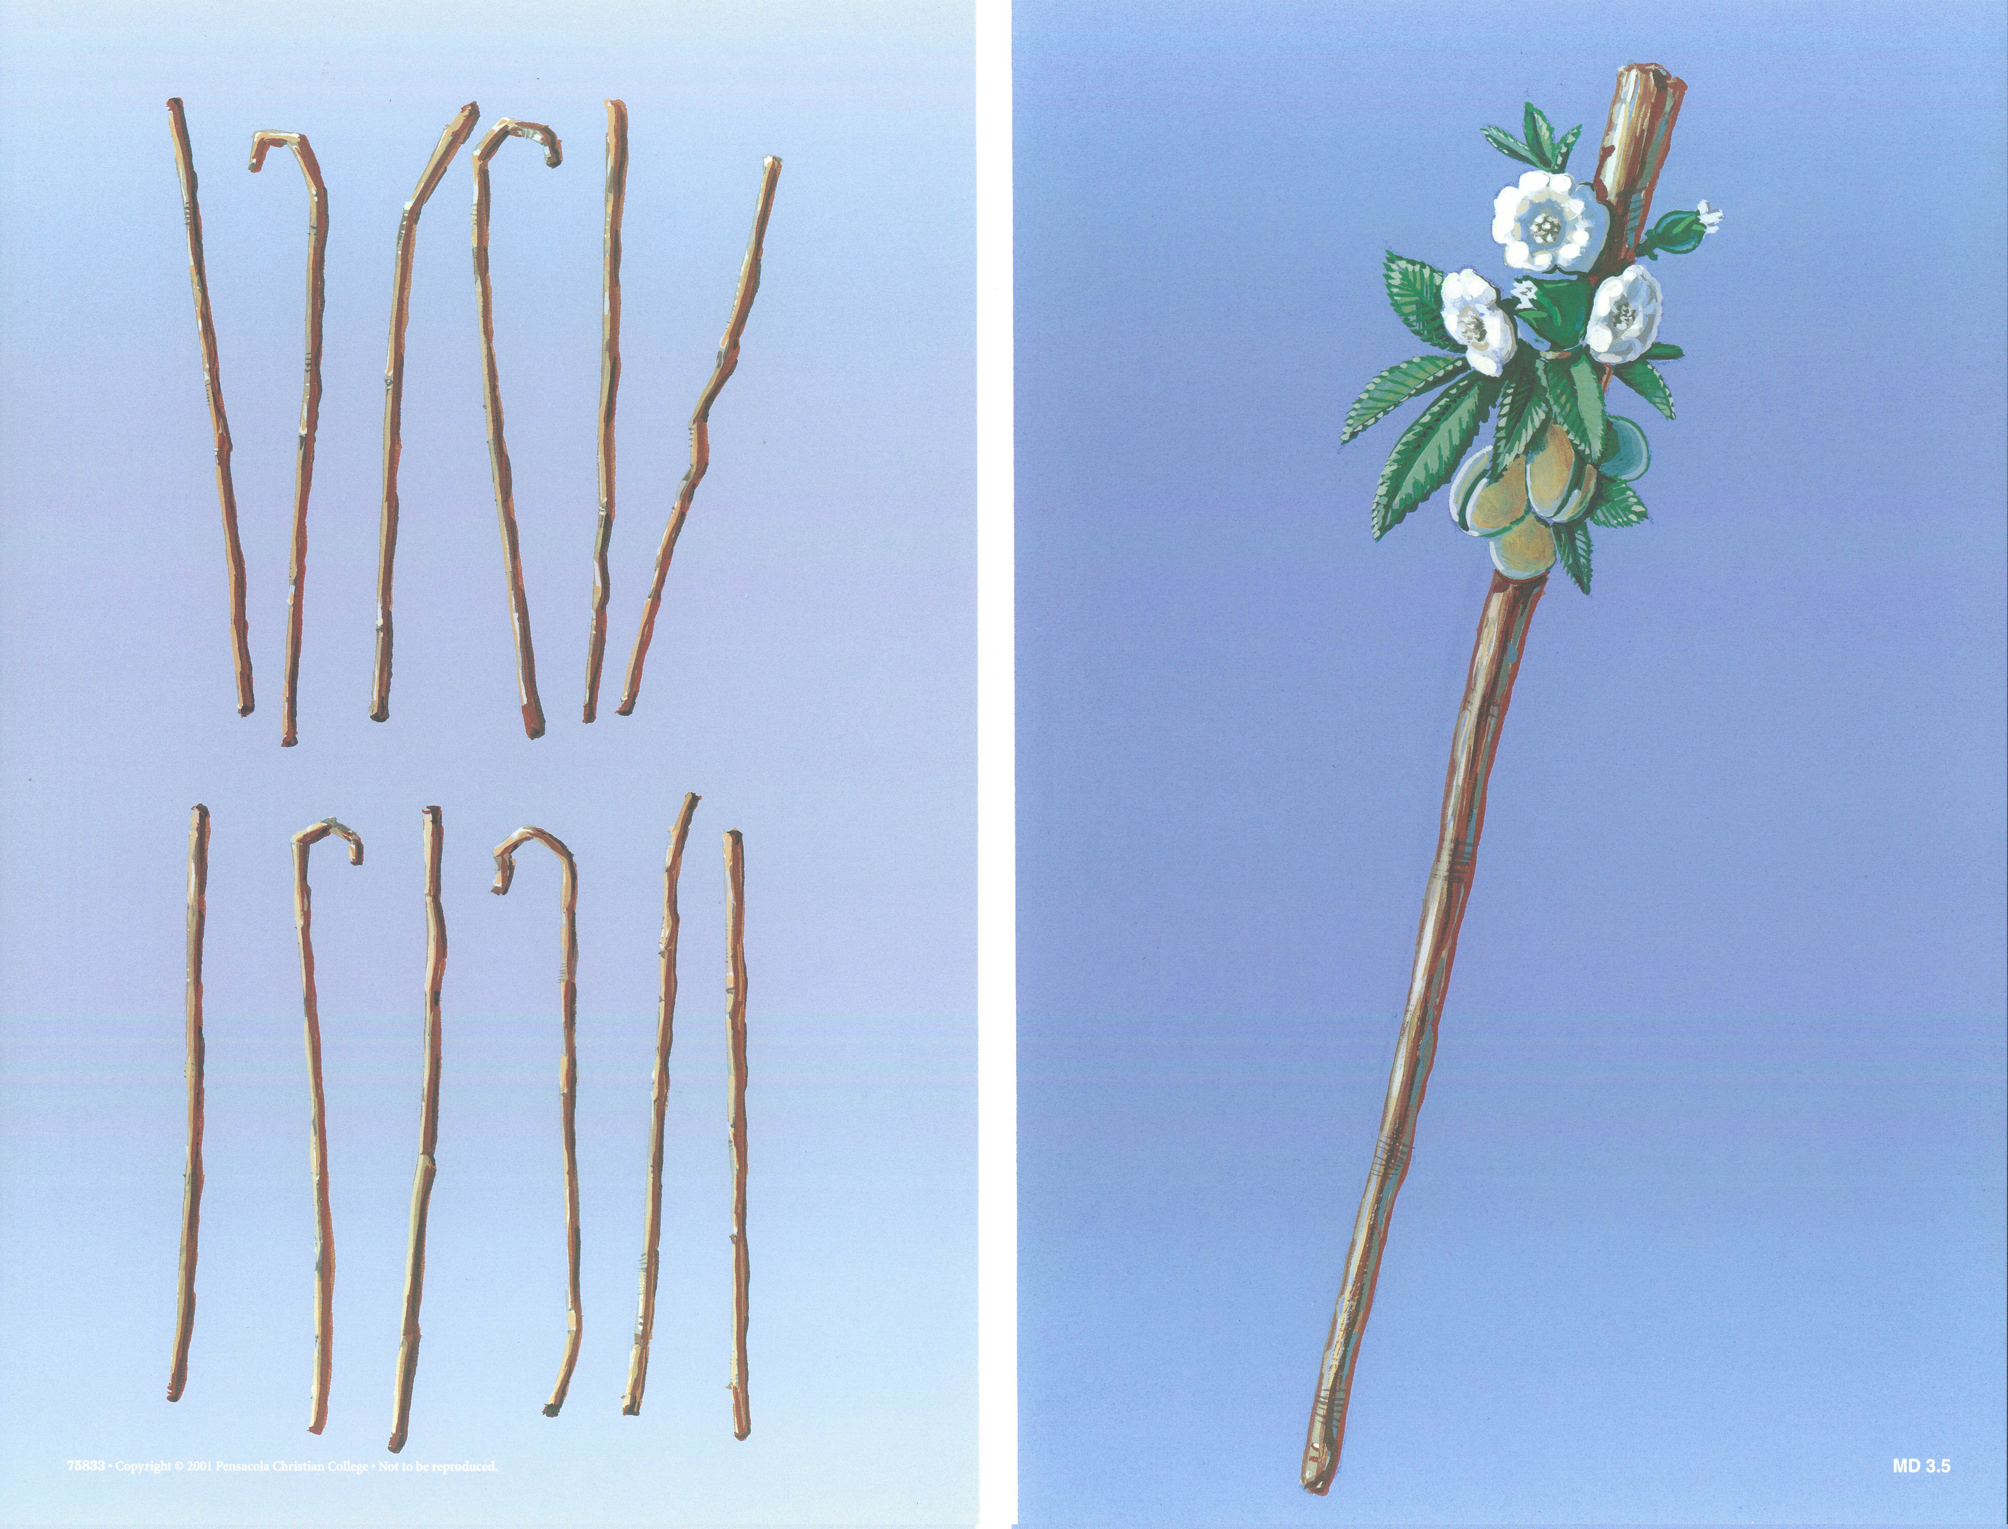
Aaron’s Rod (Number 17)
Twelve rods from each tribe brought to tent of meeting
Each has name of leader written on it (including Aaron’s)
The rod of the man the LORD chooses would sprout
Overnight, the rod of Aaron had budded, blossomed, and produced almonds
Aaron’s rod kept as a sign to end their grumblings, that they may not die

