Slide 1
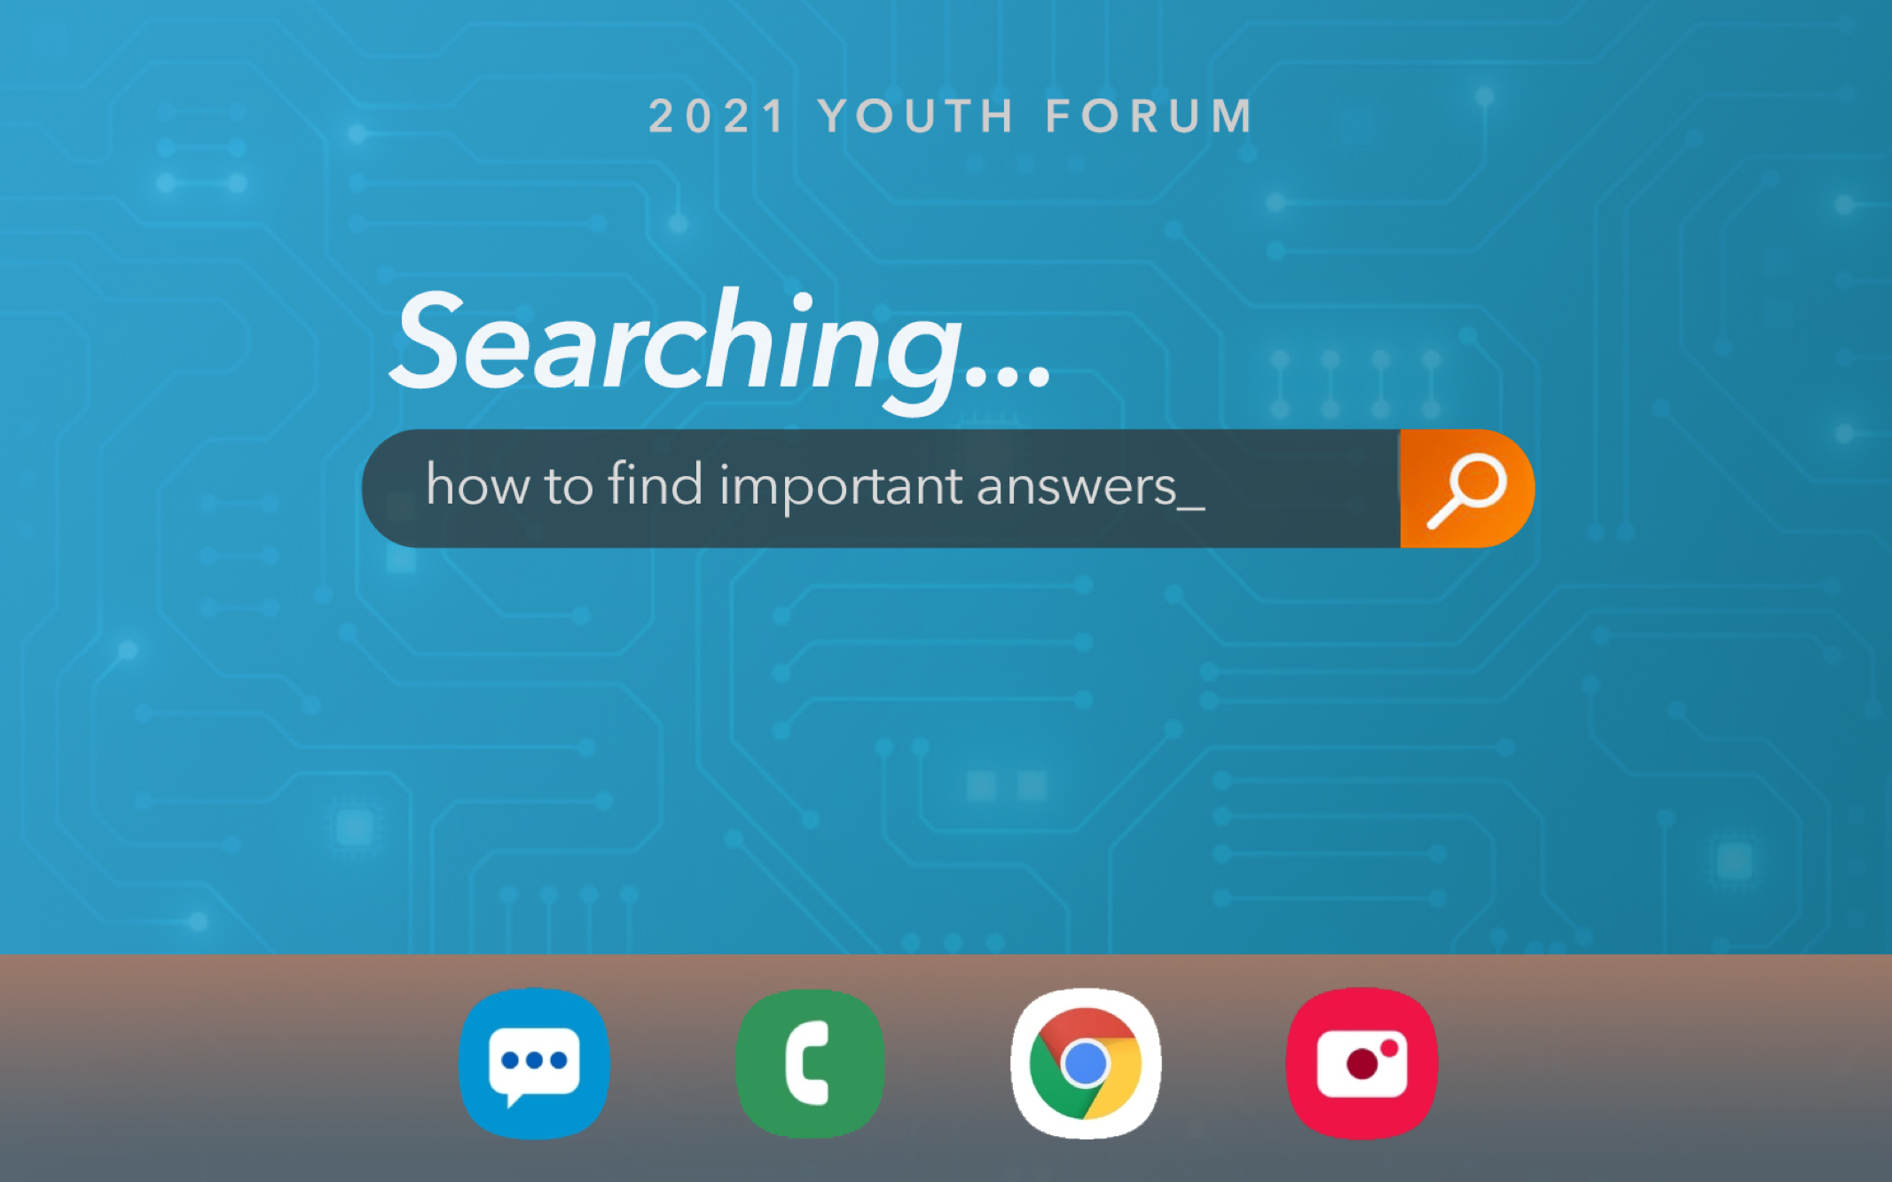

Slide 2
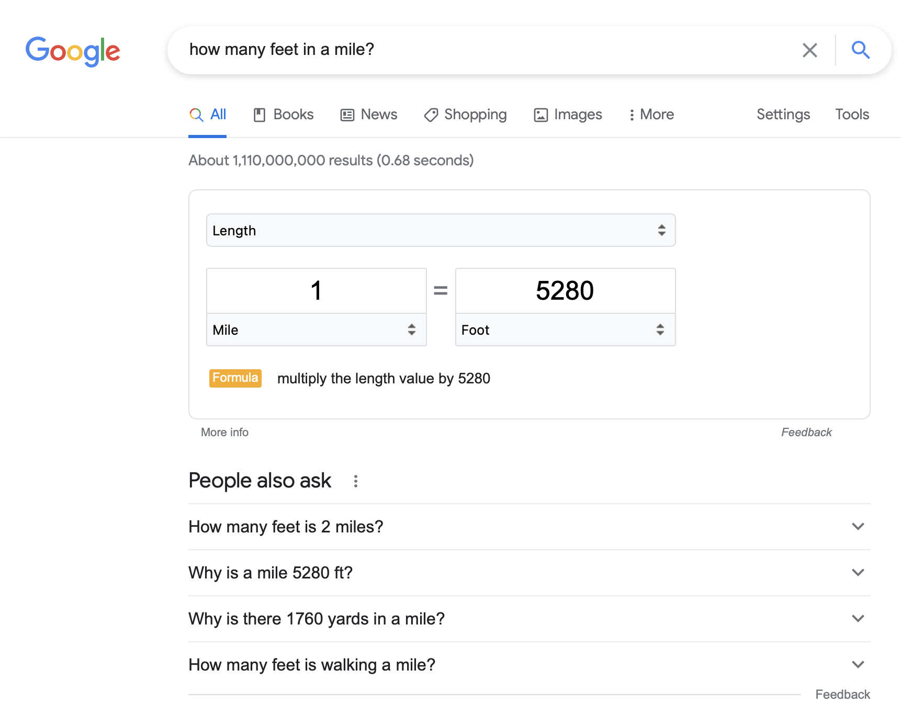

Slide 3
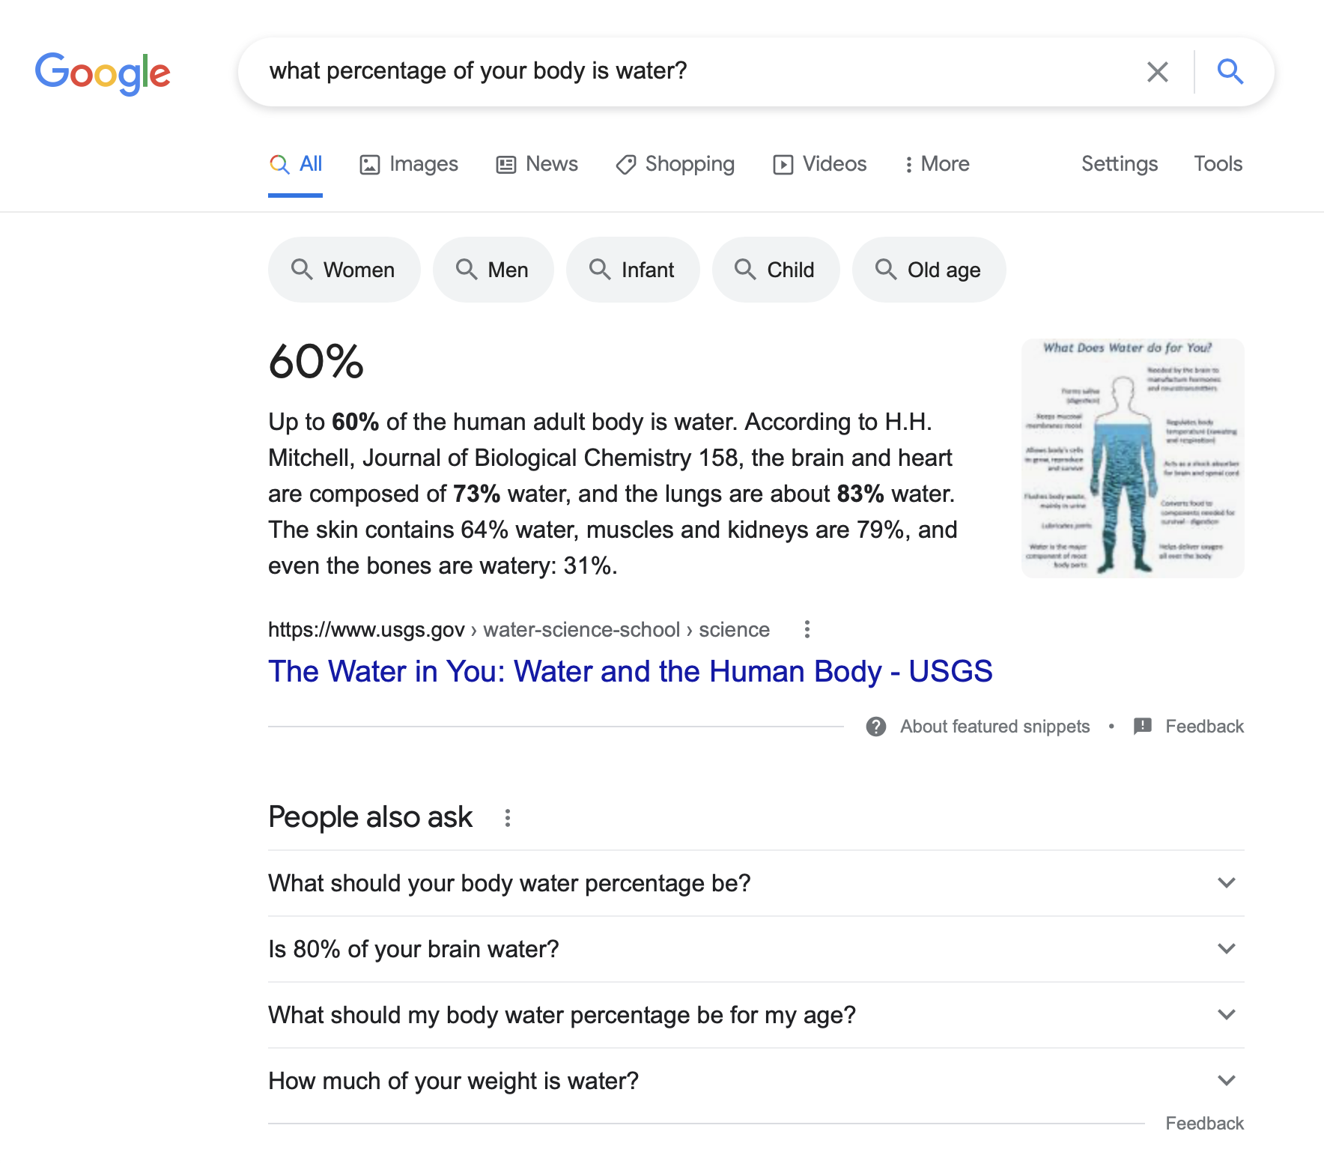

Slide 4
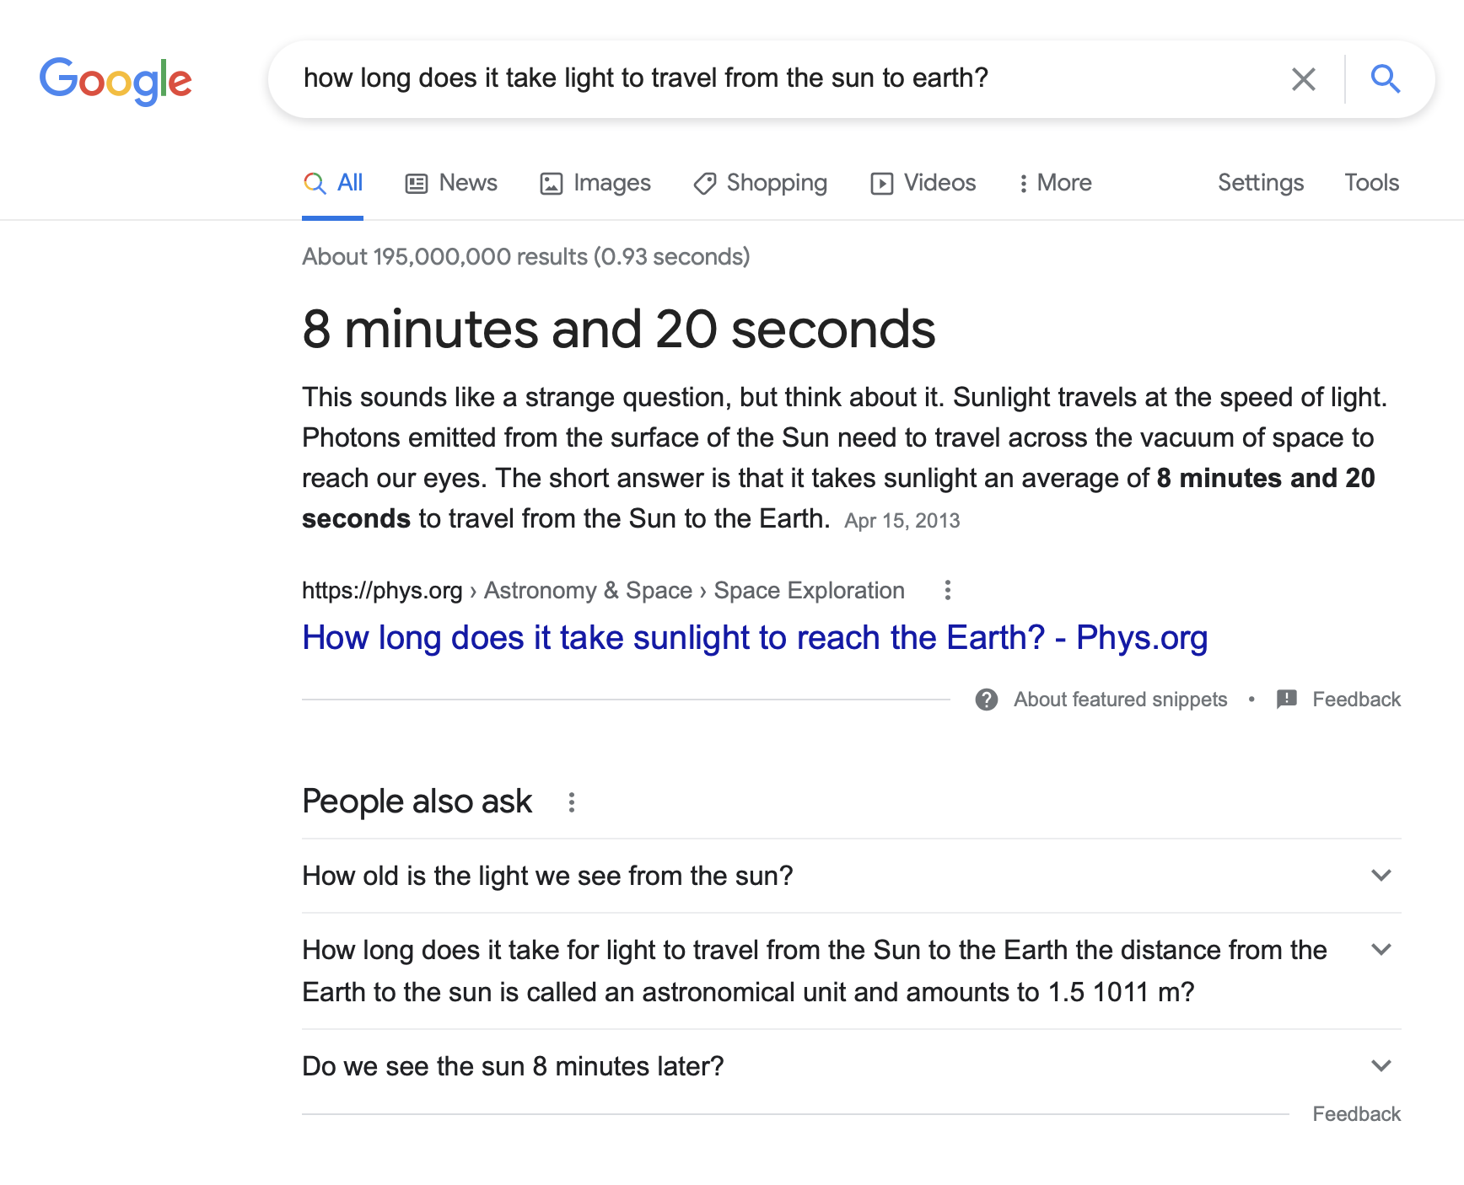

Slide 5
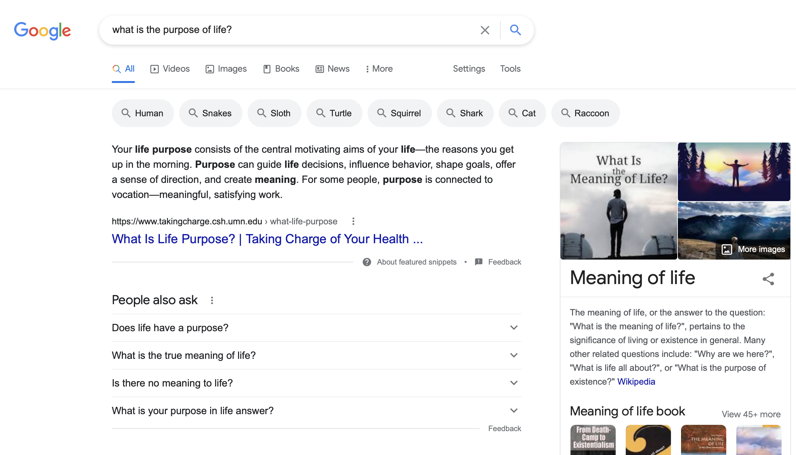

Slide 6
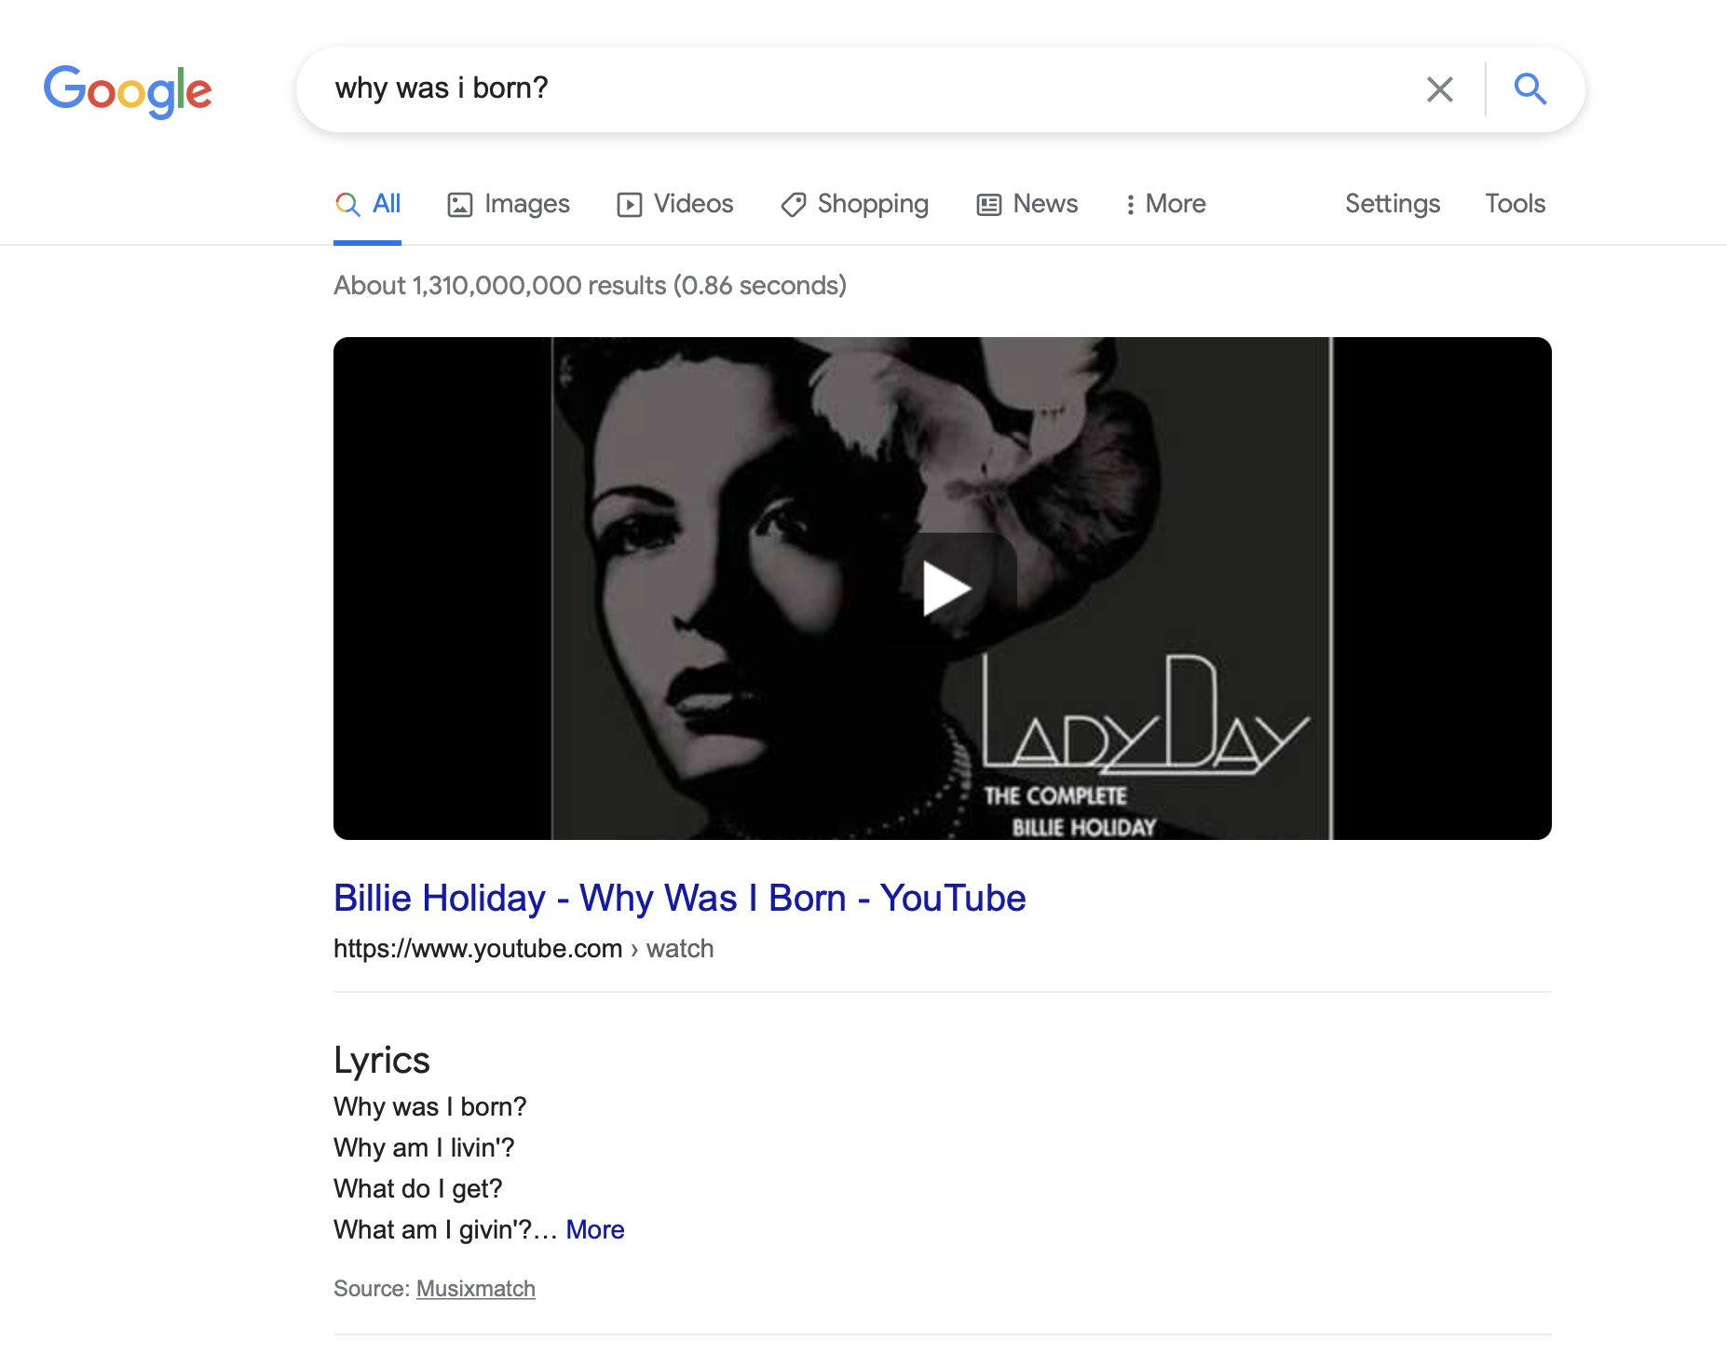

Slide 7
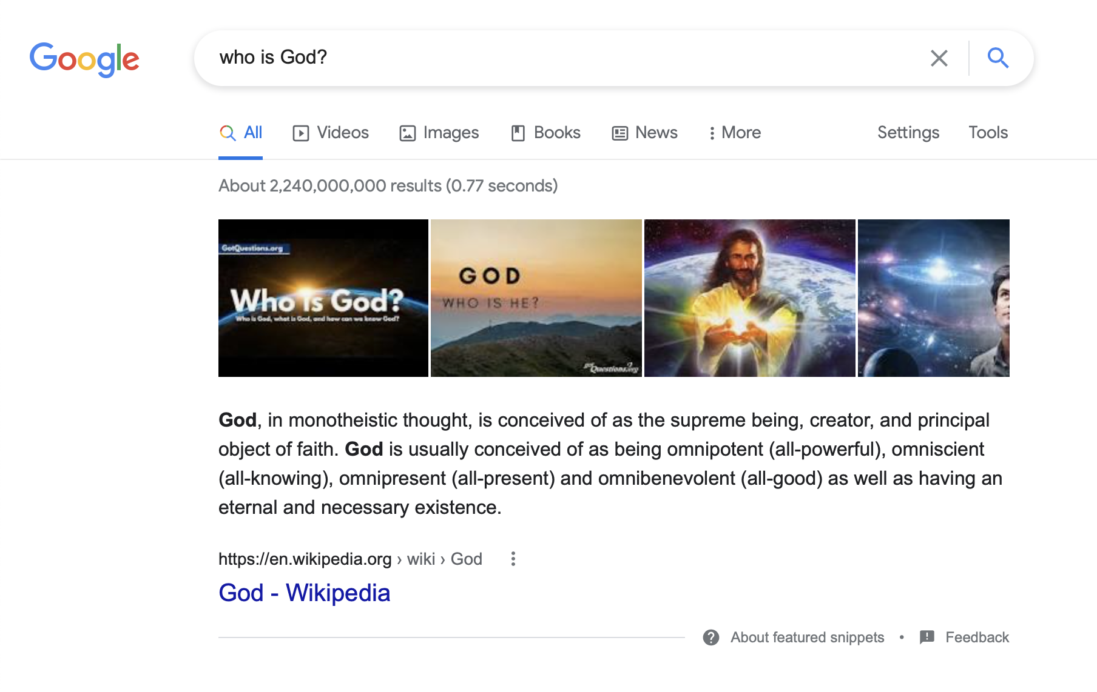

Slide 8
Answering the Questions Google Can’t

Slide 9
Why Are These Questions Harder?

Slide 10
Why Are These Questions Harder?
A problem much older than Google… see Ecclesiastes

Slide 11
Why Are These Questions Harder?
A problem much older than Google… see Ecclesiastes
“The streetlight effect”

Slide 12
Why Are These Questions Harder?
A problem much older than Google… see Ecclesiastes
“The streetlight effect”
Demonstrated in John 4

Slide 13
Knowing God

Slide 14
Knowing God
“So God created man in his own image, in the image of God he created him; male and female he created them” (Gen. 1:27).

Slide 15
Knowing God
“So God created man in his own image, in the image of God he created him; male and female he created them” (Gen. 1:27).
“… Whoever has seen me has seen the Father” (John 14:9; cf. 1:1).

Slide 16
Knowing God
“So God created man in his own image, in the image of God he created him; male and female he created them” (Gen. 1:27).
“… Whoever has seen me has seen the Father” (John 14:9; cf. 1:1).
“Jesus said to him, ‘I am the way, and the truth, and the life. No one comes to the Father except through me. If you had known me, you would have known my Father also. From now on you do know him and have seen him” (John 14:6-7).

Slide 17
Knowing God
“So God created man in his own image, in the image of God he created him; male and female he created them” (Gen. 1:27).
“… Whoever has seen me has seen the Father” (John 14:9; cf. 1:1).
“Jesus said to him, ‘I am the way, and the truth, and the life. No one comes to the Father except through me. If you had known me, you would have known my Father also. From now on you do know him and have seen him” (John 14:6-7).
1 Cor. 1:20-25; Col. 2:8, 3; Jer. 9:23-24

Slide 18
“… and all these things will be added to you.”

Slide 19
“… and all these things will be added to you.”
Eccl. 2:24; 5:18-19; 9:7-9

Slide 20
“… and all these things will be added to you.”
Eccl. 2:24; 5:18-19; 9:7-9
“But seek first the kingdom of God and his righteousness, and all these things will be added to you” (Matt. 6:33).

Slide 21
“
Come, everyone who thirsts, come to the waters;
and he who has no money, come, buy and eat!
Come, buy wine and milk without money and without price.
Why do you spend your money for that which is not bread, and your labor for that which does not satisfy?
Listen diligently to me, and eat what is good, and delight yourselves in rich food.
Incline your ear, and come to me;
hear, that your soul may live;
and I will make with you an everlasting covenant, my steadfast, sure love for David.
”
— Isaiah 55:1-3

