Slide 1
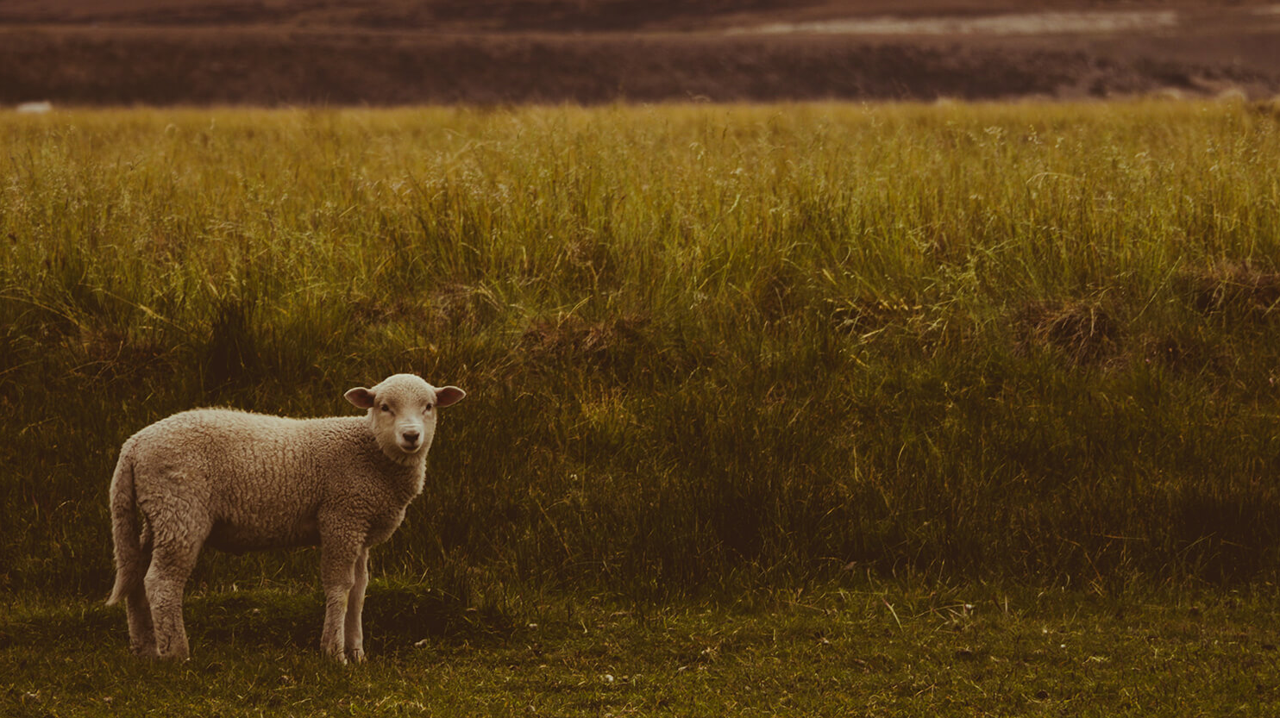
The Parable of the Lost Sheep

Slide 2
I. Our Needs
“Christianity Fits Our Deepest Needs”
Our Need for Meaning
Our Need for Satisfaction
Our Need for Identity
Our Need for Morality
Our Need for Hope
+1 Christianity Fits Our Need to be Wanted
Why does everyone have a need to be wanted?

Slide 3
II. God Himself Desires to be Wanted
Exodus 34:14
for you shall not worship any other god, for the Lord, whose name is Jealous, is a jealous God
Malachi 1
6 “A son honors his father, and a servant his master. If then I am a father, where is my honor? And if I am a master, where is my fear? says the Lord of hosts
John 12:32
And I, when I am lifted up from the earth, will draw all people to myself.
James 4:8
Draw near to God, and he will draw near to you.

Slide 4
III. The Parable: Luke 15:1-7
14:35- He who has ears to hear, let him hear!”
15:1 Now the tax collectors and sinners were all gathering around to hear Jesus. 2 But the Pharisees and the teachers of the law muttered, “This man welcomes sinners and eats with them.” 3 Then Jesus told them this parable.
4 “Suppose one of you has a hundred sheep and loses one of them. Doesn’t he leave the ninety-nine in the open country and go after the lost sheep until he finds it?

Slide 5
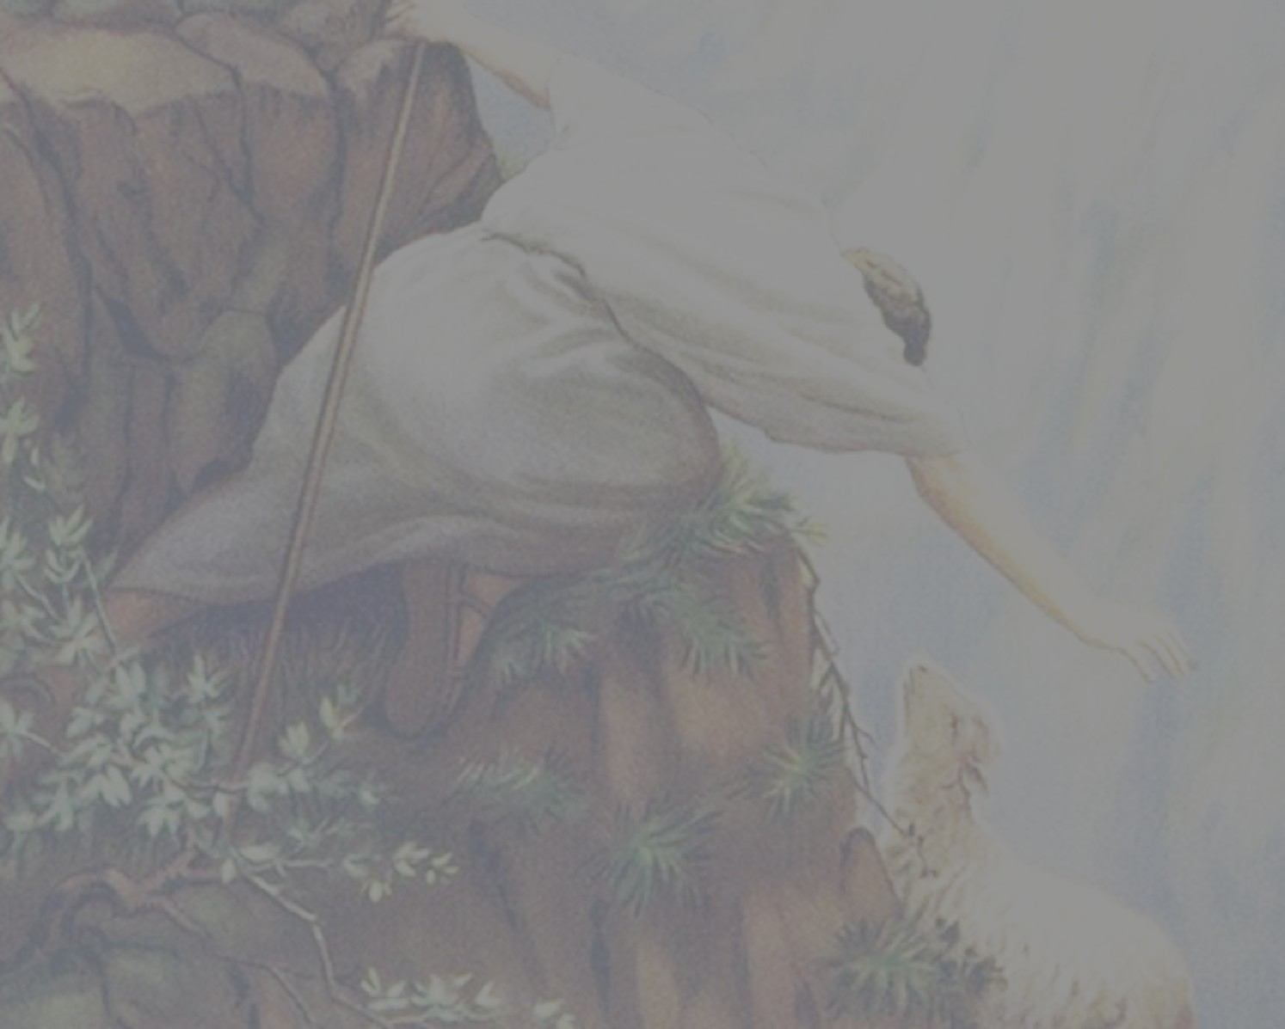
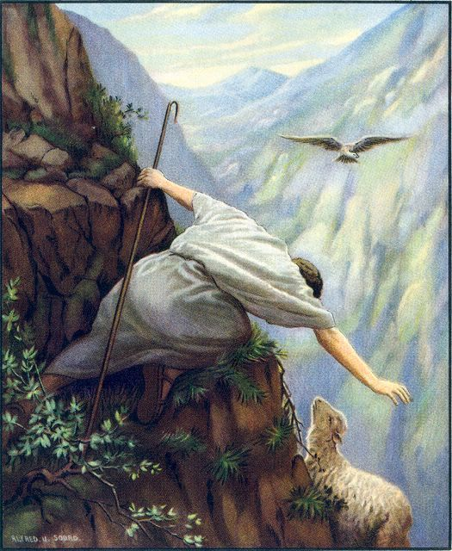

Slide 6
III. The Parable: Luke 15:1-7
14:35- He who has ears to hear, let him hear!”
15:1 Now the tax collectors and sinners were all gathering around to hear Jesus. 2 But the Pharisees and the teachers of the law muttered, “This man welcomes sinners and eats with them.” 3 Then Jesus told them this parable.
4 “Suppose one of you has a hundred sheep and loses one of them. Doesn’t he leave the ninety-nine in the open country and go after the lost sheep until he finds it?
5 And when he finds it, he joyfully puts it on his shoulders 6 and goes home. Then he calls his friends and neighbors together and says, ‘Rejoice with me; I have found my lost sheep.’
7 I tell you that in the same way there will be more rejoicing in heaven over one sinner who repents than over ninety-nine righteous persons who do not need to repent.

Slide 7
IV. What Can We Learn?
What are the “traditional” lessons we learn from this parable?
We learn that the Pharisees did not see people who were truly in need.
We learn that God values the potential one sinner’s repentance as much as the many already saved.
We learn that all of heaven knows and rejoices when are won over to Christ.

Slide 8
V. What Else Can We Learn?
What are some of the “overlooked” lessons we learn from this parable?
1. We learn that the shepherd (God) displays a “foolish” love.
2. We learn that God desires us; that God “goes after us”; that God pursues us.
3. We learn that God has put us on His shoulders.

Slide 9
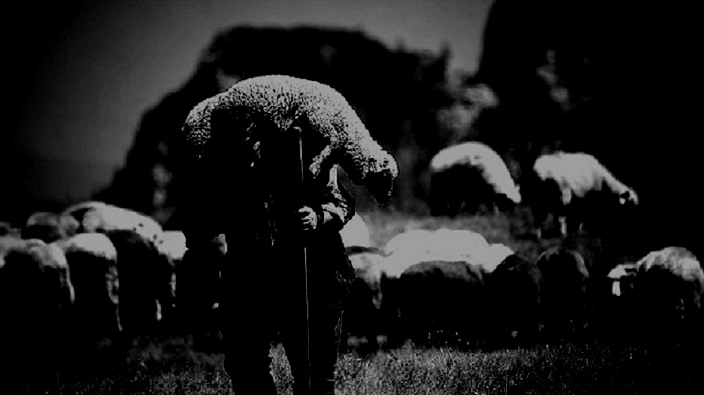
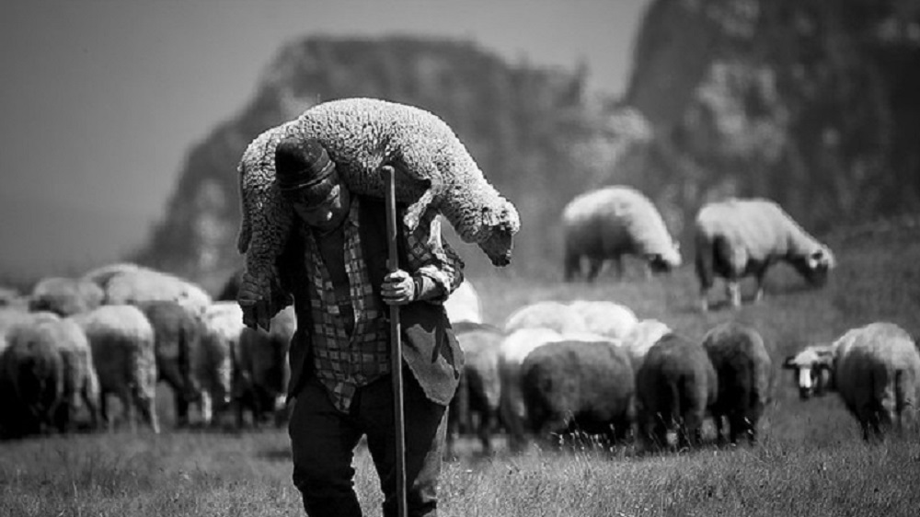
⁵ And when he finds it, he joyfully puts it on his shoulders ⁶ and goes home. Then he calls his friends and neighbors together and says, ‘Rejoice with me; I have found my lost sheep.’

