Slide 1
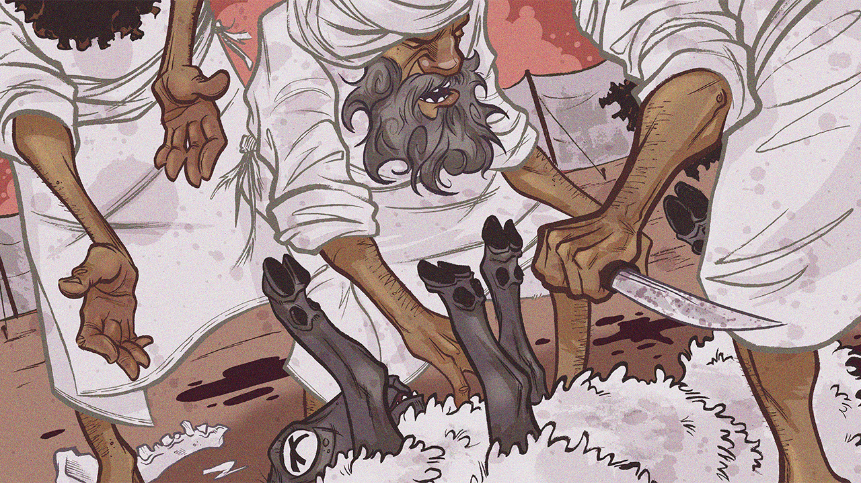
The Priesthood
Leviticus 8-10

Slide 3
The Priesthood
Introductory Thoughts
  Theme of Leviticus: Be Holy (11:44-45; 19:2; 20:7, 26)
  Flow of Thought
    Leviticus 1-7 – Sacrifices (So God Can Dwell With Israel)
    Leviticus 8-10 – Priests (To Assist With Sacrifices & Teach Israel)
  First Narrative Section in Leviticus
  All Christians Are Priests (Rev. 1:6; 5:10; 20:6)
Outline of Section
  Consecration (8:1-36)
  Inauguration (9:1-24)
  Infraction (10:1-20)

Slide 4
Consecration (8:1-36)
Preparation (vs. 1-5)
  Aaron & Sons Will Be Consecrated
    Instructions From Exodus 28-29 Will Be Enacted
    After Failing With Golden Calf, Aaron Can Still Serve (God’s Grace)
  “Assemble All the Congregation” (Public Event)
    Establishes the Role of Aaron & Sons Before the People
    The People Need to See God’s Approval of Them
  Moses Functions as High Priest Throughout Chapter
Washed (vs. 6)
  Priests & Washing
    Ordinarily, They Are to Wash Hands & Feet (Exodus 30:17-21)
    To Consecrate, They Seem to Wash Whole Bodies
  Moses “Brought” Aaron & Sons (cf. vs. 13)
    Same Word for “Presented” Offerings (vs. 18, 22)
    Completely Given to the Lord
  Priests in New Covenant Are Washed (Heb. 10:22)

Slide 5
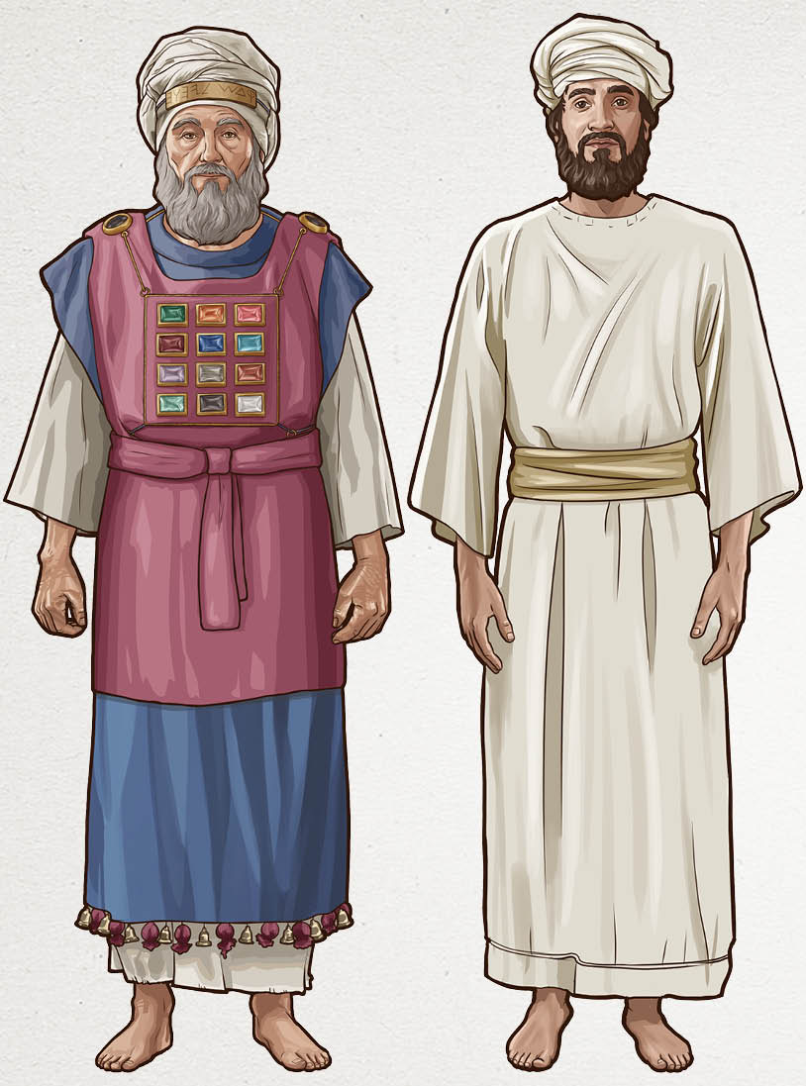
Consecration (8:1-36)
Clothed (vs. 7-9, 13)
  High Priest (vs. 7-9; cf. Exodus 28:1-39)
    Same As Priest, But Also Includes…
      Ephod
      Breastplate (Representing Tribes)
      Robe
      Golden Plate on Turban (“Holy to the Lord”)
    Urim & Thummin on Breastpiece (vs. 8)
      Not Given a Lot of Information
      If We Knew More, People Would Replicate?
  Priest (vs. 13; cf. Exodus 28:40-43)
    Tunic / Sash / Turban
    How HP Dressed on Day of Atonement (16:4)
  No Footwear (cf. Ex. 3:5; Josh. 5:15)
  Clothing We Wear
    Clothed With Christ (Gal. 3:27)
    Received After Washing

Slide 6
Consecration (8:1-36)
Anointing (vs. 10-12)
  Recipe for Anointing Oil in Exodus 30:22-33
  Tabernacle (vs. 10)
    Including Everything In It (Detailed Work)
    Location Could Be Made Unclean (Lev. 16:16)
  Altar (vs. 11)
    “Altar” Mentioned 24x in Leviticus 8-10
    Sprinkled Seven Times
    Altar is About to be Used for the First Time
  Aaron (vs. 12)
    “Anointed” = Messiah in Hebrew (“Christ” in Greek)
    Others Anointed in Old Testament
      Kings (1 Sam. 10:1; 16:13)
      Prophets (1 Kings 19:16)
    Jesus is The True “Anointed One” (Acts 10:38)

Slide 7
Consecration (8:1-36)
Sacrifices (vs. 14-30)
  Bull for Sin/Purification Offering (vs. 14-17)
    Priests Must Be Atoned For Before They Can Help Others
    Blood Like Detergent for Purifying Altar (vs. 15)
    Priests Could Not Eat From These Sacrifices (6:30)
  Ram for Burnt Offering (vs. 18-21)
  Ram for Ordination Offering (vs. 22-29)
    Similar Procedure as Fellowship/Peace Offering
    Blood Placed on Priests (vs. 23-24; cf. 14:14, 17, 25, 28)
      Right Earlobe: Must Heed What God Says
      Right Thumb: Must Handle Offerings Correctly
      Right Big Toe: Must Walk in God’s Ways
    Bread Offering (vs. 25-28)
    Moses Ate From Offering As a Priest Would (vs. 29)
  Blood/Oil Sprinkled on Aaron & Sons (vs. 30)

Slide 8
Consecration (8:1-36)
Priests (Leviticus 8) | Levites (Numbers 8)
Washed in Water (vs. 6) Put on New Clothes (vs. 7-9, 10) Blood Applied (vs. 23-24; 30) Made Holy (vs. 9) | Sprinkled With Water (vs. 7a) Shave (vs. 7) Washed Clothes (vs. 7b) Made Clean (vs. 6)
Final Instructions (vs. 31-36)
  Eat From Ordination Offering (vs. 31-32)
  Command to Stay (vs. 33-35)
    Must Stay in Outer Courtyard Seven Days
      If They Leave, They Will Die; They Hold a Serious Position (vs. 35)
      They Must Make Sacrifices Every Day (Exodus 29:35-37)
    Sanctification Takes Time
  Obedience (vs. 36; cf. vs. 4, 5, 9, 13, 17, 21, 29)
    Five Priests For 2+ Million Israelites Now Installed

Slide 9
Inauguration (9:1-24)
Instructions (vs. 1-7)
  Eight Day (New Beginning)
    The Time of Sanctification is Completed
    Now Aaron & Sons Will Function as Priests for the People (vs. 8, 12, etc…)
  Offerings First for Priests (vs. 2; cf. 9:8-14)
  Offerings Secondly For the People (vs. 3-5; cf. 9:15-21)
    The People “Drew Near” Before the Lord
  Goal of Sacrifices (vs. 6-7)
    For Glory of God to Appear (vs. 6)
    “Glory” Only Here & Verse 23 in Leviticus
Sacrifices for Priests (vs. 8-14)
  Must Offer Sacrifices for Self First
    Even After the Ordination Sacrifices, They Still Need More Offerings
  Calf for Sin Offering (vs. 8-11)
    First Offering as a High Priest (Atonement Always Priority)
    Ironic That Last Time Aaron Interacted With a Calf was in Exodus 32
  Ram for Burnt Offering (vs. 12-14)

Slide 10
Inauguration (9:1-24)
Sacrifices for the People (vs. 15-21)
  What They Offered
    Goat for Sin Offering (vs. 15)
    Calf & Lamb for Burnt Offering (vs. 16)
    Grain Offering (vs. 17)
    Ox & Ram for Peace Offering (vs. 18-21)
  They Are Obeying the Lord (vs. 21)
Priestly Blessing (vs. 22-23a; cf. Numbers 6:22-27)
  Blessing Comes After Sacrifices Are Made
  Our Role as Priests is to Bless Others
The Lord Appears (vs. 23b-24; cf. vs. 6)
  Fire from God Consumes the Burnt Offering (cf. 1 Chr. 21:26; 2 Chr. 7:1-3)
    Dramatic Opening Day at the Tabernacle
    Proves God Has Accepted Their Sacrifices
  The People Shouted & Fell Down
    God Has Accepted Them; Shouts of Joy
    Nadab & Abihu Will Contrast This Event

Slide 11
Infraction (10:1-20)
Introduction to Story
  Barely Gets Off the Ground When Tragedy Strikes
  Leviticus 8-9 Emphasizes Israel’s Obedience
  Mentioned 3x in Pentateuch (Lev. 16:1-2; Num. 3:4; 26:61)
The Sin (vs. 1-3)
  What Nadab & Abihu Did (vs. 1)
    “Took” Censor & “Put” Strange Fire in It (cf. Ex. 30:9)
      Pattern of Obedience Interrupted (cf. Numbers 11)
    Coals From Wrong Source? Offered At Wrong Time?
  What God Did (vs. 2)
    Fire Consumes Nadab & Abihu (Must Conform to God’s Standards)
    Contrast to Fire That Consumes Offering in Leviticus 9:24
  Instruction (vs. 3)
    Leaders Must Treat God as Holy Before the People
    What Moses Later Fails to Do (cf. Numbers 20:12)
    Aaron Holds Peace (Ominous Silence Contrasting From 9:24)
      Aaron Knew His Children Did Wrong

Slide 12
Infraction (10:1-20)
Burial (vs. 4-7)
  Mishael & Elzaphan Carry & Bury Bodies (vs. 4-5)
    Sons of Aaron’s Uncle (Exodus 6:16-22)
    Aaron Can’t Touch Dead Bodies (Lev. 21:10-14)
  No Mourning (vs. 6-7; cf. Lev. 21:10)
    Mourning Would Indicate Disagreement With God’s Judgment
      Personal Feelings Must Not Interfere With Service
    Failure to Obey Results in Death
Prohibition & Responsibility (vs. 8-11)
  Only Time in Book God Speaks Directly to Aaron (vs. 8; cf. Num. 18:1, 8, 20)
  Priests Must Not Have Alcohol (vs. 9)
    Possible That Nadab & Abihu Were Intoxicated?
    Possible That Mourning Involved Alcohol?
    Work of Priesthood Demands Sober-Mindedness (cf. 1 Peter 1:13)
  Priests Must Teach
    Distinguish Clean & Unclean (vs. 10; cf. Lev. 11; Ezekiel 22:26; 44:23-24)
    The Law (vs. 11; cf. Malachi 2:4-9)
    We Are to Teach the World about the Lord

Slide 13
Infraction (10:1-20)
Sacrifices to be Eaten (vs. 12-20)
  What Priests Need to Eat (vs. 12-15)
    Eat in Holy Place (Tabernacle Grounds)
      Portion of Grain Offering (vs. 12-13)
    Eat in “Clean Place” (Houses of Priests)
      Breast/Thigh (vs. 14-15; cf. 9:18-21)
  Dispute (vs. 16-20)
    Moses’ Argument (vs. 16-18)
      Moses “Diligently” Inquires About Goat of Sin Offering (9:15)
      They Had Burned It When They Should Have Eaten It
      Eating Offerings Somehow Played Role in Making Atonement (vs. 17)
    Aaron’s Argument (vs. 19-20)
      Eating Sin Offering Would Not Be Approved by God
        Cannot Eat of This Sin Offering (cf. Lev. 6:30)
        Priesthood Sinned, So it Isn’t Right to Eat
      Moses Approved of Aaron’s Argument (Moses Concedes)
        Moses Humble to Listen to Another View

