Slide 1
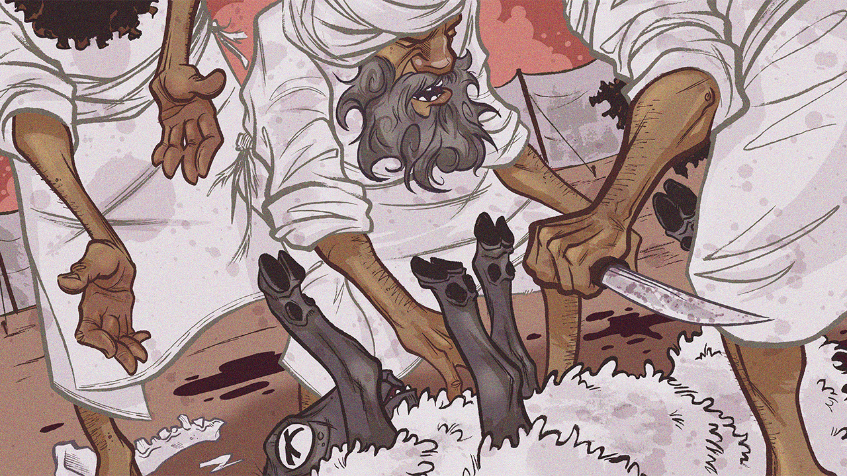
Clean & Unclean, Pt. 1
Leviticus 11-12

Slide 3
Clean & Unclean, Pt. 1
Introductory Thoughts
  New Section on Clean/Unclean
    Regarding Food (11:1-47)
    Regarding the Body (12-15)
  Duration of Uncleanness in Leviticus 11-15
    Ch. 11: Dietary – Hours of Uncleanness
    Ch. 12: Childbirth – Weeks/Months of Uncleanness
    Ch. 13-14: Skin Diseases – Possibly Years of Uncleanness
    Ch. 15: Discharges – Variable, Yet Ongoing
Outline of Section
  Clean & Unclean Food (11:1-47)
  Clean & Unclean After Childbirth (12:1-8)

Slide 4
Clean & Unclean Food (11:1-47)
Introduction (vs. 1)
  Moses & Aaron Addressed Together
  Aaron & Priests Must Teach Clean & Unclean (Lev. 10:10-11)
Classification of Animals (vs. 2-23)
  Distinctions Existed Prior to Mosaic Laws (Genesis 7:2-3, 8; 8:20)
  Land Animals (vs. 1-8; cf. Deut. 14:3-8)
    Accepted: Divided Hoof & Chews Cud (vs. 2-3; Eats Plants)
    Forbidden: Anything Without Both Criteria (vs. 4-8)
      Can’t Eat or Touch Carcass (Don’t Get As Close As You Can!)
      You Could Contact a Living Unclean Animal (Riding a Horse)
  Sea Creatures (vs. 9-12; cf. Deut. 14:9-10)
    Accepted: Fins & Scales (vs. 9)
    “Detestable”: Anything Without Both Criteria (vs. 10-12)
  Birds (vs. 13-19; cf. Deut. 14:11-18)
    Lists Only Birds That Cannot Be Eaten (Deut. 14 is More Positive)
    Some Kinds of Birds Are Debated (Some Words Used Only Here)
    Many of these Birds are Predators
  Winged Insects (vs. 20-23; cf. Deut. 14:19)
    Accepted: Anything That Jumps (John the Baptist Ate Locusts; Mk. 1:6)
    Forbidden: Anything That Crawls

Slide 5
Clean & Unclean Food (11:1-47)
“Interestingly, in the high country in the eastern part of Canaan, where Israelite population was concentrated toward the end of the second millennium B.C.E, the percentage of pig bones discovered is only a fraction of what it is in the Canaanite lowlands.”
Robert Alter, The Hebrew Bible. pg. 402

Slide 6
Clean & Unclean Food (11:1-47)
Instructions for Impurity (vs. 24-40)
  Land Animals (vs. 24-28)
    How to Become Unclean
      Touching a Carcass (vs. 24, 26)
      Carrying Part of a Carcass (vs. 25)
    How to Become Clean
      No Offerings (Lowest Level of Uncleanness)
      Wash Clothes / Wait “Until Evening” (vs. 24, 25, 27, 28, 31, 32, 39)
  Swarming Creatures (vs. 29-38)
    Examples of Swarming Things (vs. 29-31)
    Items/Food Unclean By Contact (vs. 32-35)
    Spring/Cistern/Dry Seed Not Unclean (vs. 36-38)
  Clean Animals That Happened to Die (vs. 39-40)
    Unclean if You Touched Dead, Yet Clean, Animal
    Eating/Carrying Carcass: Must Wash Clothes & Wait Until Evening

Slide 7
Clean & Unclean Food (11:1-47)
Animals | Land Vs. 2-8; 29-30; 41-42 | Waters Vs. 9-12 | Sky Vs. 13-23
Pure (Edible) | Divided Hoof & Chews the Cud | Fins & Scales | Insects With Jointed Legs
Impure (Inedible) | Those Without Divided Hoof or Don’t Chew Cud Anything With Paws (vs. 26-27) Various Small Animals Listed in 29-30 | Those Without Fins & Scales | Birds Listed in 13-19 Most Insects

Slide 8
Clean & Unclean Food (11:1-47)
Concluding Summary (vs. 41-47)
  Restatement of Unclean (vs. 41-43)
    “Whatever Goes on Its Belly” (vs. 42; cf. Gen. 3:14)
    Become Detestable If You Eat the Detestable (vs. 43)
      You Are What You Eat
      “﻿Do you spend as much time with the Bible each day as you do even with the newspaper? What fools some of us are!” (Packer, J.I. Knowing God (p. 101).)
  Call to Holiness (vs. 44-45; cf. 1 Pet. 1:14-16)
    “Consecrate” is Verb Form of “Holy”
    These Laws Make Israel Different
    Basis of Holiness
      God is Holy (We Are to Be Like Our Father)
      God’s Grace (vs. 45)
  Concluding Call to Make Distinctions (vs. 46-47)

Slide 9
Possible Reasons for Food Laws
Health/Hygienic Explanation
  “Unclean Animals More Dangerous to Eat”
  Problem: Why Are They Acceptable in New Covenant?
False Religion Explanation
  “Unclean Animals Used in Pagan Rituals”
  Problem: So Were Cattle, Sheep, & Goats
Symbolic Moral Explanation
  “Unclean Animals Have Similarities to Immorality” (Like Predators)
  Problem: Some Unclean Animals Pictured Positively (Ex. 19:4)
Modern Anthropology Explanation
  “Unclean Animals Don’t Express the Norm”
  Problem: Difficult to Apply to Birds in 11:13-19
Contact Avoidance With Canaanites (cf. 11:46-47)
  “Table Fellowship With Gentiles Prevented by These Laws”
  Fits With Context of Leviticus 20:22-26 (cf. Acts 10-11)

Slide 10
Lessons from Food Laws
God Makes Distinctions
  Clean & Unclean is Binary
  God Calls His Priests to Teach Differences
God Wants us Holy in All Aspects of Life
  Entertainment
  Clothing
  Friendships
Food Distinctions Don’t Apply Now
  References: Rom. 14:14; 1 Tim. 4:1-5; Acts 10:9-16
  Be Thankful for the Food We Have
  Table Fellowship Can Be With Anyone (Acts 10-11)

Slide 11
Clean & Unclean After Birth (12:1-8)
Birth of a Son (vs. 1-4)
  Two Stages of Uncleanness
    Stage 1: Seven Days (vs. 2)
      Compared to Menstrual Unclean (cf. Lev. 15:19-24)
      Most “Severe” Form of Uncleanness (Contagious Uncleanness)
    Stage 2: Thirty-Three Days (vs. 4)
      Non-Contagious Uncleanness
      Cannot Enter Tabernacle or Touch Sacred Things
  Circumcised on 8th Day (vs. 3; Only Time Circumcision Mentioned)
Birth of a Daughter (vs. 5)
  Two Stages of Uncleanness
    Stage 1: Fourteen Days (Contagious Uncleanness)
    Stage 2: Sixty-Six Days (Non-Contagious Uncleanness)
  Why is Mother Unclean Twice as Long for Daughter?
    Male & Female Both Made in God’s Image (Genesis 1:27)
    Women Are Unclean More Often Than Men?
    Command to Circumcise Men Requires Different Rules?

Slide 12
Clean & Unclean After Birth (12:1-8)
Offerings For Cleansing (vs. 6-8)
  Same Offerings Given Whether Son or Daughter (Equally Valued)
    Burnt Offering: Lamb, One Year Old
    Sin Offering: Pigeon or Turtledove
      “She Shall Be Clean”; Not “Forgiven” (vs. 7; cf. 4:20, 26, 31, 35, 5:10, 13)
      Same Procedure as Sin Offering, But It Purifies
      Text Says The Mother Needs Atonement, Not the Children (vs. 7)
  Special Provision for the Poor (vs. 8)
    Two Turtledoves or Two Pigeons
    What Jesus’ Family Brought (Luke 2:21-24; cf. 2 Cor. 8:9)
      Ironically, Jesus Was The Lamb Who Would Later Be Sacrificed
    “Cannot Afford a Lamb” Implies Sacrifices Sometimes Purchased?
Why Does Childbirth Cause Uncleanness?
  Connected to Loss of Blood (12:4, 5, 7)
  Contrast to Ancient Fertility Cults
    Sex Often Associated With False Worship
    Uncleanness Prevents Immediately Offering Child on Altar (Like Pagans)

