Slide 1
Rabbi: Reflecting On Jesus
Notes:
Let’s Read the TEXT, and look at how this encounter with Jesus begins…
1.) Notice Jesus’ Behavior. Not the behavior of a terrified fugitive…but of a Serene Savior doing the will of God.
2.) Notice How Many People Are Here. “Great Multitude” – A large crowd would observe and hear Jesus as He responds to his arrest. This large crowd is armed, ready “to forcibly subdue any resistance they encounter.” If the disciples put up a fight, they are ready to stop this movement here and now.
3.) Notice the Hypocritical Greeting. Hail…& Kiss – an elaborate sign of affection.
4.) Notice The EVENT Unfolding. He is being arrested. This is a technical term. (Acts 4:3) 26:48 – He is the One “hold him fast. KJV” “sieze him.” NASB.
When we recognize Jesus – let us HOLD FAST our memory of Him.
Let’s hold onto HIM, not to lead him to trial, but so that HE can lead us through life!
Today, we are giving extra time and attention to FOCUS on Jesus as we remember Him in the Lord’s Supper, and this short passage is going to help us see 5 specific qualities of Jesus, that can help us prepare well.

Slide 2
Remembering Jesus As Our “Rabbi”
The Term “Rabbi” Shows Respect & Readiness to Learn.
Honored Teacher (Matthew 23:7-8, John 1:49)
Often Used With Questions (John 6:25, 9:2, 11:8)
Used Regularly By The Apostles
Peter in Mark 9:5, 11:21, and even Judas in Mt 26:25
Mary, the sister of Lazarus, Used the Longer Form: Rabboni (John 20:16)
Respecting Jesus Obviously Calls For More Than A Title. How Can I Better Listen To & Follow His Teaching?
Notes:
Used in Matt, Mark, & John (Jewish audiences)
QUESTIONS: John 9:2 And His disciples asked Him, “Rabbi, who sinned, this man or his parents, that he would be born blind?”
RESPECTING JESUS: Means knowing that HE HAS THE REAL ANSWERS. The truth about the FATHER, about our sins, and about our NEEDS. And that His answers aren’t confined to a textbook, but call for us to act.

Slide 3
Remembering Jesus As Our Friend
Friend: One He Recognizes & Does No Wrong Against.
“But he answered and said to one of them, ‘Friend, I am doing you no wrong; did you not agree with me for a denarius?” (Matthew 20:13)
Judas Was Far From A True Friend, But Jesus Has Done No Wrong To Him.
During His Arrest, Jesus Is Actually Advocating To Protect His Disciples. (John 18:1-8)
A Greater Friend: One That Loves & Redeems.
Association & Fondness. John 15:12-15
Notes:
FRIEND: Greek Word Is Used Only 4 Times. (Strongs 2083). The Root word is from Clansman – Doesn’t have the emotional bond we often associate with friend. Rather it is used to show that we have no ill intentions. Like if we are talking with a stranger who is upset and we say, “Friend, slow down, let’s talk this out..” It expresses our mindset towards them.
As we approach the Lord’s Supper today – what is our purpose? Do we come as a true friend, with affection, gratitude, and loyalty? Or like Judas are we here with hypocrisy, greed, and worldly agenda?
** Today is a time to remember that JESUS has come as a Friend. He may not be exactly what we expect, do what we expect, or say what we expect. BUT HE SEEKS to have a friendship with US!

Slide 4
Remembering Jesus As Our Peacemaker
“Then Jesus said to him, “Put your sword back into its place; for all those who take up the sword shall perish by the sword.” (Mt. 26:52)
Jesus Immediately Rebukes Peter’s Response.
Jesus Knows Violence Leads To More Violence.
“Not only does it lead to more, but it ultimately destroys those who adopt it.” Chumbley, 474
Jesus Builds His Kingdom With Love & Grace.
Luke 22:51, Ephesians 2:14
Notes:
Peter’s response is both courageous and pathetic (Carson, 547)
Jesus shows that Violence leads to more Violence. + Violence is Unnecessary
Not only does it lead to more, but it ultimately destroys those who adopt it. (Chumbley 474)
We are not doing battle in this manner.
In Christ’s kingdom it is LOVE, not a sword, that will win the day.
Luke records Jesus’ miracle of healing Malchus’ ear. – Not because Malchus had great faith, but because Jesus had great GRACE.
Jesus heals and cures because of His good grace – not our worthiness.
We are not worthy on our own merits, but we honor the one who is truly worthy.

Slide 5
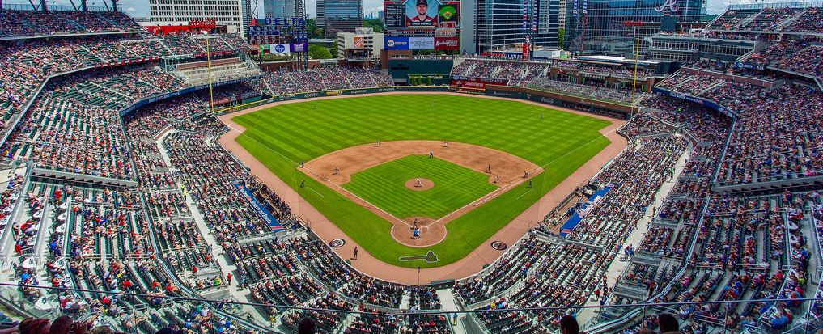
Remembering Jesus As God’s Son
Pause & Think: “…do you think…?” (vs. 53)
“My Father… My disposal…”
They are on HIS SIDE and AT HIS CALL.
“more than 12 legions of angels…”
Notes:
Vs. 53 is a question. Who do you think I am? Do you rightly judge who is before you? Have you forgotten that I’ve never feared being arrested? What do you really think?
They should remember how he walked on water and calmed the storm.
They should remember how he raised Jarius’ daughter from the dead and gave sight to the blind.
They should remember God speaking from HEAVEN on the Mt. of Transfiguration “This is my beloved Son in whom I am well-pleased, Listen to Him” Mt 17:5
But, they are acting like they haven’t seen any of this. I us all to PAUSE together this morning and THINK. Who is this man in the garden? This Teacher, This Friend, This Peacemaker. BECAUSE HE IS GOD’s SON!
This morning, we are here to REMBMER. To stop and think of all we know about HIM – because it changes how we react – even in the most extreme moments.
(Someone is probably already looking up: how many was a legion again? 4 to 6 thousand. So yes, 60,000 is a good estimate. The Braves’ stadium holds about 41,000. So you certainly get the idea – it is a lot. Which actually seems to be the usage of ”12” – a number of fullness, and “Legions” large groups. I can call a complete army!
But the emphasis is NOT on the number – it SHOULD BE on the ONE the FATHER WOULD LISTEN TO SO IMMEDIATELY!
If the Jews had been upset when he spoke of God as His Father on previous occasions this one would have really caught their attention.
If we know HIM well – We will know that he is not lacking any defense. The ver angels of heaven are on His side and at His call.

Slide 6
Remembering Jesus As Our Messiah
Matthew Emphasizes Jesus’ Fulfillment of the Old Testament Prophets 15 Times.
Luke 22:48 “Son of Man” Prophesied in Daniel 7:13
The Crowd Is Treating Jesus Like A Criminal, So He Gives A Mini-Sermon To Prompt Self-Examination.
Do We Believe The Words of the Prophets?
How Are We Treating Him?
Do We Know Who This Is?
Notes:
Fulfill – Jesus especially appeals to the books of Isaiah or Jeremiah – He makes it clear that they are talking about HIM! Right here and right now!
Fulfillment
Jesus is exactly who He claimed to be.
Jesus is doing exactly what the prophets said he would do.
Vs 55 – His mini-sermon: Self-Examination.
Why are you treating me this way?
Why do you feel threatened by Me?
I have been with you in the temple teaching day after day.
They are treating HIM like a criminal but the only thing He is guilty of is:
Teaching (Lawful)
In the Temple ( A Place of Respect & Worship)
Publicly – He isn’t Hiding.

Slide 7
Rabbi: Reflecting On Jesus
Notes:
Judas was RIGHT when he called Jesus our RABBI. Even in this short passage, HE TEACHES US INCREDIBLE LESSONS about WHO HE IS.
What’s the outcome of these Compact & Powerful Statements? His disciples all flee. This is exactly what he said would happen.
Just as Jesus said in vs. 31 – They all Flee…BUT NOT THIS MORNING…
But, Today His disciples come together.
Knowing HIS LOVE. KNOWING HIS SACRIFICE. Remembering His Calm Determination to Do the Father’s Will. And WE REMEMBER.

