Slide 1
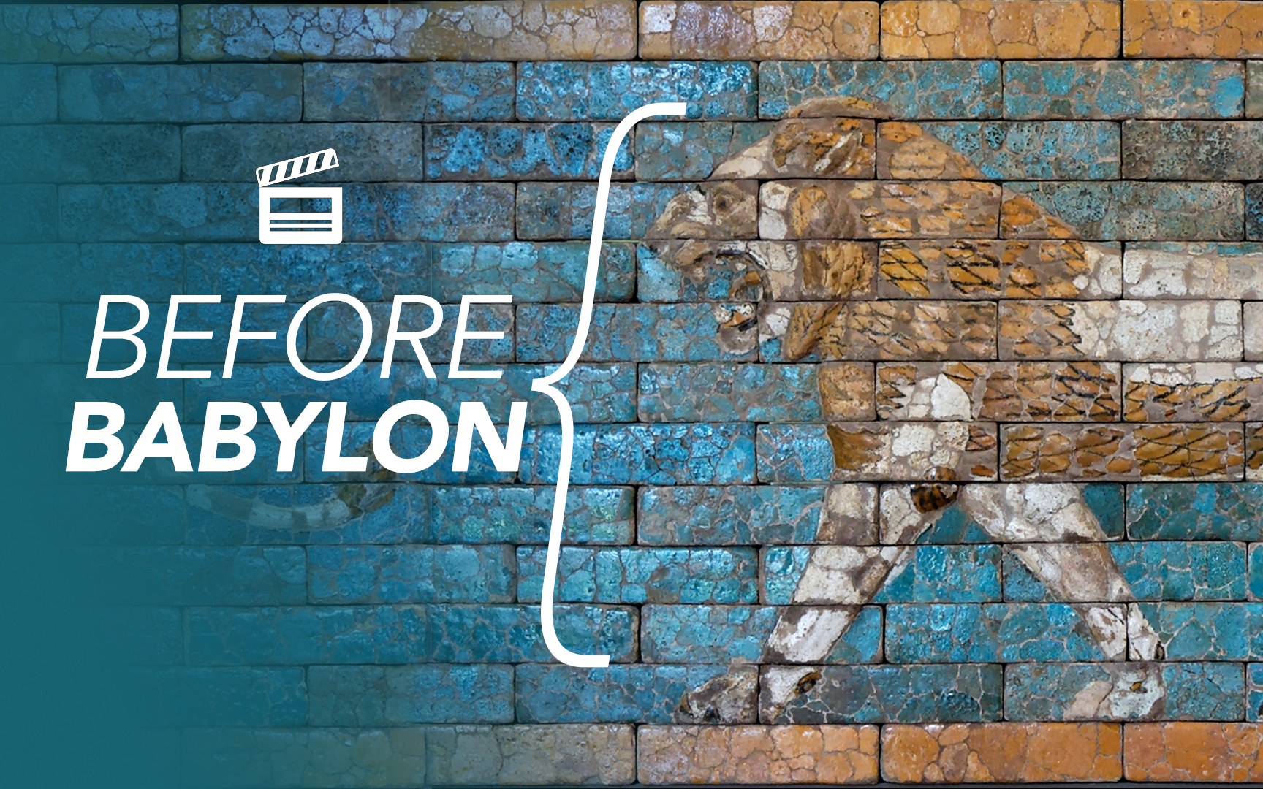
Before Babylon: The Story Behind Daniel’s Captivity
Notes:
The events in the book of Daniel are world-famous. God’s rescue of Daniel from the Lion’s Den is loved by people young and old.
But before VBS begins tomorrow, I want us to see WHY AND HOW these servants of God ended up in Babylon in the first place.
If you’ve ever enjoyed a show that took you “Behind the Scenes” to learn how a Movie was made, or read a great biography – that took you into the early life of an incredible person – then I hope you’ll see tonight – that when we study the events leading up to the book of Daniel make his great faith stand out even more.
Especially, given the wide-spread Unfaithfulness during those years just before Babylon.
In light of the Unfaithfulness in Judah – the GREAT FAITH of Daniel and his friends stands out as even more admirable.

Slide 2
Before Babylon… God’s People Had A Precious Covenant.
King Hezekiah Worked Hard To Restore The People’s Relationship With God.
2 Chronicles 29:1-2, 5-11, 29-30
2 Chronicles 30:5
2 Chronicles 31:1-5, 20
God Rescued The People & Extended Hezekiah’s Life, But Hezekiah Became Prideful.
Isaiah 39:2-8
2 Chronicles 32:20-25

Slide 3
Before Babylon… Judah’s Kings “Did Evil In The Sight of the Lord”
Manasseh’s Horrible Sins Required A Punishment & A Humbling Experience.
2 Chronicles 33:10-17, 2 Kings 21:10-15
Jehoiakim – Reigned 11 Years
2 Chronicles 36:5
Jehoiachin – Reigned 3 Months & 10 Days
2 Chronicles 36:9
Zedekiah – Reigned 11 Years
2 Chronicles 36:12
The Evil of These Kings Cost Them Everything.

Slide 4
Before Babylon, The Prophets Were Ignored
Ignored By The Kings. Who Chose To Look To Egypt.
2 Chronicles 36:12
The Kings Were Too Focused On Egypt.
Ignored By The Leaders & Priests.
2 Chronicles 36:14-16
The People Were Too Focused On The Nations.
Where Will We Focus?
Colossians 3:2

Slide 5
These Are Hard Lessons, But They Are Backed Up By Both Scripture & History.
In Scripture: John 8:31-34, Romans 6:11-18
In History:
The Jehoiachin Inscription
The Lachish Letters
The Babylonian Chronicles
Notes:
Sin Leads To Slavery!
We can learn them from Chronicles.
We can learn them from the archeology that confirms The Scriptures.
We can learn them from JESUS & HIS Apostles.
The Lachish Letters – inscribed on pottery.
The Jehoiachin Inscription
The Babylonian Chronicles

Slide 6
These Are Hard Lessons, But They Are Backed Up By Both Scripture & History.
2 Kings 25:27-30
Jeremiah 52:31-34
Notes:
Sin Leads To Slavery!
We can learn them from Chronicles.
We can learn them from the archeology that confirms The Scriptures.
We can learn them from JESUS & HIS Apostles.
The Jehoiachin Inscription: These tablets were discovered in the royal residene of Nebuchadnezzar in
This is actually mentioned in two places: 2 Kings 25:27-30 (and Jeremiah 52:31-34)
²⁷ Now it came about in the thirty-seventh year of the exile of Jehoiachin king of Judah, in the twelfth month, on the twenty-seventh day of the month, that Evil-merodach king of Babylon, in the year that he became king, ^{[l]}released Jehoiachin king of Judah from prison;²⁸ and he spoke kindly to him and set his throne above the throne of the kings who were with him in Babylon.^{29 [m]}Jehoiachin changed his prison clothes and ^{[n]}had his meals in ^{[o]}the king’s presence regularly all the days of his life; ³⁰ and for his allowance, a regular allowance was given him by the king, a portion for each day, all the days of his life.
The Babylonian Chronicles

Slide 7
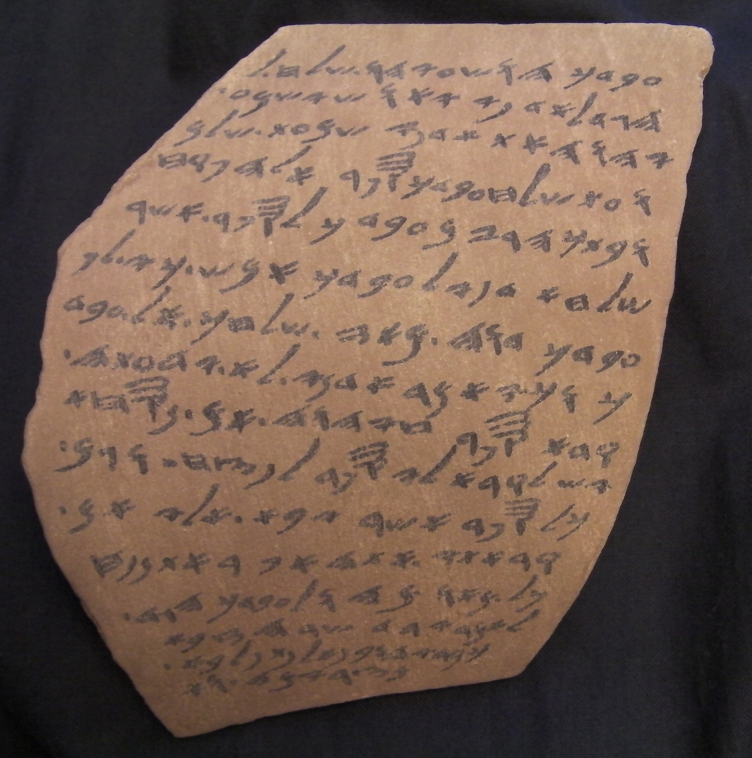
These Are Hard Lessons, But They Are Backed Up By Both Scripture & History.
Jeremiah 34:7
Notes:
The Lachish Letters – inscribed on pottery. “Why didn’t you read my email?!”
21 lines between a soldier and his commander, discussing if he read or did not read, a letter send. But what’s so fascinating, is the reference to the city of Lachish and one described simply as “the prophet” – which corresponds to Jeremiah 34:7
when the army of the king of Babylon was fighting against Jerusalem and against all the remaining cities of Judah, that is, Lachish and Azekah, for they alone remained as fortified cities among the cities of Judah.

Slide 8
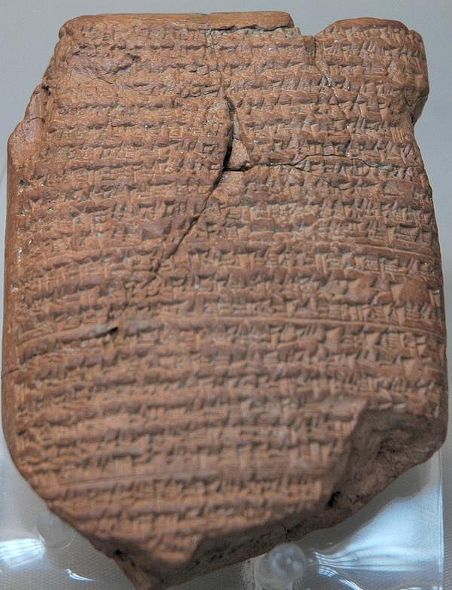
These Are Hard Lessons, But They Are Backed Up By Both Scripture & History.
Daniel 1:1
(605 B.C.)
Notes:
The Nebuchadnezzar Chronicle – especially interesting to US because it is a reference to HIS FIRST siege of Jerusalem. It was this first attack that aligns with Daniel 1 – when he and his friends are taken captive.
The Chronicle does not refer to Jerusalem directly but mentions a "City of Iaahudu", interpreted to be "City of Judah". The Chronicle states:
In the seventh year (of Nebuchadnezzar) in the month Chislev (Nov/Dec) the king of Babylon assembled his army, and after he had invaded the land of Hatti (Syria/Palestine) he laid siege to the city of Judah. On the second day of the month of Adar (16 March) he conquered the city and took the king (Jeconiah) prisoner. He installed in his place a king (Zedekiah) of his own choice, and after he had received rich tribute, he sent forth to Babylon.^{[9]}

Slide 9
Before Babylon… There’s A Lot To Learn.
Will We Repent with Humility Like Manasseh?
Will We Make A Difference Like Josiah?
Will We Treasure The Wisdom of Godly Women Like Huldah? (34:21-28)
These Young Kings Remind Us: The Decisions We Make Now Are Critical, Especially During Your 20’s!
Notes:
Huldah – when they discover the Law of God – they want to know what to do? They know just who to ask: a prophetess named Huldah.
God gives us glimpses into the lives of each of these people, to help us learn how to Love and Obey Him. I hope this background gets us even more excited for the study that begins this week looking at Daniel’s courage in captivity.

Slide 10
Before Babylon: The Story Behind Daniel’s Captivity
Notes:
Closing Prayer

