Slide 1
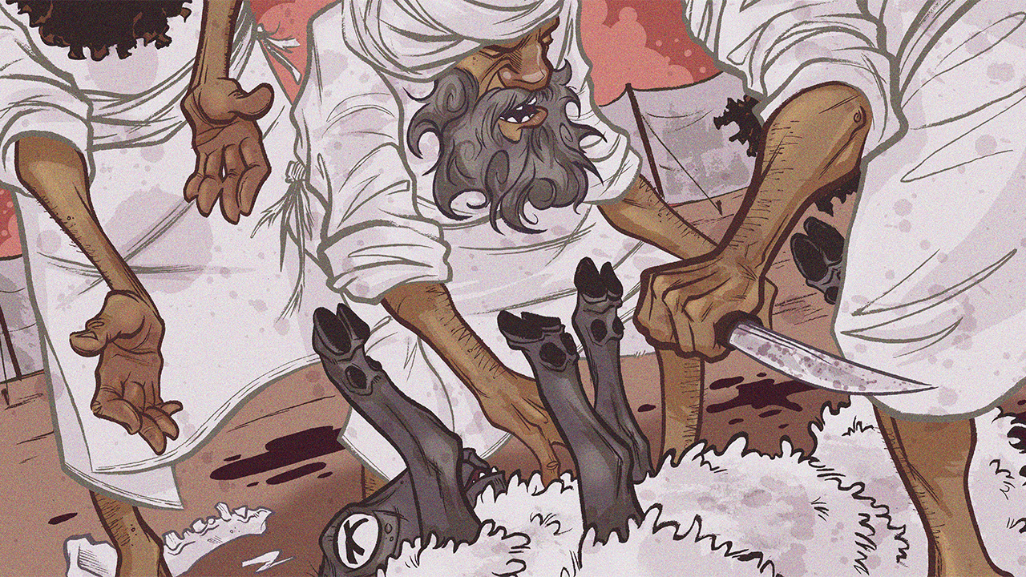
Life in the Blood
Leviticus 16-17

Slide 3
Life in the Blood
Introductory Thoughts
  Day of Atonement Most Solemn Day of Year
    Center of the Book of Leviticus
    Leviticus at the Center of Pentateuch
    Even Some Secular Jews Still Keep This Feast
  Other References
    Discussed Again in Leviticus 23:26-32
    Hebrews 9-10 Shows Fulfillment in Christ (cf. 9:25; 10:1, 3)
  Shows Seriousness of Sin
Outline of Section
  Day of Atonement (16:1-34)
  Consumption of Sacrifices & Blood (17:1-16)

Slide 4
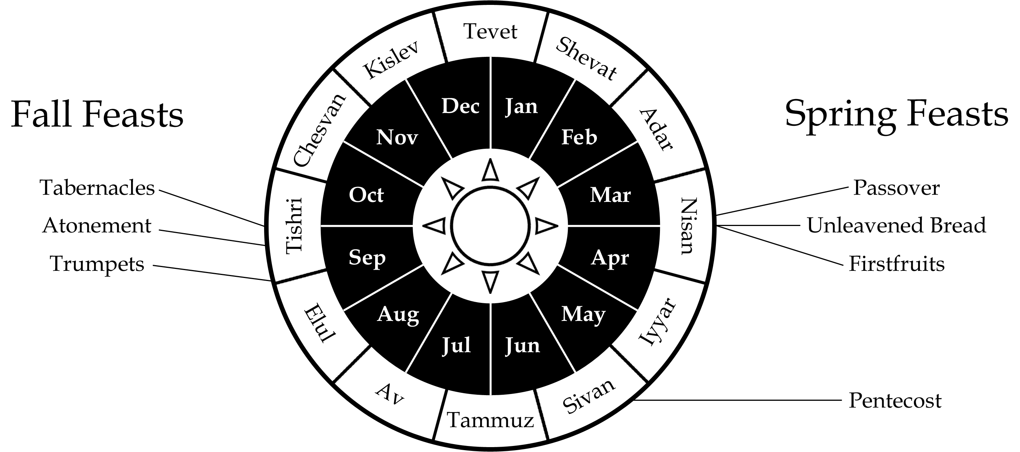
Day of Atonement (16:1-34)
Also Called “Yom Kippur”
The Only Day Someone Could Enter Most Holy Place
Atonement = To Make Reconciliation (vs. 10, 16, 17, 30)

Slide 5
Day of Atonement (16:1-34)
Preparation of Aaron (vs. 1-4)
  Warning to Carefully Enter Most Holy Place (vs. 1-2)
    Nadab & Abihu Serves as Cautionary Tale (Instructions Come After Lev. 10)
    Appropriate Time to Explain How One Approaches God
    Cannot Come At Any Time into Most Holy Place (God’s Glory is There)
      God’s Throne is Called a “Mercy Seat”
  How Aaron Must Approach God (vs. 3-4)
    Offerings For Self: Bull for Sin & Ram for Burnt (vs. 3; cf. vs. 6, 24)
    Wash Whole Body (vs. 4b; We Also Wash to Enter in Heb. 10:22)
    Wears Less Elaborate, Linen, Clothing (vs. 4a; cf. Exodus 28:1-39)
      Representing People to God (Not Representing God to People)
      Simplicity, Humility, & Contrition (Laid Aside Garments of Glory)
Brief Outline of Ceremony (vs. 5-10)
  Take Two Goats For Sin Offering & One Ram for Burnt Offering (vs. 5)
  Offer Bull for Sin Offering for Priests (vs. 6; cf. Heb. 9:25)
  Choosing the Goats by Lot Before the Lord (vs. 7-10)
    Sacrificed: First as a Sin Offering – Means of Atonement (cf. vs. 15-19)
    Scapegoat: Second Into Wilderness – Effect of Atonement (cf. vs. 20-22)

Slide 6
Day of Atonement (16:1-34)
Sacrifice for Priests (vs. 11-14)
  Bull For Sin Offering (cf. vs. 6)
    “For His House” = Fellow Priests (cf. Hebrews 7:26-27; 9:25)
    Before He Can Serve Nation, Priest Must be Pure
  Instructions for Incense (vs. 12-13)
    Coals For Censor Must Come From Altar
      Source of Fire/Coals is Important (cf. Lev. 10:1-2)
    Two Handfuls of Sweet Incense (cf. Exodus 30:34-38)
      Smoke Covers/Obscures God’s Glory (To Protect Aaron From God’s Glory)
      Reminds of God’s Fire & Smoke at Sinai
    Failure to Obey Results in Death (vs. 13)
      God Doesn’t Give Unnecessary Instructions
  Instructions for Blood (vs. 14)
    Blood Brought Into Most Holy Place
    Blood Sprinkled on Mercy Seat Seven Times
      Cherubim Flanked the Mercy Seat (Exodus 25:20)
      “And she saw two angels in white, sitting where the body of Jesus had lain, one at the head and one at the feet.” (John 20:12)
      Jesus Has Become the Mercy Seat

Slide 7
Day of Atonement (16:1-34)
Sacrifices for the People (vs. 15-22)
  Goat For Sin Offering (vs. 15-19)
    Blood of Goat Sprinkled on Mercy Seat (Second Time Into MHP)
    Holy Place Will Also be Atoned (vs. 16)
      Unclean People Can Defile Tabernacle (cf. 15:31)
      Sometimes Unaware (cf. 4:1-2; 5:2-3)
    Nobody Else Could Enter While the High Priest Was Working (vs. 17)
      We Didn’t See Jesus Go Into God’s Presence
      Jesus Was Alone When He Atoned For Our Sins
    Blood Applied to Brazen Altar (vs. 18-19)
  Scapegoat (vs. 20-22)
    Laid Both Hands on Goat (vs. 21)
      Regular Offerings Only Lay One Hand (cf. Leviticus 3:2, 8, 13; 4:4, 15, 24)
      Transferring Sins on Regular Sacrifices Would Defile the Altar
    Confesses Iniquities, Sins, & Transgressions Over Animal
      Must Confess to be Forgiven (1 John 1:9-10)
      This Goat is “Bearing” The Sins of the Nation
      Animal Sent Away (Like a Ritual Garbage Truck)
    Two Goat Offerings Fulfilled in One Sacrifice in Christ (cf. Isa. 53:4; 1 Pe. 2:24)

Slide 8
Day of Atonement (16:1-34)
Concluding Instructions (vs. 23-28)
  For Aaron (vs. 23-25)
    Leaves Linen Garments Inside Holy Place (vs. 23)
      White Linen Would Become Bloody (Picture of Sin)
      “⁵And stooping to look in, he saw the linen cloths lying there, but he did not go in. ⁶Then Simon Peter came, following him, and went into the tomb. He saw the linen cloths lying there, ⁷and the face cloth, which had been on Jesus' head, not lying with the linen cloths but folded up in a place by itself.” (John 20:5-7)
    Bathe Body in Water & Put on Garments (vs. 24a)
    Offers 2 Rams for Burnt Offering: One For Self & One For Nation
  Scapegoat Runner & Carrier/Burner of Remains (vs. 26-28)
    Wash Clothes & Bathe in Water
    As if Sacrifices Had Taken on Impurities

Slide 9
Day of Atonement (16:1-34)
Instructions to the People (vs. 29-31)
  Tenth Day of Seventh Month (Sixth of Seven Feasts)
  Permanent Statute (vs. 29, 31, 34)
    These Were Shadows of the Substance Found in Christ
    We Keep the Real “Day of Atonement”
  Afflict Selves (vs. 29-31; cf. Ezra 8:21)
    Word Associated With Fasting (Ezra 8:21)
    “The Fast” Mentioned In Acts 27:9
    Only Fast Commanded By God In Scripture (Usually Circumstantial)
  Do No Work
    Feasts Include Additional Sabbath-Styled Days
    Must Reflect Personally & Focus on the Spiritual
Conclusion (vs. 32-34)
  Only Priest in Aaron’s Line Can Perform Ceremony (vs. 32-33)
  Aaron Did All God Had Commanded (vs. 34)

Slide 10
Day of Atonement (16:1-34)
Sacrifice #1 | Sacrifice #2 | Sacrifice #3 | Sacrifice #4 | Sacrifice #5
Bull for a Sin Offering For Aaron & Priesthood Lev. 16:3 Lev. 16:6 Lev. 16:11-14 | Goat for a Sin Offering for the People Lev. 16:5 Lev. 16:15-19 | Scapegoat to Bear the Iniquities of the People Lev. 16:5 Lev. 16:20-22 | Ram for a Burnt Offering For Aaron Lev. 16:3 Lev. 16:24 | Ram for a Burnt Offering for the People Lev. 16:5 Lev. 16:24

Slide 11
Day of Atonement (16:1-34)
“¹⁶Therefore let no one pass judgment on you in questions of food and drink, or with regard to a festival or a new moon or a Sabbath. ¹⁷These are a shadow of the things to come, but the substance belongs to Christ.” (Col. 2:16-17)
Foreshadowing's & Fulfillments
  Aaron Entered Earthly Tent, Jesus the Heavenly Tent
  Aaron Offered Blood of Animals, Jesus Offered His Own
  Aaron Sacrificed First for Own Sin, Jesus Did Not
  Aaron Was Alone When Making Atonement, Jesus Was Forsaken
  Aaron Repeated Ritual Yearly, Jesus Once & For All

Slide 12
Consumption of Sacrifices & Blood (17:1-16)
Location of Sacrifice (vs. 1-9)
  Question of Sacrifice
    Vs. 3 – Specifically Mentions Sacrificial Animals (Ox, Lamb, or Goat)
    Vs. 5 – Question of Making Sacrifice in “Open Field”
    Vs. 5 – Instruction Regarding Peace Offering (Which Worshippers Ate From)
  Must Bring to Tent of Meeting
    Prevents From Sacrificing to Goat Demons (vs. 7; cf. Amos 5:25-27)
    Outlawing High Places Where Tabernacle is Not Located
      We Must Not Base our Worship Off of the World (cf. Deuteronomy 12:29-31)
      Animal Sacrifice Anywhere Other Than Tabernacle is Idolatry
      God Wants His People Together
  Law Later Amended?
    “²⁰When the LORD your God enlarges your territory, as he has promised you, and you say, ‘I will eat meat,’ because you crave meat, you may eat meat whenever you desire. ²¹If the place that the LORD your God will choose to put his name there is too far from you, then you may kill any of your herd or your flock, which the LORD has given you, as I have commanded you, and you may eat within your towns whenever you desire.” (Deuteronomy 12:20-21)
  Applies to the Strangers/Sojourners (vs. 8-9)

Slide 13
Consumption of Sacrifices & Blood (17:1-16)
Prohibition Against Consuming Blood (vs. 10-14)
  Applies To Sacrificial & Game Animals (vs. 13-14)
  Applies to Israelites & Strangers/Sojourners (vs. 10, 12, 13)
    Also Taught in the New Testament (Acts 15:19-20)
  Reason for Instruction
    Life is in the Blood (Must Respect Life; cf. Genesis 9:5-6)
    Blood Graciously Given for Atonement (Blood Has a Sacred Purpose)
    Ancient People Consumed Blood of Animals to Take on Trait of Animal?
  “⁵⁴Whoever feeds on my flesh and drinks my blood has eternal life, and I will raise him up on the last day. ⁵⁵For my flesh is true food, and my blood is true drink.” (John 5:54-55)
    Jesus’ Blood is What Gives us Life
    We Metaphorically Feed on Jesus’ Life
Eating “Roadkill” (vs. 15-16)
  Must Bathe & Wash Clothes
  Implied That You Still Cannot Consume Blood

