Slide 1
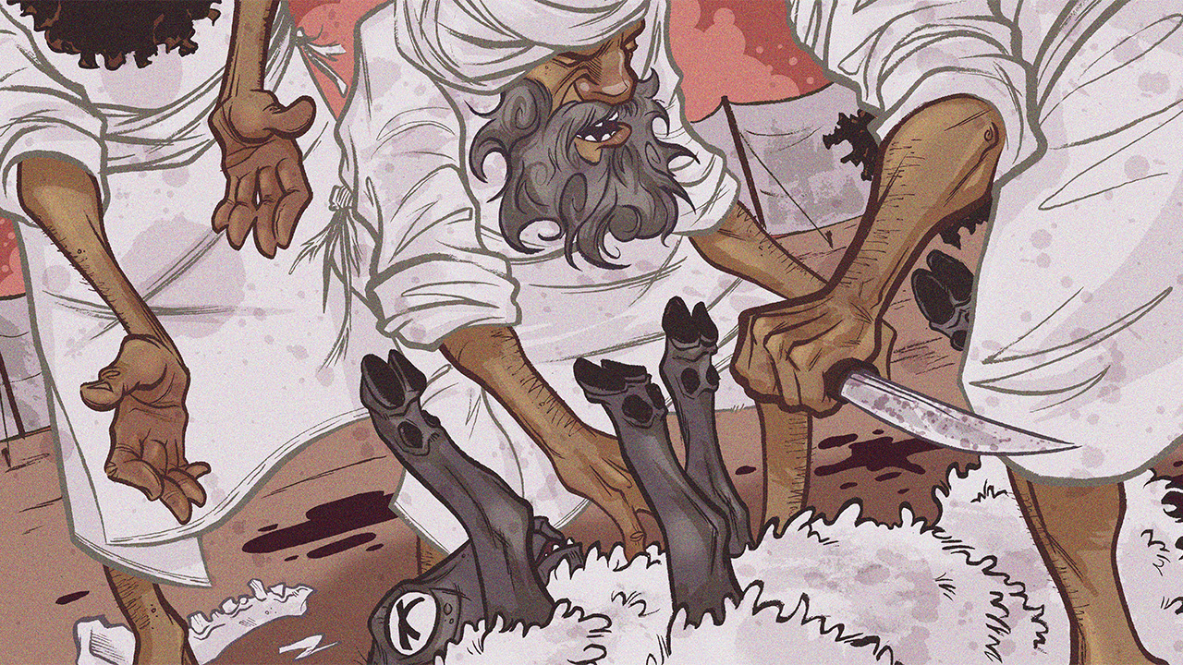
Glorify God in Your Body
Leviticus 18

Slide 3
Glorify God in Your Body
Introductory Thoughts
  Overview of New Section (Leviticus 18-20)
    Imitating the Canaanites (18:1-30)
      Various Laws for a Holy Community (19:1-37)
    Punishments For Imitating Canaanites (20:1-27)
  “You were bought with a price. So glorify God in your body.” (1 Corinthians 6:20)
Outline of Section
  Standards (vs. 1-5)
  Sexual Sins (vs. 6-23)
  Sickness (vs. 24-30)

Slide 4
Standards (vs. 1-5)
“I Am the Lord Your God…” (vs. 1-2; 16x in Lev. 18-20)
  Constant Reminder Laws Come From Royal Authority
Exhortation to Avoid Evil Examples (vs. 3)
  Israelites Between Two Wicked Places
    Looking Backward – Egypt (Temptation to Return to Past)
    Looking Forward – Canaan (Temptations We Are Yet Unaware)
  “You Shall Not Walk In Their Statutes” (God’s Law Not Copied From Nations)
    Many “Weird” Laws Are Examples/Reactions of What Pagans Did
    “Keep them and do them, for that will be your wisdom and your understanding in the sight of the peoples, who, when they hear all these statutes, will say, ‘Surely this great nation is a wise and understanding people.’” (Deut. 4:6)
The Unchanging Guide of God’s Laws (vs. 4-5)
  God’s Statutes Would Serve as Guide in a Confusing World
  “He Shall Live By Them” (cf. Galatians 3:12)
    Obedience Would Prevent Judgments That Brought Death (cf. Deut. 5:33)
    Can Mean Quality of Life (Abundant Life That God Wants to Give)

Slide 5
Sexual Sins (vs. 6-23)
Introduction to Section
  Outline of Section
    Sexual Sin With Close Relatives (vs. 6-18)
    Sexual Sin Outside Close Relatives (vs. 19-23)
  “Uncover Nakedness” (15x in Leviticus 18)
    Exposing One’s Body (Genesis 9:20-27; Exodus 20:26)
    Vs. 6 – “Approach” & “Uncover Nakedness” Implies Intercourse (cf. Isa. 8:3)
  Laws Protect Women
    Laws Written Largely for Men (Who Are Often the Aggressor; Except for in vs. 23)
    Restrictions Show Women Are Not Mere Objects for Men
    Sexual Violations Often Occur Within Circle of “Close Relatives”
  Desires/Passions Must Be Submitted to God’s Will
    One of the Most Offensive Teachings in Scripture Today
    God’s Plan for Intimacy Leads to True “Life” (vs. 5)

Slide 6
Prohibitions With “Close Relatives” (vs. 6-18)
General | Further Breakdown | Instances of “Violations”
Mothers | Biological Mother (vs. 7) Stepmother (vs. 8) | Reuben With Bilhah (Gen. 35:22) Absalom (2 Sam. 16:22) The Man in 1 Corinthians 5
Aunts | Paternal Aunt (vs. 12) Maternal Aunt (vs. 13) Paternal Uncle’s Wife (vs. 14)
Sisters | Biological Sister (vs. 9) Stepsister (vs. 11) Fraternal Sister-in-Law (vs. 16) Sister of Your Wife; “Rival Wife” (vs. 18) | Abram & Sarai (Gen. 20:12) Jacob: Rachel & Leah (Gen. 29-31) Amnon & Tamar (2 Sam. 13) Herod & Herodias (Mark 6:14-29)
Daughters | Biological Daughter (vs. 6; cf. 21:2) Daughter-in-Law (vs. 15) Wife’s Daughter (vs. 17a) | Lot & His Daughters (Gen. 19)
Granddaughters | Biological Granddaughter (vs. 10) Wife’s Granddaughter (vs. 17b)

Slide 7
Sexual Sins (vs. 6-23)
Additional Notes on “Close Relatives” (vs. 6-18)
  Recorded “Violations” of These Laws
    Why Would These Stories of Be Made Up?
    The Bible Candidly Shows the Flaws of God’s People
  “Close Relatives” Includes Those Connected Through Marriage
    Stepmother or Additional Wife (vs. 8)
    Aunt by Marriage (vs. 14)
    Daughter/Sister-in-Law (vs. 15-16)
  Implications of “One Flesh” (vs. 7)
    “Nakedness” of a Married Woman Belongs to Her Husband
    Union With Step “Mother” is Uncovering Nakedness of Father
  “Rival Wife” (vs. 18)
    Applies to Sisters Being to Same Man
    Principle Extends Beyond “Sister Wives” (cf. Genesis 29-31; 1 Samuel 1)

Slide 8
Sexual Sins (vs. 6-23)
Sexual Sin Outside of Close Relatives (vs. 19-20, 22-23)
  Relations During Menstrual Uncleanness (vs. 19)
    Earlier Mention May Be Accidental Occurrence (Leviticus 15:24)
  Neighbor’s Wife; Anyone Not Your Spouse (vs. 20)
  Homosexuality (vs. 22)
    References: Genesis 19; Leviticus 20:13; Romans 1; 1 Corinthians 6:9; 1 Timothy 1:10
    Don’t Underestimate Christian’s Eventually (Or Currently) Accepting This Sin
  Bestiality (vs. 23)
Warning Against Molech Worship (vs. 21; cf. 20:2-5)
  How Does This Fit the Context?
    May Refer to Giving Children as Prostitutes for Idol
    Offering Children Another Way People Disregard the Lives of Others
    Offering Children Another Example of “Wasting Seed”
  Molech Worship Today
    Abortion (Helps in Financial Hardship – Molech Promised Wealth)
    Offering Children to Idolatrous Altars (Success, Politics, Education, Sports, etc…)

Slide 9
Sickness (vs. 24-30)
Coming Judgment on Canaanites
  They Became “Unclean” Through Their Iniquities & Abominations
  God Patiently Waited Before Punishing the Canaanites
    “And they shall come back here in the fourth generation, for the iniquity of the Amorites is not yet complete.” (Genesis 15:16)
    Without Judgment, A Skeptic May Question God’s Justice
    God Holds Gentiles Accountable in the Old Testament
      Amos 1:3-2:3 Condemns Six Gentile Nations
      Nahum Condemns Nineveh (120 Years After Jonah)
  They Will Be “Vomited Out” of the Land (vs. 25, 28)
    These Nations Made God “Sick”
    The Conquest in Joshua Shows This Judgment
      Sometimes God Uses Nature (Flood, Earthquake, etc…)
      Israelites Were the Instrument of God’s Judgment

Slide 10
Sickness (vs. 24-30)
Learning From Canaanite Example
  Israel Could Likewise Become “Unclean”
    Do Not Imitate the Canaanites (vs. 30)
    Ritual State Used as a Picture of Sin
    Being “Unclean” Prevents From Being in God’s Presence
      Applied to the Temple (Leviticus 11-15)
      Applied to the Land (2 Kings 17:18, 20, 23)
  Israel Could Likewise be “Vomited” Out of Land”
    Sins That Make Land “Unclean” or “Defiled” (vs. 28)
      Sexual Sin (Leviticus 18:24-25)
      Murder (Numbers 35:33-34)
      Idolatry (Leviticus 19:31; Jeremiah 16:18)
    Warnings Proves God Was Not an Ethnic Cleanser; He Was Always Fighting Sin
  Sojourners Must Submit to God’s Laws (vs. 26)
    We Expect Temporary Residents in the U.S. to Obey Laws
    We Expect Immigrants to the U.S. to Obey Laws

