Slide 1
Beatitudes
Notes:
There is a depth and gravity to these statements that makes an extensive study profitable – but Jesus used them as His attention grabbing, rapid-fire, toss your expectations opener! They came hard and fast to those looking for a very different kingdom.
They tear down our false assumptions and self-reliance. Like firing up a chainsaw and falling a massive cedar tree – Jesus drops the vain and worldly thoughts to the ground, so He can build up a HEAVENLY KINGDOM. He chops down our ego and greed with 8 back to back declarations that show us HIS TIME HAS COME and HIS PEOPLE will never be the same.

Slide 2
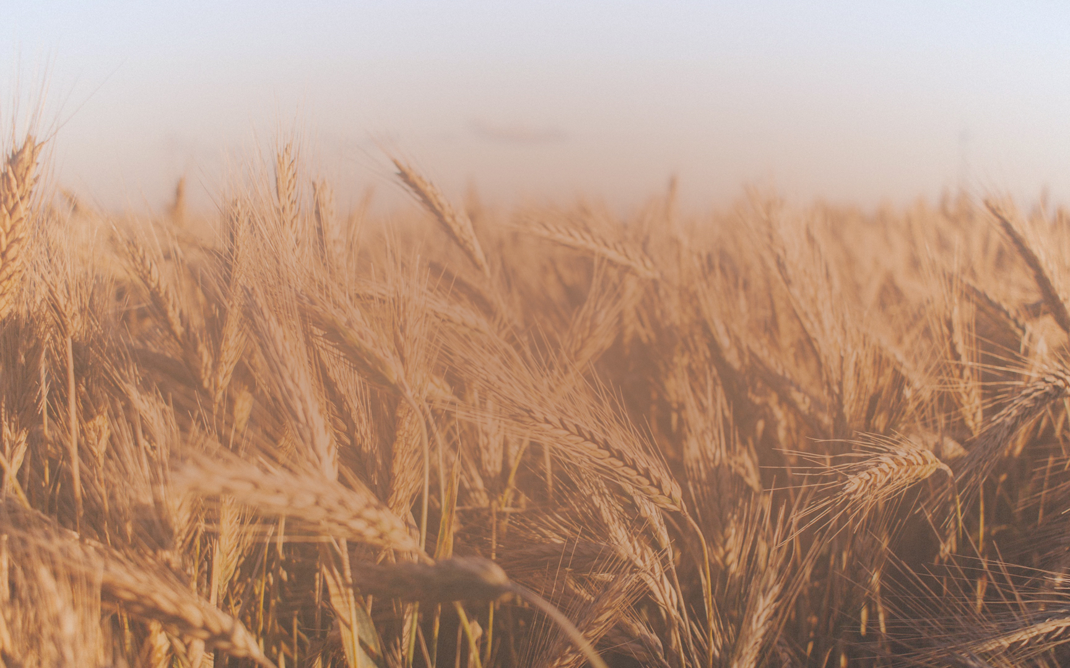
8
• Poor In Spirit • Mourn
• Meek
• Hunger & Thirst
• Merciful
• Pure In Heart
• Peacemakers
• Persecuted
QUALITIES
OF A KINGDOM
CITIZEN
Notes:
Not 8 different people – but 8 qualities that disciples of Jesus accept and develop.

Slide 3
The Beatitudes Are Not One Sided.
• Who To Be
• What To Do
Jesus Teaches
• Current Fulfillment
• Future Fulfillment
• Physical Status
BOTH
• Internal Status
• Personal Growth
• Outward Service
In Life & In Death
• Blessings
• Hardships
Notes:
Jesus Teaches Us BOTH Who To Be & What To Do.
Jesus Points To BOTH Current & Future Fulfillment.
Jesus Addresses BOTH our Physical & Personal Status.
Jesus Speaks To BOTH our Inward & Outward Joy.
Inward: Comfort, Satisfaction
Outward: extending compassion, showing mercy, making peace
Jesus Explains BOTH the Blessings & Persecutions to Expect.
Jesus Exemplifies All 8 In BOTH His Life & His Death.
They are so comprehensive, such a powerful summary – that ALL of us can find aspects of these traits to grow in and to use to serve others in the chaotic world around us.
They Give Us STABILITY. They Stir Our GROW. They Help us SERVE. They Elevate our Thinking ABOVE the Chaos and Noise.

Slide 4
Elevate Our Thinking
Help Us Serve
Stir Our Growth
Give Us Stability
Notes:
They are so comprehensive, such a powerful summary – that ALL of us can find aspects of these traits to grow in and to use to serve others in the chaotic world around us.
They Give Us STABILITY. They Stir Our GROW. They Help us SERVE. They Elevate our Thinking ABOVE the Chaos and Noise.

Slide 5
Blessed Are The Poor In Spirit…
“To Crouch” In Poverty Begging For Assistance.
Luke 18:9,13 & Titus 3:3-7 Reveal Who Enters The Kingdom.
Notes:
“to crouch” – one who was forced to crouch in poverty as they begged for assistance.
Luke 18 – God be merciful to me a sinner.
“Can’t work, need forgiveness” (Lawn Clothes)
Not standing before God saying, look what I did with the talents you gave me, but instead saying: God, I broke it, and I can’t fix it. (titus 3)
THE KINGDOM OF HEAVEN - God’s Promises, Family, Dominion are for these people.

Slide 6
Blessed Are Those Who Mourn…
Mourning our Spiritual Condition.
Godly Sorrow of 2 Corinthians 7:10.
Comfort Comes When We Are Made A New Creation.
Notes:
Mourning Over A Death: Ours.
Godly Sorrow Over Our Sins.
Comfort – Peace, Healing, Forgiveness, Renewal, Usefulness, Hope
To the one who deeply regrets what they’ve broken, destroyed, and killed, God gives a new life to walk in a new path.
What was shattered is now a New Creation.

Slide 7
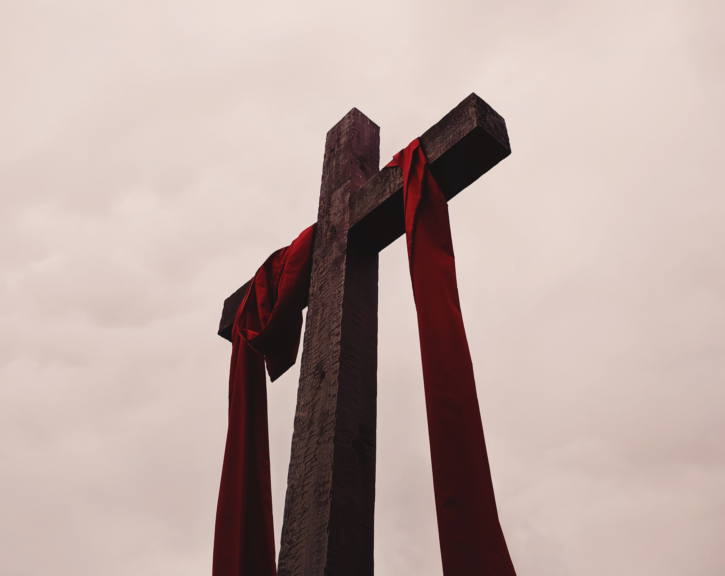
Blessed Are The Meek…
Who Wins In The End?
Power-Hungry?
Wealthy Elite?
Psalm 37 Is Jesus’ Answer.
Meekness Is Cultivated Through:
Trust In God
Long-Suffering
Humility
Notes:
Psalm 37
Who Wins In The End?
Is it the power-hungry, the ruthless?
Is the the privileged and elite?
No, it is GOD!
Meekness is Cultivated
Trusting In God
Long-Suffering
Humility

Slide 8
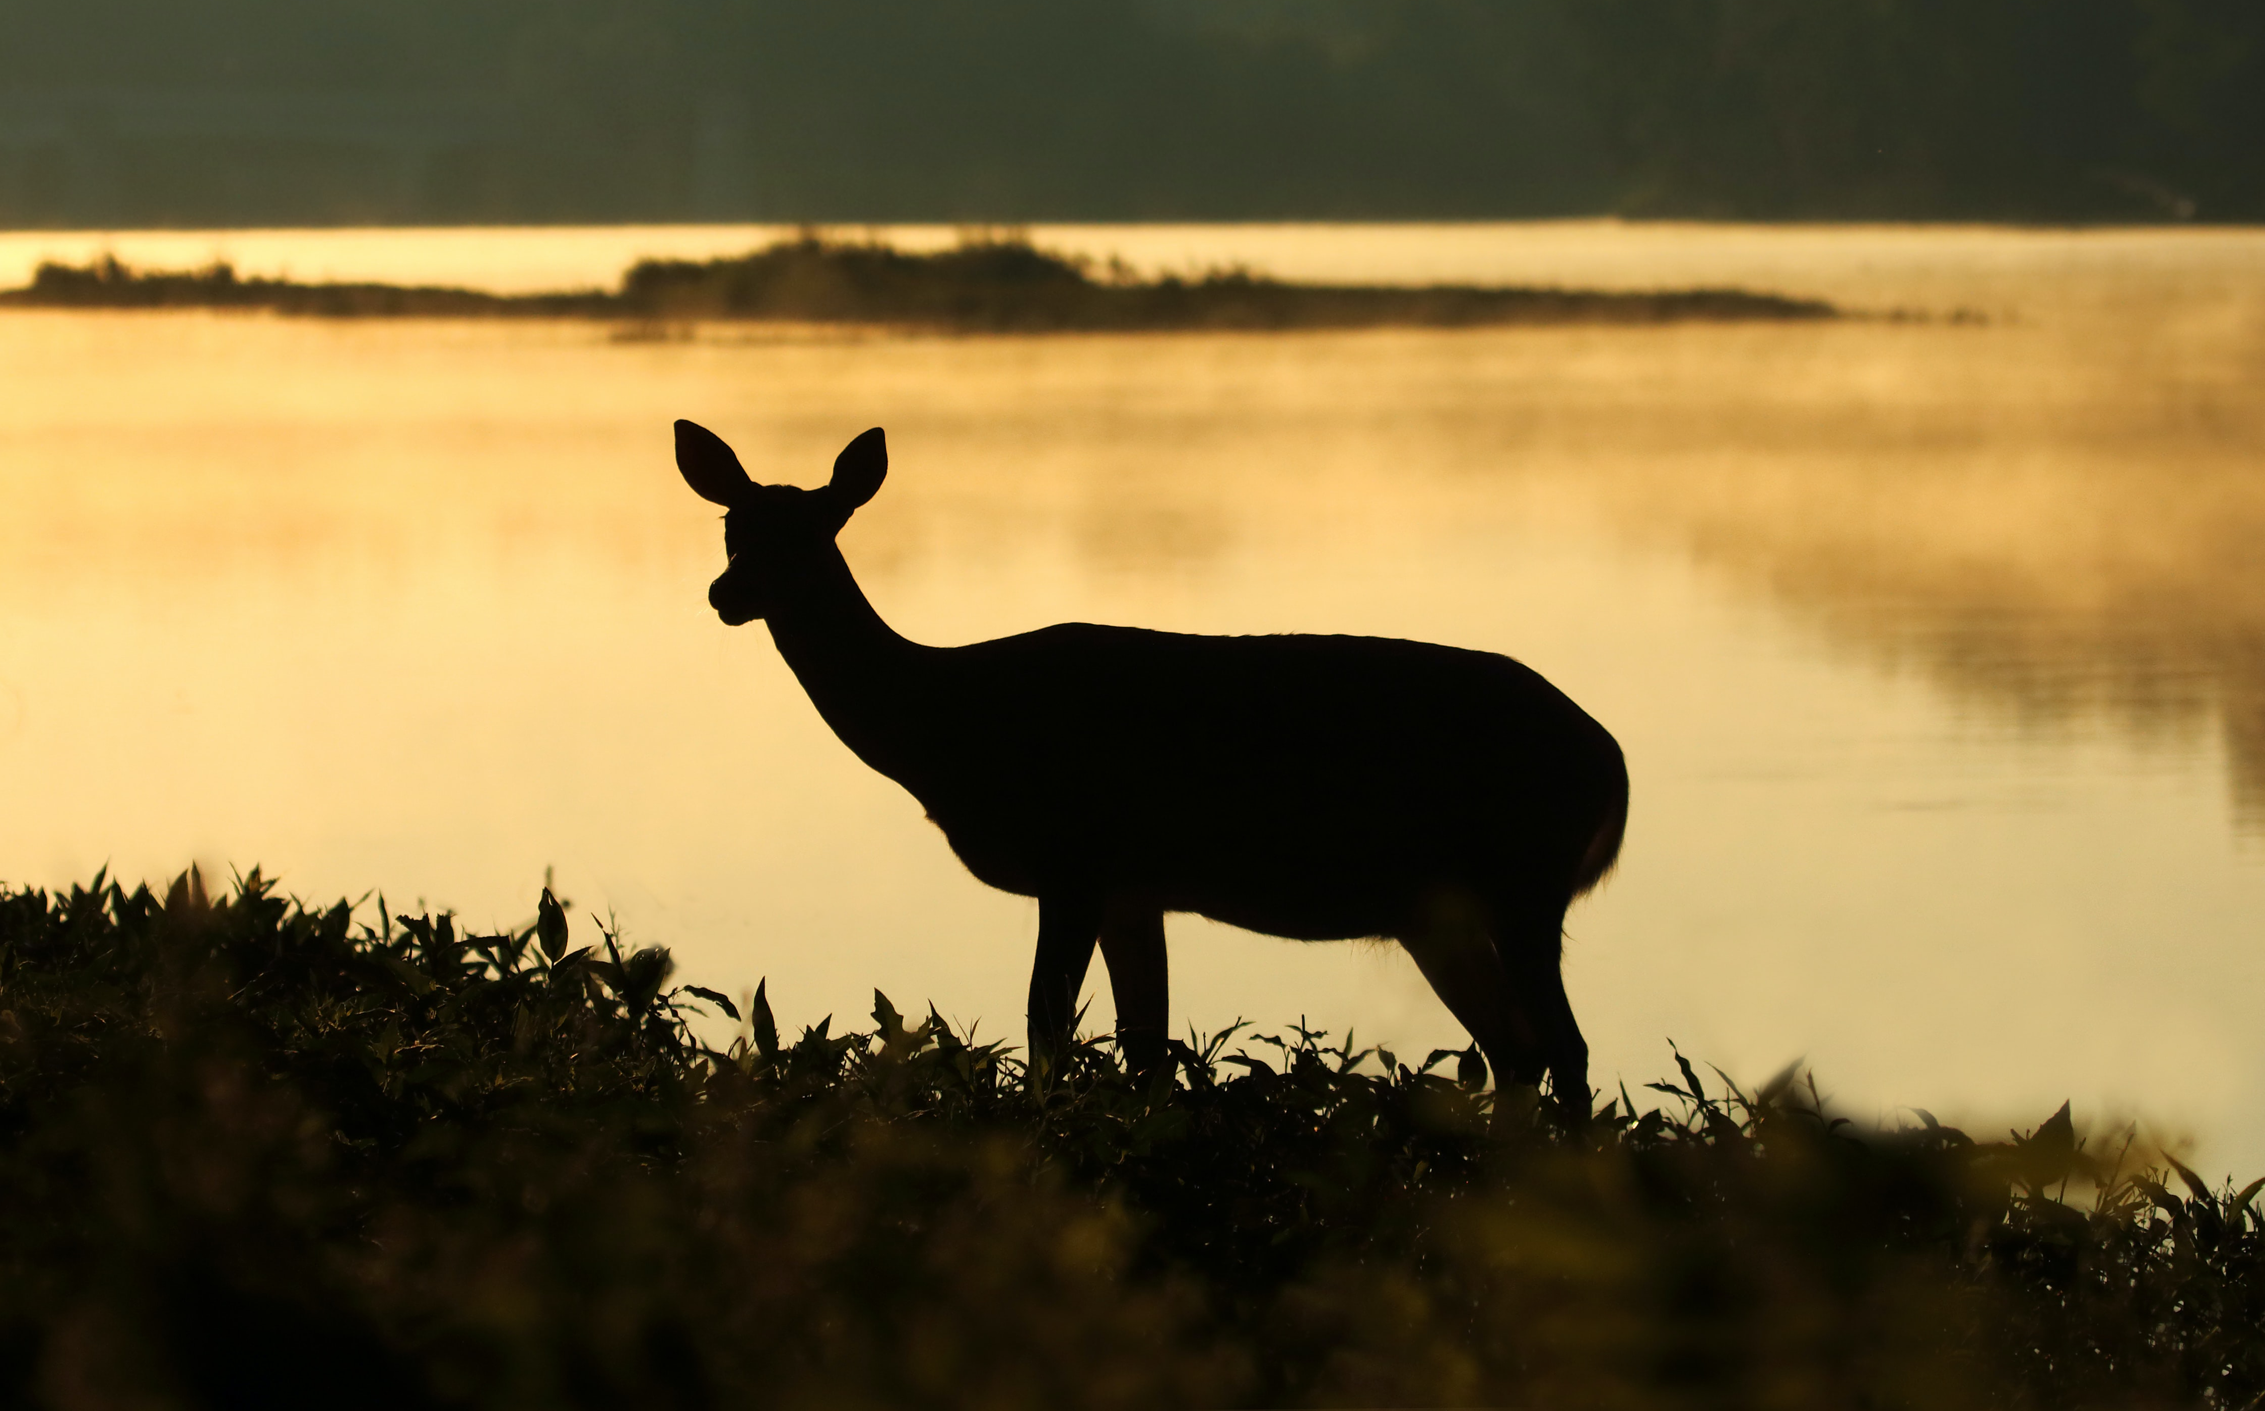
Blessed Are Those Who Hunger & Thirst…
Psalm 42:1-2
Our World Is Hungry For Happiness, But It Doesn’t Satisfy.
We Hunger For Righteousness Personally & In Our Community.
Notes:
Ps 42:1-2
Our World is Hungry for Happiness, & It Doesn’t Satisfy.
Our World Is Hungry for Fame on TikTok, & It Doesn’t Satisfy.
Christians Are Hungry For Righteousness, & Find A Joy Only Jesus Can Provide.
We would welcome righteousness in our surroundings, but we are first interested in being MADE righteous by God. The fellowship we lost being restored.
Adam & Eve the moment their eyes were open. When they couldn’t “just put it back” but found themselves naked, ashamed, and in sin.

Slide 9
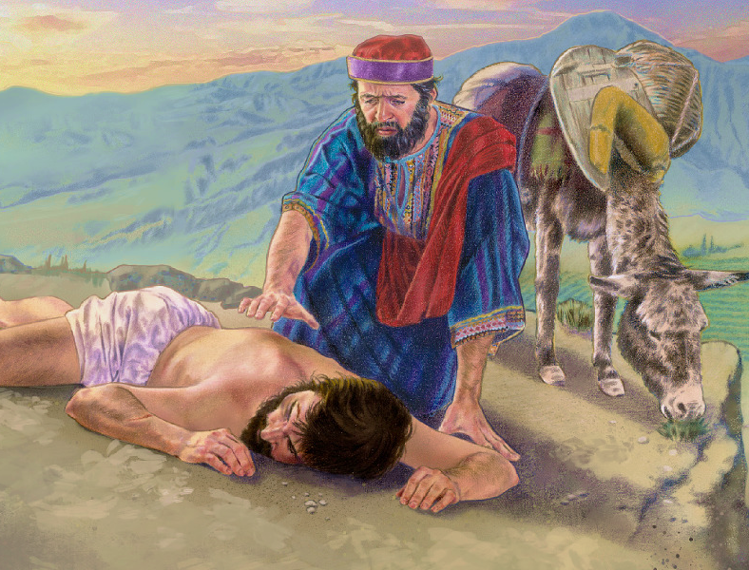
Blessed Are The Merciful…
The Active Compassion of Luke 10:37.
Thoughtfulness To Consider What Others Are Going Through.
Proverbs 11:24-25
Notes:
** But we don’t stop at RIGHTEOUSNESS. We are not so obsessed with what is RIGTH, that we’ve lost sight of what is LOVING.
No, the justice we desire includes a healthy portion of MERCY.
Actively Compassionate.
Go and Do the Same. Luke 10:37
Mt 25 – Those in need are shown active mercy.
What are others going through? How can I help?
Proverbs 11:24-25

Slide 10
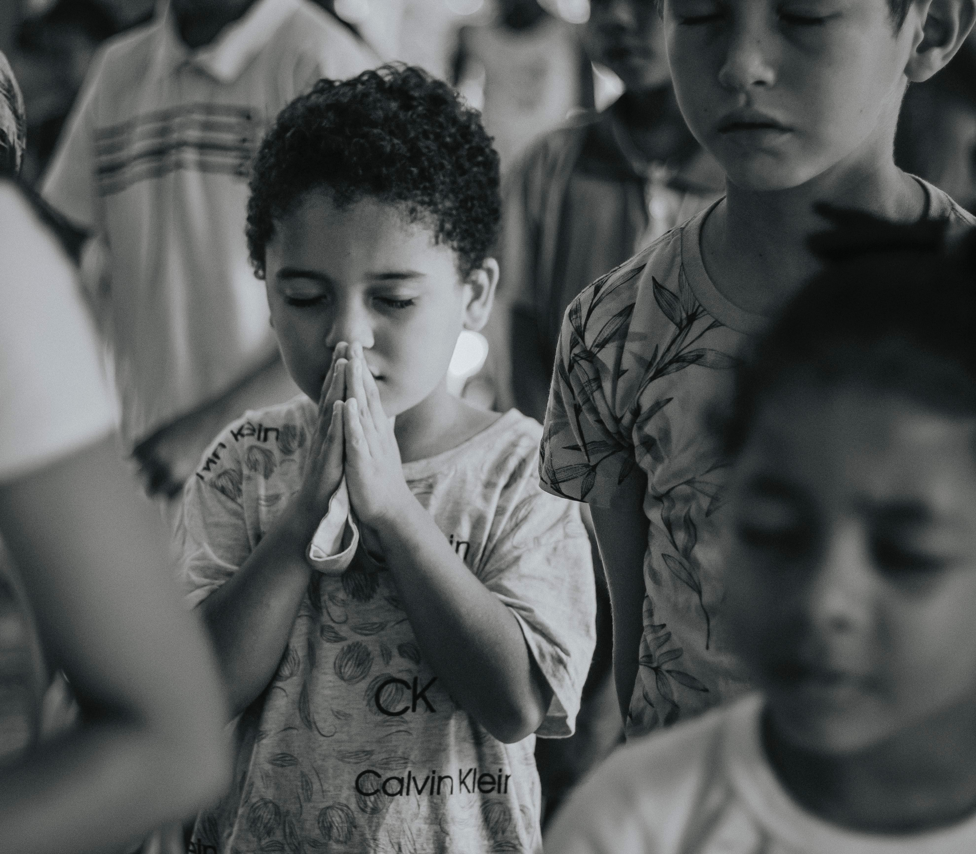
Blessed Are The Pure In Heart…
Pure In Purpose Such As Mt. 6:24 or Jam. 4:8
The Pure Heart of Joshua. (24:15)
See God: In Heaven, But Even Now In The Light of Jesus’ Disciples (5:14-16)
Notes:
To Set our heart on pleasing the Lord.
Contrast of James 4:8 = pure vs. double-minded.
Elaborated on in Mt. 6:24
To Set aside hypocrisy and posturing. (Mt 23:25-28)
Joshua 24:15!
Psalm 73 – we get distracted, but refreshed in worship.
See God: yes in heaven, but now, in the light of Jesus shining out of His followers. (5:14-16)

Slide 11
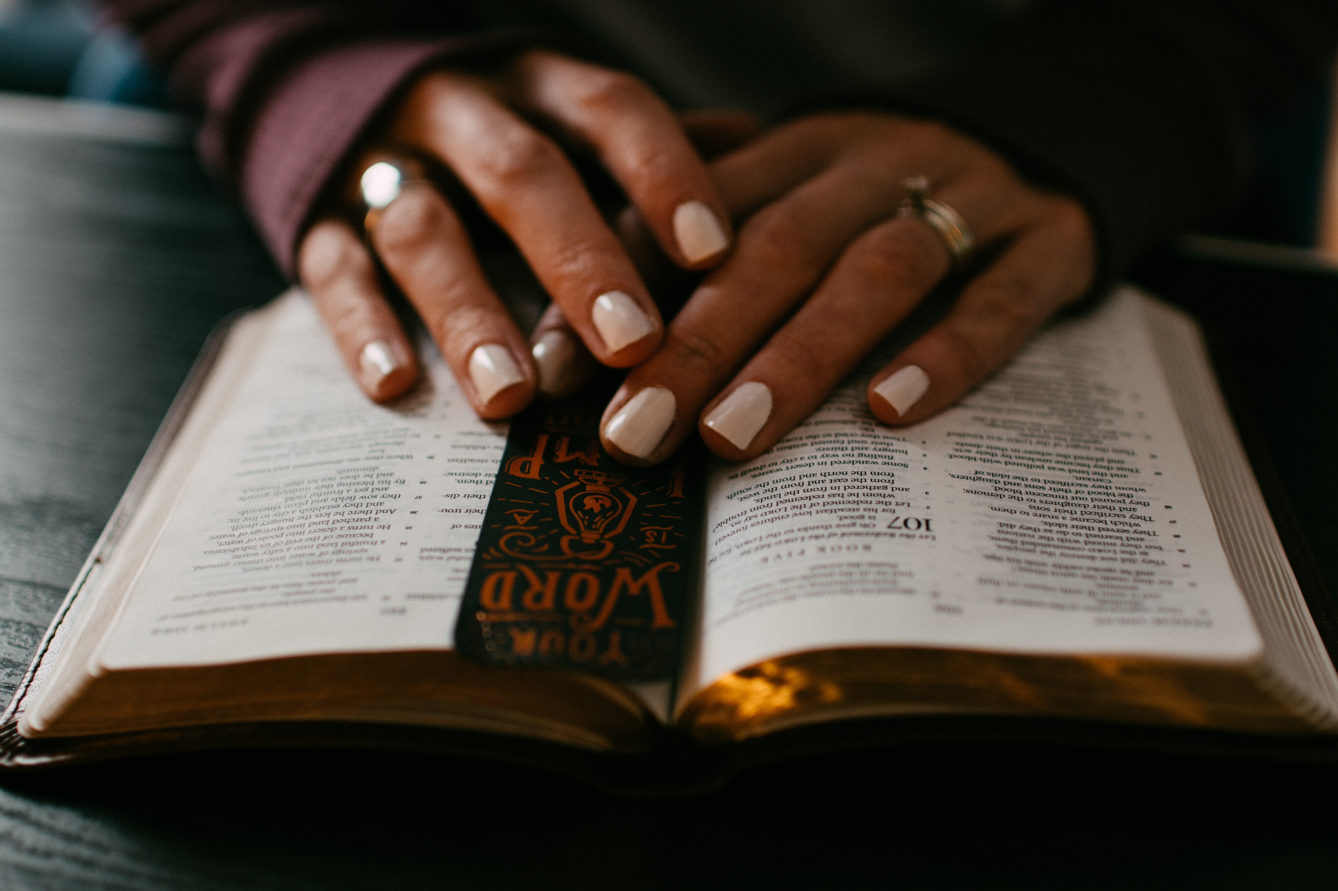
Blessed Are The Peacemakers…
Would The Messiah Be A Warrior Who Dominates & Overpowers?
Would The King’s Children Be Warriors or Ambassadors of Peace?
2 Corinthians 5:18-20
Notes:
Contrast with Warriors who Dominate & Overpower. The peacemaker offers terms of surrender to those he hopes to redeem, not destroy.
Like the Sons of a Great King, they bring His terms.
You’ll Recognize God’s Children As Ambassodors on the Ministry of Reconcilliation.
They are interested in, and actively pursuing, extending the terms of peace God offers.
2 Corinthians 5:18-20.
It is clear that we “fight the good fight” and put on the “armor of God” but these are spiritual battles.

Slide 12
Blessed Are The Persecuted…
All The Opposition, Harm, & Ridicule Meant To Deter Us.
Hated For Both A Life of Righteousness & Loyalty to Jesus.
Rejoice, “…Theirs Is The Kingdom of Heaven.”
Notes:
Opposition, Harm, Ridicule meant to deter us from being who, and doing what God desires.
2 Things About Kingdom Citizes The World Will Hate:
Life of Rigtheousness
Loyalty to Jesus
The Darkness hates the Light. Rejoice that there was enough of Jesus in us for anyone to notice and object.
“Theirs is the Kingdom of Heaven”
No matter who else rejects you, GOD will not!
Rejoice – proceed in fellowship with God’s servants.

Slide 13
QUALITIES
OF A KINGDOM
CITIZEN
• Poor In Spirit • Merciful • Mourn • Pure In Heart
• Meek • Peacemakers
• Hunger & Thirst • Persecuted
Notes:
Not 8 different people – but 8 qualities that disciples of Jesus accept and develop.

Slide 14
Beatitudes
Notes:
There is a depth and gravity to these statements that makes an extensive study profitable – but Jesus used them as His attention grabbing, rapid-fire, toss your expectations opener! They came hard and fast to those looking for a very different kingdom.
They tear down our false assumptions and self-reliance. Like firing up a chainsaw and falling a massive cedar tree – Jesus drops the vain and worldly thoughts to the ground, so He can build up a HEAVENLY KINGDOM. He chops down our ego and greed with 8 back to back declarations that show us HIS TIME HAS COME and HIS PEOPLE will never be the same.

Slide 15
Blessed Are Those Who Mourn
Mourning Over A Death: Ours.
Godly Sorrow Over Our Sins.
Comfort – Peace, Healing, Forgiveness, Renewal, Usefulness, Hope
To the one who deeply regrets what they’ve broken, destroyed, and killed, God gives a new life to walk in a new path.
What was shattered is now a New Creation.

Slide 16
Blessed Are The Meek…Inherit
Psalm 37
Who Wins In The End?
Is it the power-hungry, the ruthless?
Is the the privileged and elite?
No, it is GOD!
Meekness is Cultivated
Trusting In God
Long-Suffering
Humility

Slide 17
Blessed Are Those Who Hunger & Thirst
Ps 42:1-2
Our World is Hungry for Happiness, & It Doesn’t Satisfy.
Our World Is Hungry for Fame on TikTok, & It Doesn’t Satisfy.
Christians Are Hungry For Righteousness, & Find A Joy Only Jesus Can Provide.
We would welcome righteousness in our surroundings, but we are first interested in being MADE righteous by God. The fellowship we lost being restored.
Adam & Eve the moment their eyes were open. When they couldn’t “just put it back” but found themselves naked, ashamed, and in sin.

Slide 18
Blessed Are The Merciful
Actively Compassionate.
Go and Do the Same. Luke 10:37
Mt 25 – Those in need are shown active mercy.
What are others going through? How can I help?
Proverbs 11:24-25

Slide 19
Blessed Are The Pure In Heart
To Set our heart on pleasing the Lord.
Contrast of James 4:8 = pure vs. double-minded.
Elaborated on in Mt. 6:24
To Set aside hypocrisy and posturing. (Mt 23:25-28)
Joshua 24:15!
Psalm 73 – we get distracted, but refreshed in worship.
See God: yes in heaven, but now, in the light of Jesus shining out of His followers. (5:14-16)

Slide 20
Blessed Are The Peacemakers, Sons of God
Contrast with Warriors who Dominate & Overpower. The peacemaker offers terms of surrender to those he hopes to redeem, not destroy.
Like the Sons of a Great King, they bring His terms.
You’ll Recognize God’s Children As Ambassodors on the Ministry of Reconcilliation.
They are interested in, and actively pursuing, extending the terms of peace God offers.
2 Corinthians 5:18-20
Notes:
Sons of God: Like Father, like Son. A Chip off the Old Block. (The Acorn doesn’t fall far from the tree.). The point is there are similarities between parent and child.
Who is Similar to God? Is he or shee the destroyer or the peacemaker?

Slide 21
Blessed Are The Persecuted
Opposition, Harm, Ridicule meant to deter us from being who, and doing what God desires.
2 Things About Kingdom Citizes The World Will Hate:
Life of Rigtheousness
Loyalty to Jesus
The Darkness hates the Light. Rejoice that there was enough of Jesus in us for anyone to notice and object.
“Theirs is the Kingdom of Heaven”
No matter who else rejects you, GOD will not!
Rejoice – proceed in fellowship with God’s servants.
Notes:
Rejoice. If evil people hate you, you must be doing something right!

Slide 23
“The kingdom, first and foremost, has to do with what we are.” (Chumbley, p83)
Good friends inspire us to do more. Great friends inspire us to be more.

Slide 24
The Beatitudes - Matthew 5:1-12
“Beatitudes” - from the Latin beatus,
“blessed,” or to “make happy”
"Blessed" – from the Greek makarios
to be fully satisfied
In classical Greek this word described those who possessed consummate bliss.
completely independent of all the chances and changes of life
Has to do with how God looks at us

Slide 25
The Beatitudes: Character of Citizens
poor in spirit - complete absence of pride, a complete absence of self-assurance and self-reliance, a consciousness that we are nothing in the presence of God
Mourn - To mourn is something that follows of necessity from being 'poor in spirit. As I confront God and His holiness, and contemplate the life that I live, I must mourn about the fact that I am like I am, what I have done, what have I said, what I have thought, how I have behaved with respect to others, that I have sinned against a holy God
Meek – those who have enough strength of character to surrender completely to the will of God, rely on his power and be soft in spirit toward others
Notes:
“For theirs is the kingdom of heaven” is an “enclusio”. This shows the true emphasis of the text. The beatitudes teach us how to be citizens in the kingdom of heaven.
At first this seems different than other beatitudes. It is not a description of a Christian but what is the result of what has gone on before and because of what a Christian is.
Christ is saying "This is what is going to happen as a result of following me". It follows right behind "blessed are the peacemakers.” If we are peacemakers, we will be persecuted by the wicked.
This has the same promise as first beatitude, “theirs is the kingdom of heaven”
The beatitudes begin and end with this promise. Blessings are attached with all the beatitudes, but this one is emphasized. Membership in the kingdom is most important thing.

Slide 26
The Beatitudes: Character of Citizens
hunger and thirst for righteousness – Must be an intense desire not only for the righteousness Gods bestows but for the ethical righteousness He demands
Merciful – actively compassionate, ability to see a need in others because we have been and are in need of God’s mercy, not to be a random impulse but a habitual trait.
pure in heart – cleanliness at the center of our being our inner man, singular devotion, clear and undivided loyalty
Notes:
“For theirs is the kingdom of heaven” is an “enclusio”. This shows the true emphasis of the text. The beatitudes teach us how to be citizens in the kingdom of heaven.
At first this seems different than other beatitudes. It is not a description of a Christian but what is the result of what has gone on before and because of what a Christian is.
Christ is saying "This is what is going to happen as a result of following me". It follows right behind "blessed are the peacemakers.” If we are peacemakers, we will be persecuted by the wicked.
This has the same promise as first beatitude, “theirs is the kingdom of heaven”
The beatitudes begin and end with this promise. Blessings are attached with all the beatitudes, but this one is emphasized. Membership in the kingdom is most important thing.

Slide 27
The Beatitudes: Character of Citizens
Peacemakers – those who make peace with God and encourage others to make peace with him and who seek to live in peace with all men
persecuted for righteousness’ sake – Those who take faith seriously by taking a stand on spiritual and moral truth will be persecuted for righteousness’ sake. They shall be welcomed into the kingdom of heaven.
Mt. 5:12Rejoice and be exceedingly glad: for great is your reward in heaven.
The journey that began in poverty (vs 3) ends in unimaginable wealth.
Notes:
“For theirs is the kingdom of heaven” is an “enclusio”. This shows the true emphasis of the text. The beatitudes teach us how to be citizens in the kingdom of heaven.
At first this seems different than other beatitudes. It is not a description of a Christian but what is the result of what has gone on before and because of what a Christian is.
Christ is saying "This is what is going to happen as a result of following me". It follows right behind "blessed are the peacemakers.” If we are peacemakers, we will be persecuted by the wicked.
This has the same promise as first beatitude, “theirs is the kingdom of heaven”
The beatitudes begin and end with this promise. Blessings are attached with all the beatitudes, but this one is emphasized. Membership in the kingdom is most important thing.

Slide 28
The Beatitudes: Character of Citizens
All Christians are meant to manifest all of these characteristics. They are not proverbs to be applied individually, they are a composite. They are a seamless garment.
These qualities are chosen qualities

