Slide 2
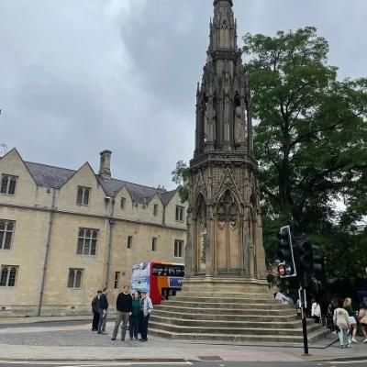
Martyr’s Monument, Oxford, England

Slide 3
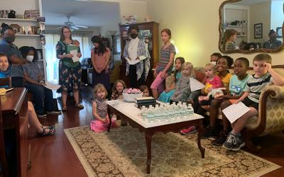

Slide 4
The Unbelieving Brothers of Jesus
John 7:1-9
Who were these brothers of Jesus?

Slide 5
Named in Matthew 13:55
“Is this not the carpenter’s son? Is not His mother called Mary? And His brothers James, Joses, Simon, and Judas?”

Slide 6
They Should have believed.
If Mary shared her story with them.
They knew of miracles in Capernaum (Lk. 4:23)
A few had been healed in Nazareth (Mark 6:5-6)
Miracles are recorded to produce faith (John 20:30-31)
His character would not allow Him to deceive.
His intelligence would forbid His being deceived.

Slide 7
Why they did not believe
Familiarity
His sudden change at the age of 30.
Their neighbors did not believe and it was easier to agree with them than to argue with them.
They would be accused of family loyalty.

Slide 8
Evidence that they did not believe
They questioned His methods, a lack of faith.
It was because they did not understand His goals.
They had in mind an earthly kingdom like Rome where obedience is accomplished by outward force.
The Kingdom of God depends on obedience from within: “faith working through love.” (Galatians 5:6)

Slide 9
Our Faith is lacking when we question the lord’s provisions.
Human Inventions
Divine purpose
Infant Baptism
Instrumental Music
Political Involvement
Social Service
Large Organizations
Forgiveness of past sins
Music to Please God
To defeat Satan
To save souls
Committed Disciples

Slide 10
THE REST OF THE STORY
Where do we find them next?
[The eleven apostles] “all continued with one accord in prayer and supplication, with the women and Mary the mother of Jesus, and with His brothers” (Acts 1:14).
“After that He was seen by James…(1 Cor. 15:7)
“But I saw none of the other apostles except James, the Lord’s brother” (Galatians 1:14)
“James, a bondservant of God and of the Lord Jesus Christ….”
“Jude, a bondservant of Jesus Christ, and brother of James…,”

Slide 11
Three great Lessons:
Evidence for the Resurrection.
Hope for unbelievers.
A place for you in the family of God.
“For whoever does the will of God is My brother and My sister and mother.”

