Slide 1
Silas
Notes:
His name is only mentioned in the Bible ____ times.

Slide 2
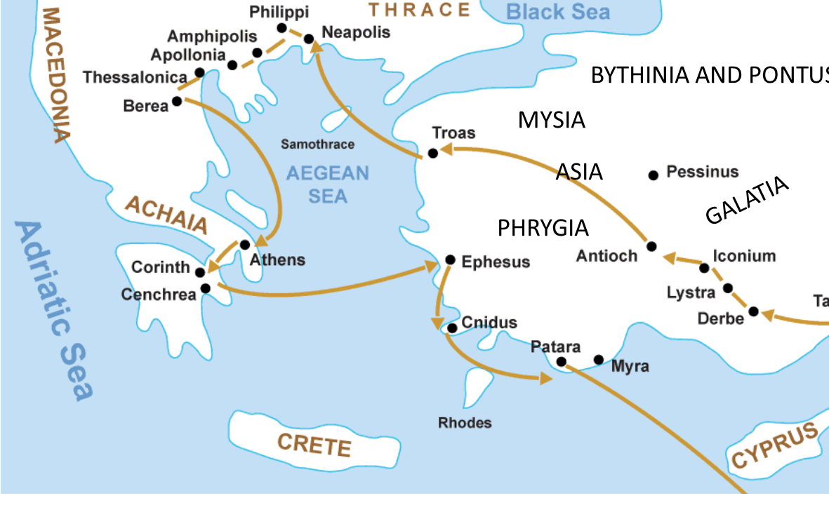
Paul & Silas On The 2nd Missionary Journey
Notes:
You may remember that Silas traveled with Paul on the 2nd Missionary Journey. Perhaps most famously – that in the Philippian Jail, Silas was singing hymns and praying with Paul through the night.
This brought him into contact with many of the churches and people we read about in the NT…but let me help you think of the significance of this in another way.
Consider the books of the NT…

Slide 3
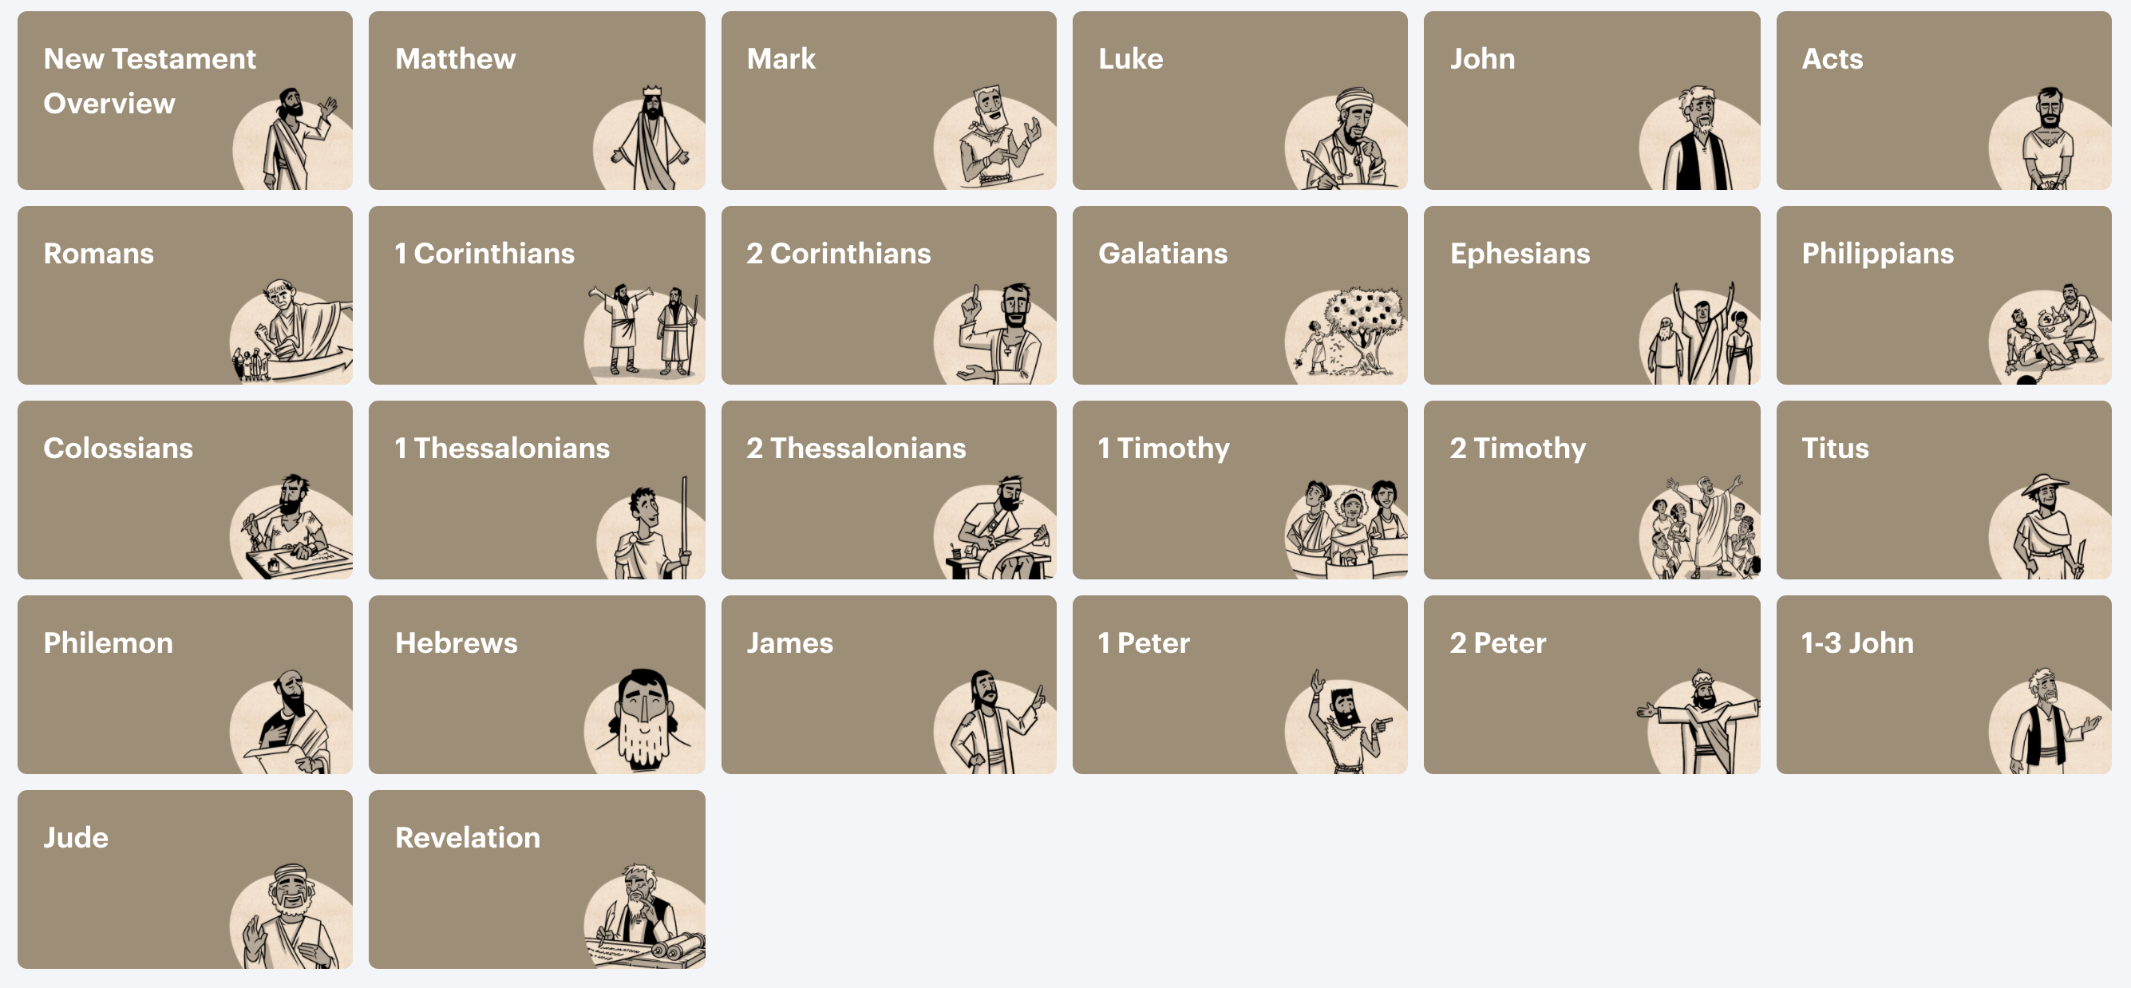
Paul & Silas On The 2nd Missionary Journey
Notes:
More than just seeing the familiar map, I’d like you to think about Silas connection to the people and churches of the New Testament.
We may not know Silas very well, but Silas KNEW EVERYONE!
He was present, and called on to serve at the Discussion in Acts 15 - so he knew the apostles….which would include both Matthew & John.
He was with Luke (who joins Paul’s travels in Acts 16:10).
He visits Corinth with Paul and carries the letter of 2 Corinthians to the church in this city.
He traveled with Paul through Galatia carrying the letter from Acts 15.
He was with Paul when they passed through Ephesus at the end of the 2nd Journey.
He was in prison in Philippi singing.
He preached in Thessalonica.
He’s “known Timothy forever” since they all met together in Acts 16 when Paul recruits him.
He’s been with James in Acts 15.
He helps Peter write 1 Peter, as mentioned in 5:12.
Silas had a hand in edifying and encouraging NEARLY EVERY CHURCH in the NT! WOW! We need to get to know this guy!

Slide 4
Getting To Know Silas
Luke Calls Silas “A Leading Man” In Jerusalem.
Peter Calls Silas “Our Faithful Brother.”
Yes, This Is The Same Person… Silas (Greek) and Silvanus (Roman)
Parallel Passage with Paul, Silas, & Timothy at Corinth
But when Silas and Timothy came down from Macedonia, Paul began devoting himself completely to the word, solemnly testifying to the Jews that Jesus was the Christ.(18:5)
For the Son of God, Christ Jesus, who was preached among you by us—by me and Silvanus and Timothy—was not yes and no, but is yes in Him. (2 Cor. 1:19)
Notes:
Acts 15:22.
Not necessarily a deacon – but a man of solid character, trustworthy, reliable, able to bring the right attitude (peacemaker) to the churches with the letter.
15:27 – Expected to Elaborate & Confirm
15:32 “with a lengthy message” – the kind of lesson you were glad kept going.
15:40 – Impressive Enough, Paul Wanted Him.
Willing Enough, He Went With Paul.
** I Want To Live With The Maturity, I Can Be Called On…
To help out, To step into, To lift up, To tell tohers…

Slide 5
Silas Knows The Difference Between Seeking God’s Will vs. Man’s Will.
Teachers Attempting To Push Their Personal Doctrine.
Acts 15:1
They Meet To Consider The ACTIONS of God.
They Meet To Consider The APPROVAL of God.
They Meet To Consider The POWER of God.
They Meet To Consider The WORD of God.
Notes:
God’s Authority, Not Man’s Preferences, Determine The Outcome.

Slide 6
Silas Gives His All For “The Progress of the Gospel.”
“Now I want you to know, brethren, that my circumstances have turned out for the greater progress of the gospel,” Philippians 1:12
²³ But I am hard-pressed from both directions, having the desire to depart and be with Christ, for that is very much better; ²⁴ yet to remain on in the flesh is more necessary for your sake. ²⁵ Convinced of this, I know that I will remain and continue with you all for your progress and joy in the faith,” Philippians 1:23-25
Notes:
When Asked To Help, Silas Gives It His All.
Asked To Deliver The Letter
Asked To Preach & Encourage Unity
Asked To Travel With Paul
Asked To Stay Behind
Asked To Free Up Paul
Asked To Write & Deliver Letters
Like Paul, He Wants The Lost To Be Saved, And He Wants The Saved To Excel.
He Will Go Where Needed, He Will Elaborate Until Clear,

Slide 7
Silas Is Outstanding At Following-Up.
After The Disagreement, Silas Is Part of the Healing.
After The 1st Journey, Silas Is Part of the Second.
After Paul Leaves Berea, Silas & Timothy Stay. (17:14)
When We Need To Follow Up:
Be A Voice of Unity (15)
Be A Voice of Courage (16)
Be A Voice of Truth (17)
Notes:
I Can Learn So Much From HIM!!
17:14 – “Clean Up Crew” – Able to fly under the radar enough to wrap things up strong and solid before departing.
18:5 – Likely worked to help support Paul’s needs
Silas Is A Problem-Solver. When The Disagreement Is Resolved, But Unity Needs To Be Encouraged – They Want Silas.
**Not only does Silas set a great example of following up – but he actually shows us the Voice we need to bring to these occasions.
Follow up with Unity…with Courage…with Truth.

Slide 8
Silas Is Great At “Explaining & Giving Evidence.”
²⁷ “Therefore we have sent Judas and Silas, who themselves will also report the same things by word of mouth. (15:27)
³² Judas and Silas, also being prophets themselves, encouraged and strengthened the brethren with a lengthy message. (15:32)
17 Now when they had traveled through Amphipolis and Apollonia, they came to Thessalonica, where there was a synagogue of the Jews. ² And according to Paul’s custom, he went to them, and for three Sabbaths reasoned with them from the Scriptures, ³ explaining and giving evidence that the Christ had to suffer and rise again from the dead, and saying, “This Jesus whom I am proclaiming to you is the Christ.”
Notes:
Also Acts 16:4-5
⁴ Now while they were passing through the cities, they were delivering the decrees which had been decided upon by the apostles and elders who were in Jerusalem, for them to observe. ⁵ So the churches were being strengthened ^{[b]}in the faith, and were increasing in number daily.
Acts 17:3 – Explaining & Giving Evidence (One of Erik’s strengths, is it yours?)
17:12 – Goes Equally to the Jews & Greeks. No partiality. A Unifier (which is consistent with his first job in Acts 15)

Slide 9
Silas Shows Us How To Persevere During Hardships.
By Adapting To The Needs of the Day.
By Remembering The Sufferings of Jesus.
By Praising God Through The Storm.
By Absorbing The Words & Example of Paul.
By Doing What’s Right Even When Unpopular.
By Taking The Gospel To The Next Group.
Notes:
Contrast with John Mark. (Acts 15)
Silas Puts His Hands To The Task & Does Not Turn Back
Silas Is On-The-Go
Not Only Endure, But Overcome Persecution & Keep Going
Consistent Quality with Paul & Peter
We Persevere By Adapting To The Needs of the Day.
Welcoming Timothy Onboard / Freeing Up Paul To Preach
Words & Example of Paul – we may not get to literally sit side-by-side with Paul like Silas did, but we do have the next best thing!!
* The list just wouldn’t be realistic if we don’t acknowledge their friendship and partnership.

Slide 10
Silas Is Named 18 Times, But There Is More To His Story.
“Indeed, true companion, I ask you also to help these women who have shared my struggle in the cause of the gospel, together with Clement also and the rest of my fellow workers, whose names are in the book of life.” Philippians 4:3
Notes:
Like Silas, There Is More To Everyone’s Story…
Your name can be in the book that REALLY MATTERS!
Like Silas preached again and again – repent of your sins, confess your faith in Christ, and be buried with Jesus in baptism to have your sins WASHED AWAY.

Slide 11
Silas
Notes:
Like Silas, There Is More To Everyone’s Story…
His name is only mentioned in the Bible ____ times.

