Slide 1
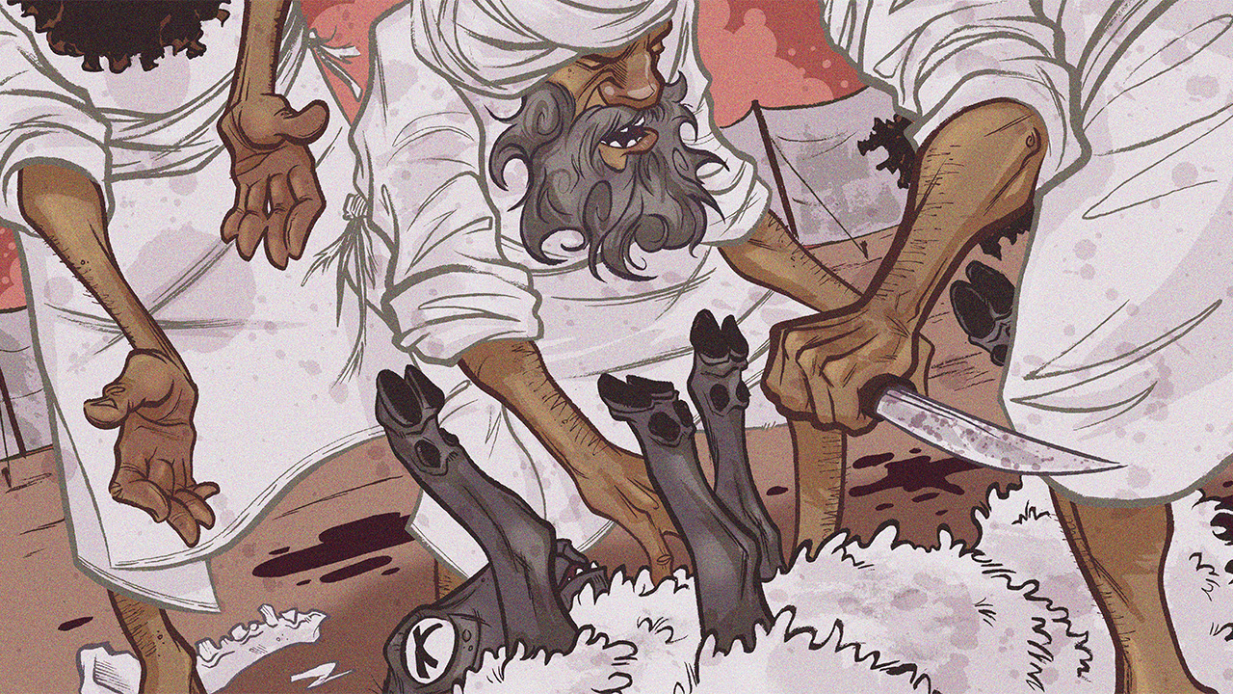
The Feasts of the Lord, Pt. 1
Leviticus 23:1-22

Slide 3
The Feasts of the Lord, Pt. 1
Introductory Thoughts
  New Section on Holy Times (Leviticus 23:1-25:55)
    Sabbath & Seven Jewish Feasts (Leviticus 23:1-44)
    Sabbath Year, Jubilee (Leviticus 25:1-34)
  To Understand a People, Know Their Holidays
  Purposes of Feasts
    Remember God’s Acts (Exodus 13:3; Numbers 10:10; Deuteronomy 16:3)
    Promote National Unity (cf. 1 Kings 12:25-33)
    Foreshadow Christ (Colossians 2:16-17)
Outline of Section
  Intro & Sabbath (vs. 1-4)
  Passover & Unleavened Bread (vs. 5-8)
  Firstfruits (vs. 9-14)
  Pentecost (vs. 15-22)

Slide 4
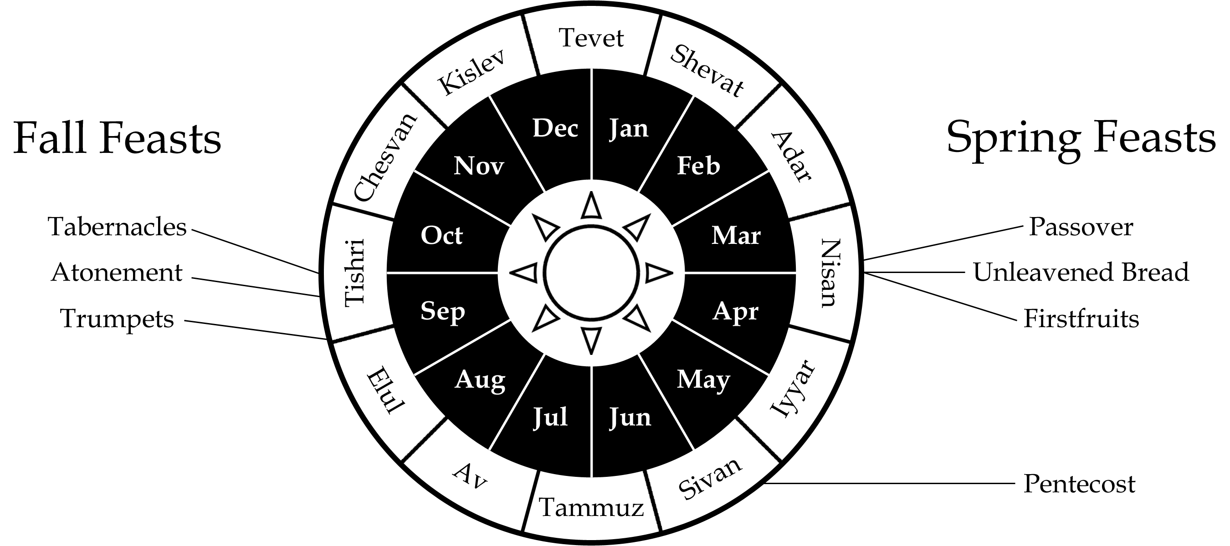

Slide 5
Intro & Sabbath (vs. 1-4)
Introduction to Chapter (vs. 1-2, 4)
  Command to Teach the People
    “Speak to the People of Israel…” (Not Only for Levites; cf. 1:2)
    “Proclaim…” (Chapter Concludes With Moses’ Obedience; vs. 44)
  Descriptions of Holy Days
    “Holy Convocations” (vs. 4; 11/19x in Leviticus 23)
      Public Call to Worship (Synagogue on Sabbath Derives From Scriptural Ideas)
      Reading (cf. Nehemiah 8:8)
      Rehearsal (Feasts Act out Events From Past)
    “My Appointed Feasts” (vs. 2, 4)
      “My Birthday” is About Me
      Feasts Are About Honoring & Remembering God
      “To the Lord” & “Before the Lord” (22x in Chapter)

Slide 6
Intro & Sabbath (vs. 1-4)
Sabbath (vs. 3)
  Hebrew: “Shabbat” (Intermission/Cease/Rest – 11x in Chapter)
    Command for the Seventh Day (Imitation of God’s Rest – Ex. 20:8-11)
    Contrast to Harsh Work / Slavery in Egypt
  Mosaic Instructions For Sabbath
    No Ordinary Work (Exodus 20:10; Leviticus 23:3)
    No Plowing/Reaping (Exodus 34:21)
    Don’t Kindle a Fire (Exodus 35:3)
    Don’t Pick up Sticks (Numbers 15:32-36)
  Relationship Between Sabbath & Feasts
    Up to Seven Extra Sabbath Days During the Seven Feasts
      First & Last Day of Unleavened Bread (vs. 7, 8)
      Pentecost / Trumpets / Atonement (vs. 21, 24, 32)
      First & Last Day of Booths (vs. 35-36)
    Feasts Feature ”Rest” of Some Sort (Rest From: Egypt, Sin, Wilderness, etc…)
  Israel Largely Failed to Keep Sabbath’s
    Times Israel is Denounced: Jeremiah 17:19-27; Nehemiah 13:15-22; Amos 8:5
    May Explain Why Jews in Jesus’ Day Were So Serious About Sabbath Traditions
  Jesus is Ultimate Source of Rest (Lk. 4:16-21; Mat. 11:28-12:14; Heb. 3:16-4:13)

Slide 7
Passover & Unleavened Bread (vs. 5-8)
Passover (vs. 5)
  Timing
    Fourteenth Day of First Month
    Reoriented Israelite Calendar (7th Month Used to be First Month; cf. Ex. 12:2)
  Instructions (cf. Exodus 12)
    Eat the Passover Meal (Exodus 12:8; cf. 12:46)
      Lamb (Sacrifice That Saved From Angel of Death)
      Unleavened Bread (Left In Haste Before Dough Could Rise)
      Bitter Herbs (To Remember Bitter Slavery; cf. Exodus 1:14)
    Who Can Join (Exodus 12:43-49)
      Any Circumcised Slave (vs. 43-44)
      Any Stranger/Sojourner Who is Circumcised (vs. 48)
  Meaning
    Past: Remembering Deliverance From Egypt
    Fulfillment: Jesus is the Passover Lamb (cf. 1 Cor. 5:7-8)

Slide 8
Passover & Unleavened Bread (vs. 5-8)
Unleavened Bread (vs. 6-8)
  Timing
    Starts on Fifteenth Day & Lasts Seven Days
    Day After Passover (Connected to Passover)
  Instructions
    No Leaven for Whole Week
    Anyone Who Eats Leaven Will Be Cut Off (Exodus 12:19)
  Meaning
    Past: Remember How Israel Left Hastily From Egypt (cf. Ex. 12:39)
    Fulfillment: Jesus is the Sinless Bread From Heaven (John 6:4; 32-35)
    The Leaven That We Must Leave Behind
      Hypocrisy (Luke 12:1)
      Teaching of Pharisees & Sadducees (Matthew 16:11-12)
      Demanding Signs From God (Mark 8:15)
      Malice & Evil (1 Corinthians 5:8)

Slide 9
Day 1 | Day 2 | Day 3 | Day 4 | Day 5 | Day 6 | Day 7
15 Nisan | 16 Nisan | 17 Nisan | 18 Nisan | 19 Nisan | 20 Nisan | 21 Nisan
Sabbath Unleavened Bread Food Offering Burnt Offering Sin Offering | Unleavened Bread Food Offering Burnt Offering *Feast of Firstfruits* | Unleavened Bread Food Offering Burnt Offering | Unleavened Bread Food Offering Burnt Offering | Unleavened Bread Food Offering Burnt Offering | Unleavened Bread Food Offering Burnt Offering | Sabbath Unleavened Bread Food Offering Burnt Offering

Slide 10
Firstfruits (vs. 9-14)
Similarities Firstfruits & Pentecost
Both Involved Firstfruits Offering (Lev. 23:10, 17) Both Obeyed After They Entered Promised Land (Lev. 23:10, 16) Both Involved Wave Offerings (Lev. 23:11, 17) Both Were On a Sunday (Lev. 23:11, 15)

Slide 11
Firstfruits (vs. 9-14)
Differences
Firstfruits (Lev. 23:9-14) | Pentecost (Lev. 23:15-22)
Offering Was Barley Part of Week of Unleavened Bread One Sheaf (vs. 11) Additional Offerings: One Male Lamb With Accompanying Grain, Food, & Drink Offerings | Offering Was Wheat Separate From Other Feasts Two Loaves With Leaven (vs. 17) Additional Offerings: Seven Lambs, One Bull, Two Rams, One Male Goat, Two Male Lambs

Slide 12
Firstfruits (vs. 9-14)
Timing
  The Day After the Sabbath During Unleavened Bread (16th of the Month?)
  Barley Came Before Wheat (cf. Exodus 9:31-32)
Instructions
  Must Bring Firstfruits to God Before They Could Eat (vs. 13-14)
  Where Firstfruits Went
    Some to God (Leviticus 2:16)
    Some Went to Priests (Numbers 18:13)
Meaning
  Trained Israel to Acknowledge All They Had Came From God
  God Gets the First of Everything
  “But in fact Christ has been raised from the dead, the firstfruits of those who have fallen asleep.” (1 Corinthians 15:20)

Slide 13
If Passover Were on a Friday…
14th of Nisan | 15th of Nisan | 16th of Nisan
Friday | Saturday | Sunday
“In the first month, on the fourteenth day of the month at twilight, is the Lord's Passover.” Leviticus 23:4 | “⁶And on the fifteenth day of the same month is the Feast of Unleavened Bread to the Lord; for seven days you shall eat unleavened bread. ⁷On the first day you shall have a holy convocation; you shall not do any ordinary work.” Leviticus 23:6-7 | “…and he shall wave the sheaf before the Lord, so that you may be accepted. On the day after the Sabbath the priest shall wave it.” Leviticus 23:11

Slide 14
14th of Nisan | 15th of Nisan | 16th of Nisan
Friday | Saturday | Sunday
Jesus Died at Twilight “³⁴And at the ninth hour Jesus cried with a loud voice, ‘Eloi, Eloi, lema sabachthani?’…³⁷And Jesus uttered a loud cry and breathed his last. Mark 15:34, 37 | Jesus Rested in the Tomb “⁵⁴It was the day of Preparation, and the Sabbath was beginning. ⁵⁵The women who had come with him from Galilee followed and saw the tomb and how his body was laid. ⁵⁶Then they returned and prepared spices and ointments. On the Sabbath they rested according to the commandment.” Luke 23:54-56 | Jesus Rose From the Dead “Christ has been raised from the dead, the firstfruits of those who have fallen asleep.” 1 Corinthians 15:20

Slide 15
Pentecost (vs. 15-22)
Timing
  Seven Full Weeks From the Day After the Sheaf Offering (vs. 15)
    Fifty Days – “Pentecost” Means “Fiftieth"
    Sunday (vs. 16; Creation Began on a Sunday)
    No Specific Date Given (Unlike Passover – “14 Day of First Month”)
  Additional Sabbath Day (vs. 21)
Instructions
  Two Loaves of Bread With Leaven (vs. 17)
    Represents Two Tablets?
    Foreshadows Jews & Gentiles Being One?
  Various Animals (vs. 18-19)
  They Made a “Proclamation” (vs. 21)
    Proclamation with Trumpets?
    Proclaim That It is a Holy Convocation?
  Supporting the Poor & Sojourner? (vs. 22)
    God Provided So That They Could Give to Others
    The Book of Ruth Traditionally Read on Pentecost (cf. Ruth 2)

Slide 16
Pentecost (vs. 15-22)
Meaning
  God’s People Are “Firstfruits” (cf. Jer. 2:3; James 1:18)
  Connections With Acts 2
    Sound of Wind Reminds of Winnowing Barley?
    First Harvest of Christians in the Bible
    Helping the Needy & Sojourner (Leviticus 23:22; Acts 2:44)
      The Early Christians Took Care of One Another
      What God Wanted in the OT, Christianity Created
  Jewish Tradition
    Giving of Law / Giving of the Spirit
      Jewish Tradition: Law Was Given 50 Days After Exodus (Birth of Israel)
      Acts 2 Was 50 Days After Passover (Birth of Spiritual Israel)
      Contrast Exodus 32:25-29 With Acts 2:37-41

Slide 17
The Seven Mosaic Feasts
The Spring Feasts |  |  |  | The Autumn Feasts
Passover Pesach | Unleavened Bread Hag HaMatzot | Firstfruits Reishit | Pentecost Shavuot | Trumpets Rosh HaShanah | Atonement Yom Kippur | Booths Sukkot
14 Nisan | 15-21 Nisan | 16 Nisan? | 6 Sivan | 1 Tishri | 10 Tishri | 15-22 Tishri
Leviticus 23:4-5 Numbers 28:16-25 Exodus 11-15 Deut. 16:1-8 John 19 | Leviticus 23:6-8 Numbers 28:16-25 1 Cor. 5:6-8 | Leviticus 23:9-14 Leviticus 2:14-16 1 Cor. 15:20 Matthew 28 | Leviticus 23:15-22 Numbers 28:26-31 Deut. 16:9-12 Acts 2:1-42 | Leviticus 23:23-25 Numbers 29:1-6 Matthew 3:1-12 Matthew 24:29-31 | Leviticus 23:26-32 Numbers 29:7-11 Hebrews 9-10 | Leviticus 23:33-44 Numbers 29:12-38 Deut. 16:13-15 John 7:1-10:20
Jewish “Independence Day” |  |  |  | Jewish “New Year” |  | Jewish “Thanksgiving”
Jesus’ Death | Jesus’ Purity Jesus as the Bread of Life | Jesus’ Resurrection | Jesus Pours Out the Spirit | Jesus’ Call to Repentance & Gathering His People | Jesus’ Atoning Sacrifice | Jesus’ Ability to Provide in Our Wilderness

