Slide 1
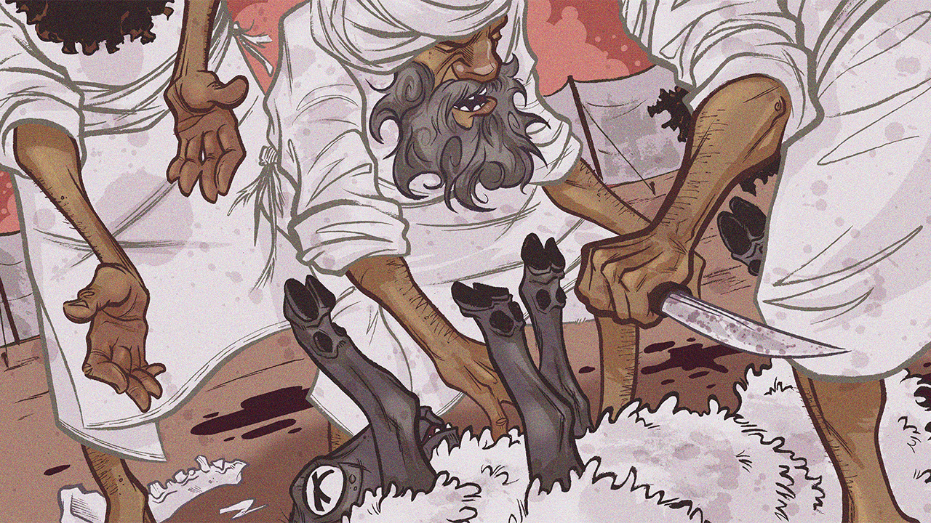
The Feasts of the Lord, Pt. 2
Leviticus 23:23-44

Slide 3
The Feasts of the Lord, Pt. 2
Introductory Thoughts
  Purposes of Feasts
    Remember God’s Acts (Exodus 13:3; Numbers 10:10; Deuteronomy 16:3)
    Promote National Unity (cf. 1 Kings 12:25-33)
    Foreshadow Christ (Colossians 2:16-17)
  “It shall be the prince's duty to furnish the burnt offerings, grain offerings, and drink offerings, at the feasts, the new moons, and the Sabbaths, all the appointed feasts of the house of Israel: he shall provide the sin offerings, grain offerings, burnt offerings, and peace offerings, to make atonement on behalf of the house of Israel.” (Ezekiel 45:17)
    In What Sense Do Christians “Keep” The Feasts Today? (Ezekiel 45:17)
Outline of Section
  The Feast of Trumpet (vs. 23-25)
  Day of Atonement (vs. 26-32)
  The Feast of Booths (vs. 33-44)

Slide 4
The Seven Mosaic Feasts
The Spring Feasts |  |  |  | The Autumn Feasts
Passover Pesach | Unleavened Bread Hag HaMatzot | Firstfruits Reishit | Pentecost Shavuot | Trumpets Rosh HaShanah | Atonement Yom Kippur | Booths Sukkot
14 Nisan | 15-21 Nisan | 16 Nisan? | 6 Sivan | 1 Tishri | 10 Tishri | 15-22 Tishri
Leviticus 23:4-5 Numbers 28:16-25 Exodus 11-15 Deut. 16:1-8 John 19 | Leviticus 23:6-8 Numbers 28:16-25 1 Cor. 5:6-8 | Leviticus 23:9-14 Leviticus 2:14-16 1 Cor. 15:20 Matthew 28 | Leviticus 23:15-22 Numbers 28:26-31 Deut. 16:9-12 Acts 2:1-42 | Leviticus 23:23-25 Numbers 29:1-6 Matthew 3:1-12 Matthew 24:29-31 | Leviticus 23:26-32 Numbers 29:7-11 Hebrews 9-10 | Leviticus 23:33-44 Numbers 29:12-38 Deut. 16:13-15 John 7:1-10:20
Jewish “Independence Day” |  |  |  | Jewish “New Year” |  | Jewish “Thanksgiving”
Jesus’ Death | Jesus’ Purity Jesus as the Bread of Life | Jesus’ Resurrection | Jesus Pours Out the Spirit | Jesus’ Call to Repentance & Gathering His People | Jesus’ Atoning Sacrifice | Jesus Dwelled Amongst Us & Provides Our Needs

Slide 5
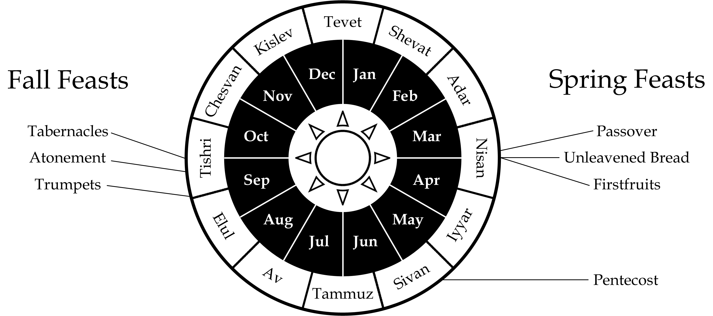
Seventh Month Feasts
Most Solemn Month of the Year
Time of Harvest of Grapes, Figs, & Olives

Slide 6
The Feast of Trumpets (vs. 23-25)
Instructions for Trumpets
  Timing
    First Day of Seventh Month
    Each New Month Began With Blowing Trumpets (Numbers 10:10)
  Instructions
    Blast the Trumpets (Gathers People Together; cf. Numb. 10:1-10)
    No Ordinary Work (No Other New Moon Was Accompanied With Extra Sabbath)
    Food Offerings (cf. Numbers 29:1-6)
  Meaning
    Memorial (vs. 24 - Text Doesn’t Say What it is Memorializing)
      To Remember God’s Covenant At Sinai (cf. Numbers 10:9-10)?
      To Prepare for Day of Atonement (Next 10 Days Called, “Days of Awe”)?
    Israelite New Year (Civil Calendar)
Trumpets in Old Testament History
  When Altar Was Rebuilt (Ezra 3:1-6)
  Rededication & Reading the Law (Nehemiah 8:1-12; “Holy Convocation”)

Slide 7
The Feast of Trumpets (vs. 23-25)
Jesus’ Call to Repent
  Each Gospel Begins with a Call to Repent (cf. Matthew 3:1-12)
  We Keep the Feast by Examining Ourselves (cf. 2 Cor. 13:5)
Jesus’ Bringing His People Together
  “¹²In that day from the river Euphrates to the Brook of Egypt the Lord will thresh out the grain, and you will be gleaned one by one, O people of Israel. ¹³And in that day a great trumpet will be blown, and those who were lost in the land of Assyria and those who were driven out to the land of Egypt will come and worship the Lord on the holy mountain at Jerusalem.” (Isaiah 27:12-13)
    In The Church: Gospel Call Goes Out (Matthew 24:31)
    In Eternity: Trumpet on Last Day (1 Thess. 4:16-18; 1 Cor. 15:52)

Slide 8
The Day of Atonement (vs. 26-32)
Comparison to Earlier Instructions
  Leviticus 16 Emphasized Responsibilities of Priest
  Leviticus 23 Emphasizes Responsibilities of Worshipers
Emphasis on Sabbath (No Working on Day of Atonement)
  Vs. 28 – “You Shall Not Do Any Work”
  Vs. 30 – The Person Who Works Will Be Destroyed (Laws Are Life & Death)
  Vs. 31 – “You Shall Do No Work”
  Vs. 32 – “It Shall Be a Sabbath of Solemn Rest”
Emphasis on “Afflicting” Yourselves (vs. 27, 29, 32)
  Only Day People Were Commanded By God to Fast (cf. Psalm 35:13)
  24 Hours (vs. 32)
  Sin Should Cause us to Mourn (Matthew 5:4; James 4:9)
Food Offerings (vs. 27; cf. Numbers 29:7-11)
  Food Offerings Emphasize Covenantal Relationship (Not “Feeding the Gods”)

Slide 9
The Day of Atonement (vs. 26-32)
Sacrifice #1 | Sacrifice #2 | Sacrifice #3 | Sacrifice #4 | Sacrifice #5
Bull for a Sin Offering For Aaron & Priesthood Lev. 16:3 Lev. 16:6 Lev. 16:11-14 | Goat for a Sin Offering for the People Lev. 16:5 Lev. 16:15-19 | Scapegoat to Bear the Iniquities of the People Lev. 16:5 Lev. 16:20-22 | Ram for a Burnt Offering For Aaron Lev. 16:3 Lev. 16:24 | Ram for a Burnt Offering for the People Lev. 16:5 Lev. 16:24

Slide 10
The Day of Atonement (vs. 26-32)
Compare/Contrast
Passover | Atonement
First Month of Religious Calendar Sacrifice (Lamb) Chosen on 10th Day of the Month (Slain on 14th) Whole Congregation Participates Blood on Doors & Lintel No Scape-Goat | First Month of Civil Calendar Two (Bull & Goat) Sacrifices Slain on 10th Day of the Month Carried out Largely by High Priest Blood Taken to Mercy Seat Scape-Goat Plays Prominent Role

Slide 11
The Feast of Booths (vs. 33-43)
Laws for Festival (vs. 33-36, 39-44)
  Timing
    Fifteenth Day of Seventh Month (vs. 34, 39)
    Lasts Eight Days Total (vs. 36, 39)
  Instructions
    Sabbath on First & Eighth Day (vs. 35-36; 39)
    Food Offerings Every Day (vs. 36)
    Take Fruit of Trees, Palm Branches, Boughs of Leafy Trees, & Willows (vs. 40)
    Commanded to Rejoice (vs. 40; cf. Deut. 16:13-15)
    Dwell in Booths for Seven Days (vs. 42)
    The Law is Read Every Seven Years (Deut. 31:10-13)
  Meaning
    To Rejoice Over Harvest (vs. 40; cf. Deut. 16:13-14)
    Memorialize Time in Wilderness (vs. 43)
Summary of Feasts (vs. 37-38)
  Everything Must Be Given “On It’s Proper Day” (Must Adhere to Rules)
  These Are Additional to the Regular Sabbath’s, Offerings, etc…

Slide 12
The Feast of Booths (vs. 33-43)
Day 1 | Day 2 | Day 3 | Day 4 | Day 5 | Day 6 | Day 7 | Day 8
15 Tishri | 16 Tishri | 17 Tishri | 18 Tishri | 19 Tishri | 20 Tishri | 21 Tishri | 22 Tishri
Sabbath Dwell in Booths Rejoice Offerings 13 Bulls 2 Rams 14 Lambs 1 Goat Read From Law (Every 7th Year) | Dwell in Booths Rejoice Offerings 12 Bulls 2 Rams 14 Lambs 1 Goat Read From Law (Every 7th Year) | Dwell in Booths Rejoice Offerings 11 Bulls 2 Rams 14 Lambs 1 Goat Read From Law (Every 7th Year) | Dwell in Booths Rejoice Offerings 10 Bulls 2 Rams 14 Lambs 1 Goat Read From Law (Every 7th Year) | Dwell in Booths Rejoice Offerings 9 Bulls 2 Rams 14 Lambs 1 Goat Read From Law (Every 7th Year) | Dwell in Booths Rejoice Offerings 8 Bulls 2 Rams 14 Lambs 1 Goat Read From Law (Every 7th Year) | Dwell in Booths Rejoice Offerings 7 Bulls 2 Rams 14 Lambs 1 Goat Read From Law (Every 7th Year) | Sabbath Offerings 1 Bull 1 Ram 7 Lambs 1 Goat Read From Law (Every 7th Year)

Slide 13
The Feast of Booths (vs. 33-43)
Booths in Old Testament History
  When Temple Was Dedicated (1 Kings 8:2)
  Counterfeit Booths: “And Jeroboam appointed a feast on the fifteenth day of the eighth month like the feast that was in Judah, and he offered sacrifices on the altar…” (1 Kings 12:32)
  Celebrated in Nehemiah
    ”The Joy of the Lord is Your Strength” (Nehemiah 8:10)
    Kept Feast & Read from the Law (Nehemiah 8:13-18)
Booths in Jewish Tradition
  Lighting Ceremony (Shekinah Glory of God in the Wilderness)
  “There a priest filled a golden pitcher as a choir chanted Isaiah 12:3, ‘With joy you will draw water from the wells of salvation.’ … When the procession arrived at the temple, the priest climbed the altar steps and poured the water onto the altar while the crowd circled him and continued singing… The priest poured water into one bowl; then he poured wine into the other, and both drained simultaneously onto the altar (Mishnah, Sukkah 4:9). According to later Jewish tradition (AD 400), this pouring was intended to remind everyone of the water that came from the rock in the wilderness (Ex. 17:1-7; Num. 20:8-13)… On the great and final day of the festival, this water procession took place seven times, drenching the altar thoroughly.”

Slide 14
The Feast of Booths (vs. 33-43)
Jesus Has Dwelled Amongst Us
  “And the Word became flesh and dwelt among us, and we have seen his glory, glory as of the only Son from the Father, full of grace and truth.” (John 1:14)
Jesus at the Feast (John 7-10)
  “Again Jesus spoke to them, saying, ‘I am the light of the world. Whoever follows me will not walk in darkness, but will have the light of life.’” (John 8:12)
  “³⁷On the last day of the feast, the great day, Jesus stood up and cried out, ‘If anyone thirsts, let him come to me and drink. ³⁸Whoever believes in me, as the Scripture has said, “’Out of his heart will flow rivers of living water.’” ³⁹Now this he said about the Spirit, whom those who believed in him were to receive, for as yet the Spirit had not been given, because Jesus was not yet glorified.” (John 7:37-39)

