Slide 1
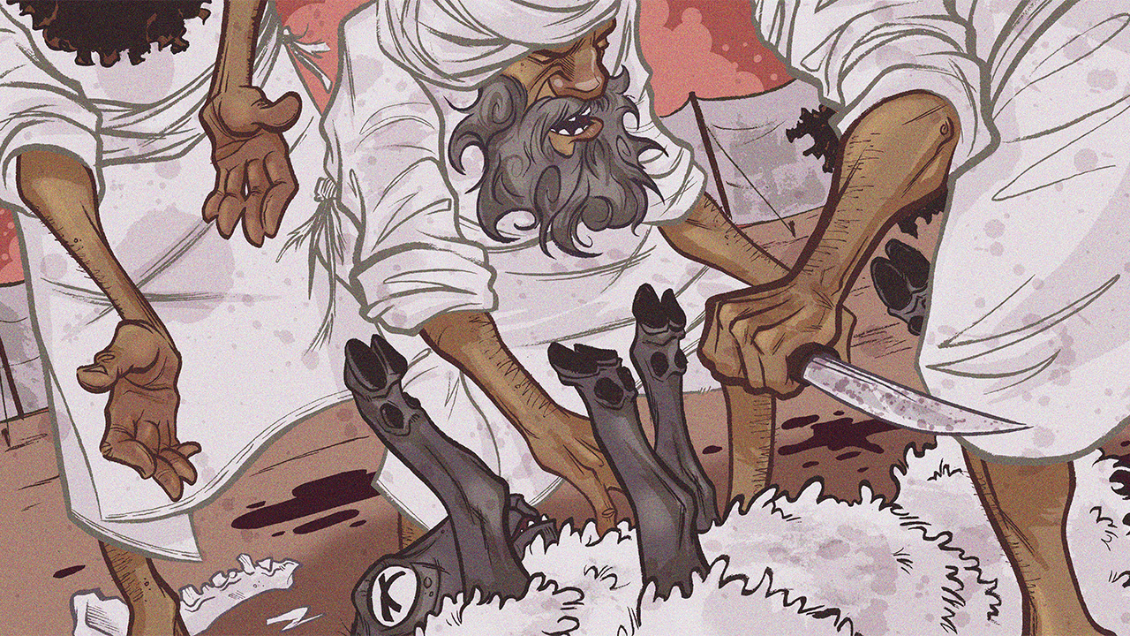
Honoring the Name
Leviticus 24-25

Slide 3
Honoring the Name
Introductory Thoughts
  Narratives in Leviticus
    Nadab & Abihu (Corresponds to Ch. 1-17 About Approaching God)
    The Son Who Blasphemed the Name (Corresponds to Ch. 18-27 About Holy Living)
  The Tabernacle as God’s House
    God Wants to Dwell in Israel’s Midst (Exodus 25:8)
    God Wants Israel to Visit His House (Leviticus 23)
    God Has Furniture & Lighting in His House (Leviticus 24:1-9)
    God’s Family Name Must be Honored (Leviticus 24:10-23)
    God’s Land Must Be Respected (Leviticus 25)
Outline of Section
  The Lamp & Bread (24:1-9)
  The Case of Blasphemy (24:10-23)
  Sabbath & Jubilee Years (25:1-55)

Slide 4
The Lamp & Bread (24:1-9)
The Lamp of “Pure” Gold (vs. 1-4; cf. Exodus 25:31-40; 27:20-21)
  Must Burn “Pure” Oil “Regularly” (vs. 2)
    Oil Provided by the People of Israel (vs. 2; Olives Would Be Brought at Feast of Booths)
    Aaron Must “Arrange” Lamp Morning & Evening
      Trim Lamps Every Morning & Oil Added (Exodus 30:7-8; cf. Matthew 25:1-13; Titus 2:10)
      In God’s House, “The Light is Always Left On”
  Connections to the New Covenant
    Jesus is the Light of the World (John 1:14 – Tabernacle Looks to Jesus)
    We Are to Regularly Be Lights in the World
The Bread on the “Pure” Gold Table (vs. 5-9; Exodus 25:23-30)
  Arrangement
    12 Loaves of Bread Baked From “Fine Flour”
    3.5 Pounds of Flour in Each Loaf of Bread (2/10 of an Ephah)
    Debate: Two Rows of Six or Two Piles of Six
    Frankincense Likely in Container on the Bread (vs. 7)
    Bread Changed Every Sabbath (vs. 8)
    Priests Eat the Old Bread (vs. 9)
  Connections to the New Covenant
    Jesus is the Bread of Life (John 6:35)
    When Jesus Multiplied the Bread, There Were 12 Baskets Left Over (Mark 6:43)

Slide 5
The Case of Blasphemy (24:10-23)
The Situation (vs. 10-12)
  The Perpetrator
    Shelomith’s Son; Tribe of Dan (Arguably the Worst Tribe)
    His Father Was an Egyptian (Mixed Ethnicity; cf. Exodus 12:38)
  The Incident
    Perpetrator Fought With An Israelite Man (May Explain Law In vs. 19-20)
    Perpetrator Blasphemed “the Name” (vs. 11; cf. Ex. 22:28)
      Verbal Attack on God’s Name
      Example of Taking God’s Name in Vain (cf. Ex. 20:7)
      Taking God’s Name in Vain Not Only Attaching His Name To Your Causes
      Using the Gift of Speech to Curse God Who Spoke World Into Existence
  Placed in Custody (vs. 12)
    Unclear What to do With Foreigner (cf. vs. 16)
    They Wait to Know the Lord’s Will
      We Must Wait For An Answer From Scripture Before Acting
      Other Times Moses Waits for an Answer: Numbers 9:1-14; 15:32-36; 27:1-11

Slide 6
The Case of Blasphemy (24:10-23)
The Lord’s Instruction Regarding Blasphemy (vs. 13-16)
  Specific Case (vs. 13-14)
    “Let All Who Heard Lay Their Hands on His Head” (Witnesses Make First Contact – Deut. 17:6-7)
    “Let All the Congregation Stone Him” (Nation Involved in Removing Sin From the Camp)
  General Principle: Any Blasphemer (Sojourner or Native) is “Surely” Put to Death (vs. 15-16)
The Lord’s Instruction Regarding Other Crimes (vs. 17-22)
  Unlawful Murder of People & Animals (vs. 17-18, 21)
    Murderers Are Put to Death (Showing the Sanctity of Human Life)
    Killing of Animals (Not Including Lawful Sacrifices)
      Killer Must “Make it Good” (Repay Monetarily or Replace Animal?)
      Animals Are a Lower Order of Being Than People
  General Principle (vs. 19-20, 22)
    Punishment is in Accordance With Crime
      “Eye for Eye… Life for Life” Found Three Times in Moses’ Writings (Ex. 21:21-25; Lev. 24:20; Deut. 19:21)
      Man is Usually Too Lenient or Too Harsh
      The Placement of These Laws Shows How Serious It is To Blaspheme God
    Laws Apply to Sojourner and the Native (vs. 22; cf. vs. 16)
Brought Outside the Camp & Killed (vs. 23; Unclean Things Go Outside Camp)
  Jesus Falsely Accused of Blasphemy & Killed Outside Camp (Mark 16:64; Heb. 13:12-13)

Slide 7
Sabbath’s in Cycles of Seven
Every Seven Days (Weekly Sabbath)
Every Seventh Month (Feast of Trumpets)
Every Seventh Year (Sabbath Year)
Every Seventh Sabbath Year (Year of Jubilee)

Slide 8
Sabbath & Jubilee Years (25:1-55)
The Sabbath Year (vs. 1-7; cf. Exodus 23:11)
  General Law (vs. 1-2)
    “When You Come Into the Land” (Conquest is Assured)
    The Land Will Have a “Sabbath” to the Lord (Allow Land to Be Rejuvenated?)
    Also When the Law Was Read During Feast of Booths (Deut. 31:9-13)
  Instructions for Sabbath Year (vs. 3-7)
    Instructions For Sabbath Year (vs. 3-4)
      Sow, Prune, & Gather for Six Years (Regular Work)
      No Sowing, Pruning, & Gathering in Seventh Year (Like A Year Long Sabbath Day)
        If Keeping Regular Sabbath Took Faith, How Much More a Sabbath Year?
        God is Not Like Pharaoh – He Wants to Provide Rest
    The Land Will Provide By Itself (vs. 5-7)
      Cannot Reap What Grows of Itself
        No Stockpiling (Like Time in Wilderness)
        Man’s Chief Duty is to Glorify God (Not Amass Wealth)
      Obedience Would Demonstrate Great Trust in God’s Providence
  No Record of Israel Keeping the Sabbath or Jubilee Years (cf. 2 Chron. 36:20-21)
    One of the Reasons for Their Exile (Lev. 26:43; 2 Chron. 36:20-21)
    Israel Failed to Trust That God Would Provide Their Needs (Warning to Us)

Slide 9
Sabbath & Jubilee Years (25:1-55)
Basic Commands for Jubilee Year (vs. 8-12)
  “Jubilee” (14x in Chapter; “Yobel” in Hebrew – “Horn or Trumpet”)
  Timing (vs. 8-9)
    Begins on Tenth Day of Seventh Month in Seventh Year
    Trumpets Blown on Day of Atonement (Announces Consecration of 50th Year)
  Instructions (vs. 10-12)
    Release: Proclaim Liberty (cf. Isaiah 61:1-3; Luke 4:16-21)
      Every Israelite Slave Returns to Their Property & Clan (As Divided In Joshua 13-17)
      Every Israelite Has Opportunity for Fresh Start (Unparalleled Law in Ancient Near East)
    Rest: No Sowing, Reaping, or Gathering (Two Years in a Row in 49th & 50th Years)
Selling Land in View of Jubilee (vs. 13-17)
  Cost of Land Transactions in Proportion to Timing of Jubilee
  Determined by Crop Value of the Land
  “You Shall Not Wrong One Another” (vs. 14, 17)
What Israel Will Eat in Jubilee (vs. 18-22)
  If They Obey, They Will Dwell in Land “Securely” (“Land” Emphasizes Security)
  God Will Provide Abundance in Sabbath Year (It Will Last For Three Years)
  Like Law of Collecting Manna on a Larger Scale (God Will Provide)

Slide 10
Sabbath & Jubilee Years (25:1-55)
Ways to Redeem Land (vs. 23-28; 47-55)
  God, as Owner, Can Dictate These Laws (vs. 23-24)
    They Are “Strangers With” God Even in the Promised Land (Made For Something Even Better)
  Three Ways to Redeem Land (vs. 25-28)
    Kinsmen Redeemer (vs. 25; Generous Concern for the Poor)
    Seller Prospers & Buys Land Back (vs. 26-27)
    Seller Waits Until the Year of Jubilee (vs. 28)
  Same Laws Apply to Stranger or Sojourner Who Becomes Rich (vs. 47-55)
Houses & Zoning (vs. 29-34)
  In In a Walled City: If Someone Doesn’t Redeem Within a Year, It Is Never Returned (Not Tied to Agriculture)
  Not In a Walled City: Subject to Redemption Laws & Jubilee Year
  Levite Town: Houses Can & Redeemed, But They Can Never Sell Their Pastureland
Slaves (vs. 35-46)
  Poor Israelites (vs. 35-43)
    Supporting a Poor Israelite (vs. 35-38)
      Charging Interest Would Be a Failure to “Fear God” (vs. 36)
      “God Has Been Good to You, You Be Good to Others” (vs. 38)
    Indentured Servitude (vs. 39-43)
      Not Same as United States Slavery
      Released In Jubilee Year
  Foreign Slaves Could be Purchased & Were Not Subject to Jubilee (vs. 44-46; Not Stolen – Ex. 21:16)

Slide 11
Sabbath & Jubilee Years (25:1-55)
Jubilee Avoids Two Extremes
  Capitalism: Laws Avoid the Buildup of Wealth by a Few
  Communism: Laws Avoid Oppressive Control
The Well Being Brethren Is More Important Than Your Wealth
A Future Trumpet Will Be Blown That Brings us to Our Possession
  “¹⁶For the Lord himself will descend from heaven with a cry of command, with the voice of an archangel, and with the sound of the trumpet of God. And the dead in Christ will rise first. ¹⁷Then we who are alive, who are left, will be caught up together with them in the clouds to meet the Lord in the air, and so we will always be with the Lord.” (1 Thessalonians 4:16-17)

