Slide 1
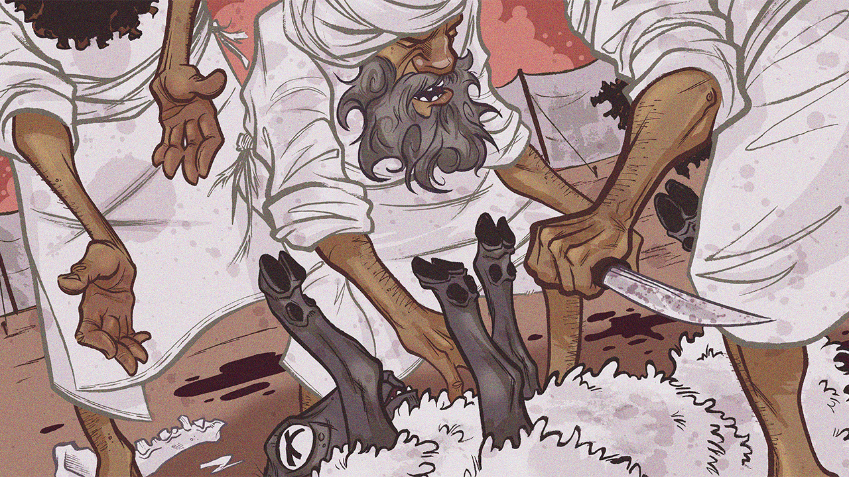
Conditions of Covenant & Vows
Leviticus 26-27

Slide 3
Conditions of Covenant & Vows
Introductory Thoughts
  Chiasm in Leviticus 25-27
    Laws About Redemption (Leviticus 25)
      Blessings & Curses (Leviticus 26)
    Laws About Redemption (Leviticus 27)
  Importance of Leviticus 26
    Echoed in Deuteronomy 28-30
    Referenced & Alluded to Throughout Old Testament
      1-2 Kings Depict Blessings & Curses
      Prophets Warn About Consequences of Disobedience
  Leviticus Begins & Ends With Freewill Offerings (Lev. 1-3; 27:1-24)
Outline of Section
  Conditions of the Covenant (26:1-46)
  Conditions of Vows (27:1-34)

Slide 4
Conditions of the Covenant (26:1-46)
Summary of Requirements (vs. 1-2)
  Most Basic Commands for Covenant (cf. Ex. 20:4-6; 8-11)
    Commission: Don’t Commit Idolatry (Four Descriptions: Idol, Image, Pillar, Figured Stone)
    Omission: Do Keep Sabbath’s & Reverence Sanctuary (cf. Lev. 23:1-44; 25:1-55)
  God Will Describe Consequences of Obedience & Disobedience to these Commands
“If You Walk in My Statutes…” (vs. 3-13; “If” Found 12x in Chapter)
  Blessing #1 – Crops (vs. 4-5; Israel Relied on Rain, Not a River – cf. Deut. 11:11-14)
    Pagan Religions Credited Baal as Source of Rain (cf. 1 Kings 17-18)
    Such Abundance of Rain They Will Constantly Work (vs. 5)
  Blessing #2 – Peace in the Land (vs. 6-8)
    Peace From Peoples & Wild Beasts (Land Pictures Rest From Enemies)
    Israel Will Defeat Their Enemies Even Though Outnumbered (vs. 8; cf. Gideon’s 300 Men)
  Blessing #3 – Fruitfulness (vs. 9-10)
    Blessings of Creation to Be Fruitful & Multiply Given to Israel (cf. Gen. 1:28)
    Promised Land & Garden of Eden Share Many Similarities
  Blessing #4 – God’s Presence (vs. 11-13; cf. 2 Corinthians 6:16)
    Climactic Blessing is God’s Presence (cf. Exodus 25:8)
    The God Who Saved Them From Egypt Wants to Dwell With Them

Slide 5
Conditions of the Covenant (26:1-46)
“If You Will Not Listen To Me…” (vs. 14-39)
  “But If…”: Curses #1 – Panic, Disease & Defeat (vs. 14-17; cf. Proverbs 28:1)
    Descriptions of Disobedience: Spurn Statutes & Abhor Rules
    Enemies Will Eat Their Produce & Rule Over Them
  “And If…”: Curses #2 – Drought & Famine (vs. 18-20)
    Curses Have Purpose of Restoration (“In Spite of This You Will Not Listen”)
    God Will Increase Discipline By “Striking Sevenfold” (vs. 18, 21, 24, 28)
    God Will Break the “Pride of Your Power” (Suffering Ought to Humble Us)
  “Then If…”: Curses #3 – Wild Beasts (vs. 21-22)
    Beasts Will “Bereave” Their Children (cf. 2 Kings 2:23-25; 17:25)
    Roads Will Be Deserted (People Too Fearful to Travel & Trade)
  “And If…”: Curses #4 – Defeated by Enemies & Famine (vs. 23-26)
    God Doesn’t Want to Destroy Israel (“If… You Are Not Turned To Me…”)
    They Will Have Food, But Not Enough to be Satisfied (vs. 26)
  “But If…”: Curses #5 – Crescendo Leading to Exile (vs. 27-39)
    “But if in Spite of This You Will Not Listen…” (What Would it Take For us to Listen?)
    God Will Show Fury Against Israel (vs. 27-28)
    Starvation, Eating Children, Destruction & Exile (vs. 29-33; cf. 2 Kings 6:26-29)
    Land Will Finally Enjoy It’s Sabbath’s (vs. 34-35; 70 Years of Captivity in 2 Chron. 36:21)
    Survivors Will Be Fragile & Weak (vs. 36-39 – Never Fully Regained Their Power)

Slide 6
Conditions of the Covenant (26:1-46)
Blessings for Obedience (Leviticus 26:3-12) | Curses for Disobedience (Leviticus 26:14-39)
Agricultural Blessings (vs. 4-5, 10) | Drought, Famine, etc… (vs. 16, 19-20, 26, 29)
Peace & Security (vs. 6-8) | War, Fear, Wild Beasts, Defeat, & Exile (vs. 16-17, 22, 25, 31-33, 36-38)
Abundant Childbearing (vs. 9) | Disease & Death (vs. 16, 22, 25-26, 29-30, 38-39)
God Dwelling Among Them (vs. 11-12) | The Lord Turning Away (vs. 24, 28, 30-31)

Slide 7
Conditions of the Covenant (26:1-46)
Future Mercy (vs. 40-46)
  “But If They Confess Their Iniquity…”
    A Final “But If…” Turns the Catastrophic Chapter Around
    Like the Prodigal Son Who ”Came to His Senses” (Luke 15:17)
    No Elaborate Ceremonies, Sacrifices, etc…
    Their Uncircumcised Heart is Humbled (First Time Circumcision Used as a Metaphor)
    Daniel’s Prayer Reflects This Kind of Confession (Daniel 9:1-19)
  “Then God…”
    God Will Remember Covenants & The Land (vs. 42; Hints At A Second Exodus)
    Mercy is Always Available
    “I Am the Lord” – 49th and Last Instance of This Phrase in Leviticus (vs. 45)
  Laws Are Between Israel & God (vs. 46; Not With the Gentiles)
Reflections From Leviticus 26
  Seek God, And All You Need Will Be Added (cf. Mat. 6:33)
  Both Positive & Negative Promises Are Appropriate Motivations
  We Must Have a Healthy Fear of God (Curses Are Like Dim Pictures of Hell)

Slide 8
Conditions of Vows (27:1-34)
Introduction to Leviticus 27
  Outline of Chapter
    Voluntary Offerings (vs. 1-25)
      People (vs. 1-8)
      Animals (vs. 9-13)
      Objects – Houses & Lands (vs. 14-24)
    Non-Voluntary Offerings (vs. 26-34)
  Vows Are Voluntary
    Some Israelites Wanted to Go “Beyond What Was Required”
    “⁴When you vow a vow to God, do not delay paying it, for he has no pleasure in fools. Pay what you vow. ⁵It is better that you should not vow than that you should vow and not pay. ⁶Let not your mouth lead you into sin, and do not say before the messenger that it was a mistake. Why should God be angry at your voice and destroy the work of your hands?” (Ecclesiastes 5:4-6)
    No Sacrifice Compares to What Christ Has Done For Us
  Flow of Thought in Context
    Leviticus 26 – God Will Keep His Vows
    Leviticus 27 – God Expects us to Keep our Vows

Slide 9
Conditions of Vows (27:1-34)
People (vs. 1-8)
  When Would a Person Be Vowed to the Lord?
    “If you will indeed look on the affliction of your servant and remember me and not forget your servant, but will give to your servant a son, then I will give him to the LORD all the days of his life, and no razor shall touch his head.” (1 Sam 1:11)
    They Could Be “Bought Out” of Their Vow
  Why Are Males Valued More Than Females?
    Can’t Be Intrinsic Value
      All Equally Made in God’s Image (Gen. 1:26-27)
      Elderly Are to be Respected (Lev. 19:32)
    Labor Value in the Fields?
  The Poor Owe What They Can Afford (vs. 8)
    Other Provisions Made for the Poor
      Sacrificial Offerings (1:14-17)
      Purification Offerings (5:7-13)
      Mother of a New Baby (12:8)
      Leprosy (14:21-31)
    Unique in That The Priest Determines What the Poor Person Can Afford
    God Doesn’t Prohibit Any Person From worshipping Him
 | Cost in Shekels
Age | Male | Female
1 Month-5 Years | 5 | 3
5-20 Years | 20 | 10
20-60 Years | 50 | 30
60+ Years | 15 | 10

Slide 10
Conditions of Vows (27:1-34)
Animals (vs. 9-13)
  Clean Animals (vs. 9-10)
    Cannot Exchange With Another Animal (If You Do, Both Are Made Holy to God)
    We Should Not Regret Anything We Give to God
  Unclean Animals (vs. 11-13)
    Unfit For Sacrifice or Eating, But Still Held Value (Giving Donkey to a Priest)
    Priest Assesses the Value (Priests Had Many Roles)
    Could Redeem a Vow With a 20% Additional Charge (vs. 13; cf. vs. 15)
Objects (vs. 14-24)
  Houses (vs. 14-15)
    Priest Functions as House Appraisers
    Must Add 20% Payout to Redeem House
  Lands (vs. 16-24)
    Could Partition Part of Their Land for the Lord (vs. 16)
    Two Kinds of Land
      Family Land (vs. 16-21)
      Purchased/Leased Land (vs. 22-24)
    Lands Valued in Relation to Production & Jubilee
Everything Redeemed With Sanctuary Shekel (vs. 25)

Slide 11
Conditions of Vows (27:1-34)
Non-Voluntary Offerings (vs. 26-33)
  Firstborn Animals (vs. 26-27)
    Cannot Be Vowed to God Since They Already Belong to God (cf. Ex. 13:2)
    An Impure Firstborn Can Be Redeemed or Sold at Valuation
  Devoted Persons/Things (vs. 28-29)
    Often Related to Spoil From War Dedicated to God (Josh. 6:17, 7:1; 1 Sam. 15:3)
    Devoted Objects Cannot be Sold or Redeemed
    Devoted Persons Must be Destroyed (cf. 1 Samuel 15)
  Tithes (vs. 30-33)
    Israelites Paid Three Tithes
      To the Priests (Numbers 18:21-32)
      Tithe to the Sanctuary (Deuteronomy 14:22-27)
      Tithe to the Poor Every Three Years (Deuteronomy 14:28-29)
    Can Be Redeemed When 20% of Value is Added
    Every Tenth Animal is Holy to the Lord (Counted & Colored By Passing Under Rod?)
Conclusion (vs. 34)
  References to Mount Sinai (7:37-38; 25:1; 26:46; 27:34)
  What the Lord Commanded (Most Direct Speech From God Found in Leviticus)

