Slide 1
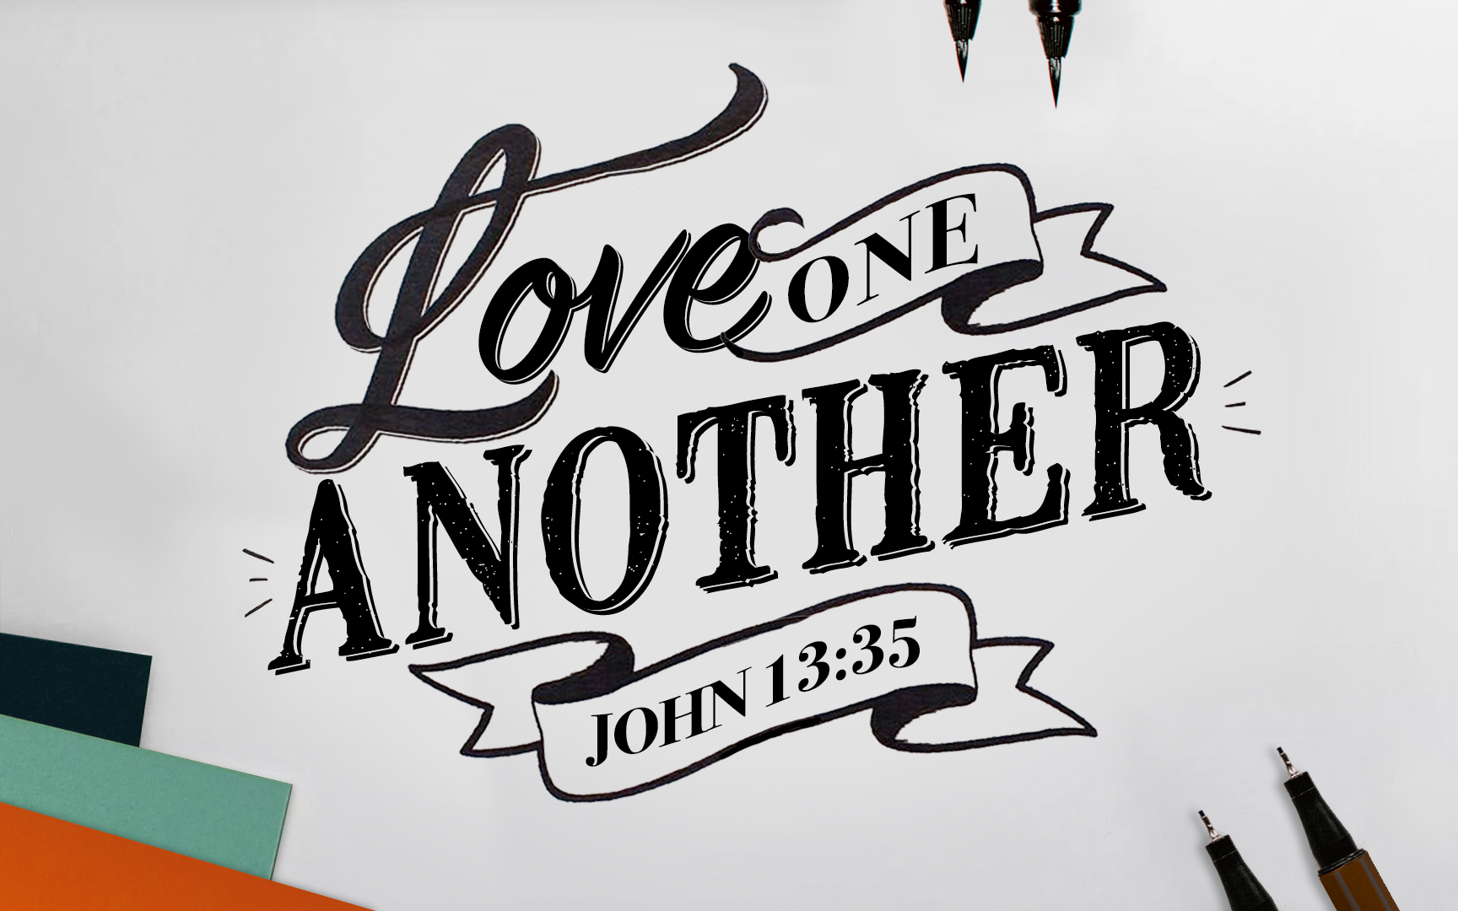
Notes:
Thankful to study together. The topic of Honor is really broad, so I have 3 goals with the lesson this morning...
First, To Encourage A Community of Honor

Slide 2
“Honor One Another” Romans 12:10
“Be devoted to one another in brotherly love; give preference to one another in honor; ” (NASB95)
“Love one another with brotherly affection. Outdo one another in showing honor.” (ESV)
Devotion
Close Friendships
Prioritize
Go Beyond
Visible Actions
Notes:
Go Beyond what is expected or required. Go beyond what others have done for you. Excel. Go the 2nd Mile…
There are so many great things to say about honor, I have to pick just a few – so here are the 3 we are going to study tonight…

Slide 3
To Encourage A Community of Honor To Overcome Roadblocks to Honor To Spark A Chain-Reaction of Honor
Notes:
There are so many great things to say about honor, I have to pick just a few – so here are the 3 we are going to study tonight…
Community: I want us to look at how Jesus created a culture of honor among his followers. Specifically the apostles, which carries into the relationships of Christians in local churches.
Roadblocks: We all desire respect and being treated with honor – but sometimes we are our own worst enemy. I want to help us recognize and get past some roadblocks.
Chain-Reaction: Like tipping over the first domino to effect all the others after it – I want to highlight some things we can do that will cause honor to spread among us as a local church.

Slide 4
Honor Begins With How I Value Others: My Brothers & Sisters Are A Treasure.
“…you are more valuable than many sparrows.” Matthew 10:31
“…think so as to have sound judgment…” Romans 12:3-8
Notes:
A Community of Honor…
Begins With How I Value Others: My Brothers & Sisters ARE A Treasure.
I am blessed to have them.
I am blessed to work along side them.
I am blessed by their insights.
I am blessed by
Jesus valued his disciples and all of us. Paul valued his co-workers and the immature churches he planted.
I cannot honor, what I do not value.
Dishonor will cause me to lose this treasure. Just like bad investments, reckless spending, and laziness will cause us to lose wealth. Dishonor, “taking for granted,” lack of courtesy, ignoring concerns, overlooking needs, etc… will cause us to lose our brothers and sisters.
Can I remember how I’ve been welcomed, included, taught, shared with, encouraged, complimented, rejoiced with, mourned with…
Honor Get’s Easy When I Treasure My Church Family.
They could make it a very “Jewish” style church (and drive away all the Gentiles.)
They could make it a very “Gentile” style church (and drive away all of the Jews.)
But God wants them to make it a very JESUS style church and invites in and honors one another with brotherly love.
We could make this a very hip church (and drive away long-time members.)
We could make this a very traditional church (and drive away new converts.)
But God wants us to make it a very JESUS style church that honors one another with brotherly love.
Halloween Candy…Trying to work a trade….
Would you trade 2 kit-kats for 1 snickers?
Would you trade skittles for a reeces peanut butter cup?
Sports – would we trade an excellent rebounder for a point guard?
I place great value on = I would not trade this thing for that thing.
I would not trade a relaxing Saturday vs. a cleaning for a potluck Saturday.
I would not trade an extra hour of sleep vs. missing Wed PM Bible classes.
I would not trade an extra conversation with my long-time friend – at the expense of a new member feeling left out and alone.
I would not trade an evening with close friends - at the expense of my wife and children.

Slide 5
Encouraging A Community of Honor
With Jesus, I Am Loved Despite My Limitations.
With Jesus, My Differences Do Not Disqualify.
With Jesus, I Am Invited To Contribute, Not Forced & Controlled.
With Jesus, I Can Share My Thoughts & Opinions.
With Jesus, I Am Not The Most Important.
Love For One Another Is Modeled & Encouraged.
We Want The Same Qualities To Be True At Embry Hills…
Notes:
With Jesus… how did Jesus create a community of Honor among the aposltes?
With Jesus, He Loved Them Despite Their Limitations.
With Jesus, He Invited Them Despite Their Differences.
With Jesus, He Listened To Them Despite Their Immaturity.
With Jesus, He Redirected Them Despite Their Ambitions.
With Jesus, He Served Them Despite His Position.
My Thoughts & Opinions Are Heard & Considered.
When we honor one another, we enrich our friendships.
Honor & Brotherly Love are complimentary qualities. You can’t have one without the other, and both enhance the other.
It feels good to be shown honor!
When we honor one another, we can navigate our differences without jeopardizing our relationships.
When we honor one another, we are doing one of the things that honors God. (Remember, the opposite is true as well.)
Same At Embry Hills..
Do you feel like/believe people take your wants and needs into consideration?
Do you feel like people help make up for your weaknesses?
Do you feel like you have an outlet to use your talents?
Do you feel like people listen closely to you?
I Feel Honored Because (When?)…
I Feel Like People Love Me Despite My Shortcomings.
I Feel Very Affirmed To Know Good People with Good Judgment See The Good In Me.
I Feel Entrusted With Tasks of High Value or Impact
I Feel Honored When Thanks or Gratitude Is Expressed

Slide 6
Overcoming Roadblocks To Honor
I Will Not Attempt To Elevate Myself With Anything That Embarrasses Someone Else.
Genesis 9:20-23, Proverbs 17:9
I Will Not Withhold Honor In An Unrealistic Pursuit of Perfection.
1 Timothy 5:17, Hebrews 13:17, 1 Peter 3:7
I Will Not Pursue Honor From Others Like A Pharisee.
Matthew 6:2, John 12:26
I Will Not Classify Innocent Behaviors As Acts of Dishonor.
Matthew 20:13-16, Matthew 26:36-39
Notes:
Unrealistic Pursuit of Perfection
Yes, We Desire For Things To Be “Just Right” & Rejoice In the Best Days & Best Friends – but we must also rejoice in the good on the hard or bad days.
Only God Is Perfect. Only God Never Fails. And In His Perfection, We Won’t Always Understand His Ways – Which Can Be Upsetting or Disappointing!
So Only With God, In Heaven Will Be Truly Perfect…
Thinking My Hunger for Honor Should Be Fulfilled By People’s Opinions of Me. We Need God’s Opinion of Us!!! We Need Humility

Slide 7
Sparking A Chain-Reaction of Honor
“Render to all what is due them…honor to whom honor.”
Romans 13:7
I Will See Myself & Others As A “Can Do” Person…
2 Timothy 2:20-21
I Will Delegate, But Will Not “Drop” Problems on You…
2 Cor. 8:6
I Will “Wash Feet” With Gladness & A Loving Heart…
John 13:12-17
I Will Use The Golden Rule To Pay-It-Forward…
Luke 6:31, 36
Notes:
Tossing a rock in a pond makes ripples that radiate out… that needs to be what we do. Toss HONOR into these situations.
DELEGATE: No one likes a boss who just drops a problem in your lap and says: deal with it. Even if you need to pass a big problem with lots of challenges to someone else – you can do it with respect because you believe in them, and show that you are sparing them from even bigger problems that you are personally tackling. To Truly Delegate: I will involve you because I respect and admire your talents, and because I have the humility to know I need your help. And confidence you can rise to this challenge. Even faith you will be more creative in your solutions than I may be.
GREET….
“It is a privilege to recognize that everyone has been made in the image of God. Everyone deserves honor because of at least two things: They have been made in God’s image, and He has given them gifts (graces and abilities) so that they can contribute to society.“
“Those who have surrendered their lives to Christ are due another level of honor—the Holy Spirit lives in them. ‘He who receives a prophet in the name of a prophet shall receive a prophet’s reward; and he who receives a righteous man in the name of a righteous man shall receive a righteous man’s reward’ (Matthew 10: 41 NASB). To receive someone into our lives is to recognize the gift that person has and acknowledge the way the Holy Spirit works through him or her. This is, in itself, an act of honor.“
I Will Show Gratitude Without Patronizing…
Patronizing: treat with an apparent kindness that betrays a feeling of superiority.
“To treat condescendingly, condescend to, look down on, talk down to, put down, treat like a child, treat with disdain.”

