Slide 1
Revelation 2 & 3 To the church at Pergamum
Notes:
Revelation 2 & 3 is a subtitle box you can edit.

Slide 2
To the church at Pergamum
¹² “And to the angel of the church in Pergamum write: ‘The words of him who has the sharp two-edged sword. ¹³ “‘I know where you dwell, where Satan's throne is. Yet you hold fast my name, and you did not deny my faith even in the days of Antipas my faithful witness, who was killed among you, where Satan dwells. ¹⁴ But I have a few things against you: you have some there who hold the teaching of Balaam, who taught Balak to put a stumbling block before the sons of Israel, so that they might eat food sacrificed to idols and practice sexual immorality. ¹⁵ So also you have some who hold the teaching of the Nicolaitans. ¹⁶ Therefore repent. If not, I will come to you soon and war against them with the sword of my mouth. ¹⁷ He who has an ear, let him hear what the Spirit says to the churches. To the one who conquers I will give some of the hidden manna, and I will give him a white stone, with a new name written on the stone that no one knows except the one who receives it.’ Revelation 2:12-17

Slide 3
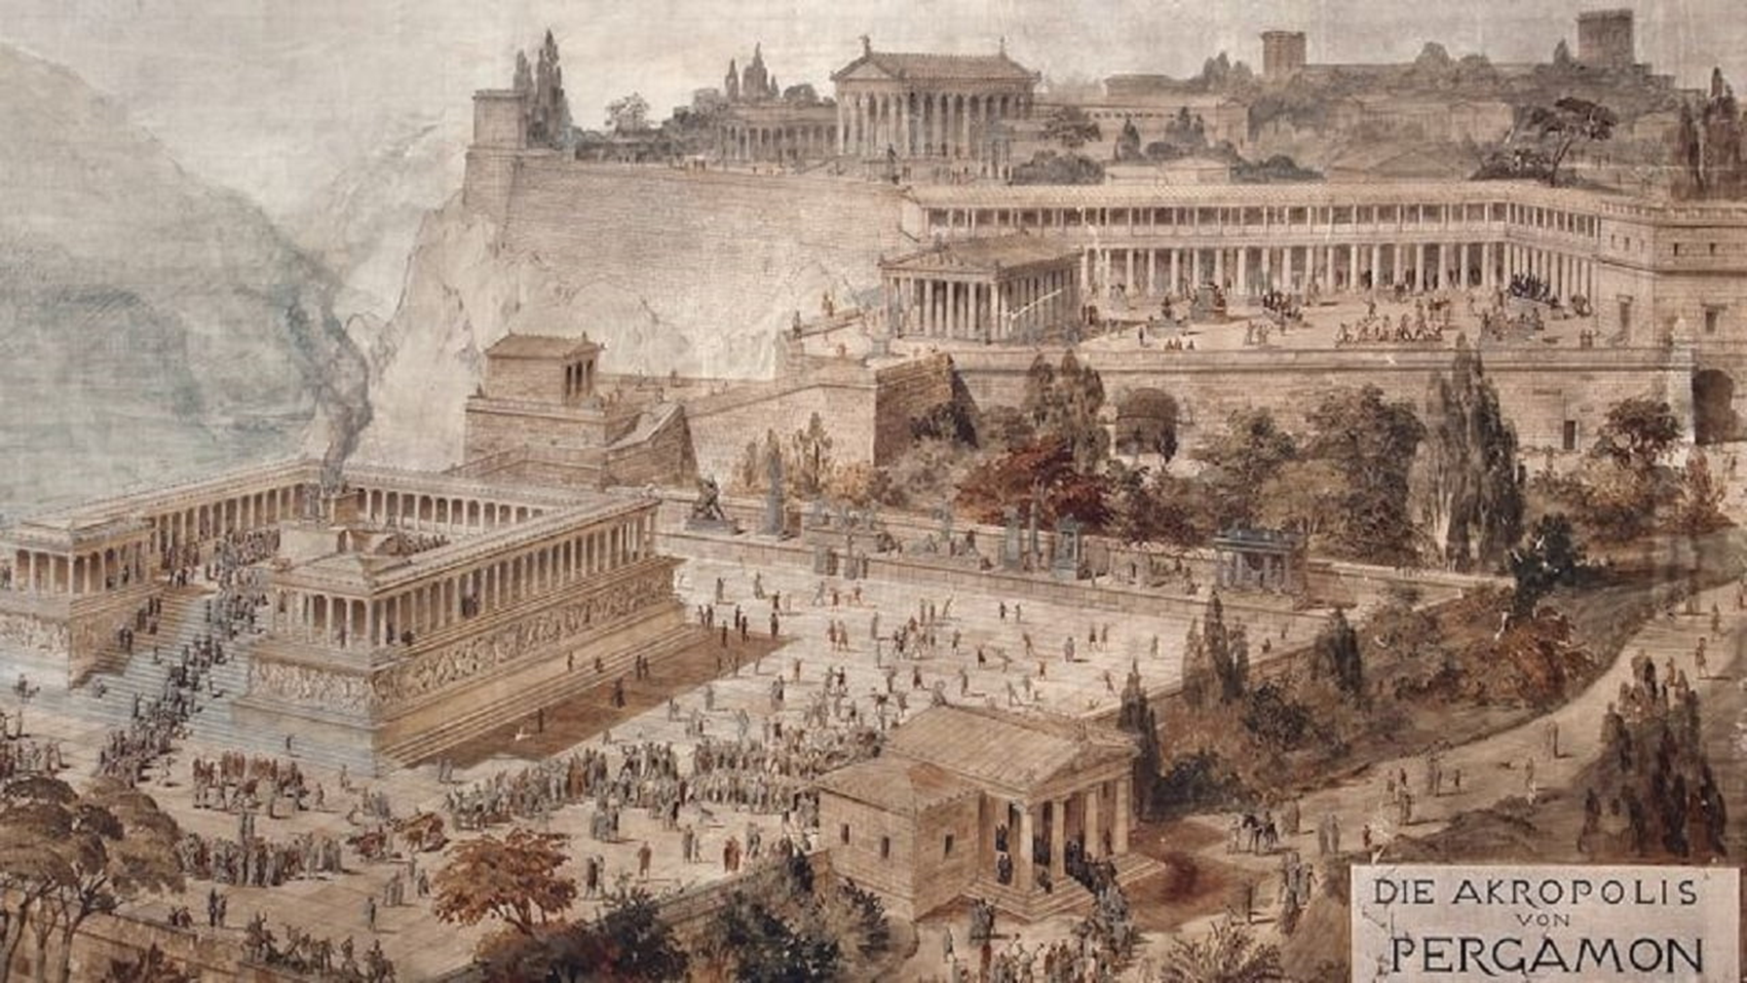
Pergamum – The City
First, it was an Intellectual Center
Secondly, Pergamum was known for its Political Power
Third Pergamum was full of Pagan Temples.
POLITICAL CENTER
IMMORALITY CENTER
IDOLATRY CENTER
FALSE HEALING CENTER
SATAN Throne was There!

Slide 4
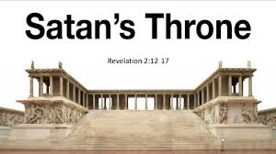
Pergamum
THE CITY
Satan’s Throne
THE CHARACTERISTICS OF CHRIST
Sharp Two-Edged Sword (Eph 6.17; Heb 4.12)
THE COMMENDATION FROM CHRIST
“I know where you live” – Satan’s Throne
“I know you hold fast to my Name”
“I know you did not deny the faith.”
“I know your Sacrifices” – Antipas
THE CRITICISM FROM CHRIST
Some hold to the teachings of Balaam
Some hold to the teachings of the Nicolaitans

Slide 5
STEPS TO SPIRITUAL COMPROMISE
A Failure to purpose in our hearts ahead of time to do the right thing.
Underestimating evil (failure to recognize temptation).
What is the #1 Problem Facing Us Today?
Rationalizing – It’s not that bad
A Failure to consider the costly consequences.
A Choice to give in to sin – although by now, we no longer consider it a sin.

Slide 6
PERGAMUM
THE CITY
THE CHARACTERISTICS OF CHRIST
THE COMMENDATION FROM CHRIST
THE CRITICISM FROM CHRIST
THE CORRECTION NEEDED
Repent and Separate
Or Else I will come with the Sword of My Mouth
2 Corinthians 6: 14-18:
Partnership, Fellowship, Accord, Portion, Agreement does Right have with Wrong?
“Temple of God”
“Temple of the Living God“.
God’s dwelling place,
He walks among us,
He is our God
We are His people.

Slide 7
PERGAMUM
THE CITY
THE CHARACTERISTICS OF CHRIST
THE COMMENDATION FROM CHRIST
THE CRITICISM FROM CHRIST
THE CORRECTION NEEDED
If You CONQUER
Hidden Manna
White Stone
A New Name
John 6:35 “I am the bread of life; whoever comes to me shall not hunger, and whoever believes in me shall never thirst
Jesus provides Access to a banquet feast.
Jesus brings Acquittal from the penalty of sin.
Jesus brings Victory over sin and death.
Jesus has Redeemed us from the curse of the law.
White Stone
A ticket to special banquets.
A vote for acquittal by a jury.
A symbol of victory for an athlete.
A symbol of freedom of a slave.

Slide 8
The Invitation from Christ
If you have lost your purity –Come back and I’ll give you my white stone.
If you have lost your intimacy – Come back and I’ll give you my new name.
If you have lost your nourishment – Come back and I’ll give you my hidden manna.
If you have lost your focus – Come back and listen to Christ speaking to you in the word.
Hold Fast

Slide 9
Revelation 2 & 3
Notes:
Revelation 2 & 3 is a subtitle box you can edit.

