Slide 1
Revelation 2 & 3

Slide 2
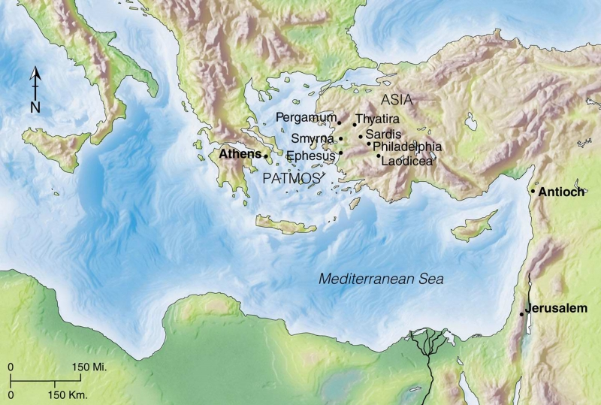

Slide 3
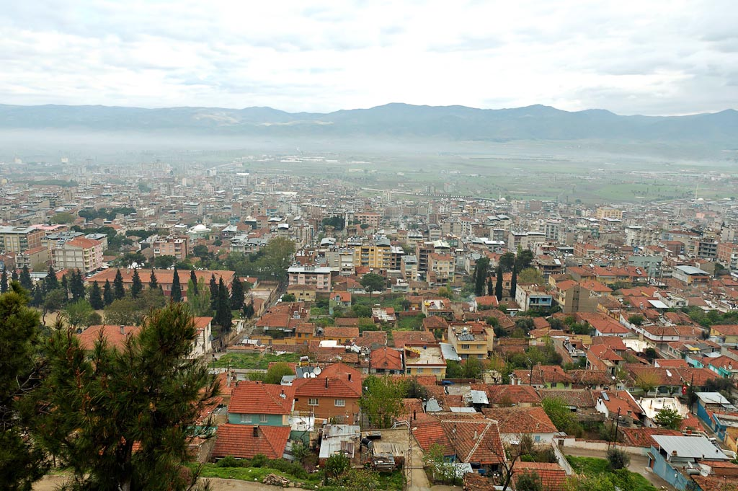
Alasehir (Philadelphia) city from acropolis

Slide 4
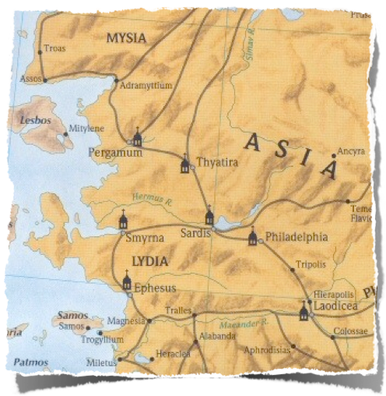
The City
Philadelphia was located on the Cogmus river, 28 miles southeast of Sardis.
Built in 140 BC (youngest city) by the Pergamum King Attalus II.
Attalus was given the nickname Philadelphius (brother lover) because of the great love he had for his brother and predecessor Eumenes II.
City was built and named after Attalus Philadelphius.
Was built to be a missionary city. Strategically located on the border of the countries of Mysia, Lydia and Phrygia. On one of the greatest highways to the east ” [i.e., “built with the deliberate attempt to Hellenize barbarian wilds of the east,” (Ramsey, 391,392)]

Slide 5
The City
Philadelphia was located on the edge of a highly active volcanic area. Volcanic cliffs behind the city
The earthquake which devastated twelve cities in 17 A.D. was particularly destructive in Philadelphia, due to its being nearest the fault line.
Frequent shocks felt and the cities inhabitants lived in constant fear of being destroyed again.
“Whenever a quake struck, the people of Philadelphia would flee the city. When the aftershocks subsided they would return. The people of Philadelphia were, therefore, ‘always going out and coming in; they were always fleeing the city and returning to it.’” D. Johnson

Slide 6
The City
After earthquake leveled the city in 17 A.D. it was rebuilt with the help of the Roman Emperor Tiberius.
Upon rebuilding it was given a new name, neo-Caesarea but it eventually changed back to Philadelphia. Had at least three name changes and reverted back to Philadelphia.
There was apparently a large and influential Jewish population and synagogue

Slide 7
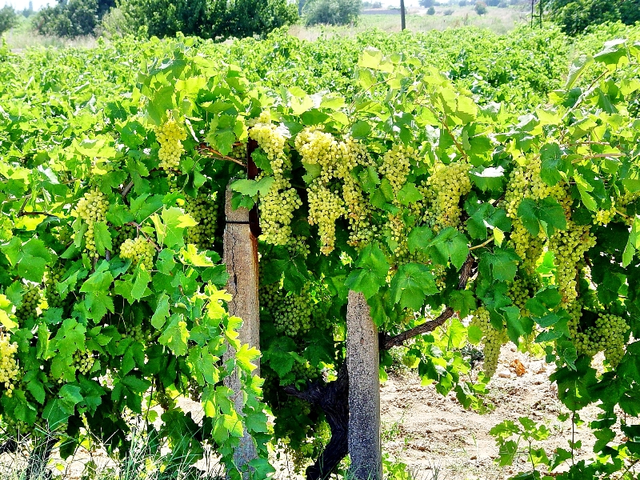
The City
Active volcanic area blessed the city by giving it rich fertile soil and hot springs
The adjacent plain was famous for wine; thus, Philadelphia’s chief pagan cult was the worship of Dionysius, the Greek god of wine and pleasure, worshiped in drunken orgies.

Slide 8
The City
Became a major center for temple worship and religious festivals
Called “little Athens” because of its numerous temples and festivals to pagan deities.
Known for its pillars in the many temples
Worthy citizens were honored by inscribing their name on one of the pillars

Slide 9
Message to Philadelphia (Revelation 3:7-13 NASB)
⁷ “And to the angel of the church in Philadelphia write:
He who is holy, who is true, who has the key of David, who opens and no one will shut, and who shuts and no one opens, says this:
⁸ ‘I know your deeds. Behold, I have put before you an open door which no one can shut, because you have a little power, and have kept My word, and have not denied My name. ⁹ Behold, I will cause those of the synagogue of Satan, who say that they are Jews and are not, but lie—I will make them come and bow down at your feet, and make them know that I have loved you. ¹⁰ Because you have kept the word of My perseverance, I also will keep you from the hour of testing, that hour which is about to come upon the whole world, to test those who dwell on the earth. ¹¹ I am coming quickly; hold fast what you have, so that no one will take your crown. ¹² He who overcomes, I will make him a pillar in the temple of My God, and he will not go out from it anymore; and I will write on him the name of My God, and the name of the city of My God, the new Jerusalem, which comes down out of heaven from My God, and My new name. ¹³ He who has an ear, let him hear what the Spirit says to the churches.’

Slide 10
The Challenges
Idolatry – “little Athens”, immorality
“Synagogue of Satan” – Jewish opposition
These were Jews in the flesh only – they rejected Jesus as the Messiah & served Satan – (John 8:44)
They were enemies of Christ and His Church (Acts 6:9; 14:1-2).
“because you have little power” (ESV - I know that you have but little power)
Perhaps small in number, weak economically, no political or cultural influence. (I Cor 1:26-27) Seen as strange and told they are nothing. That is how they felt.
Embry Hills church faces similar challenges

Slide 11
Christ’s Self Designation
He who is HOLY (hágios)
sacred, pure, separate from common condition and use
God is called “the Holy One of Israel” (Isaiah 40:25; 43:3; Ps. 111:9).
God refers to Himself as holy -1Peter 1:16 – “you shall be holy for I am holy.”
The angel told Mary that Jesus was to be the Holy One - (Luke 1:35)
The apostles referred to Jesus as Holy (Acts 3:14, 4:30)
Jesus is the divine, promised Messiah, Savior of the world.
In contrast, Jews called themselves God’s holy people with an open door to God’s presence and Jewish Christians would be called apostate Jews
He who is TRUE (alēthinos)
Real, Genuine, Dependable - contrasted nonbelieving Jews (vs 9)
As the Father is true (Rom 3:3-4; Rev 6:10; 15:3; 16:7; 19:2), so is His Son - (1 Jn 5:20; Rev 19:11) “True” bread (Jn 6:32); “True” Light (John 1:9); “True” Vine (John 15:1)
We can so trust His Word and promises that we can rest our eternal destiny on it. (Mat 24:35; Titus 1:2)

Slide 12
Isaiah 22:15-23 – “the key of the house of David”
Thus says the Lord God of hosts, “Come, go to this steward, To Shebna, who is in charge of the royal household, ¹⁶ ‘What right do you have here, And whom do you have here, That you have hewn a tomb for yourself here, You who hew a tomb on the height, You who carve a resting place for yourself in the rock? ¹⁷ ‘Behold, the Lord is about to hurl you headlong, O man. And He is about to grasp you firmly ¹⁸ And roll you tightly like a ball, To be cast into a vast country; There you will die And there your splendid chariots will be, You shame of your master’s house.’
¹⁹ “I will depose you from your office, And I will pull you down from your station.
²⁰ “Then it will come about in that day, That I will summon My servant Eliakim the son of Hilkiah, ²¹ And I will clothe him with your tunic And tie your sash securely about him. I will entrust him with your authority, And he will become a father to the inhabitants of Jerusalem and to the house of Judah. ²² “Then I will set the key of the house of David on his shoulder, When he opens no one will shut, When he shuts no one will open. ²³ “I will drive him like a peg in a firm place, And he will become a throne of glory to his father’s house.

Slide 13
Christ’s Self Designation
“He who has the key of David,” - “Key” implies authority over His Kingdom
The “key of the house of David” was laid upon the shoulder of Eliakim (a type of Christ & Christians), to whom was given governmental powers to open and shut (Isa 22:22)
Belongs to Christ by right (Isa 9:6-7) He is the fulfillment of God’s promise to David - (II Sam. 7:12-16; Luke 1:32-33)
Jesus is on David’s throne, has ultimate Messianic authority & will rule to the end of time over the Kingdom of God (Acts 2:29-36; 1 Cor 15:22-26).
Luke 1:32-33 - He will be great and will be called the Son of the Most High; and the Lord God will give Him the throne of His father David; ³³ and He will reign over the house of Jacob forever, and His kingdom will have no end.

Slide 14
Christ’s Self Designation
“He who opens and no one will shut, and who shuts and no one opens,” Jesus has all authority in heaven and on earth (Matt. 28:18; Eph 1:22-23),
The one who is holy and true, has all authority and power to govern access into the Kingdom and divine fellowship.
He can open the storehouse of God’s treasures and distribute
This strikes at the foundation of all Jewish claims to the contrary
Christ is the reality (not shadow) and the substance (Col 2:16-17)
This places Him in contrast to all the deceptions of the world and the false and futile answers they offer to man.
The true answer is, “I am the way, and the truth, and the life; no one comes to the Father but through Me.” (John 14:6).
Jesus Christ is God, He is holy and true in character, He is Sovereign, has messianic authority over the Kingdom, has access to all the treasures of heaven. We are blessed in Christ with all spiritual blessings (Eph.1:3)

Slide 15
“‘I know your deeds. Behold, I have put before you an open door which no one can shut…” (3:8a)
Assurances and Opportunities
Access to the Kingdom/Salvation in Christ is Secured
Context – 3:7,9
Isa 22 - was speaking of access to the king
Revelation is providing much-needed encouragement and comfort during trying circumstances.

Slide 16
“‘I know your deeds. Behold, I have put before you an open door which no one can shut…” (3:8a)
Assurances and Opportunities
Evangelistic Opportunity?
A “door of faith” had been opened to the Gentiles (Acts 14:27)
“But I will remain in Ephesus until Pentecost; for a wide door for effective service has opened to me, and there are many adversaries.” (I Cor 16:9)
As the city had been built on the border of Mysia, Lydia and Phrygia as an open door for the spread of Greek civilization, so now the Lord had opened a door of evangelism to the church in that city. Its position gave it a special opportunity and challenge. (Revelation -Hailey -151)

Slide 17
Assurances and Opportunities
Salvation in Christ is Secured
Earthly circumstances don’t inform the status of salvation
Christ alone holds the key and has opened the door to His Kingdom, God’s presence and the church’s salvation.
We can be assured of our place in the Kingdom. Results in boldness and confidence to fulfill our mission in the midst of conflicting voices
Evangelistic Opportunities
Thriving and large city
Ideal location for our gathering
Members spread over large geographical area
Members who are knowledgeable of God’s word and prepared to evangelize (home and meet up studies, Spanish speaking opportunities)
Financial means to support evangelists locally and around world
Diversity all around
People looking for hope and purpose
Religious people in error
Evangelism helps us focus on eternal not present trials and opposition

Slide 18
The Commendation
⁷ “And to the angel of the church in Philadelphia write:
He who is holy, who is true, who has the key of David, who opens and no one will shut, and who shuts and no one opens, says this:
⁸ ‘I know your deeds. Behold, I have put before you an open door which no one can shut, because you have a little power, and have kept My word, and have not denied My name. ⁹ Behold, I will cause those of the synagogue of Satan, who say that they are Jews and are not, but lie—I will make them come and bow down at your feet, and make them know that I have loved you. ¹⁰ Because you have kept the word of My perseverance, I also will keep you from the hour of testing, that hour which is about to come upon the whole world, to test those who dwell on the earth. ¹¹ I am coming quickly; hold fast what you have, so that no one will take your crown. ¹² He who overcomes, I will make him a pillar in the temple of My God, and he will not go out from it anymore; and I will write on him the name of My God, and the name of the city of My God, the new Jerusalem, which comes down out of heaven from My God, and My new name. ¹³ He who has an ear, let him hear what the Spirit says to the churches.’
Notes:
.

Slide 19
The Commendation
“because you have a little power”
The church in Philadelphia had the poverty of spirit to know they really needed God’s strength
Philadelphia would have appeared beat down and unimpressive, but their circumstances and hardships were training them to rely on God.
Their “little” power was sufficient to achieve Christ’s purpose

Slide 20
Power is Perfected through Weaknesses
Weakness allows God’s power to be made perfect
False teachers boasted in their “strength”. Paul boasts about his weaknesses (2 Cor. 12:9-10)
Hebrew 11:32-34 – heroes of faith “from weakness were made strong”
A recognition of our weaknesses results in greater reliance on God and the ability to show true strength in the Lord.
This is a church with “little power” that can be used to accomplish great things in service to God. We are workers with God. This is the Lord’s church.
It is not our own wisdom, eloquence, or ability that will bring spiritual success.
The Lord can use whatever we have and multiply our effectiveness “exceeding abundantly above all that we may ask or think” (Eph. 3:20; 2 Cor. 9:8-11).
Conflicting voices from outside will persist
Notes:
left this point out - What influence can a group with “little power” have in a large city? Remember Zechariah 4:10 - For who has despised the day of small things? God rebukes Israel for their view of the insignificance of small things as they looked upon the foundation of the second temple laid by Zerubbabel (Ezra 3:12)

Slide 21
The Commendation
“because you have a little power; and have kept my word, and have not denied My name.”
Through whatever trial of faith they went through, they honored the holy and true one by trusting Him and keeping His Word. (Rev 14:12)
The keeping of His word is a test of love for Him and His Father (John 14:23)
In the face of opposition, they had boldness and courage to remain faithful and loyal. They confessed the name of Jesus.
Holding fast to the words of Christ and being loyal is the only means of salvation, spiritual growth & success (Rom 1:16; 2 Tim 1:13; 4:7).

Slide 22
The Lord’s Promises
⁷ “And to the angel of the church in Philadelphia write:
He who is holy, who is true, who has the key of David, who opens and no one will shut, and who shuts and no one opens, says this:
⁸ ‘I know your deeds. Behold, I have put before you an open door which no one can shut, because you have a little power, and have kept My word, and have not denied My name. ⁹ Behold, I will cause those of the synagogue of Satan, who say that they are Jews and are not, but lie—I will make them come and bow down at your feet, and make them know that I have loved you. ¹⁰ Because you have kept the word of My perseverance, I also will keep you from the hour of testing, that hour which is about to come upon the whole world, to test those who dwell on the earth. ¹¹ I am coming quickly; hold fast what you have, so that no one will take your crown. ¹² He who overcomes, I will make him a pillar in the temple of My God, and he will not go out from it anymore; and I will write on him the name of My God, and the name of the city of My God, the new Jerusalem, which comes down out of heaven from My God, and My new name. ¹³ He who has an ear, let him hear what the Spirit says to the churches.’

Slide 23
The Lord’s Promises
Their Vindication – “…I will make them come and bow down at your feet, and make them know that I have loved you (3:9b)
These were Jews in the flesh who rejected Jesus as the Messiah and were enemies of Christ and His Church
True Jew was one inwardly, spiritually (Rom. 2:28-29)
Through conversion or judgment, they will recognize (“bow down”) Jesus for who He is, and His followers as the true children of God, the true Israel (Phil 2:10,11; 1 Cor 6:2)
In Isaiah (45:14, 49:23, 60:14) the Gentiles are described as bowing down at the feet of the Jews. Ironically, this is fulfilled in NT times by the Jews bowing down at the feet of the Christians who are mainly Gentiles.
“I also will keep you from the hour of trial” (3:10b)
Not a promise to keep them from being persecuted, rather they will be brought safely through. (Acts 14:21-22; 2 Tim 3:12; 2 Pet 2:9)
The Lord will not allow Satan to try us beyond our ability to withstand (1 Cor 10:13).
A day is coming when all those who mocked and persecuted Christians will realize that we are the ones loved by God.
We must focus on Jesus and faithful obedience. God will take care of the rest.
Isaiah 60:14 - The sons of those who afflicted you will come bowing to you, And all those who despised you will bow themselves at the soles of your feet; And they will call you the city of the Lord, The Zion of the Holy One of Israel.

Slide 24
The Lord’s Promises
⁷ “And to the angel of the church in Philadelphia write:
He who is holy, who is true, who has the key of David, who opens and no one will shut, and who shuts and no one opens, says this:
⁸ ‘I know your deeds. Behold, I have put before you an open door which no one can shut, because you have a little power, and have kept My word, and have not denied My name. ⁹ Behold, I will cause those of the synagogue of Satan, who say that they are Jews and are not, but lie—I will make them come and bow down at your feet, and make them know that I have loved you. ¹⁰ Because you have kept the word of My perseverance, I also will keep you from the hour of testing, that hour which is about to come upon the whole world, to test those who dwell on the earth. ¹¹ I am coming quickly; hold fast what you have, so that no one will take your crown. ¹² He who overcomes, I will make him a pillar in the temple of My God, and he will not go out from it anymore; and I will write on him the name of My God, and the name of the city of My God, the new Jerusalem, which comes down out of heaven from My God, and My new name. ¹³ He who has an ear, let him hear what the Spirit says to the churches.’

Slide 25
The Lord’s Promises
“I will make him a pillar in the temple of My God”
Worthy citizens of Philadelphia had their name inscribed on a pillar in a pagan temple or and entire pillar was dedicated.
Christians, though rejected and despised, become part of a greater city, the temple (figurative) in which the true and living God dwells (Rev 7:14-15; 21:3-4).
Communicates the promise of intimate communion with God
Pillars have been destroyed and the names are gone but Christians will be honored in eternity if we keep His word and not deny His name.
“he will not go out from it anymore”
After earthquakes, citizens would flee and go out in the country and live in tents until safe to return

Slide 26
The Lord’s Promises
“I will write on him the name of My God and the name of the city of My God, the new Jerusalem, which comes down out of heaven from My God, and My new name”
Philadelphia had been renamed several times.
Pillars (Christians) in God’s temple will have the name of “My God” written on them…
Names tied to Jesus’ identity indicating our belonging to the Lord, - (Rev 14:1); Permanent citizens of the city of God (Heb 12:22; Rev. 21:2-5)

Slide 27
The Exhortation
⁷ “And to the angel of the church in Philadelphia write:
He who is holy, who is true, who has the key of David, who opens and no one will shut, and who shuts and no one opens, says this:
⁸ ‘I know your deeds. Behold, I have put before you an open door which no one can shut, because you have a little power, and have kept My word, and have not denied My name. ⁹ Behold, I will cause those of the synagogue of Satan, who say that they are Jews and are not, but lie—I will make them come and bow down at your feet, and make them know that I have loved you. ¹⁰ Because you have kept the word of My perseverance, I also will keep you from the hour of testing, that hour which is about to come upon the whole world, to test those who dwell on the earth. ¹¹ I am coming quickly; hold fast what you have, so that no one will take your crown. ¹² He who overcomes, I will make him a pillar in the temple of My God, and he will not go out from it anymore; and I will write on him the name of My God, and the name of the city of My God, the new Jerusalem, which comes down out of heaven from My God, and My new name. ¹³ He who has an ear, let him hear what the Spirit says to the churches.’

Slide 28
The Exhortation
“hold fast what you have”
They had trust in the holy and true one, salvation, His Word, steadfast endurance and assuring promises and an open door.
“so that no one will take your crown”
Crowns communicate royalty & victory
How much is a crown from God worth? How much effort to obtain this incorruptible crown? (I Cor 9:25)
Even the strongest Christians must be on guard of the danger of falling away. (Col 1:23; 1 Cor. 10:12; 15:58; Gal 5:1-6)
The crown may be forfeited by an individual who grows careless, complacent, self satisfied, overconfident, weary, fearful or who neglects opportunity and duty.

Slide 29
He who has an ear, let him hear what the Spirit says to the churches.
Embry Hills church – “hold fast what you have”
Trust in the Holy, True and Sovereign Lord
Reliance on God’s power and not our “little strength”
Confidence in His assurances of salvation and promises
Faithfulness and loyalty to Jesus and Word. Not moved by opposition
Patiently enduring trials as demonstrated by Jesus
Taking advantage of open doors
Reigning with Christ and anticipating the future Crown of Victory where we will live with God forever.
I Peter 5:8 - Be of sober spirit, be on the alert. Your adversary, the devil, prowls around like a roaring lion, seeking someone to devour

Slide 30
Revelation 2 & 3

