Slide 1
2021:
Lessons Learned for
2022

Slide 3
Apostles to NT churches
They ‘watched game tape’
Reminded them of the ‘fundamentals’
[1 John 3:11] For this is the message that you heard from the beginning, that we should love one another, 12 not as Cain who was of the wicked one and murdered his brother. And why did he murder him? Because his works were evil and his brother’s righteous.
[2 Peter 1:12-13] For this reason I will not be negligent to remind you always of these things, though you know and are established in the present truth. ¹³ Yes, I think it is right, as long as I am in this tent, to stir you up by reminding you,
[1 Corinthians 4:16-17] Therefore I urge you, imitate me. 17 For this reason I have sent Timothy to you, who is my beloved and faithful son in the Lord, who will remind you of my ways in Christ, as I teach everywhere in every church.

Slide 4
Apostles to NT churches
Called out ‘departures from the plan’
[Galatians 1:6-7] I marvel that you are turning away so soon from Him who called you in the grace of Christ, to a different gospel, 7 which is not another; but there are some who trouble you and want to pervert the gospel of Christ. 8 But even if we, or an angel from heaven, preach any other gospel to you than what we have preached to you, let him be accursed.

Slide 5
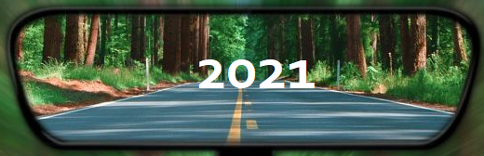
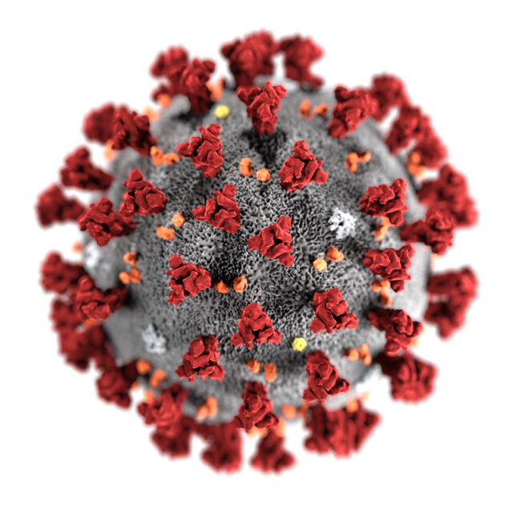
Covid
Physical Impact – Sickness, Loss, Job, Finances
James 5: 13 Is anyone among you suffering? Let him pray. Is anyone cheerful? Let him sing psalms. 14 Is anyone among you sick? Let him call for the elders of the church, and let them pray over him, anointing him with oil in the name of the Lord. 15 And the prayer of faith will save the sick, and the Lord will raise him up. And if he has committed sins, he will be forgiven. 16 Confess your trespasses to one another, and pray for one another, that you may be healed. The effective, fervent prayer of a righteous man avails much.

Slide 6
2022
Philippians 4: 6 Be anxious for nothing, but in everything by prayer and supplication, with thanksgiving, let your requests be made known to God; 7 and the peace of God, which surpasses all understanding, will guard your hearts and minds through Christ Jesus.
Covid
Physical Impact
2 Corinthians 1:3 Blessed be the God and Father of our Lord Jesus Christ, the Father of mercies and God of all comfort, ⁴ who comforts us in all our tribulation, that we may be able to comfort those who are in any trouble, with the comfort with which we ourselves are comforted by God.

Slide 7
Covid
Assembly as a church family
John 16: 31 Jesus answered them, “Do you now believe? 32 Indeed the hour is coming, yes, has now come, that you will be scattered, each to his own, and will leave Me alone. And yet I am not alone, because the Father is with Me. 33 These things I have spoken to you, that in Me you may have peace. In the world you will have tribulation; but be of good cheer, I have overcome the world.”

Slide 8
2022
Covid
1 Thessalonians 2: 17 But we, brethren, having been taken away from you for a short time in presence, not in heart, endeavored more eagerly to see your face with great desire. 18 Therefore we wanted to come to you—even I, Paul, time and again—but Satan hindered us. 19 For what is our hope, or joy, or crown of rejoicing? Is it not even you in the presence of our Lord Jesus Christ at His coming? 20 For you are our glory and joy.
Assembly as a church family

Slide 9
Covid
Spiritual Impact ?
Job 1:9 So Satan answered the Lord and said, “Does Job fear God for nothing? 10 Have You not made a hedge around him, around his household, and around all that he has on every side? You have blessed the work of his hands, and his possessions have increased in the land. 11 But now, stretch out Your hand and touch all that he has, and he will surely curse You to Your face!”

Slide 10
2022
Covid
Spiritual Impact?
Matthew 10:27 And do not fear those who kill the body but cannot kill the soul. But rather fear Him who is able to destroy both soul and body in hell.

Slide 11
2022
Covid
Ephesians 5:15 See then that you walk circumspectly, not as fools but as wise, 16 redeeming the time, because the days are evil.
17 Therefore do not be unwise, but understand what the will of the Lord is.
Family / personal time

Slide 12
2022
Covid
Physical Impact
Assembly as a church family
Spiritual Impact?
Family / personal time
-Pray , Give Comfort & thanks
-Desire assembly / higher good
-Know we are being tested
-Redeem the time

Slide 13
There is not enough love in the world
You shall love the Lord your God
You shall love your neighbor as yourself
  Racism
Matthew 23:37 Jesus said to him, “‘You shall love the Lord your God with all your heart, with all your soul, and with all your mind.’ 38 This is the first and great commandment. 39 And the second is like it: ‘You shall love your neighbor as yourself.’ 40 On these two commandments hang all the Law and the Prophets.”

Slide 14
There is not enough love in the world
You shall love the Lord your God
You shall love your neighbor as yourself
  Racism
  Country of origin
Matthew 25:31 “When the Son of Man comes in His glory, and all the holy angels with Him, then He will sit on the throne of His glory. 32 All the nations will be gathered before Him, and He will separate them one from another, as a shepherd divides his sheep from the goats. 33 And He will set the sheep on His right hand, but the goats on the left.

Slide 15
There is not enough love in the world
You shall love the Lord your God
You shall love your neighbor as yourself
  Racism
  Country of origin
  Social / Economic status
James 2:1 My brethren, do not hold the faith of our Lord Jesus Christ, the Lord of glory, with partiality. 2 For if there should come into your assembly a man with gold rings, in fine apparel, and there should also come in a poor man in filthy clothes, 3 and you pay attention to the one wearing the fine clothes and say to him, “You sit here in a good place,” and say to the poor man, “You stand there,” or, “Sit here at my footstool,” 4 have you not shown partiality among yourselves, and become judges with evil thoughts?

Slide 16
2022
There is not enough love in the world
You shall love the Lord your God
You shall love your neighbor as yourself
  Racism
  Country of origin
  Social / Economic status
Luke 10: 29 But he, wanting to justify himself, said to Jesus, “And who is my neighbor?”
30 Then Jesus answered and said: “A certain man went down from Jerusalem to Jericho, and fell among thieves, who stripped him of his clothing, wounded him, and departed, leaving him half dead. 31 Now by chance a certain priest came down that road. And when he saw him, he passed by on the other side. 32 Likewise a Levite, when he arrived at the place, came and looked, and passed by on the other side. 33 But a certain Samaritan, as he journeyed, came where he was. And when he saw him, he had compassion.
36 So which of these three do you think was neighbor to him who fell among the thieves?”
37 And he said, “He who showed mercy on him.” Then Jesus said to him, “Go and do likewise.”

Slide 17
There is not enough love in the world
You shall love the Lord your God
You shall love your neighbor as yourself
  Racism
  Country of origin
  Social / Economic status
  Political bias / hostility
1 Peter 3:8 Finally, all of you be of one mind, having compassion for one another; love as brothers, be tenderhearted, be courteous; 9 not returning evil for evil or reviling for reviling, but on the contrary blessing, knowing that you were called to this, that you may inherit a blessing

Slide 18
2022
There is not enough love in the world
2 Timothy 2:22 Flee also youthful lusts; but pursue righteousness, faith, love, peace with those who call on the Lord out of a pure heart.
23 But avoid foolish and ignorant disputes, knowing that they generate strife. 24 And a servant of the Lord must not quarrel but be gentle to all, able to teach, patient, 25 in humility correcting those who are in opposition, if God perhaps will grant them repentance, so that they may know the truth, 26 and that they may come to their senses and escape the snare of the devil, having been taken captive by him to do his will.
You shall love the Lord your God
You shall love your neighbor as yourself
  Racism
  Country of origin
  Social / Economic status
  Political bias / hostility

Slide 19
2022
There is not enough love in the world
You shall love the Lord your God
You shall love your neighbor as yourself
  Racism
  Country of origin
  Social / Economic status
  Political bias / hostility
-Identify & Confront your biases
-Do something good for someone
-Check your ego
-Picture yourself in Judgement
-Love each other, have compassion -Don’t quarrel over things that drive others away… focus on the larger goal

Slide 20
‘Growing Pains’
Changing Membership
  People leaving
  Many new faces
‘This change makes me feel uncomfortable’
‘I’m not involved like I once was’
‘I don’t matter anymore’

Slide 21
2022
‘Growing Pains’
Ephesians 4:11 And He Himself gave some to be apostles, some prophets, some evangelists, and some pastors and teachers, ¹² for the equipping of the saints for the work of ministry, for the edifying of the body of Christ, ¹³ till we all come to the unity of the faith and of the knowledge of the Son of God, to a perfect man, to the measure of the stature of the fullness of Christ; ¹⁴ that we should no longer be children, tossed to and fro and carried about with every wind of doctrine, by the trickery of men, in the cunning craftiness of deceitful plotting, ¹⁵ but, speaking the truth in love, may grow up in all things into Him who is the head—Christ—
Changing Membership
  People leaving
  Many new faces
‘This change makes me feel uncomfortable’

Slide 22
2022
‘Growing Pains’
Changing Membership
  People leaving
  Many new faces
‘This change makes me feel uncomfortable’
‘I’m not involved like I once was’
‘I don’t matter anymore’
Ephesians 4:16 from whom the whole body, joined and knit together by what every joint supplies, according to the effective working by which every part does its share, causes growth of the body for the edifying of itself in love.

Slide 23
‘Growing Pains’
Changing Membership
  People leaving
  Many new faces
Meeting Space
  Long process
  Resistance along the way

Slide 24
2022
Romans 8:26 Likewise the Spirit also helps in our weaknesses. For we do not know what we should pray for as we ought, but the Spirit Himself makes intercession for us with groanings which cannot be uttered. 27 Now He who searches the hearts knows what the mind of the Spirit is, because He makes intercession for the saints according to the will of God.
28 And we know that all things work together for good to those who love God, to those who are the called according to His purpose.
31 What then shall we say to these things? If God is for us, who can be against us?
‘Growing Pains’
Changing Membership
  People leaving
  Many new faces
Meeting Space
  Long process
  Resistance along the way

Slide 25
2022
‘Growing Pains’
- Grow beyond your comfort zone
Realize everyone has a role to play
Seek out others who are in need of comfort
-Continue in prayer
-Know God’s will is the outcome
-Don’t lose heart in the difficulties
Changing Membership
  People leaving
  Many new faces
Meeting Space
  Long process
  Resistance along the way

Slide 26
Apathy
-lack of interest, enthusiasm, or concern.

