Slide 1
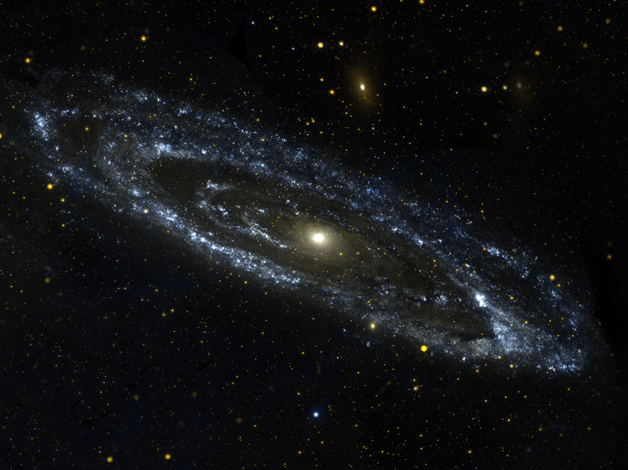
Christ is …
Notes:
CHRIST IS …
Years ago, some men were building a very large metal structure, Kind of like an old-fashioned barn raising. It looked sort of like a warehouse, like a massive metal pole barn, but with huge metal beams instead of poles. It was an open-air structure. There were many men constructing it, working on it and beneath it. Many others -women, children, etc.-were sitting on a slight hill beside the structure watching the work take place. Seemed like the whole town showed up to watch this new kind of barn be built. The men had put the structure together in record time and were all standing beneath it. Everyone was excited and happy at the quick and successful construction, proud of their work.
Just moments later, the building began to lean, and then collapse. The center metal beams, which were mounted up into an apex, began collapsing, as the apex had not been secured with the main bolt. Everyone panicked and began frantically looking all around for the bolt. The men in the center just beneath the apex began to yell, "Where's the bolt?!" Just a minute later the building collapsed with the men beneath it. Many of the men were killed that day.
What does a bolt do? It holds something, or two things together.
They were proud of their accomplishments, the speed, the grandeur, the elegance, of what they had built. Yet, because of One Bolt - Many lives were destroyed because they neglected one thing – and the lack of this one thing caused everything else to fall apart.
Many have said, that perhaps no other paragraph in the New Testament contains more concentrated doctrine about Jesus Christ than Colossians 1:13-23.
You see – He is the Bolt! He is the Main Thing! The Most Important Thing! He holds your life together. The Temple, which is your body, is held together only by him.
How is your life? Do you struggle, do you hurt, have you made a series of bad choices that landed you in an unwanted destination? Do you sometimes feel that things are falling apart?
Maybe you are missing The Bolt – the Christ who holds all things together.
Please don’t mis-understand me – Peter, and Paul and James make it very clear that you will go through trials and hardships if you try to live holy. The world will despise you. And you will hurt, and you will struggle, and sometimes you will feel your life was not supposed to turn out this way. And you are right! You were not designed for that.
You were created for So Much More!
Let me ask you three questions;
When you picture God, what do you think of?
When you picture Jesus, what do you think of?
When God pictures you, what does He think of?

Slide 2
CHRIST IS …
^{Col 1:15} He is the image of the invisible God, the firstborn of all creation. ¹⁶ For in him all things were created, in heaven and on earth, visible and invisible, whether thrones or dominions or rulers or authorities—all things were created through him and for him. ¹⁷ And he is before all things, and in him all things hold together.
CHRIST IS OUR CREATOR (1:15-17)
He Existed Before Creation (v. 15) - Firstborn
John 1:2 – He was in the beginning with God
He is the Image of God
Heb 1:3 – The Exact Imprint of His Nature
John 1:18 – He has made Him known
He Created All Things In Him (v. 16a).
“All things were made by him” (John 1:3).
All Things Exist By Him and For Him (v. 16b).
Thru whom are all things, and thru Him we Exist
He Holds All Things Together (v. 17).
This is My Fathers World!

Slide 3
CHRIST IS …
¹⁸ And he is the head of the body, the church. He is the beginning, the firstborn from the dead, that in everything he might be preeminent.
CHRIST IS OUR CREATOR (1:15-17)
CHRIST IS OUR HEAD (1:18) - Preeminent
“That in all things He might have the preeminence” 18
The Head gives Direction to the Body
The Head Rules the Body
The Head has Authority Over the Body
The Head gives the Body Spiritual Life and Nourishment
Christ is the SOURCE of all Things (Creation)
And He is the Source of the Life of His Church
Christ is all, and in all” (Col. 3:11).

Slide 4
CHRIST IS …
¹⁹ For in him all the fullness of God was pleased to dwell,
CHRIST IS OUR CREATOR (1:15-17)
CHRIST IS OUR HEAD (1:18)
CHRIST IS OUR FULLNESS (1:19)
Col 2:8-15 – He is Our FULNESS because We Have Been Filled in Him!
2:9 – In Him the whole fullness of deity dwells
2:10 – We have been filled In Him
2:11 - In Him we have put off the flesh
2:12 - We have been buried With Him in Baptism
2:13 - We are made alive together With Him
2:15 – We Triumph In Him
For those whom he foreknew he also predestined to be conformed to the image of his Son Romans 8:29

Slide 5
CHRIST IS …
¹³ He has delivered us from the domain of darkness and transferred us to the kingdom of his beloved Son, ¹⁴ in whom we have redemption, the forgiveness of sins.
CHRIST IS OUR CREATOR (1:15-17)
CHRIST IS OUR HEAD (1:18)
CHRIST IS OUR FULLNESS (1:19)
CHRIST IS OUR SAVIOR (1:13-14, 20)
He Delivered (Rescued) Us (v. 13a).
He Has Translated Us (13b)
He Redeemed Us (v. 14a).
He Has Forgiven Us (v. 14b).
He Has Reconciled Us (20a)
He Has Made Peace For Us (20c)
20 and through him to reconcile to himself all things, whether on earth or in heaven, making peace by the blood of his cross.
1:21-23:
Alienated, Hostile, Evil
Reconciled by His Death
Make us Holy and Blameless
Above Reproach
IF you Remain in the Faith

Slide 6
CHRIST IS …
First, Jesus Christ has taken care of all things.
Second, all we need is Jesus Christ.
Third, God is pleased when His Son, Jesus Christ, is honored and given preeminence.
CHRIST IS OUR CREATOR (1:15-17)
CHRIST IS OUR HEAD (1:18)
CHRIST IS OUR FULLNESS (1:19)
CHRIST IS OUR SAVIOR (1:13-14, 20)

Slide 7
CHRIST IS …
HE IS THE BELOVED OF THE FATHER (1:19-20)

