Slide 1
Hosea & Amos: Lesson 1
Please connect with your smartphone below to participate in our class activities

Slide 2
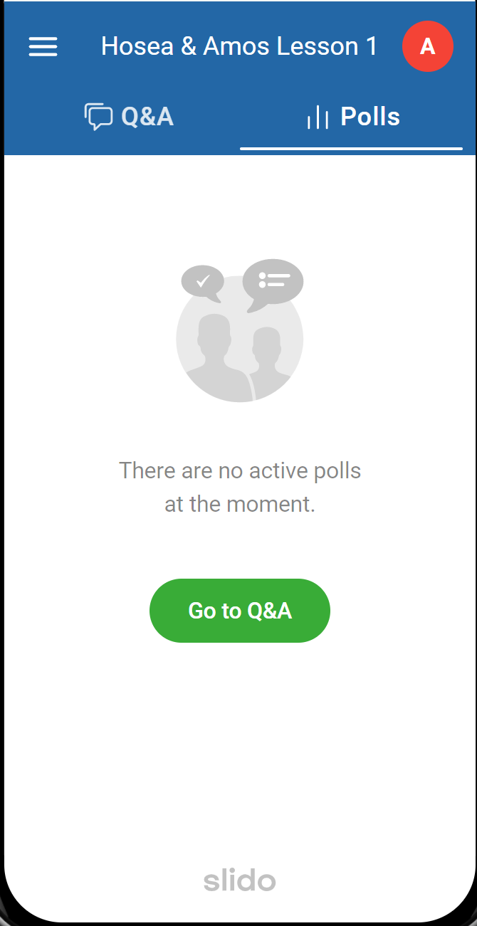
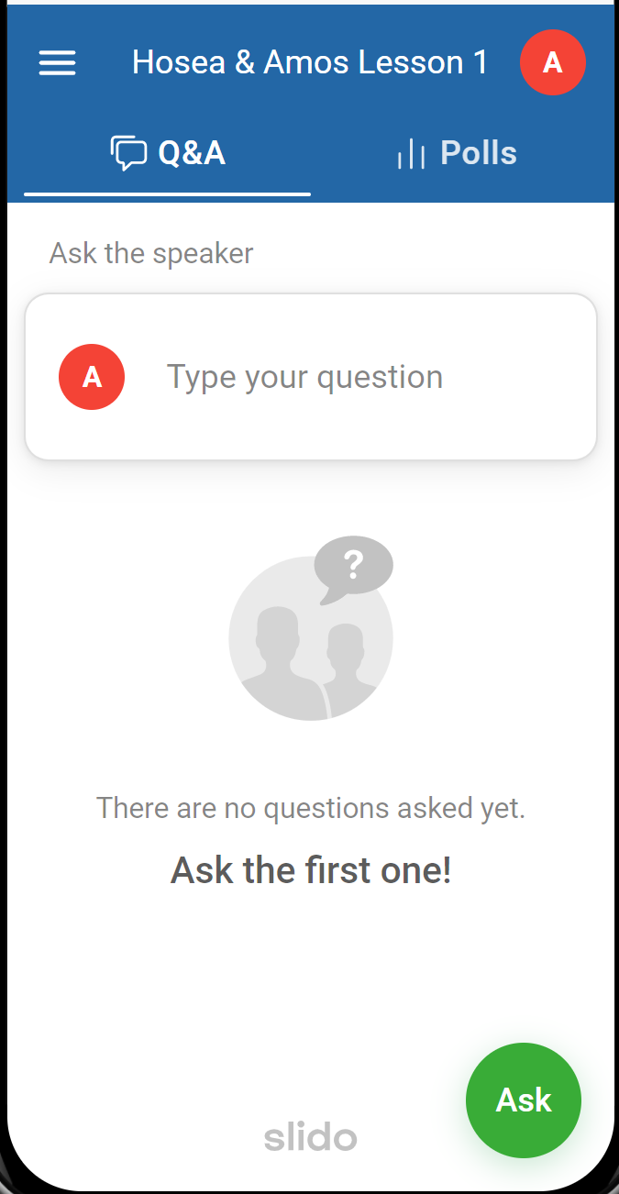
Polls Tab for answering questions
Q&A Tab for asking questions

Slide 3
Why did you join our Hosea & Amos class today?
ⓘ Start presenting to display the poll results on this slide.

Slide 4
Now these things happened to them as an example, and they were written for our instruction, upon whom the ends of the ages have come.
Therefore let him who thinks he stands take heed that he does not fall.
No temptation has overtaken you but such as is common to man; and God is faithful, who will not allow you to be tempted beyond what you are able, but with the temptation will provide the way of escape also, so that you will be able to endure it.
Therefore, my beloved, flee from idolatry.
God gave us the OT for our learning
We can make the same mistakes
Others before us have experienced the same temptations we do
This is the way
1 Corinthians 10:11-14

Slide 5
Hosea & Amos in a Nutshell
Prophesied to Israel during reign of Jeroboam II
Life was prosperous and peaceful
But the people, outwardly religious, were wicked
“The Lord is going to destroy you … if you don’t repent”
[ They do not repent ]
[ Israel falls to Assyria ~30 years later ]

Slide 6
What sins do Christians today tend to ignore in their lives the most?
ⓘ Start presenting to display the poll results on this slide.

Slide 7
There is
swearing,
deception,
murder,
stealing and
adultery.
They employ violence, so that bloodshed follows bloodshed…
…There is no
faithfulness or
kindness or
knowledge of God
in the land.
HOSEA 4:1-2

Slide 8
Why did the Israelites worship the golden calf at Mount Sinai?
ⓘ Start presenting to display the poll results on this slide.

Slide 9
Nearly 700 years before Hosea & Amos, what did Moses warn the Israelites about in Deuteronomy?
ⓘ Start presenting to display the poll results on this slide.

Slide 10
~700 Years before Hosea & Amos
Otherwise, you may say in your heart, “My power and the strength of my hand made me this wealth.” But you shall remember the LORD your God, for it is He who is giving you power to make wealth, that He may confirm His covenant which He swore to your fathers, as it is this day.
It shall come about if you ever forget the LORD your God and go after other gods and serve them and worship them, I testify against you today that you will surely perish.
Deuteronomy 8:17-19

Slide 11
Why did the Israelites repeatedly serve idols during the period of the Judges?
ⓘ Start presenting to display the poll results on this slide.

Slide 12
What was the primary reason the kingdom divided?
ⓘ Start presenting to display the poll results on this slide.

Slide 13
Why did Jeroboam establish golden calf worship?
ⓘ Start presenting to display the poll results on this slide.

Slide 14
Baal worship became popular during Ahab's reign because:
ⓘ Start presenting to display the poll results on this slide.

Slide 15
Which of these did King Jehu not accomplish?
ⓘ Start presenting to display the poll results on this slide.

Slide 16
Pathways to Disobedience
Sinai
Deuteronomy
Judges
Solomon
Jeroboam
Jezebel
Jehu
Losing “sight” of God
Our own wealth and pride
Lack of strong leadership
Close bonds to worldly influences
Political Forces
Persecution
Complacency

Slide 17
Hosea & Amos Reveal God to Us
Love
Kindness
Faithfulness
Power
Judgment
Patience
Compassion

Slide 19
Audience Q&A Session
ⓘ Start presenting to display the audience questions on this slide.

