Slide 1
Hosea & Amos: Lesson 2
Please connect with your smartphone below to participate in our class activities

Slide 2
Pathways to Disobedience
Join at slido.com with #embryhills
Sinai
Deuteronomy
Judges
Solomon
Jeroboam
Jezebel
Jehu
Losing “sight” of God
Our own wealth and pride
Lack of strong leadership
Close bonds to worldly influences
Political Forces
Persecution
Complacency

Slide 3
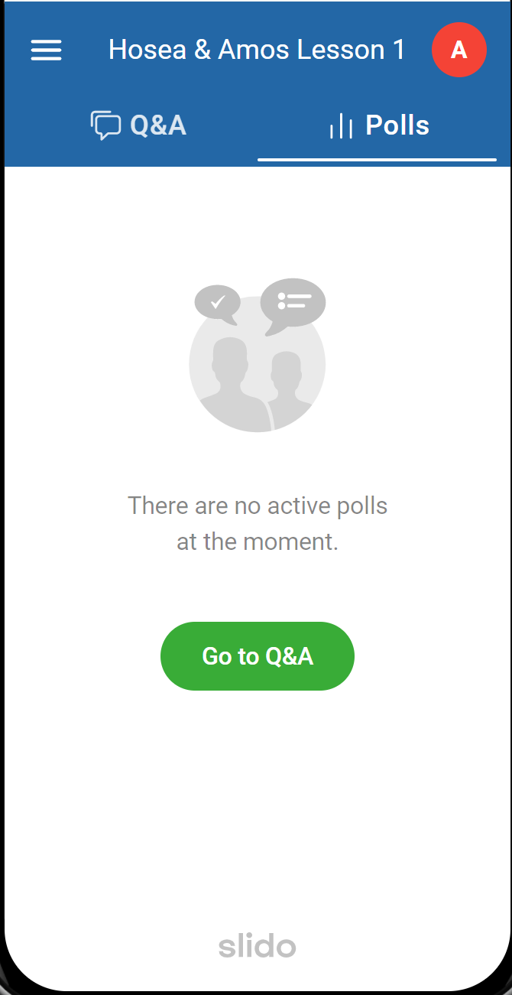
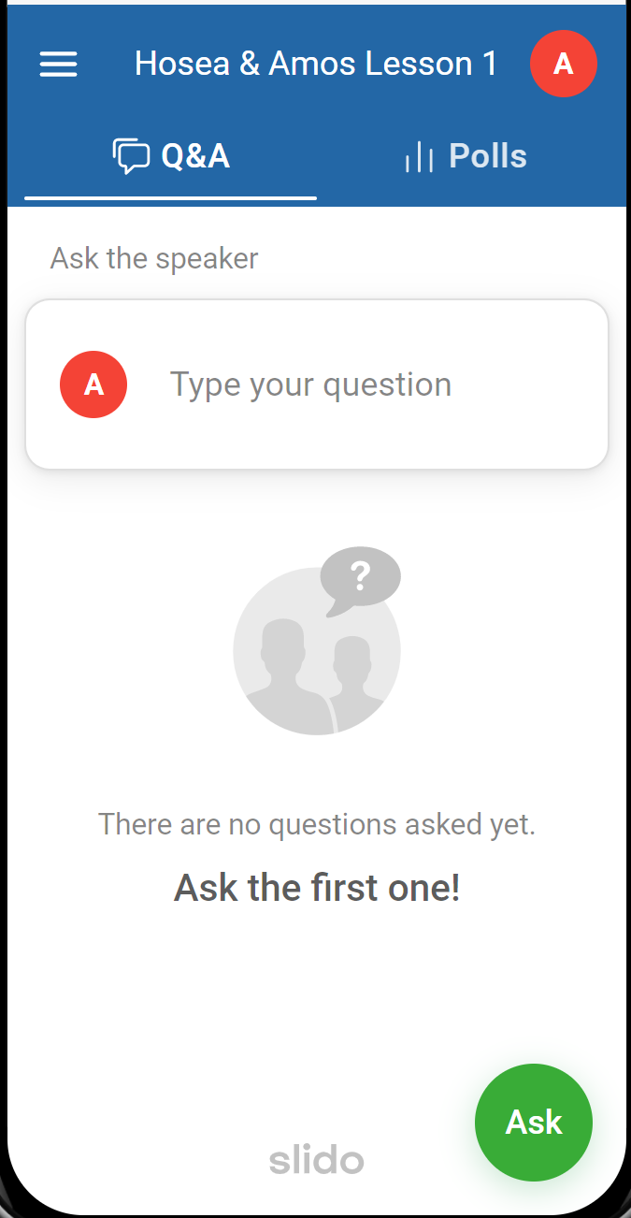
Polls Tab for answering questions
Q&A Tab for asking questions

Slide 4
What must you do to be a "prophet" in the Bible?
ⓘ Start presenting to display the poll results on this slide.

Slide 5
Hosea and Amos are known as "minor" prophets because:
ⓘ Start presenting to display the poll results on this slide.

Slide 6
Hosea & Amos in a Nutshell
Prophesied to Israel during reign of Jeroboam II
Life was prosperous and peaceful
But the people, outwardly religious, were wicked
“The Lord is going to destroy you … if you don’t repent”
[ They do not repent ]
[ Israel falls to Assyria ~30 years later ]

Slide 7
Timeline before Jeroboam II
Conquest 700 years
United Kingdom 300 years
Cult of Jeroboam I 170 years
Baal (Ahab & Jezebel) 90 years
Hosea & Amos

Slide 8
Best Fit for Amos 1:1-2
ⓘ Start presenting to display the poll results on this slide.

Slide 9
Best Fit for Amos 1:3-2:3
ⓘ Start presenting to display the poll results on this slide.

Slide 10
Judgment on Foreign Nations (1:3-2:3)
Concerning Damascus (1:3-5)
Concerning Philistia (1:6-8)
Concerning Tyre (1:9-10)
Concerning Edom (1:11-12)
Concerning Ammon (1:13-15)
Concerning Moab (2:1-3)

Slide 11
Best Fit for Amos 2:4-6:14
ⓘ Start presenting to display the poll results on this slide.

Slide 12
Judgment on God’s People (2:4-6:14)
Concerning Judah (2:4-5)
Concerning Israel (2:6-16)
Hear the Word Against Israel (3)
Hear the Word Against the Cows of Bashan (4)
Seek Me and Live (5)
Woe to Those at Ease in Zion (6)

Slide 13
Best Fit for Amos 7:1-9:15
ⓘ Start presenting to display the poll results on this slide.

Slide 14
The Visions of Amos (7:1-9:15)
Locusts (7:1-3)
Fire (7:4-6)
The Dreaded Plumbline (7:7-9)
Amos & Amaziah (7:10-17)
Basket of Ripe Fruit (8:1-14)
The Lord Judging (9:1-10)
Hope for the Future (9:11-15)

Slide 15
Amos: Major Sections
The Lord Roars from Zion (1:1-2)
Judgment on Foreign Nations (1:3-2:3)
Judgment on God’s People (2:4-6:14)
The Visions of Amos (7:1-9:15)

Slide 16
Think of one word to describe the preaching style of Amos
ⓘ Start presenting to display the poll results on this slide.

Slide 17
What dominant themes do you hear from Amos?
ⓘ Start presenting to display the poll results on this slide.

Slide 18
What other minor prophet worked during the time of Jeroboam II?
ⓘ Start presenting to display the poll results on this slide.

Slide 20
Audience Q&A Session
ⓘ Start presenting to display the audience questions on this slide.

