Slide 1
Hosea & Amos: Lesson 3
Please connect with your smartphone below to participate in our class activities

Slide 2
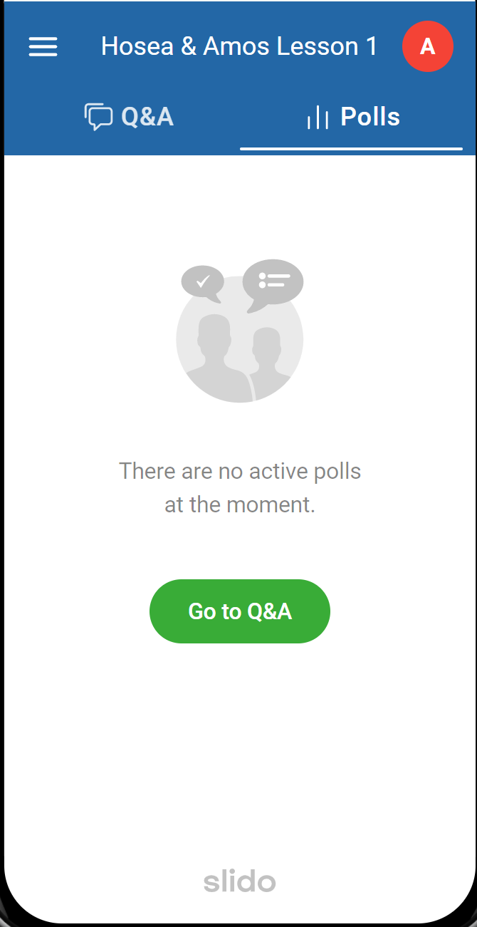
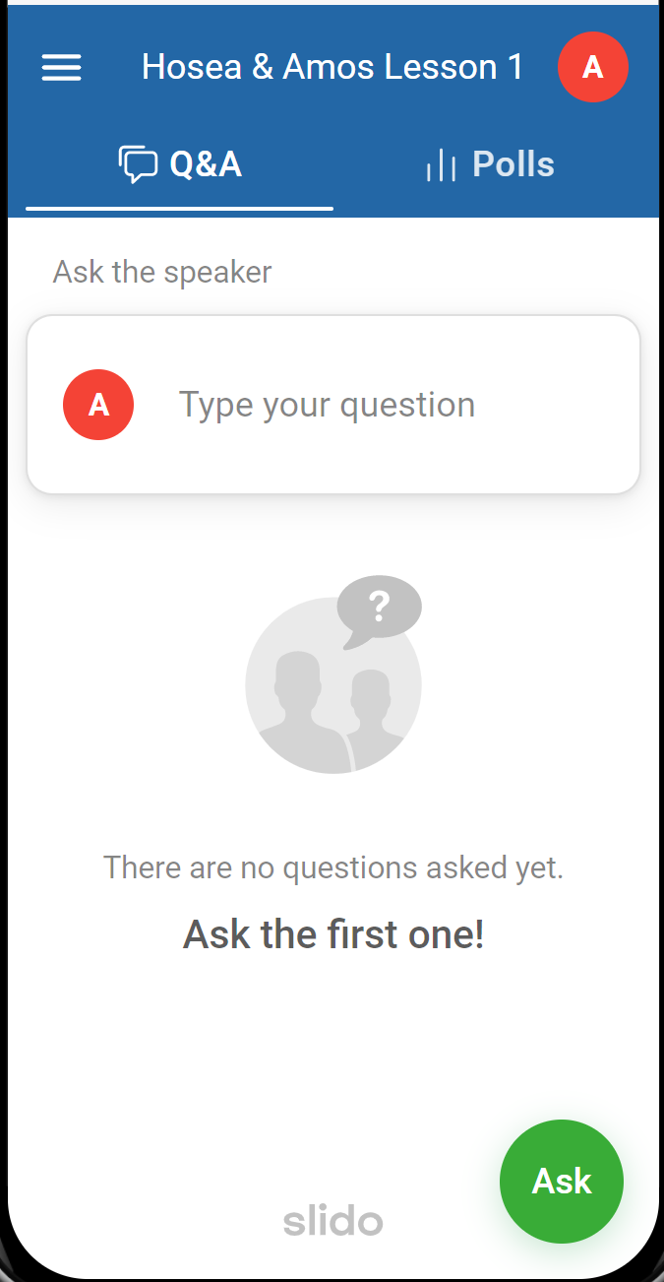
Polls Tab for answering questions
Q&A Tab for asking questions

Slide 3
Hosea & Amos prophesied primarily during the reign of which king of Israel?
ⓘ Start presenting to display the poll results on this slide.

Slide 4
What best describes the people of Israel during the time of Hosea & Amos?
ⓘ Start presenting to display the poll results on this slide.

Slide 5
What did Amos preach against most emphatically?
ⓘ Start presenting to display the poll results on this slide.

Slide 6
What message did Amos have for Israel?
ⓘ Start presenting to display the poll results on this slide.

Slide 7
Amos
Hosea
Location
Date
Occupation
Style
Message
Judah
Israel, we think
Uzziah
Uzziah to Hezekiah
[Farmer]
? (Priest?)
Blunt
Justice

Slide 8
Think of one word to describe the preaching style of Hosea.
ⓘ Start presenting to display the poll results on this slide.

Slide 9
What dominant themes do you hear from Hosea?
ⓘ Start presenting to display the poll results on this slide.

Slide 10
Amos
Hosea
Location
Date
Occupation
Style
Message
Judah
Israel, we think
Uzziah
Uzziah to Hezekiah
[Farmer]
? (Priest?)
Blunt
Pleading
Justice
Love

Slide 11
What are the best descriptions of the two major sections of Hosea (Chapters 1-3 and 4-14)?
ⓘ Start presenting to display the poll results on this slide.

Slide 12
The Prodigal Wife (1:1-3:5)
Her Unfaithfulness (1:1-11)
Her Punishment (2:1-13)
Her Restoration and Israel’s (2:14-23)
Her Redemption (3:1-5)

Slide 13
What are the best descriptions of the two sections of the second half of Hosea (Chapters 4-10 and 11-14)?
ⓘ Start presenting to display the poll results on this slide.

Slide 14
The Prodigal People (4-14) The Message of Judgment (4-10)
The indictment (4)
The verdict (5)
The plea of Israel (6:1-3)
The reply of the Lord (6:4-11)
The crimes of Israel (7)
The prophecy of judgment (8-10)

Slide 15
The Prodigal People (4-14) The Message of Restoration (11-14)
God’s love for the prodigal people (11:1-11)
God’s chastisement of the prodigal people (11:12-13:6)
God’s restoration of the prodigal people (14)

Slide 17
Which approach is more likely to cause you to repent from an entrenched sin you've been ignoring?
ⓘ Start presenting to display the poll results on this slide.

Slide 18
Which of these is a valid explanation for the names that Hosea sometimes uses?
ⓘ Start presenting to display the poll results on this slide.

Slide 20
Audience Q&A Session
ⓘ Start presenting to display the audience questions on this slide.

