Slide 2
Why Should I Believe in Jesus?

Slide 3
““Are you really the one we are waiting for, or shall we keep on looking?”
— Matthew 11:3

Slide 4
01
02
Matthew 11:4-6
03
04
The prophecies are true
I’m performing miracles
The dead are being raised
My good news is for the poor

Slide 5
Jesus Actually Existed
More manuscripts (~25,000) attest to his existence than any other ancient person.
The manuscript evidence for the teachings of Jesus and the apostles is 100% accurate.

Slide 6
Jesus Actually Existed
The written testimony in the NT about Jesus is based on multiple eyewitness testimony.
Fifteen contemporary, non-Christian writers attest to the existence of Jesus. (E.g., Tacitus, Josephus, Lucian, etc.)

Slide 7
TWO MORE REASONS TO BELIEVE

Slide 8
— Matthew 11:27
“All things have been handed over to me by my Father, and no one knows the Son except the Father, and no one knows the Father except the Son and anyone to whom the Son chooses to reveal him.”

Slide 9
01
His mind was powerful to know and reveal God.
“Jesus was the smartest person who ever lived.”
—Dallas Willard, The Divine Conspiracy

Slide 10
HE SPEAKS AS GOD
PAST
PRESENT
FUTURE
“Truly, truly, I say to you, before Abraham was, I am”
(Jn 8:58)
“Take heart, my son; your sins are forgiven.”
(Matt 9:2)
“The word that I have spoken will judge him on the last day.”
(Jn 12:48)

Slide 11
HE CLAIMS TO BE GOD
— John 14:9
“Any one who has seen me has seen the father”
“I and the Father are one.”
— John 10:30

Slide 12
— Matthew 11:28-29
“Come to me . . . for I am gentle and lowly in heart . . . “

Slide 13
02
His heart was humble to sacrifice for everyone else
“Jesus was
The Man for Others.”
— Dietrich Bonhoeffer, Letters and Papers from Prison

Slide 14
Jesus Came to Give his Life for Many
Come to me, All who labor and are heavy laden, and I will give you rest.”
— Matt 11:28
“. . . a friend of tax collectors and sinners!”
— Matt 11:19
(e.g., Luke 19:1-10; Mark 1:40-42)
“For my yoke is easy (‘kind’), and my burden is light.”
— Matt 11:30

Slide 15
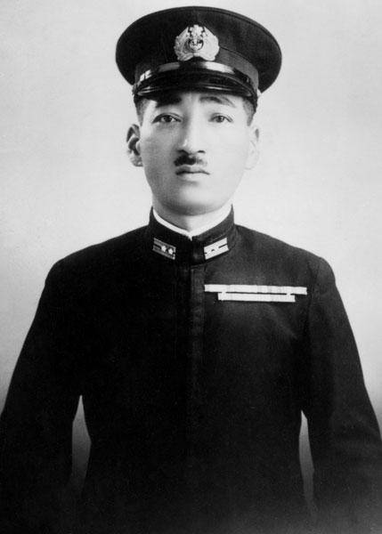
Mitsuo Fuchida
When the Japanese pilot read for the first time the story about Jesus crying out to his Father for forgiveness of those who were crucifying him, Fuchida believed that Jesus must be the Son of God because no human being could forgive his enemies like that. He spent the rest of his life telling others about the love of Jesus

Slide 16
Reflection
(From: Tom Gilson, Too Good to be False)

Slide 17
01
Napoleon,
Bill Gates,
Thanos,
Stalin,
Genghis Khan,
Superman,
Mark Zuckerberg,
etc.
WHO ARE THE MOST POWERFUL PEOPLE IN HISTORY AND LITERATURE?

Slide 18
02
Mother Theresa,
Martin Luther King, Jr, Mahatma Gandhi, Frodo,
Abraham,
Lincoln,
Mom
WHO ARE THE MOST SELF-SACRIFICAL PEOPLE IN HISTORY AND LITERATURE, (OUTSIDE THE BIBLE)?

Slide 19
03
Mother Theresa,
Martin Luther King, Jr, Mahatma Gandhi, Frodo,
Abraham,
Lincoln,
Mom
Napoleon,
Bill Gates,
Thanos,
Stalin,
Genghis Khan,
Superman,
Mark Zuckerberg,
What do you notice about these two lists?

Slide 20
Jesus is the only perfectly powerful and self-sacrificial person in all of history and literature
No one has ever written anything like the Gospels.

Slide 21
WHY SHOULD WE BELIEVE?
The Gospels are true accounts of the real life of the most extraordinary person ever.

Slide 22
Don’t dismiss Jesus, but trust in him and come to him to give you rest and to lead your life.

