Slide 1
Hosea & Amos: Lesson 4
Please connect with your smartphone below to participate in our class activities

Slide 2
When the LORD first spoke through Hosea, the LORD said to Hosea, “Go, take to yourself a wife of harlotry and have children of harlotry; for the land commits flagrant harlotry, forsaking the LORD.”
Hosea 1:2

Slide 3
What were the names of Gomer's children?
ⓘ Start presenting to display the poll results on this slide.

Slide 4
Which explanation of Gomer’s story best fits the application that Hosea makes of this marriage in his prophecy?
ⓘ Start presenting to display the poll results on this slide.

Slide 5
Would God really command his prophet to enter a life full of difficulty, just to illustrate a message?

Slide 6
Cult of Jeroboam
Cult of Baal
Origin
Object
Emphasis
Rituals
Jeroboam I
Canaanites
Golden Calves
Baals & Asherah
National Religion
Fertility, Weather
Sacrifices @ Dan & Bethel
Sacrifices
Temple Prostitutes

Slide 7
So he went and took Gomer the daughter of Diblaim, and she conceived and bore him a son. And the LORD said to him, “Name him Jezreel; for yet a little while, and I will punish the house of Jehu for the bloodshed of Jezreel, and I will put an end to the kingdom of the house of Israel. On that day I will break the bow of Israel in the valley of Jezreel.”
Hosea 1:3-5

Slide 8
"Jezreel" is
ⓘ Start presenting to display the poll results on this slide.

Slide 9
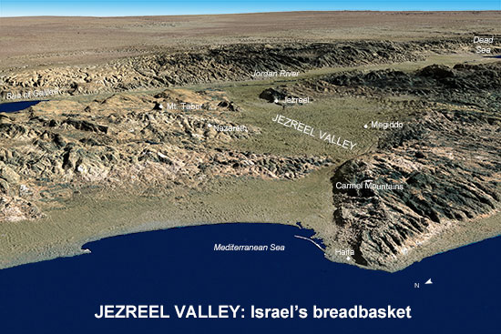

Slide 10
Jezreel
“God sows” or “God scatters”
The “breadbasket of Israel” – a very fertile valley
Ahab & Jezebel had a palace there
Naboth’s Vineyard: God’s judgment upon Ahab & Jezebel
Ahab’s blood, carried by his chariot, lapped up by dogs there
Jehu stormed Jezreel to kill Jezebel and the kings of Israel & Judah
From Jezreel, Jehu demanded the heads of Ahab’s 70 sons
Jehu later went to Samaria to massacre the worshippers of Baal

Slide 11
Gomer’s Children
Jezreel
Lo-ruhamah
Lo-ammi
“God scatters”
Scattering of Israel
“Unpitied”
No compassion
“Not my people”
Rejection of Israel

Slide 12
What words describing agricultural products do you find in Hosea 2? (see verses 5, 8-9, 12, 15, 22)
ⓘ Start presenting to display the poll results on this slide.

Slide 13
The agricultural imagery in Hosea 1-2 represents
ⓘ Start presenting to display the poll results on this slide.

Slide 14
The restoration of God's people in Hosea 1-2:
ⓘ Start presenting to display the poll results on this slide.

Slide 15
But you are A CHOSEN RACE, A royal PRIESTHOOD, A HOLY NATION, A PEOPLE FOR God's OWN POSSESSION, so that you may proclaim the excellencies of Him who has called you out of darkness into His marvelous light; for you once were NOT A PEOPLE, but now you are THE PEOPLE OF GOD; you had NOT RECEIVED MERCY, but now you have RECEIVED MERCY
1 peter 2:9-10

Slide 16
And He did so to make known the riches of His glory upon vessels of mercy, which He prepared beforehand for glory, even us, whom He also called, not from among Jews only, but also from among Gentiles. As He says also in Hosea, “I WILL CALL THOSE WHO WERE NOT MY PEOPLE, 'MY PEOPLE,' AND HER WHO WAS NOT BELOVED, 'BELOVED.'" "AND IT SHALL BE THAT IN THE PLACE WHERE IT WAS SAID TO THEM, 'YOU ARE NOT MY PEOPLE,' THERE THEY SHALL BE CALLED SONS OF THE LIVING GOD."
Romans 9:23-26

Slide 17
The name "Baali" means
ⓘ Start presenting to display the poll results on this slide.

Slide 18
Hosea and Gomer's marriage was restored when
ⓘ Start presenting to display the poll results on this slide.

Slide 20
Audience Q&A Session
ⓘ Start presenting to display the audience questions on this slide.

