Slide 1
Hosea & Amos: Lesson 6
Please connect with your smartphone below to participate in our class activities

Slide 2
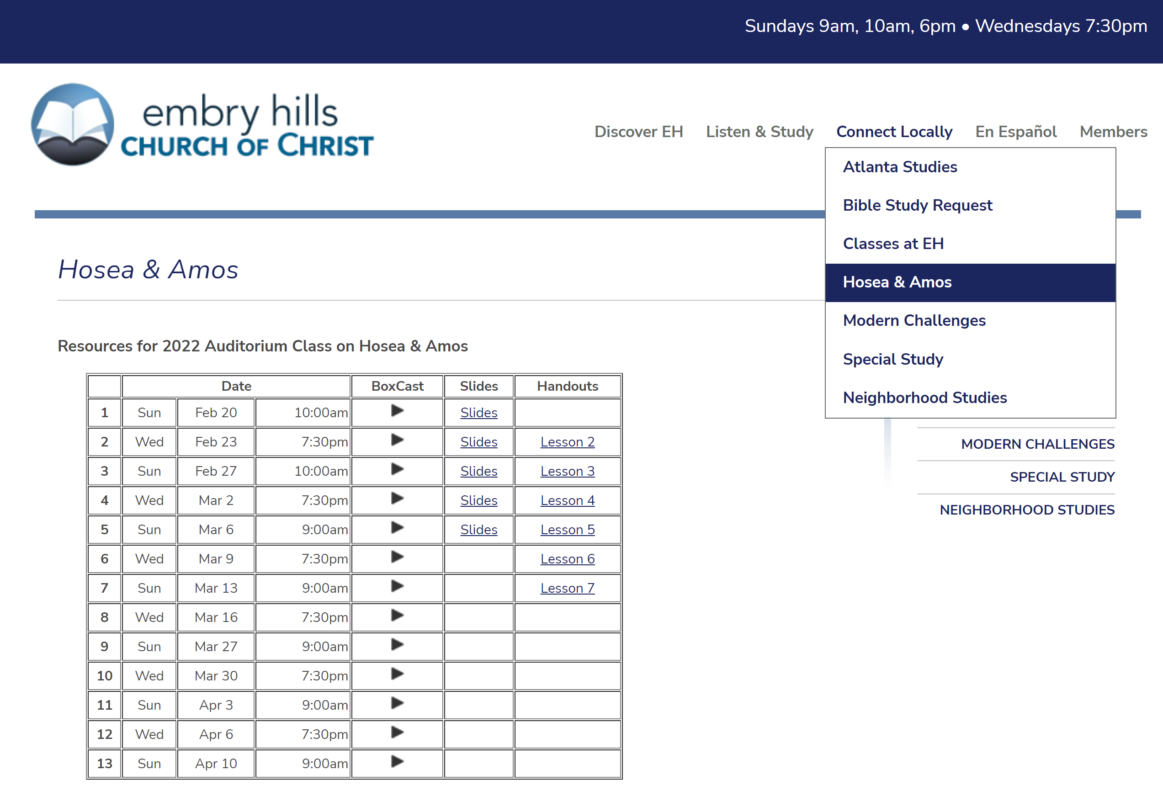

Slide 3
Which is NOT true about Hosea?
ⓘ Start presenting to display the poll results on this slide.

Slide 4
Which is NOT true about Amos?
ⓘ Start presenting to display the poll results on this slide.

Slide 5
What best describes the people of Israel during the time of Hosea & Amos?
ⓘ Start presenting to display the poll results on this slide.

Slide 6
Hosea 4

Slide 7
Hosea 4

Slide 8
According to Deuteronomy 17:8-12, anyone who disagrees with the instructions of a priest:
ⓘ Start presenting to display the poll results on this slide.

Slide 9
Hosea 4

Slide 10
Hosea 4

Slide 11
Hosea 4

Slide 12
In Amos 4, the "cows of Bashan" were
ⓘ Start presenting to display the poll results on this slide.

Slide 13
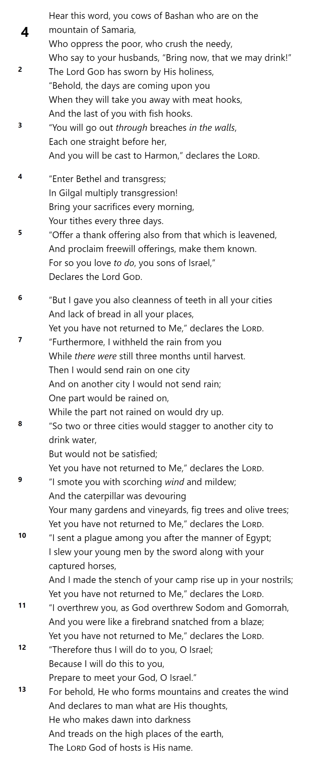
Amos 4

Slide 14
Amos 4

Slide 15
FAMINE
DROUGHT
Amos 4

Slide 16
FAMINE
DROUGHT
PESTILIENCE
PLAGUE
Amos 4

Slide 17
FAMINE
DROUGHT
PESTILIENCE
PLAGUE
UPHEAVAL
Amos 4

Slide 18
FAMINE
DROUGHT
PESTILIENCE
PLAGUE
UPHEAVAL

Slide 19
Amos 4

Slide 20
When we encounter turmoil in our lives:
ⓘ Start presenting to display the poll results on this slide.

Slide 21
Hosea 4

Slide 22
Hosea 4

Slide 23
In Chapter 4, Hosea compares Israel to
ⓘ Start presenting to display the poll results on this slide.

