Slide 1
Hosea & Amos: Lesson 7
Please connect with your smartphone below to participate in our class activities

Slide 2
Hosea explains that destruction was coming to Israel because
ⓘ Start presenting to display the poll results on this slide.

Slide 3
Amos reminds Israel that God had warned them in the past by:
ⓘ Start presenting to display the poll results on this slide.

Slide 4
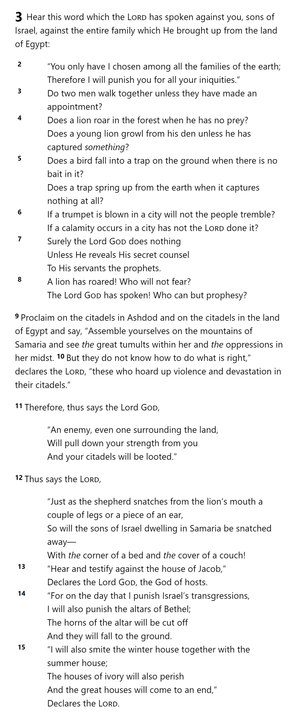
From everyone who has been given much, much will be required; and to whom they entrusted much, of him they will ask all the more – Luke 12:48
What has God entrusted to us that requires more of us?
Amos 3

Slide 5
Amos 3

Slide 6
Why do we sometimes fail to heed God's warnings?
ⓘ Start presenting to display the poll results on this slide.

Slide 7
Amos 3

Slide 8
Amos 3

Slide 9
Amos 3

Slide 11
Amos 3

Slide 12
What symbol does Amos use to represent the strength of a nation?
ⓘ Start presenting to display the poll results on this slide.

Slide 13
At the start of Chapter 5, Hosea declares judgment on
ⓘ Start presenting to display the poll results on this slide.

Slide 14
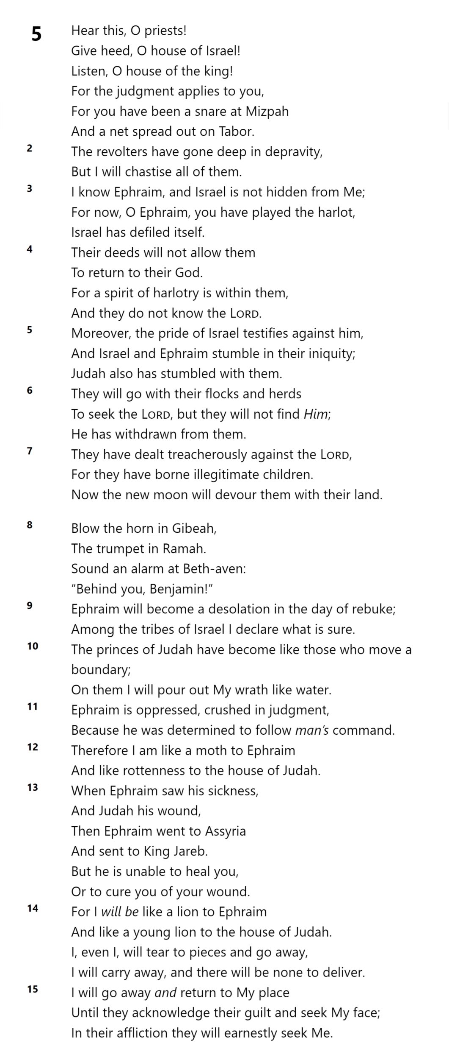
Hosea 5

Slide 15
Hosea 5

Slide 16
Gibeah and Ramah were:
ⓘ Start presenting to display the poll results on this slide.

Slide 17
Hosea 5

Slide 18
Hosea 5

Slide 19
Hosea 5

Slide 20
2 Kings 17

Slide 21
2 Kings 17

Slide 22
Which prophet specifically names Assyria as the instrument of God's judgment on Israel?
ⓘ Start presenting to display the poll results on this slide.

Slide 23
