Slide 1
Hosea & Amos: Lesson 8
Please connect with your smartphone below to participate in our class activities

Slide 2
In Hosea 5, what nation did Israel turn to for help with their troubles?
ⓘ Start presenting to display the poll results on this slide.

Slide 3
How do Hosea and Amos use the image of a lion to represent God's treatment of Israel?
ⓘ Start presenting to display the poll results on this slide.

Slide 4
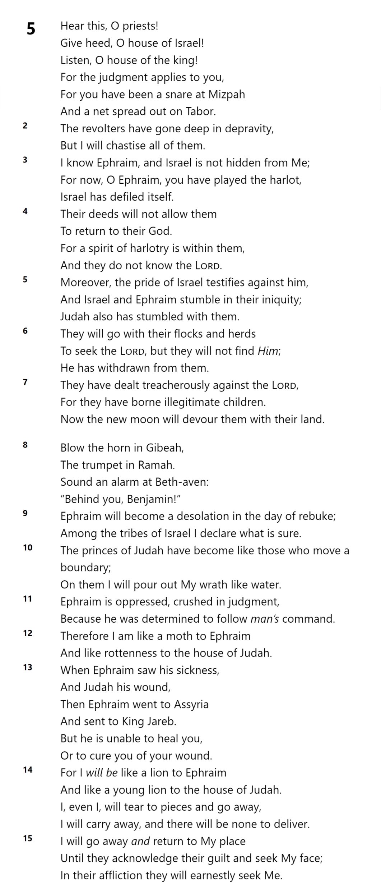
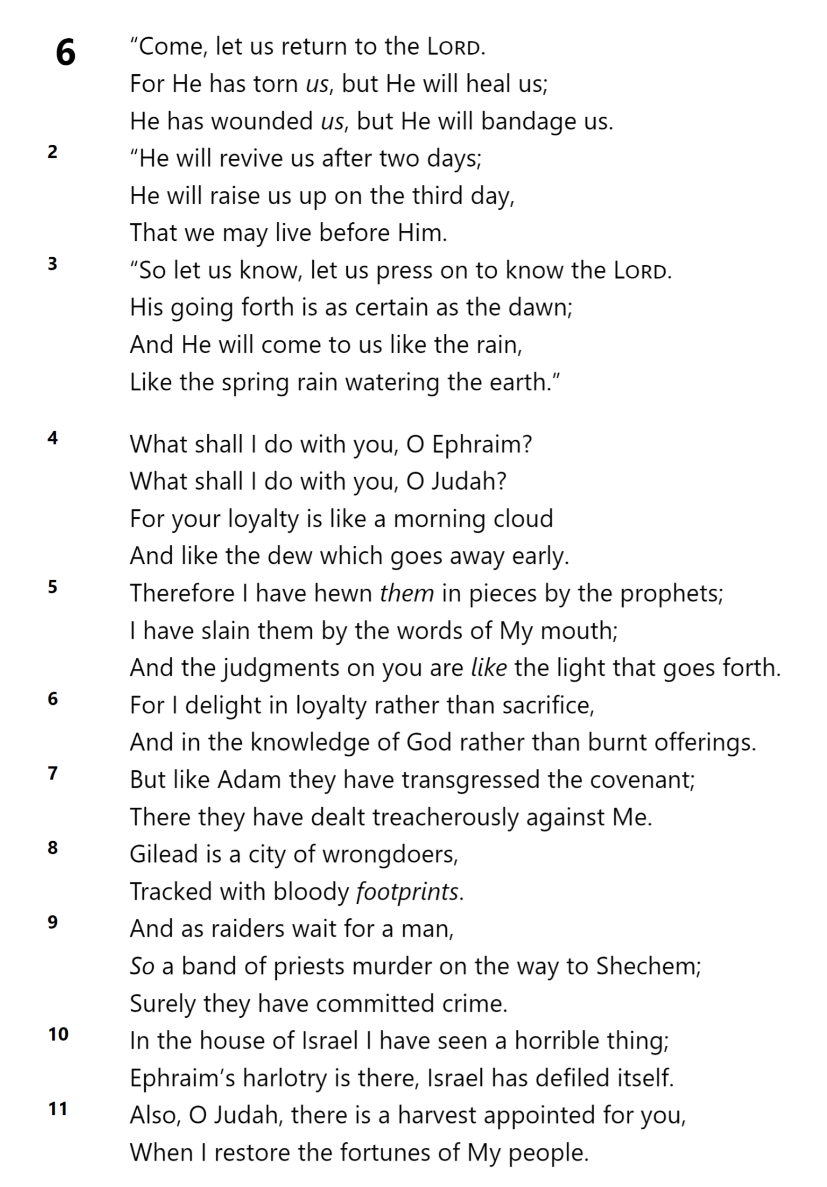
Hosea?
Israel in response to Hosea?
Israel during Assyrian captivity?
Who is speaking in these verses?
HOSEA 6

Slide 5
Past (or current) trouble facing Israel
Future judgment coming to Israel
Future contrition after judgment?
HOSEA 6

Slide 6
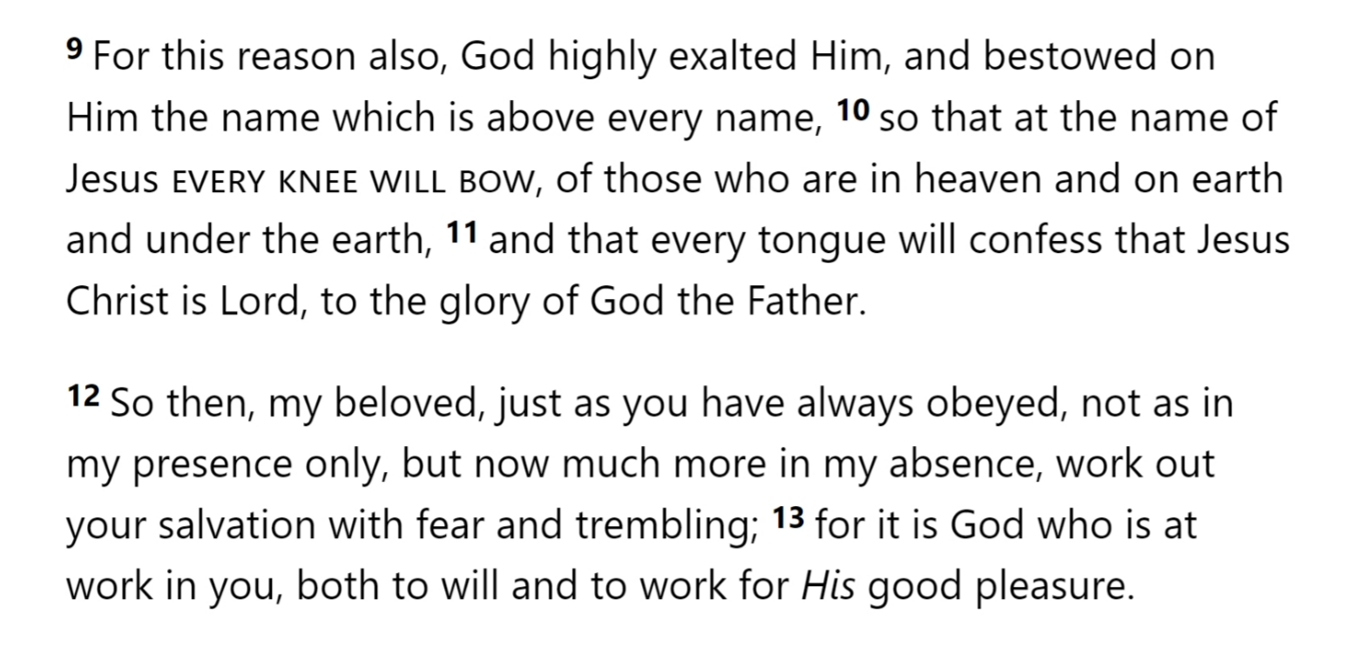
, saying,
They will go with their flocks and herds To seek the Lord, but they will not find Him; He has withdrawn from them. (5:6)
On them I will pour out My wrath like water. (5:10)
HOSEA 6

Slide 7
HOSEA 6
Philippians 2

Slide 8
HOSEA 6
Philippians 2

Slide 9
HOSEA 6

Slide 10
Saul & the Amalekites
(I Samuel 15)
Has the Lord as much delight in burnt offerings and sacrifices As in obeying the voice of the Lord? Behold, to obey is better than sacrifice, And to heed than the fat of rams.
Time of Judgment
Weak Leadership
Desire for Profit
“Who Me?” Disobedience
“God Wants Sacrifices”
Incomplete Confession
HOSEA 6

Slide 11
What became of Agag, king of the Amalekites?
ⓘ Start presenting to display the poll results on this slide.

Slide 12
Saul & the Amalekites
(I Samuel 15)
But Samuel said, “As your sword has made women childless, so shall your mother be childless among women.” And Samuel hewed Agag to pieces before the Lord at Gilgal.
Has the Lord as much delight in burnt offerings and sacrifices As in obeying the voice of the Lord? Behold, to obey is better than sacrifice, And to heed than the fat of rams.
Time of Judgment
Weak Leadership
Desire for Profit
“Who Me?” Disobedience
“God Wants Sacrifices”
Incomplete Confession
Hewing Prophets
HOSEA 6

Slide 13
In one word, what do we sometimes rely on as a substitute for loyalty to God?
ⓘ Start presenting to display the poll results on this slide.

Slide 14
Saul & the Amalekites
(I Samuel 15)
But Samuel said, “As your sword has made women childless, so shall your mother be childless among women.” And Samuel hewed Agag to pieces before the Lord at Gilgal.
Has the Lord as much delight in burnt offerings and sacrifices As in obeying the voice of the Lord? Behold, to obey is better than sacrifice, And to heed than the fat of rams.
Time of Judgment
Weak Leadership
Desire for Profit
“Who Me?” Disobedience
“God Wants Sacrifices”
Incomplete Confession
Hewing Prophets
HOSEA 6

Slide 15
HOSEA 6

Slide 16
Amos describes his opening of Chapter 5 as
ⓘ Start presenting to display the poll results on this slide.

Slide 17
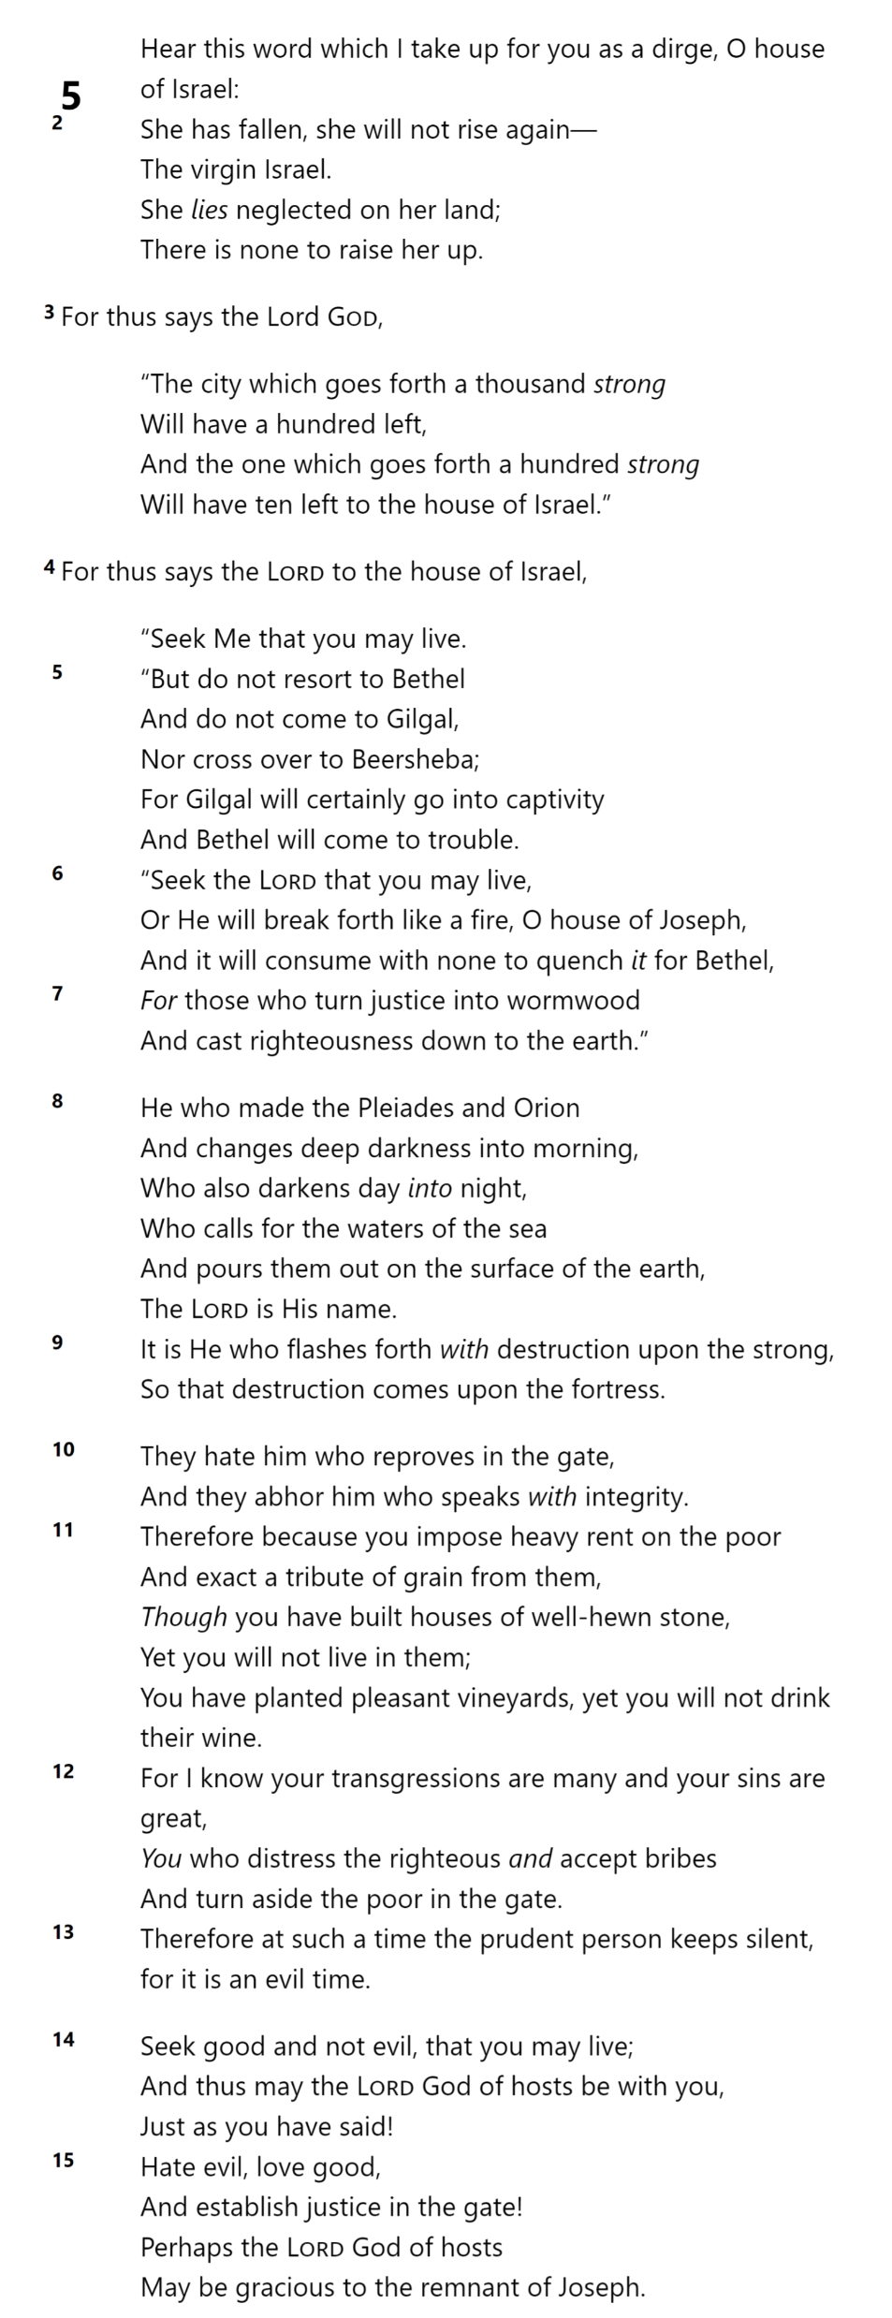
AMOS 5

Slide 18
AMOS 5

Slide 19
AMOS 5

Slide 20
AMOS 5

Slide 21
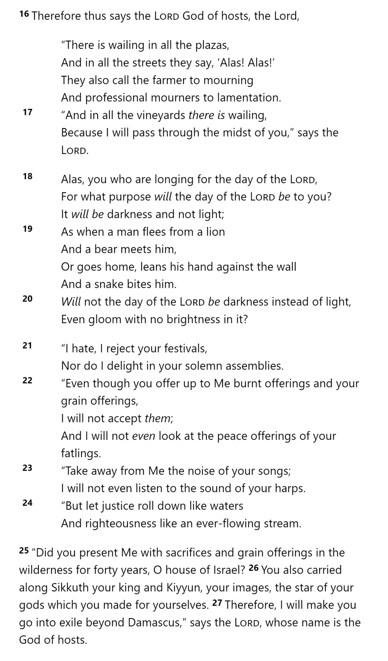
AMOS 5

Slide 22
AMOS 5

Slide 23
AMOS 5

Slide 24
For those who turn justice into wormwood And cast righteousness down to the earth.
AMOS 5

Slide 25
⁴² But God turned away and delivered them up to serve the host of heaven; as it is written in the book of the prophets, ‘It was not to Me that you offered victims and sacrifices forty years in the wilderness, was it, O house of Israel? ⁴³ You also took along the tabernacle of Moloch and the star of the god Rompha, the images which you made to worship. I also will remove you beyond Babylon.’ (Acts 7)
AMOS 5

Slide 26
For Amos, the gate of the city represented
ⓘ Start presenting to display the poll results on this slide.

Slide 27
