Slide 1
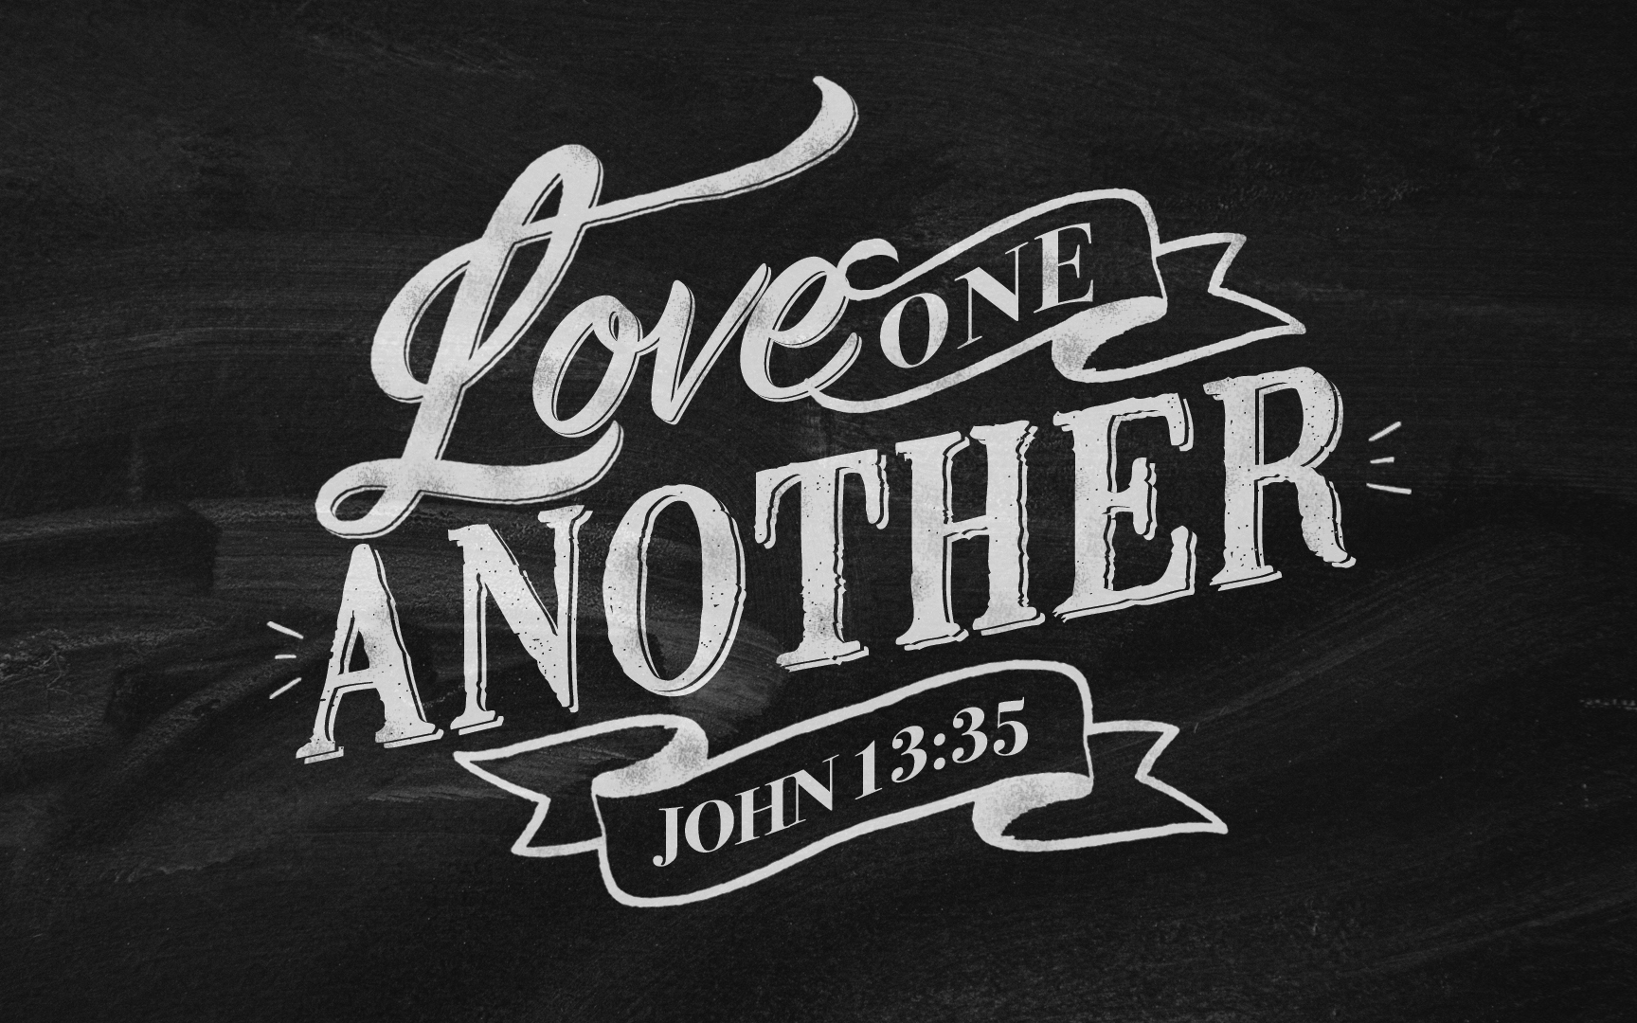

Slide 2
Confer with One Another
Acts 4:15

Slide 3
The Participants, The Topics, The Results
Unbelievers
Believers (verses 23-31)
Who:
Elders, Scribes, Priests
The Challenge:
To stop the spread of faith in Jesus.
The Result:
An injunction forbidding gospel preaching.
Who:
Their companions
The Challenge:
The Injunction
The Result:
Prayer (vs. 24)
Bible quoting (vs. 23)
Bold preaching (vs. 32)
The results were totally different!

Slide 4
All of us “Confer”
With Unbelievers
With Believers
In the office
In school
At dinner
At games
With neighbors
On telephone
On facebook
TV
In worship
In classes
After morning worship
After evening worship
After Wednesday classes

Slide 5
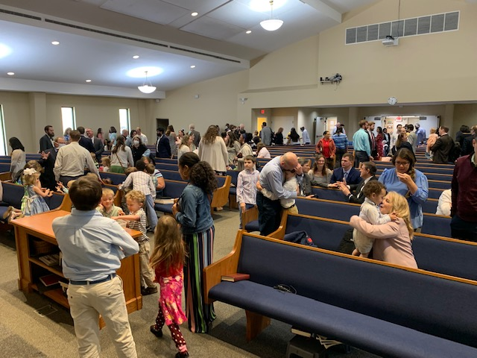
Conferring with One Another

Slide 6
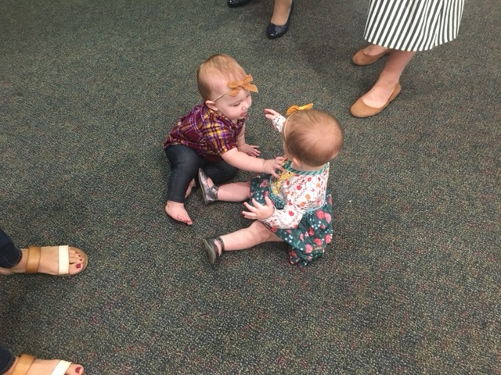

Slide 7
All of us “Confer”
With Unbelievers
With Believers
Difference
In the office
In school
At dinner
At games
With neighbors
On telephone
On facebook
TV
In worship
In classes
After morning worship
After evening worship
After Wednesday classes
In group meetings
On phone, internet
Visiting in our homes

Slide 8
A Christian’s Communication
“Therefore, putting away lying, “Let each one of you speak truth with his neighbor,” for we are members of one another.
“Let no corrupt word proceed out of your mouth, but what is good for necessary edification that it may impart grace to the hearers” (Ephesians 4:29) .
“A good man out of the good treasure of his heart brings forth good; and an evil man out of the evil ^{[i]}treasure of his heart brings forth evil. For out of the abundance of the heart his mouth speaks” (Luke 6:45).

Slide 9
All of us “Confer”
With Unbelievers
With Believers
Difference
In the office
In school
At dinner
At games
With neighbors
On telephone
On facebook
TV
God’s Name
Marriage
Rearing children
Offenses
Evolution
LGBTQ
Finances
Religion
After Death
In worship
In classes
After morning worship
After evening worship
In group meetings
After Wednesday classes
On phone, internet
Visiting in our homes

Slide 10
If you are a Christian, you believe that:
“The fear of the Lord is the beginning of wisdom, and knowledge of the Holy One is understanding” (Prov. 9:10).
“If you abide in My word, you are My disciples indeed. And you shall know the truth, and the truth shall make you free” (John 8:31-32).
“The wisdom of this world is foolishness with God” (1 Corinthians 3:19).
Who will share God’s Wisdom with you?

Slide 11
Early Church drew strength from togetherness!
Weekly Gathering for “Breaking of Bread”
Social (Acts 2:44-47)
Special Gatherings Reported in Acts
Following Persecution
Discipline
Burying Stephen
Grief over Dorcas
Joy over her revival
Membership Question
Examining preacher for preaching to Gentiles
Special teaching
Paul’s conferring with:
Sending out preachers
Receiving reports from preachers
Conferring to determine Truth
Assemblies to hear truth
To say “farewell.”
Ephesian elders
Saints in Tyre
Saints in Caesarea
Elders in Jerusalem
Luke & Aristarchus
Saints in Puteoli
Brethren from Rome
In “hired house.”
Would you have been there?

Slide 12
Such assemblies continued to be encouraged!
The Didache (Late 1st century) urged “ye shall gather yourselves together frequently, seeking what is fitting for your souls” (4:3; 16:4)
Ignatius (about 140 AD) said, “Do your diligence therefore to meet together more frequently for thanksgiving to God and for His glory. For when ye meet together frequently, the powers of Satan are cast down; and his mischief cometh to nought in the concord of your faith” (“To the Ephesians”)
Hippolytus (A.D. 170-236) urged saints preparing for work each day to first consider whether there may be an assembly for Bible instruction and prayer on that day.

Slide 13
God is pleased when we confer together! Malachi 3:16-18
Then those who feared the Lord spoke to one another, And the Lord listened and heard them;
So a book of remembrance was written before Him For those who fear the Lord And who meditate on His name.
¹⁷ “They shall be Mine,” says the Lord of hosts, “On the day that I make them My jewels (my own possession)
And I will spare them As a man spares his own son who serves him.”
¹⁸ Then you shall again discern Between the righteous and the wicked, Between one who serves God And one who does not serve Him.

