Slide 1
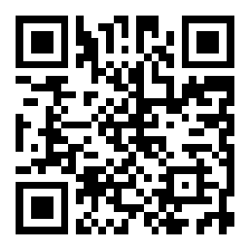
Hosea & Amos: Lesson 12
Please connect with your smartphone below to participate in our class activities

Slide 2
The sins of Israel during the time of Hosea & Amos
ⓘ Start presenting to display the poll results on this slide.

Slide 3
In Amos 4, which of these did God inflict on Israel to nudge them to repent?
ⓘ Start presenting to display the poll results on this slide.

Slide 4
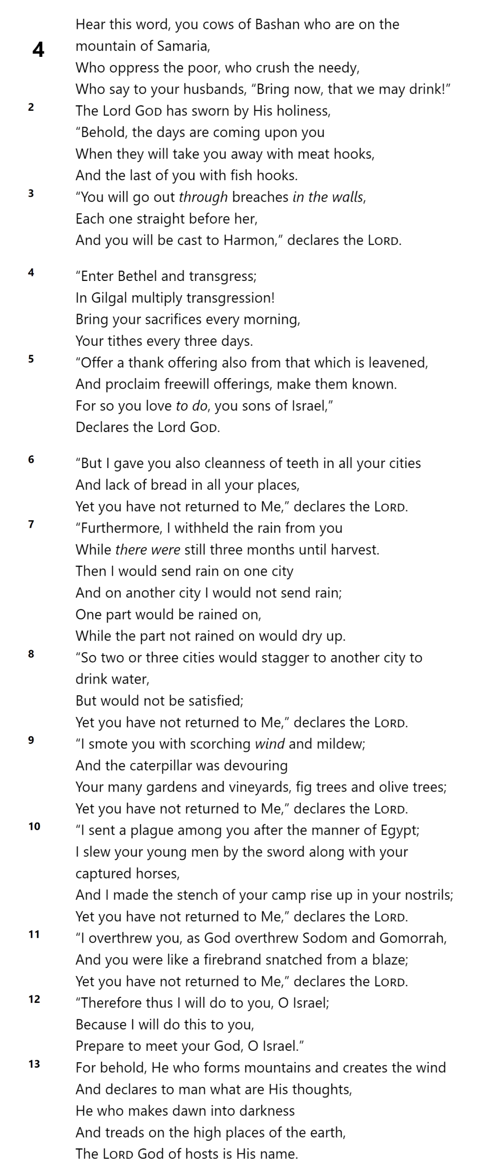
FAMINE
DROUGHT
PESTILIENCE
PLAGUE
UPHEAVAL
Amos 4

Slide 5
Amos 4

Slide 6
The Visions of Amos (7:1-9:15)
Locusts (7:1-3)
Fire (7:4-6)
The Dreaded Plumbline (7:7-9)
Amos & Amaziah (7:10-17)
Basket of Ripe Fruit (8:1-14)
The Lord Judging (9:1-10)
Hope for the Future (9:11-15)

Slide 7
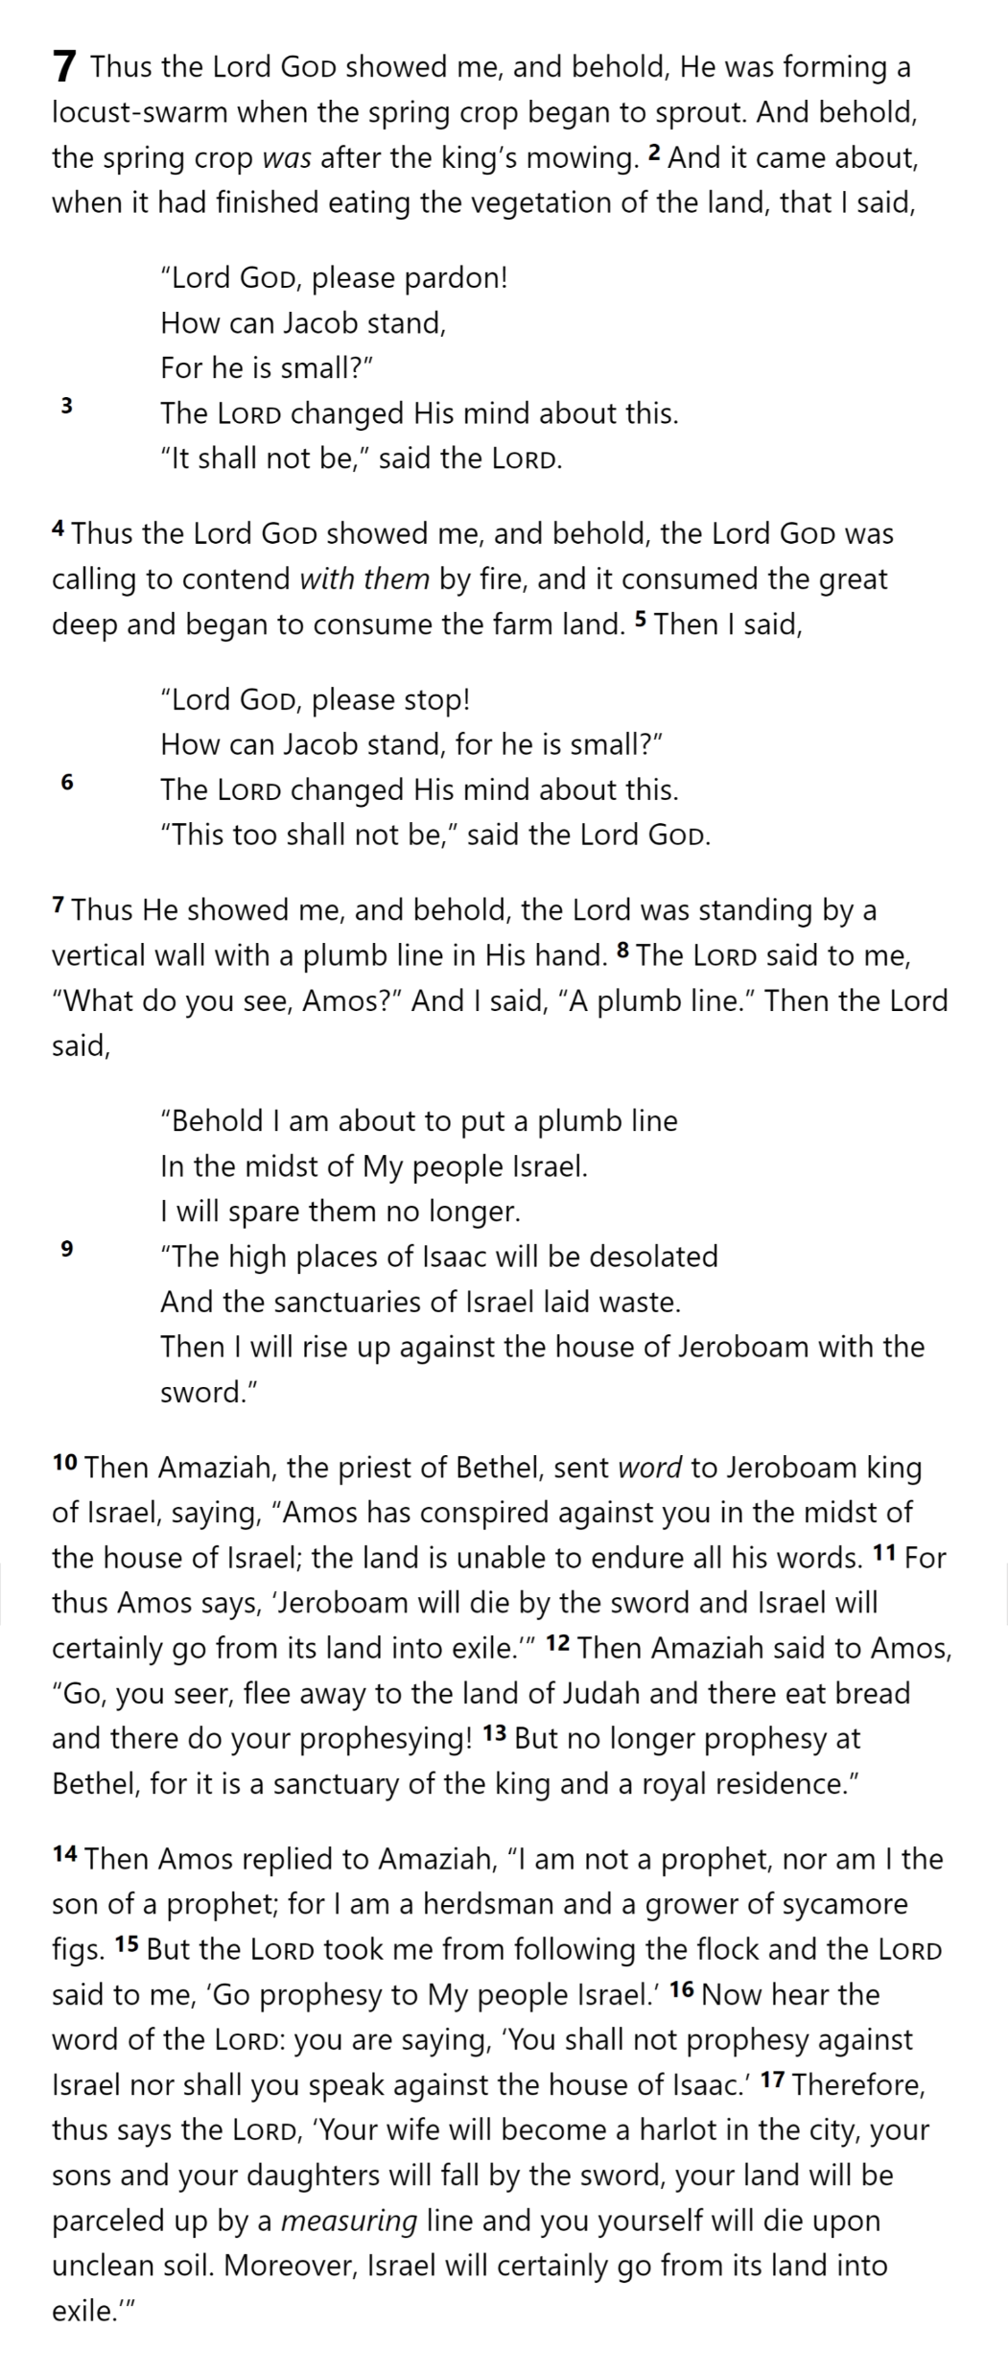
1
AMOS 7

Slide 8
G1: From Amos 7:1-3, we learn that:
ⓘ Start presenting to display the poll results on this slide.

Slide 9
God is longsuffering and merciful
AMOS 7

Slide 10
2
AMOS 7

Slide 11
G2: From Amos 7:1-6, we learn that:
ⓘ Start presenting to display the poll results on this slide.

Slide 12
God responds to the prayers of the righteous
AMOS 7

Slide 13
3
AMOS 7

Slide 14
G3: From Amos 7:7-9, we learn that:
ⓘ Start presenting to display the poll results on this slide.

Slide 15
God demands adherence to His standards
AMOS 7

Slide 16
AMOS 7

Slide 17
What human loyalties might prevent us from accepting the truth of God's word?
ⓘ Start presenting to display the poll results on this slide.

Slide 18
AMOS 7

Slide 19
4
AMOS 7

Slide 20
G4: From Amos 7:14-15, we learn that:
ⓘ Start presenting to display the poll results on this slide.

Slide 21
God sends truth through unlikely messengers
AMOS 7

Slide 22
5
AMOS 7

Slide 23
G5: From Amos 7:16-17, we learn that:
ⓘ Start presenting to display the poll results on this slide.

Slide 24
God judges harshly those who defy His message
AMOS 7

Slide 25
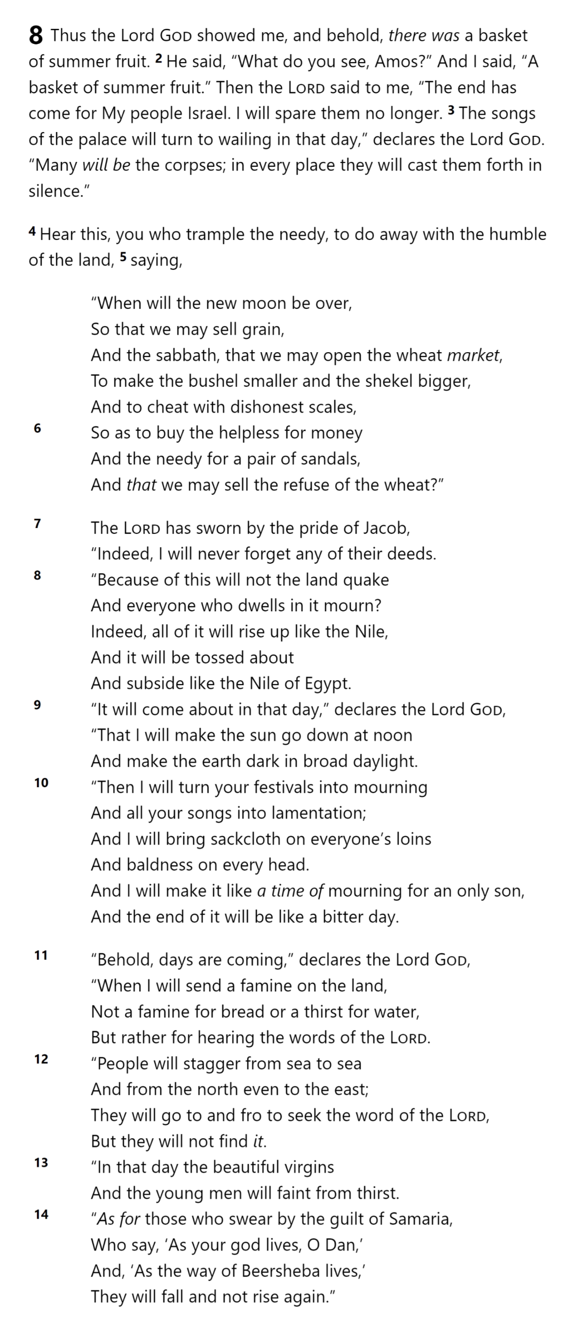
6
AMOS 8

Slide 26
G6: From Amos 8:1-3
ⓘ Start presenting to display the poll results on this slide.

Slide 27
God decides when His patience will end
AMOS 8

Slide 28
7
AMOS 8

Slide 29
G7: From Amos 8:4-7, we learn that:
ⓘ Start presenting to display the poll results on this slide.

Slide 30
God knows all our deeds, even the hidden ones
AMOS 8

Slide 31
8
AMOS 8

Slide 32
G8: From Amos 8:8-10, we learn that:
ⓘ Start presenting to display the poll results on this slide.

Slide 33
God brings judgment suddenly and dramatically
AMOS 8

Slide 34
AMOS 8

Slide 35
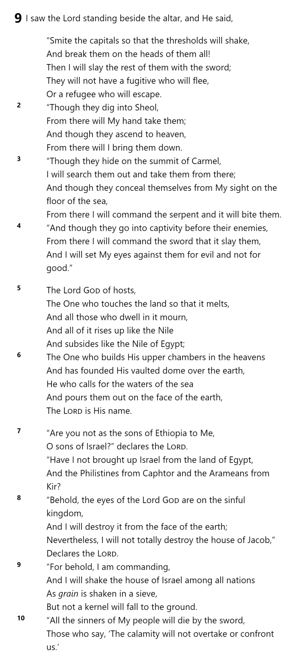
AMOS 9

Slide 36
9
AMOS 9

Slide 37
G9: From Amos 9:2-4, we learn that:
ⓘ Start presenting to display the poll results on this slide.

Slide 38
God exists in every place
AMOS 9

Slide 39
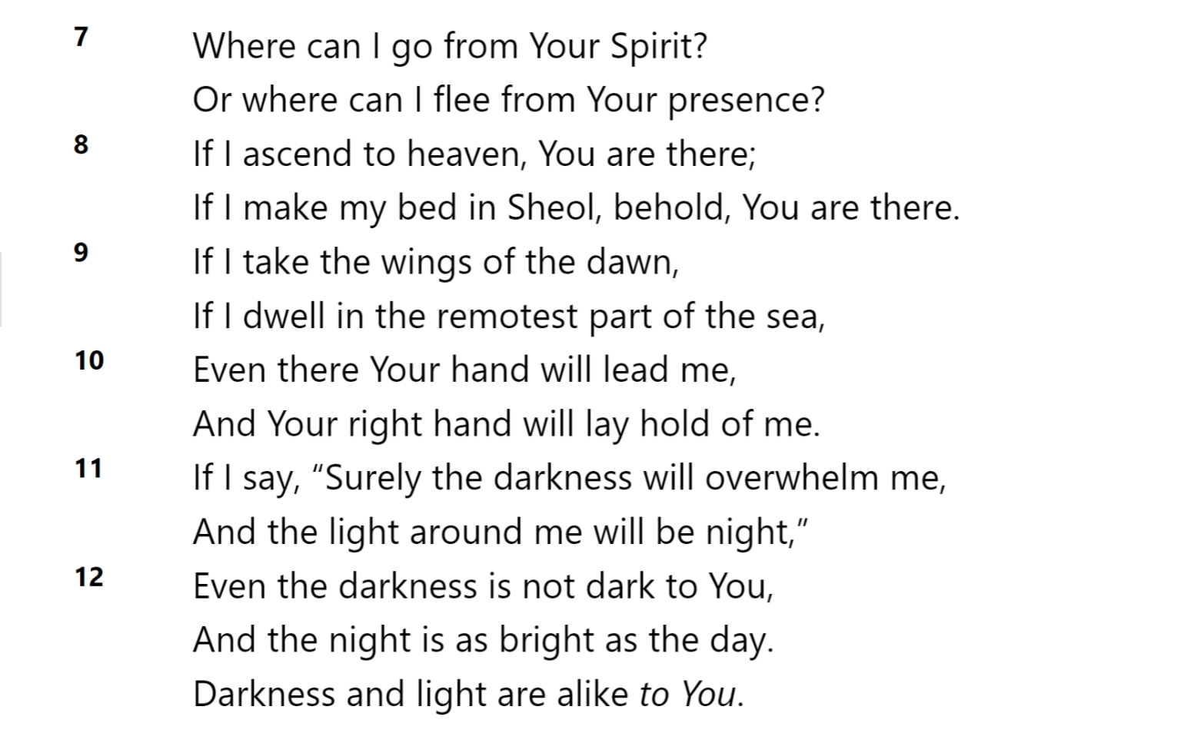
Psalm 139
Terrifying
Comforting
God exists in every place
AMOS 9

Slide 40
10
AMOS 9

Slide 41
G10: From Amos 9:5-6, we learn that
ⓘ Start presenting to display the poll results on this slide.

Slide 42
God wields unlimited power to judge
AMOS 9

Slide 43
11
AMOS 9

Slide 44
G11: From Amos 9:7-8a, we learn that:
ⓘ Start presenting to display the poll results on this slide.

Slide 45
God is sovereign over all the nations
AMOS 9

Slide 46
12
AMOS 9

Slide 47
G12: From Amos 9:8b-10, we learn that:
ⓘ Start presenting to display the poll results on this slide.

Slide 48
God protects His people, even during judgment
AMOS 9

Slide 49
The Visions of Amos
God is longsuffering and merciful
God responds to the prayers of the righteous
God demands adherence to His standards
God sends truth through unlikely messengers
God judges harshly those who defy His message
God decides when His patience will end
God knows all our deeds, even the hidden ones
God brings judgment suddenly and dramatically
God exists in every place
God wields unlimited power to judge
God is sovereign over all the nations
God protects His people, even during judgment

Slide 50
From what place had God brought the Philistines to their land?
ⓘ Start presenting to display the poll results on this slide.

Slide 51
