Slide 1
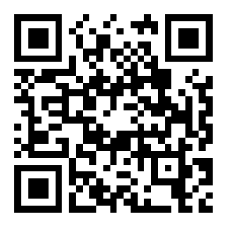
Hosea & Amos: Lesson 13
Please connect with your smartphone below to participate in our class activities

Slide 2
Amos concludes his book of prophecy with
ⓘ Start presenting to display the poll results on this slide.

Slide 3
Which of these represents the sequence of visions in Amos 7-8?
ⓘ Start presenting to display the poll results on this slide.

Slide 4
The Visions of Amos (7:1-9:15)
Locusts (7:1-3)
Fire (7:4-6)
The Dreaded Plumbline (7:7-9)
Amos & Amaziah (7:10-17)
Basket of Ripe Fruit (8:1-14)
The Lord Judging (9:1-10)
Hope for the Future (9:11-15)

Slide 5
What we Learn About God in the Visions
God is longsuffering and merciful
1
2
3
4
5
6
7
9
8
10
11
12

Slide 6
God responds to the prayers of the righteous
God is longsuffering and merciful
2
3
4
2
3
4
5
6
7
9
5
6
7
9
8
10
11
12
8
10
11
12

Slide 7
God demands adherence to His standards
God is longsuffering and merciful
God responds to the prayers of the righteous
3
4
3
4
5
6
7
9
5
6
7
9
8
10
11
12
8
10
11
12

Slide 8
God sends truth through unlikely messengers
God is longsuffering and merciful
God responds to the prayers of the righteous
God demands adherence to His standards
4
5
6
7
9
5
6
7
9
8
10
11
12
8
10
11
12

Slide 9
God judges harshly those who defy His message
God is longsuffering and merciful
God responds to the prayers of the righteous
God demands adherence to His standards
God sends truth through unlikely messengers
5
6
7
9
5
6
7
9
8
10
11
12
8
10
11
12

Slide 10
God decides when His patience will end
God is longsuffering and merciful
God responds to the prayers of the righteous
God demands adherence to His standards
God sends truth through unlikely messengers
God judges harshly those who defy His message
6
7
9
6
7
9
8
10
11
12
8
10
11
12

Slide 11
God knows all our deeds, even the hidden ones
God is longsuffering and merciful
God responds to the prayers of the righteous
God demands adherence to His standards
God sends truth through unlikely messengers
God judges harshly those who defy His message
God decides when His patience will end
7
9
7
9
8
10
11
12
8
10
11
12

Slide 12
God brings judgment suddenly and dramatically
God is longsuffering and merciful
God responds to the prayers of the righteous
God demands adherence to His standards
God sends truth through unlikely messengers
God judges harshly those who defy His message
God decides when His patience will end
God knows all our deeds, even the hidden ones
9
8
10
11
12
8
10
11
12

Slide 13
God exists in every place
God is longsuffering and merciful
God responds to the prayers of the righteous
God demands adherence to His standards
God sends truth through unlikely messengers
God judges harshly those who defy His message
God decides when His patience will end
God knows all our deeds, even the hidden ones
9
God brings judgment suddenly and dramatically
10
11
12
10
11
12

Slide 14
God wields unlimited power to judge
God is longsuffering and merciful
God responds to the prayers of the righteous
God demands adherence to His standards
God sends truth through unlikely messengers
God judges harshly those who defy His message
God decides when His patience will end
God knows all our deeds, even the hidden ones
God exists in every place
God brings judgment suddenly and dramatically
10
11
12
10
11
12

Slide 15
God is sovereign over all the nations
God is longsuffering and merciful
God responds to the prayers of the righteous
God demands adherence to His standards
God sends truth through unlikely messengers
God judges harshly those who defy His message
God decides when His patience will end
God knows all our deeds, even the hidden ones
God exists in every place
God brings judgment suddenly and dramatically
God wields unlimited power to judge
11
12
11
12

Slide 16
God protects His people, even during judgment
God is longsuffering and merciful
God responds to the prayers of the righteous
God demands adherence to His standards
God sends truth through unlikely messengers
God judges harshly those who defy His message
God decides when His patience will end
God knows all our deeds, even the hidden ones
God exists in every place
God brings judgment suddenly and dramatically
God wields unlimited power to judge
God is sovereign over all the nations
12
12

Slide 17
The Visions of Amos (7-9)
God is longsuffering and merciful
God responds to the prayers of the righteous
God demands adherence to His standards
God sends truth through unlikely messengers
God judges harshly those who defy His message
God decides when His patience will end
God knows all our deeds, even the hidden ones
God exists in every place
God brings judgment suddenly and dramatically
God wields unlimited power to judge
God is sovereign over all the nations
God protects His people, even during judgment

Slide 18
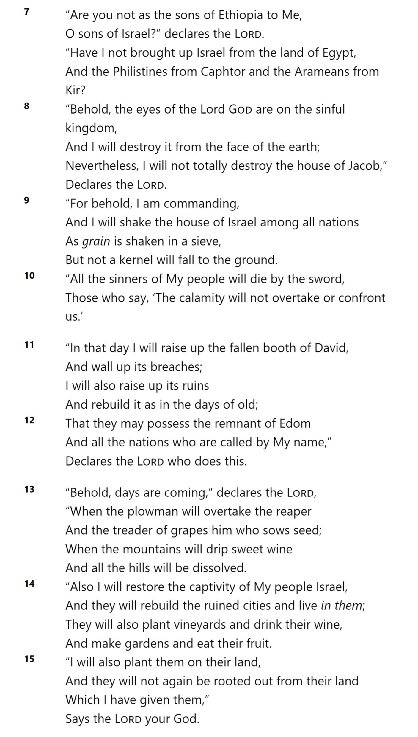
God is sovereign over all the nations
AMOS 9

Slide 19
God protects His people, even during judgment
AMOS 9

Slide 20
AMOS 9

Slide 21
What promises had God made with David?
ⓘ Start presenting to display the poll results on this slide.

Slide 22
Your house and your kingdom shall endure before Me forever; your throne shall be established forever.
(2 Samuel 7:16)
He will be great and will be called the Son of the Most High; and the Lord God will give Him the throne of His father David
(Luke 1:32)
AMOS 9

Slide 23
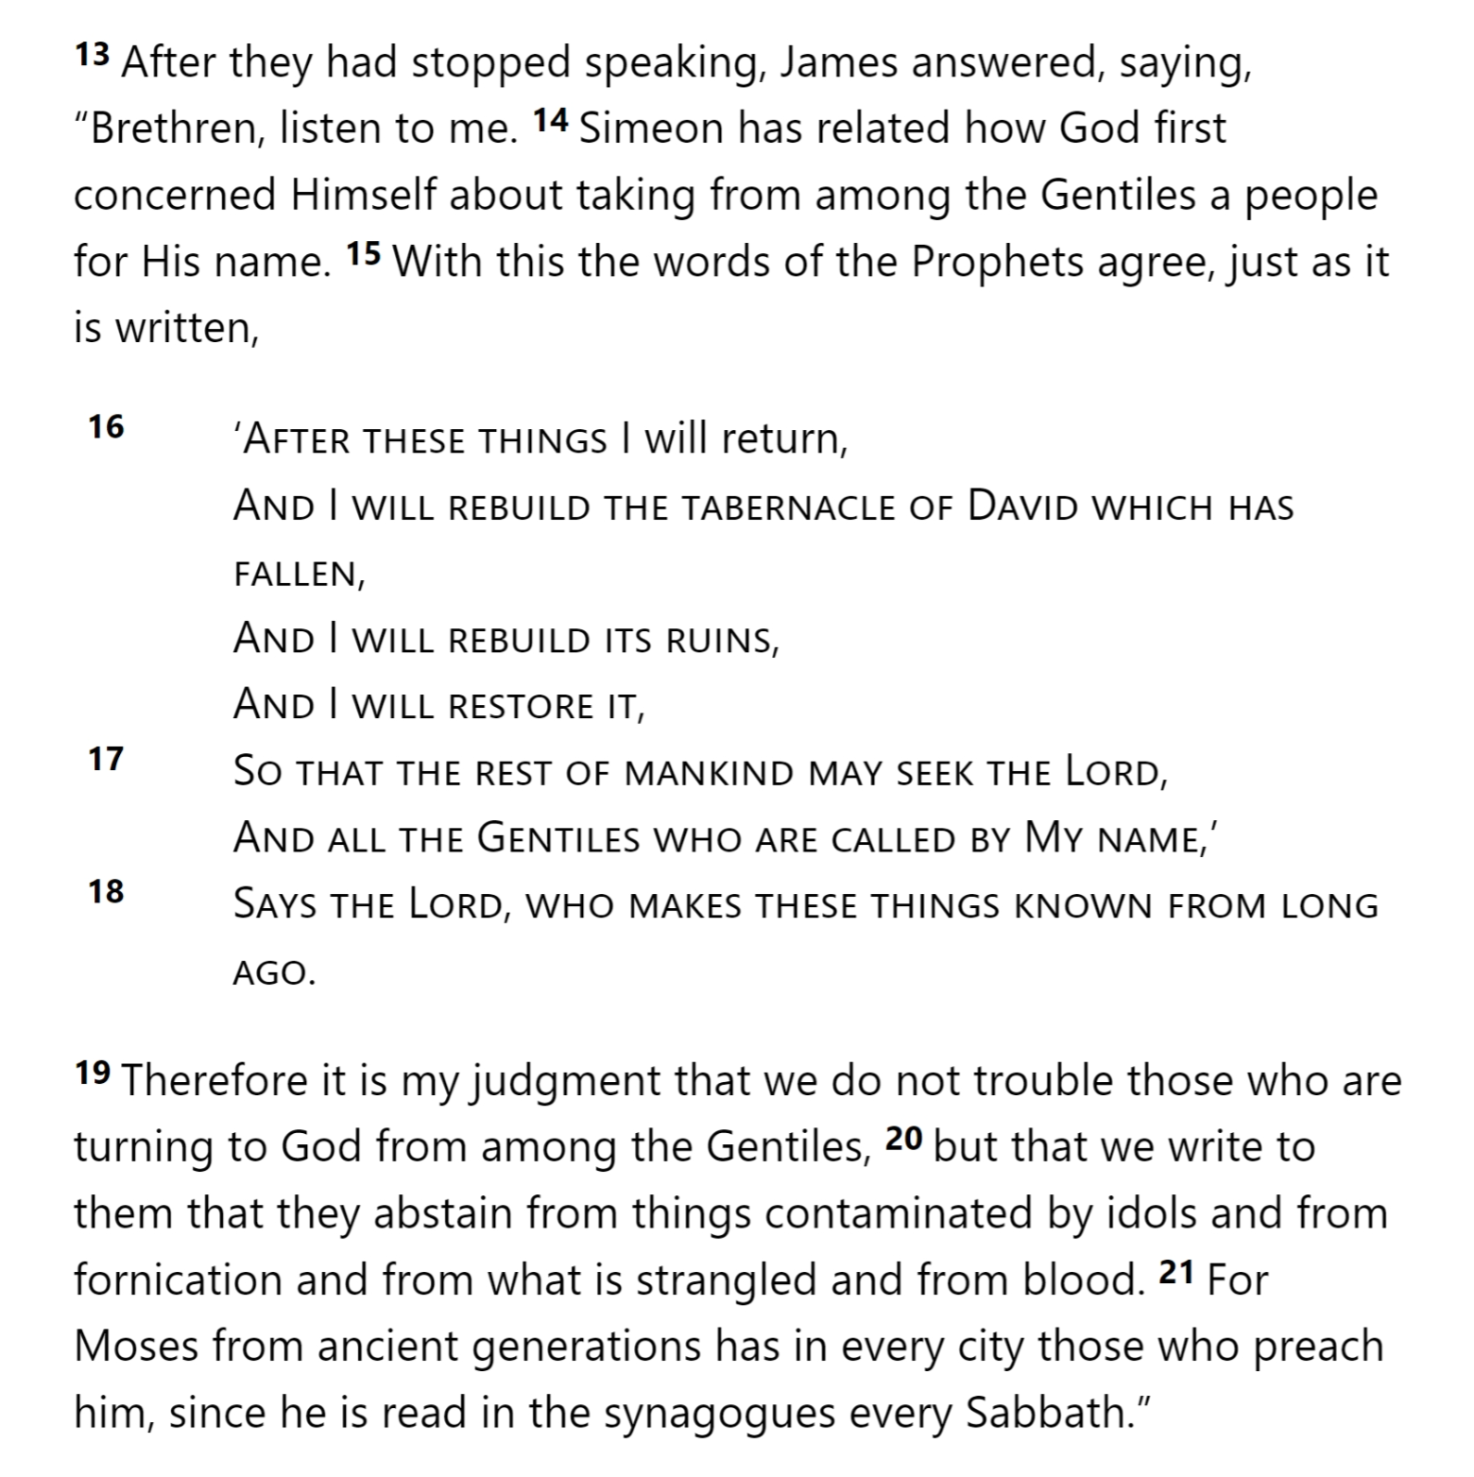
AMOS 9
Acts 15

Slide 24
AMOS 9
Acts 15

Slide 25
ABUNDANCE
FREEDOM
SECURITY
AMOS 9

Slide 26
God is sovereign over all the nations
God protects His people, even during judgment
ABUNDANCE
FREEDOM
SECURITY

Slide 27
What is a spiritual blessing of abundance, freedom, or security that we enjoy in Christ?
ⓘ Start presenting to display the poll results on this slide.

Slide 28
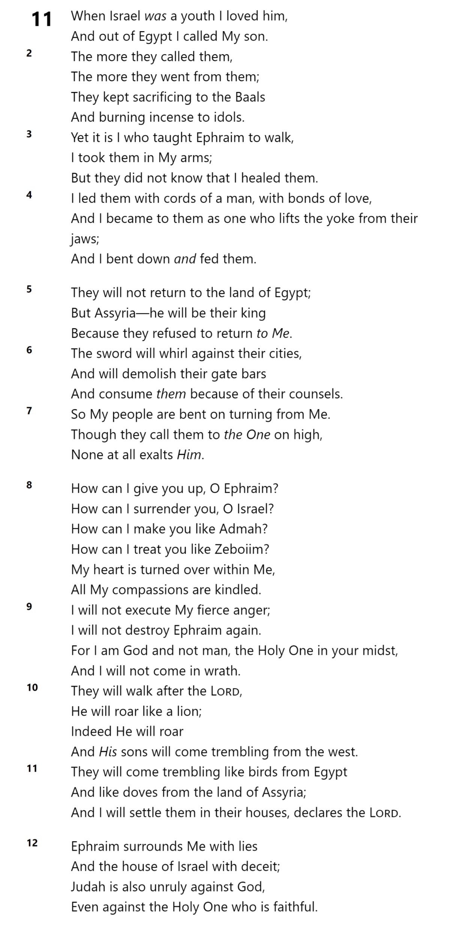
So Joseph got up and took the Child and His mother while it was still night, and left for Egypt. He remained there until the death of Herod. This was to fulfill what had been spoken by the Lord through the prophet: “Out of Egypt I called My Son.”
(Matthew 2:14-15)
Hosea 11

Slide 29
Hosea 11

Slide 30
Hosea 11

Slide 31
Hosea 11

Slide 32
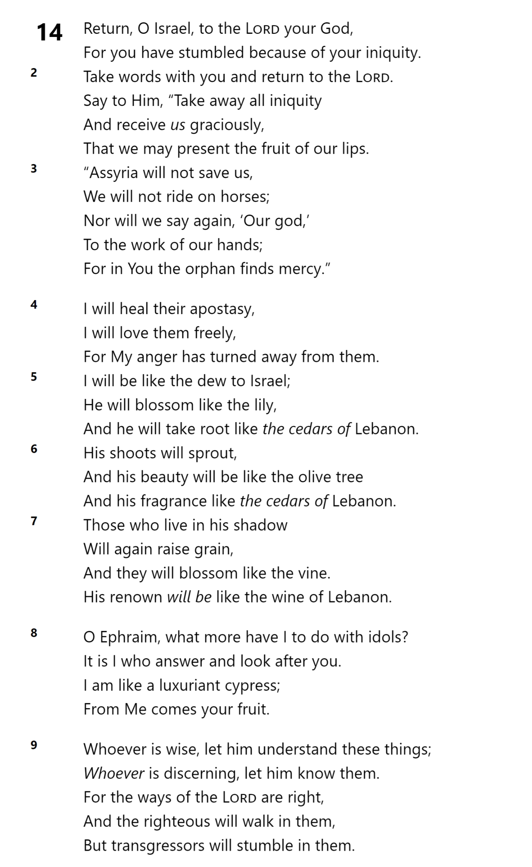
Hosea 14

Slide 33
Hosea 14

Slide 34
Hosea 14

Slide 35
Hosea 14

Slide 36
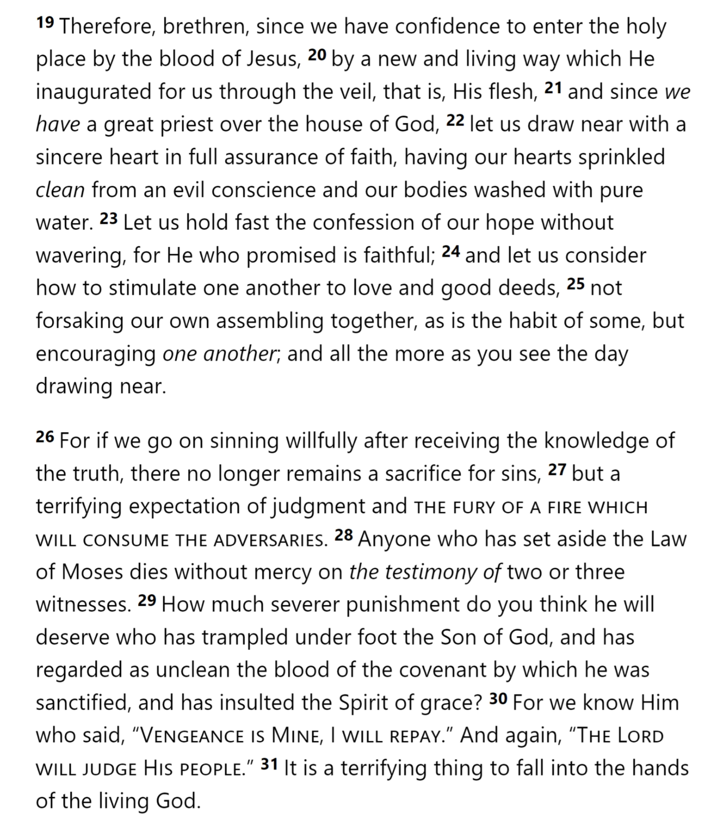
Hebrews 12

Slide 37
Hebrews 12

Slide 38
What were Admah and Zeboiim?
ⓘ Start presenting to display the poll results on this slide.

Slide 39
Thank you!

