Slide 1
Lesson 12: Spreading God’s Grace

Slide 2
Seeing God’s Grace Clearly
God’s grace can be described as: God’s admirable character, to act with kindness we do not deserve, to accomplish what we cannot alone.
Notes:
This may seem simplistic – but please trust me – IT BECOMES SO HELPFUL to really SEE how Paul organizes his thoughts to TELL US ABOUT GOD’S GRACE…

Slide 3
Notes:
These are the things we will be emphasizing in each section.
You can see that the first half is focused on the projects and the city. The second half is focused on the people who fill the city.

Slide 4
To help students gain greater clarity and comfort in God’s grace. Today’s Goal: To view evangelism and giving through the incredible lens of God’s grace.
Notes:
Class Goal is = Clarity and Comfort
To see grace abound, not from sin, but from understanding and gratitude.

Slide 5
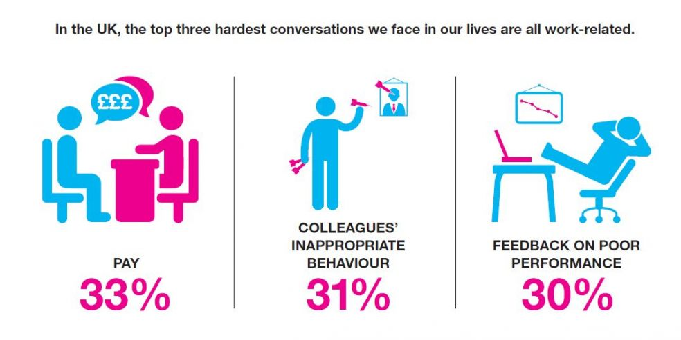
Sometimes Evangelism Feels Like An Awkward Conversation To Avoid…

Slide 6
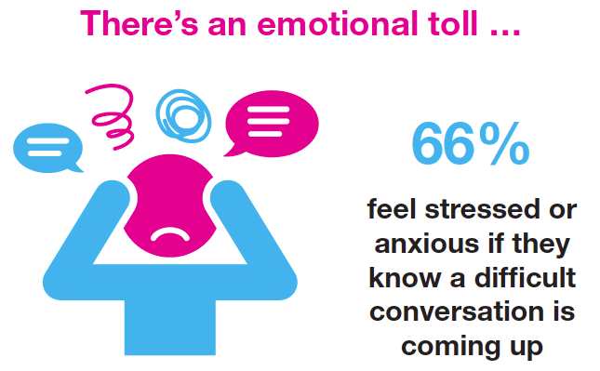
Sometimes Evangelism Feels Like An Awkward Conversation To Avoid…

Slide 7
Spreading God’s Grace doesn’t have to be this way. In light of God’s grace, we can share the gospel with both excitement and gravity.
Notes:
We are not so excited that we forget how serious this is, but we are also not so DEADLY SERIOUS that we forget about the JOY!

Slide 8
Spreading God’s Grace Is Less Awkward When We Make It Personal…
Key Text: Mark 5:9-20
¹⁸ As He was getting into the boat, the man who had been demon-possessed was imploring Him that he might accompany Him. ¹⁹ And He did not let him, but He said to him, “Go home to your people and report to them what great things the Lord has done for you, and how He had mercy on you.” ²⁰ And he went away and began to proclaim in Decapolis what great things Jesus had done for him; and everyone was amazed.
Notes:
We can be excited about what the Lord Has Done for us…

Slide 9
It’s Less Awkward When We Remember What God’s Grace Accomplishes…
EPHESIANS 1:7
“In Him we have redemption through His blood, the forgiveness of our trespasses, according to the riches of His grace…”

Slide 10
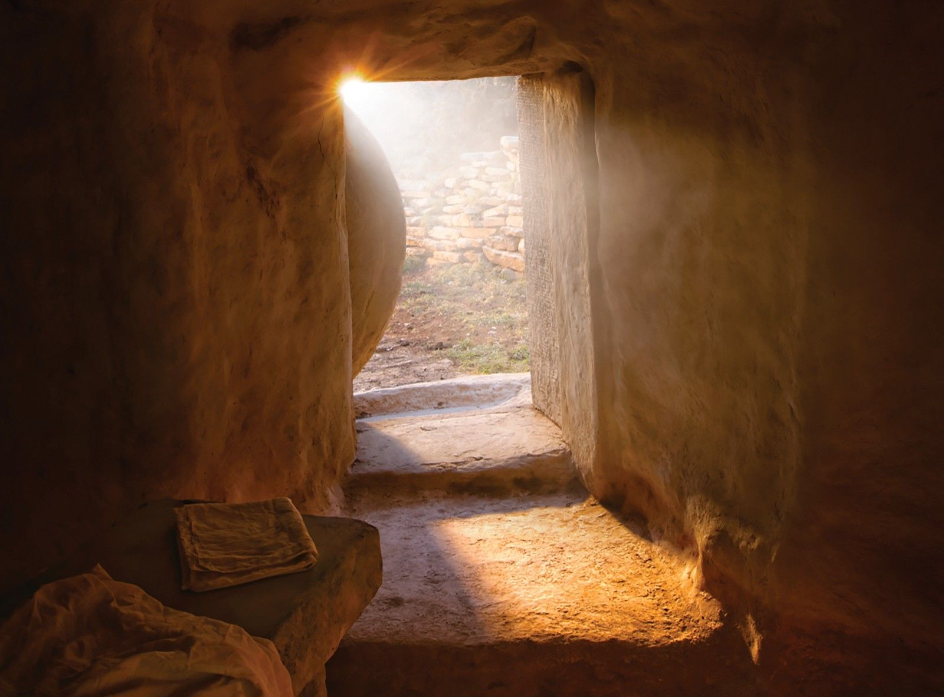
It’s Less Awkward When We Remember What God’s Grace Accomplishes…
EPHESIANS 2:5
“even when we were dead in our transgressions, made us alive together with Christ by grace you have been saved,”

Slide 11
It’s Less Awkward When We Remember What God’s Grace Accomplishes…
ROMANS 6:6
“knowing this, that our old self was crucified with Him, in order that our body of sin might be done away with, so that we would no longer be slaves to sin;”

Slide 12
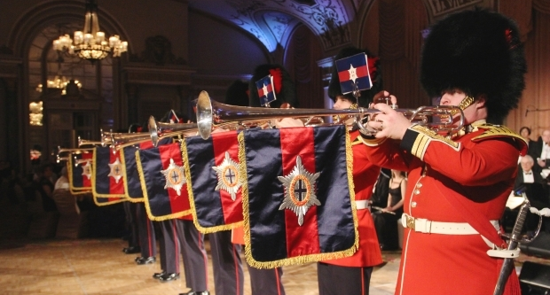
It’s Less Awkward When We Remember What God’s Grace Accomplishes…

Slide 13
Spreading God’s Grace… “For all things are for your sakes, so that the grace which is spreading to more and more people may cause the giving of thanks to abound to the glory of God.” (NASB95)
Notes:
We are not so excited that we forget how serious this is, but we are also not so DEADLY SERIOUS that we forget about the JOY!

Slide 14
Key Text: 2 Corinthians 4:15
“For all things are for your sakes, so that the grace which is spreading to more and more people may cause the giving of thanks to abound to the glory of God.” (NASB95)
“For all things are for your sakes, that the grace, being multiplied through the many, may cause the thanksgiving to abound unto the glory of God.” (ASV)
God Shows Grace
Multiplied To Many People
Many People Become Thankful
Thanks To God Abound
God Is Glorified
Notes:
When We Respond To God’s Grace With Understanding & Gratitude
We Want More People To Receive God’s Gift.
Others Can See How Grateful We Are For God’s Gift.
We Express Our Thanks To God For All He Has Done.
We Acknowledge His Wonderful, Admirable Character.
*This goes back to one of my personal goals for this class. To show that it’s not just “gratitude” but “understanding” with gratitude.
(I could be thankful for the most enjoyable food fight of my life – but it would still be the wrong response because it would be lacking an understanding of the True Price paid, lacking understanding of the hope the Generous vendor was acting with, lacking understanding of who I could become…)

Slide 15
God’s Grace Can Multiply Like A Seed…
“…and others fell upon the good ground, and yielded fruit, some a hundredfold, some sixty, some thirty. He that hath ears, let him hear.” - Matthew 13:8-9
Notes:
Jesus wants to see one soul – impact many souls

Slide 16
Spreading God’s Grace In 2 Corinthians 4
Those Who Know That God’s Saving Grace Is Abundant & Available To All…
Put The Spotlight on Jesus, Not Themselves. (4:5)
Have Seen God’s Goodness & Are Impressed With What They’ve Seen. (4:6)
Realize The Are Ordinary Messengers. (4:7)
Willingly Endure Hardships To Carry The Message. (4:8-11)
Can’t Help But Speak… (4:13, Acts 4:20)
Think Soberly About The Future. (4:14-18)
Notes:
*This goes back to one of my personal goals for this class. To show that it’s not just “gratitude” but “understanding” with gratitude.
(I could be thankful for the most enjoyable food fight of my life – but it would still be the wrong response because it would be lacking an understanding of the True Price paid, lacking understanding of the hope the Generous vendor was acting with, lacking understanding of who I could become…)

Slide 17
Spreading God’s Grace In Ephesians 3
Paul Was Sent To The Gentiles.
Like Paul, We Are Uniquely Positioned To Tell A Circle of Other People About God’s Grace. (3:1)
Paul Was Clear About The Purpose of God’s Grace.
Like Paul, We Need To Understand That God’s Grace Is For Us & For Us To Share With Others. (3:2)
Paul Was Given A Specific Ministry.
Like Paul, We All Have A Position of Service In God’s Family.
Paul Was Honored To Speak About The Riches of Christ.
Like Paul, We “Get To” Tell Others About Our Friend & Savior.
Notes:
Paul Responds With Understanding & Gratitude
3:2 – like Paul – we also have a sphere of influence…
Notice even more fundamentally – God showed grace/acted with Grace towards Paul, with the intent to show grace to others too!
God Showed Grace To Paul, With The Intent of Showing Even More Grace To Others Through Paul.
“if indeed you have heard of the stewardship of God’s grace which was given to me for you;” (3:2), See Also Matthew 25:26
By Grace, Paul Was Given A ‘Target Audience,’ Gentiles.
By Grace, Paul Was Given A Position of Service
“the gospel ⁷of which I was made a minister, according to the gift of God’s grace which was given to me according to the working of His power.” (3:7)
It Is Those Who Receive Grace, Who Can Speak Personally & Passionately About “The Unfathomable Riches of Christ.”

Slide 18
Spreading God’s Grace In Acts 20
Consider Acts 20:17-21 What type of teaching did Paul carry out in Ephesus?
Consider Acts 20:24-31 Why did Paul preach with a strong sense of responsibility?
Consider Acts 20:32 What did Paul trust the “word of His grace” to accomplish for the saints in Ephesus?
Notes:
A Joy & A Serious Responsibility
Paul’s Content & Delivery…
Paul Did Not Hold Back Anything That Was Useful. (20:17-20)
Paul Spoke Openly In Public Places & In Homes. (20:20)
Paul’s Message Called For Both Repentance & Faith. (20:21)
Paul’s Sense of Responsibility…
Paul Was Determined To Carry Out The Mission Knowing It Was Given By God & Centered On God’s Good News. (20:24)
Paul Understood How Important His Message Was & The Danger of Neglecting It. (20:29-31)
Paul’s Confidence In The Gospel of Grace…
The “Word of His Grace” Included All They Would Need For Edification, Salvation, & Sanctification. (20:32)

Slide 19
Spreading God’s Grace In 2 Cor. 8 & 9
We Give Generously. We’re Motivated By God’s Grace.
“Now, brethren, we wish to make known to you the grace of God which has been given in the churches of Macedonia, ² that in a great ordeal of affliction their abundance of joy and their deep poverty overflowed in the wealth of their liberality.”
We Give Sacrificially. We Imitate God’s Grace.
⁹ For you know the grace of our Lord Jesus Christ, that though He was rich, yet for your sake He became poor, so that you through His poverty might become rich.

Slide 20
Spreading God’s Grace In 2 Cor. 8 & 9
We Give Cheerfully. We Trust In God’s Grace.
⁸ And God is able to make all grace abound to you, so that always having all sufficiency in everything, you may have an abundance for every good deed; ⁹ as it is written, “He scattered abroad, he gave to the poor, His righteousness endures forever.” ¹⁰ Now He who supplies seed to the sower and bread for food will supply and multiply your seed for sowing and increase the harvest of your righteousness; ¹¹ you will be enriched in everything for all liberality, which through us is producing thanksgiving to God.

Slide 21
Spreading God’s Grace In 2 Cor. 8 & 9
We Give To Saints Regardless of Cultural Differences. We Desire For God To Be Glorified In Every Nation!
¹³ Because of the proof given by this ministry, they will glorify God for your obedience to your confession of the gospel of Christ and for the liberality of your contribution to them and to all, ¹⁴ while they also, by prayer on your behalf, yearn for you because of the surpassing grace of God in you. ¹⁵ Thanks be to God for His indescribable gift!

Slide 22
To help students gain greater clarity and comfort in God’s grace. Today’s Goal: To view evangelism and giving through the incredible lens of God’s grace.
Notes:
Class Goal is = Clarity and Comfort
To see grace abound, not from sin, but from understanding and gratitude.

Slide 23
Lesson 12: Spreading God’s Grace

