Slide 1
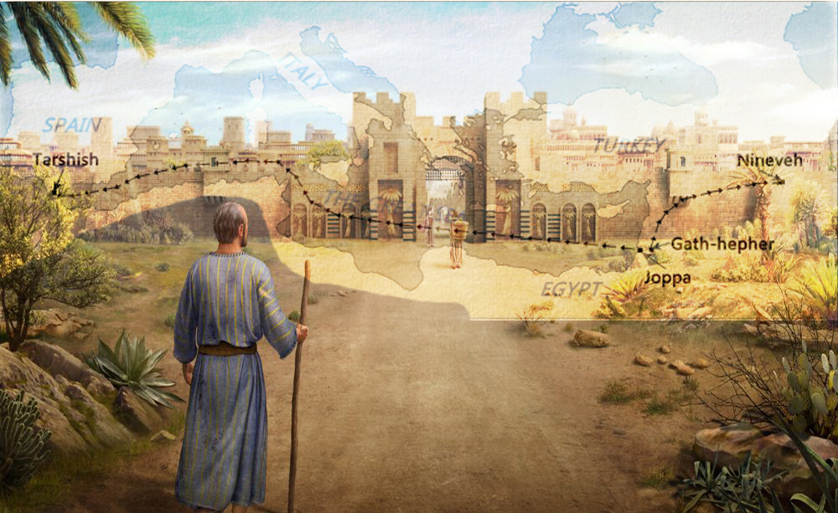
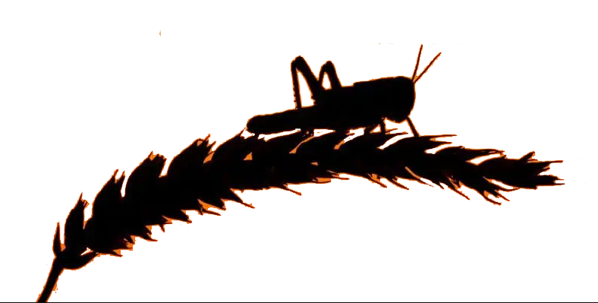
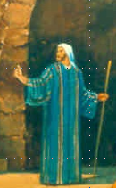
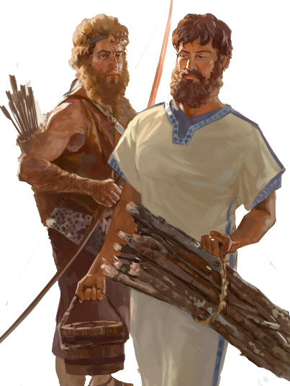
Lesson 3
Jonah Flees Chap 1 & 2

Slide 2
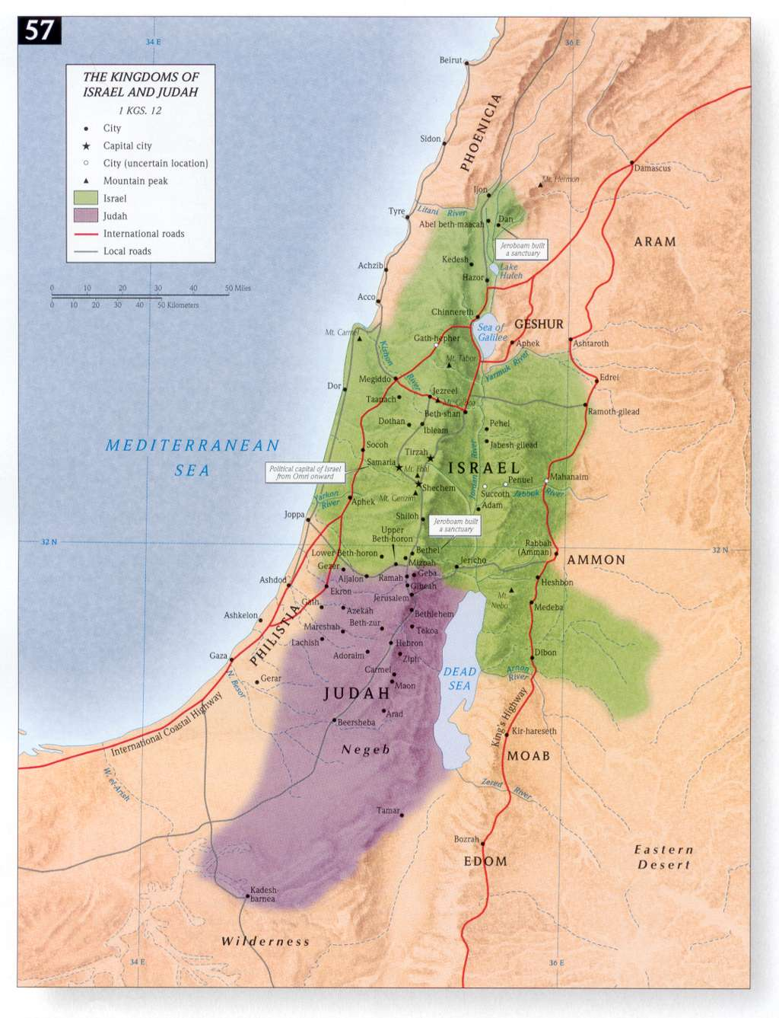
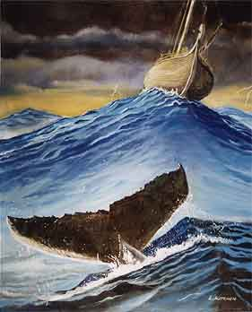
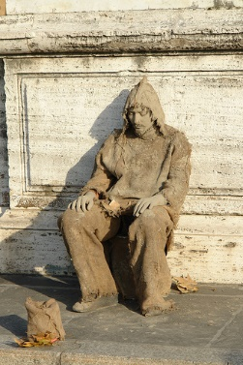
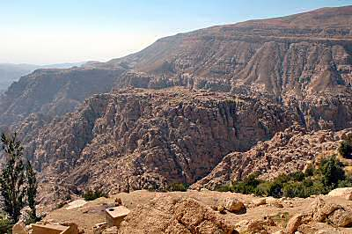
Where are the 4 Prophets?
NINEVEH
Obadiah Edom Punished
Jonah Nineveh repent or
be overthrown in 40 days
Joel Day of the Lord is great and terrible, who can endure
Micah do justly, love mercy & walk
humbly with your God
JONAH
ISRAEL
JOEL
MICAH
EDOM
OBADIAH
JUDAH

Slide 3
Class Objectives
Evidence of the Inspiration of the Scriptures
Learn timeline and events occurring for the prophets
Establish a connection between the Old Testament to the New Testament
Examine what God desires for His people as told us by the prophets
Exercise our Bible Study Skills

Slide 4
The purpose of the prophets was threefold
1
2
3
To warn the nations of the coming judgment.
To explain why the judgment had come upon them.
To give assurance, at least to a remnant, of a hope that lay beyond the judgment.
Notes:
1. The purpose of the prophets was threefold:
a. To warn the nations of the coming judgment.
b. To explain why the judgment had come upon them.
To give assurance, at least to a remnant, of a hope that lay beyond the judgment.

Slide 5
The Role of the Prophets
They are Spokesmen for God, serving as “forthtellers,” speaking what God put in their mouth.
They are Preachers of the Covenant, relating their message to God’s previous promises to the nation of Israel. These covenants were made with or through Abraham, Moses, and David
They are historians, or Interpreters of the Israelites’ History. With out their interpretation God’s people would not know why an event was occurring.

Slide 6
Prophetic Waves
Assyrian Threat
Syrian Threat
Babylonian Threat
Romans
Moses
Exodus
Persian
Written
Israel Falls
Abraham
Judah Falls
Judges
Kingdom Divides
Captivity
& Return
United Kingdom
Oral
Daniel
roars
Greeks
2100
1400
1100
1000
900
800
700
600
500
400
100
0
~30
100
605
597
586
538
458
444
722
Christ
Exile
Return
Notes:
Prophet waves –
God tends to give the last gen before day of the Lord a chance to repent – ie lots of prophet activity
Between the Testament ok
400 years of silince not so much, Daniel roars In Between the Testament

Slide 8
Predictive Elements in Minor Prophets
Book | Distinct Predictions | Predictive Verses | % Predictive | Messianic | Focus Prediction
Hosea | 28 | 111 | 56% | 4 vv. | Destruction of Samaria
Joel | 25 | 50 | 68% | 1 v. | Day of Yahweh
Amos | 26 | 85 | 58% |  | Destruction of Samaria
Obadiah | 10 | 17 | 81% |  | Edom Cut Off
Jonah | 4 | 5 | 10% |  | Overthrow of Nineveh
Micah | 40 | 73 | 70% | 7 vv. | Fall of Jerusalem
Nahum | 2 | 35 | 74% |  | Fall of Nineveh
Habakkuk | 4 | 23 | 47% | 4 vv. | Judgment on the Chaldeans
Zephaniah | 20 | 47 | 89% |  | Judgement on Judah
Haggai | 7 | 15 | 39% | 6 vv. | The Great Shaking
Zechariah | 78 | 144 | 69% | 21 vv. | Temple to be Rebuilt
Malachi | 19 | 31 | 56% | 2 vv. | Coming of Messengers of Yahweh
 | 263 | 636 | 61% Avg. | 45 vv.
21 vs in Book

Slide 9
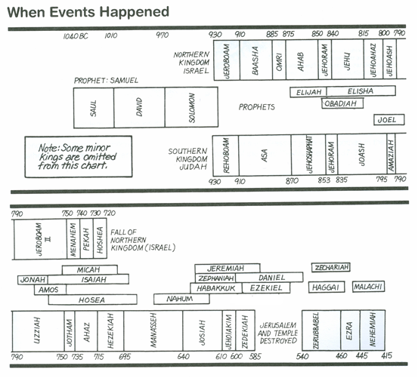
Kings & Prophets

Slide 10
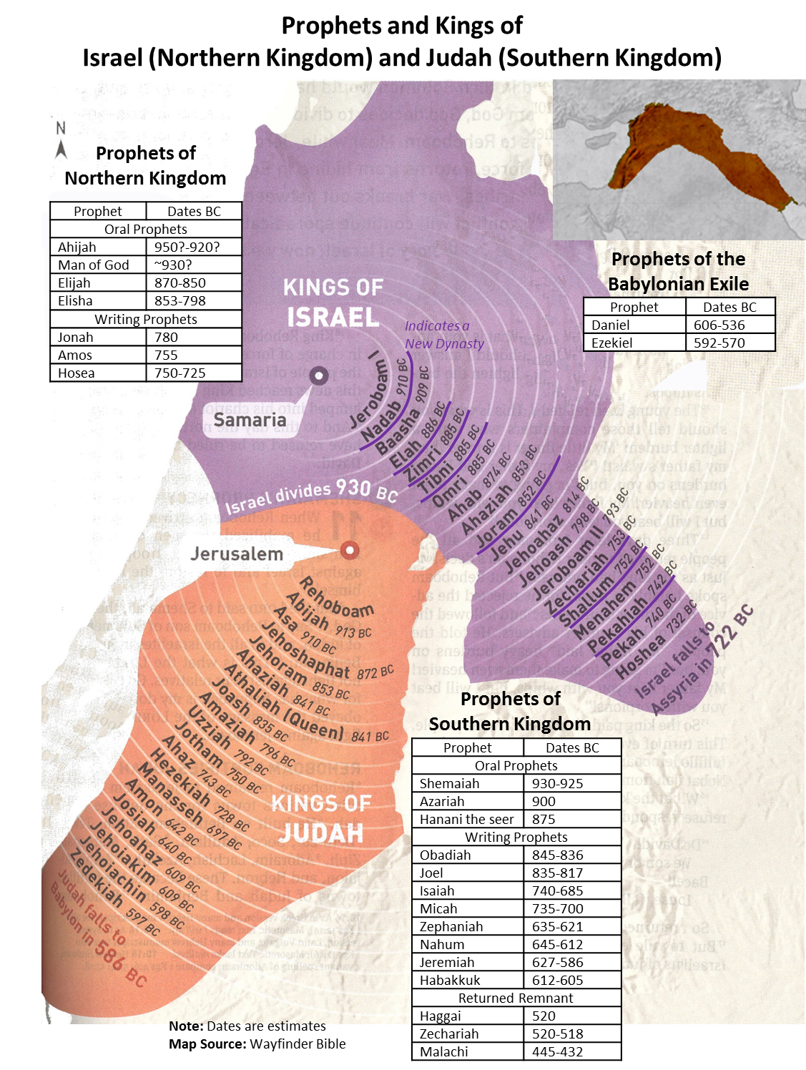
Jonah was from Gath Hepher (meaning “winepress of the pit”), a town in lower Galilee near Nazareth (2 Kgs 14:25).
Gath Hepher was within the tribal territory given to Zebulun (see Josh 19:10, 13), so it is likely Jonah belonged to that tribe.
Faithlife Study Bible
Jonah
780 BC

Slide 11
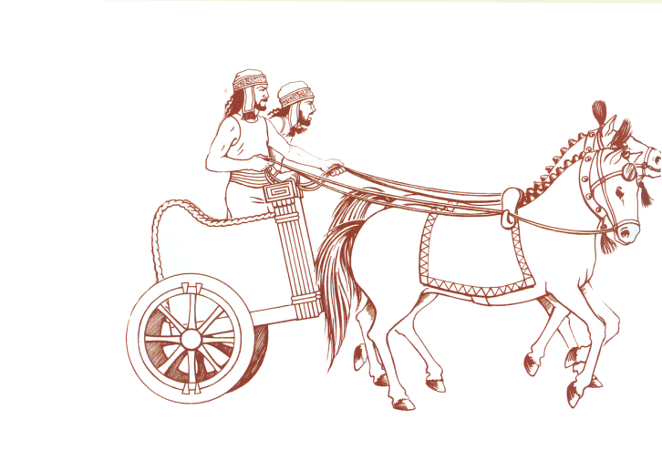
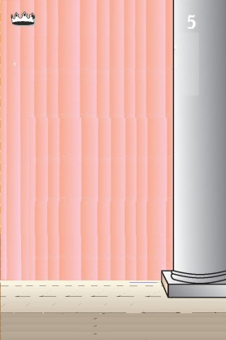
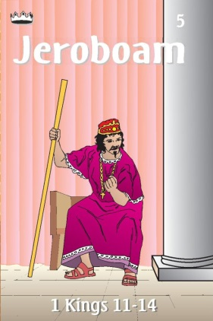
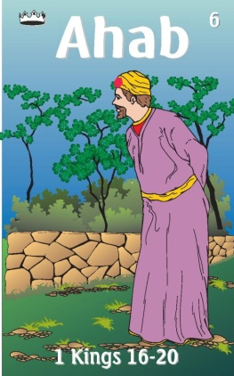
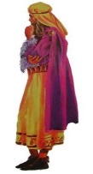
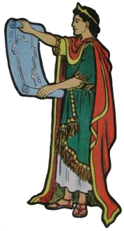
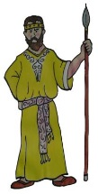
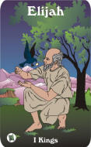
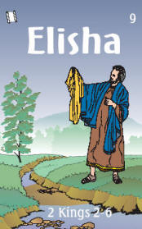
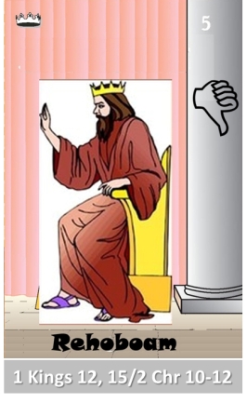
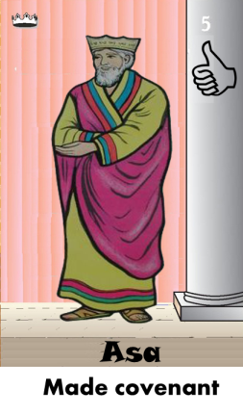
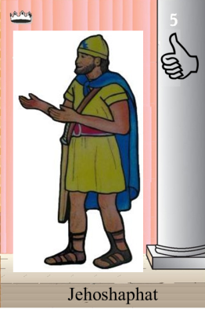
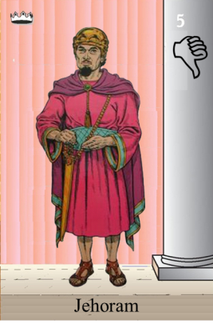
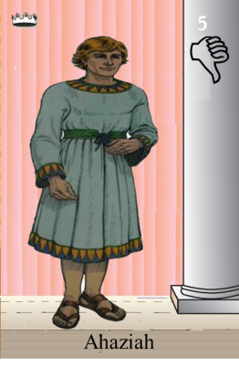
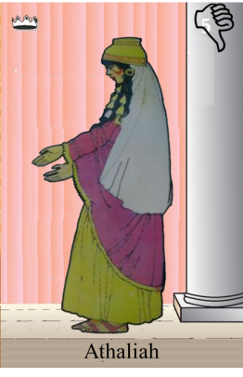
Ahaziah
Jehoram
Killed by Jehu
Baasha
Jehu
Ahijah
Man of God
Rocks for
Mizpah & Geba
Early Kings
Omri Kings
Jehu Kings
Brings in Syria
Obadiah 845-836
Killed by Jehu
Shemaiah
Azariah
Hanani the Seer
Notes:
Jeroboam – not Judha
Baasha & Asa – rocks for fort/Asa turns to Syria not God
Ahab worst King of Israel – God responds – Elijah, troubler of Israel
Elisha – troubles Syria to help Israel God’s compassion
Jehu so well wipes out Ahab’s house – to the fifth king, driving skills with chariot
Obadiah days of Jehoram

Slide 12
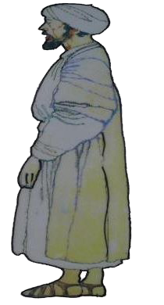
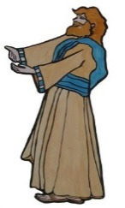
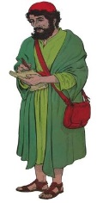
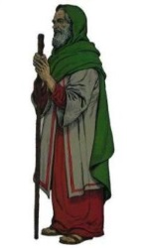
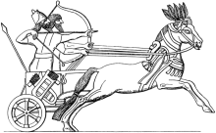
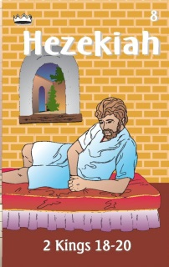
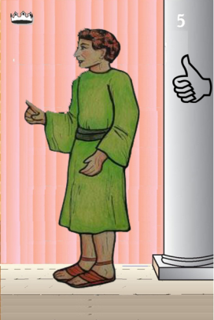
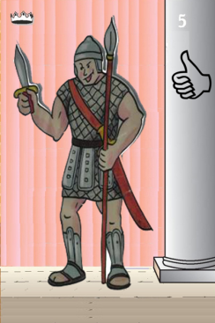
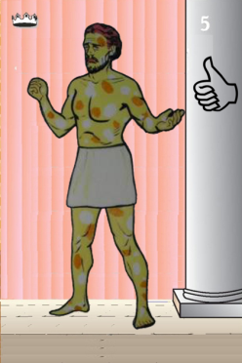
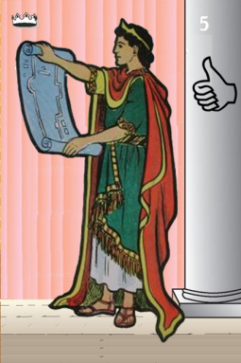
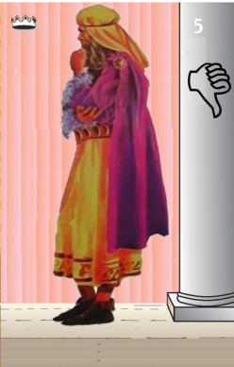
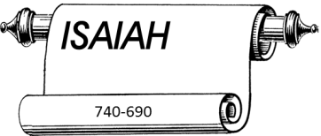
Jehu
841-814
Jehoahaz
Jehoash
Elisha &
the Arrows
Jeroboam II
Zechariah
Tiglath-pileser III
(745–727 b.c.)
793-753
Jehu Kings
Confusing
Brings in Assyria
Joash
Amaziah
Uzziah
Jotham
Ahaz
Jehoiada Made covenant
Notes:
Joel in days dya so f Joash when Jehoiada rules
Jeroboam II – Jonah and Amos
Isaiah – starts in last year of Uzziah
Micah – same time as of Isaiah – days of Ahaz
Ahaz – anybody but God would he turn/worship

Slide 13
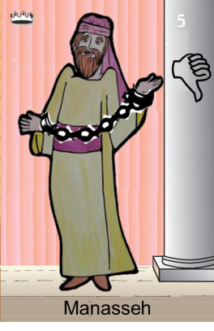
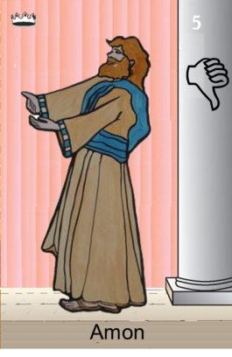
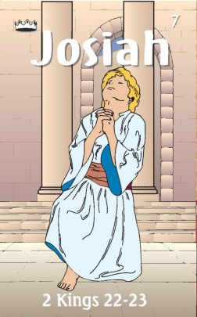
Confusing
Judah Alone
Tiglath-pileser III
(745–727 b.c.)
Revolt of 652 BC
Maybe occasion of Manasseh
Being taken captive
Shallum 752
Menahem 752-742
Pekahiah 742-740
Pekah(752) 740-732
Hoshea 732-722
697-642
640-609
Made covenant
Brings in Aayria
Uzziah
Jotham
Ahaz

Slide 14
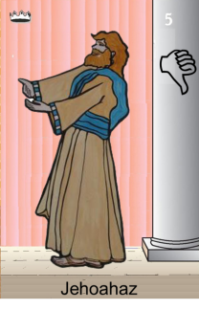
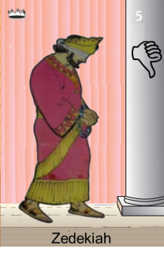
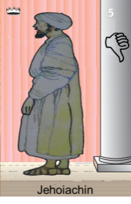
Confusing
Judah Alone
Tiglath-pileser III
(745–727 b.c.)
697-642
640-609
Shallum 752
Menahem 752-742
Pekahiah 742-740
Pekah(752) 740-732
Hoshea 732-722
Made covenant
609
609-597
Egypt
597-586
Babylon
Uzziah
Jotham
Ahaz
597
Babylon
Notes:
Manasseh worse king but repents – born in last 15 years of Hezekiah

Slide 15
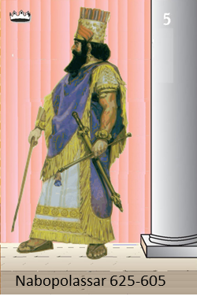
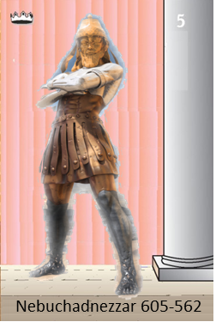
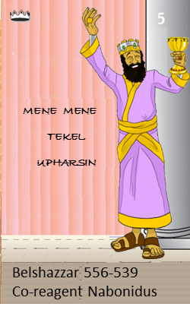
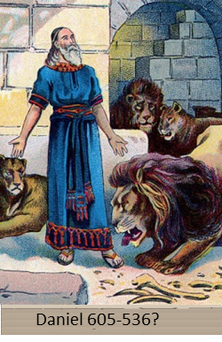
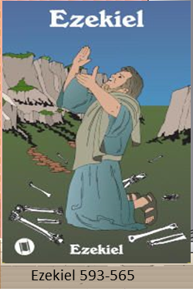
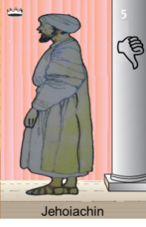
Judah Alone
605-538 BC
Return From Exile
640-609
Babylonian Captivity
538-425?
Daniel
605 BC
597 BC
586 BC

Slide 16
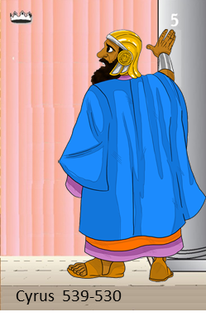
538-425? BC
Return From Exile
640-609
Cyrus Cylinder
Freeing People
537 Rebuild Altar
516 Rebuild Temple

Slide 17
Kings & Prophets
Oral Prophets
Prophet | King | Peoples | Purpose
Ahijah
Jeroboam
Israel
Divide Kingdom
Man of God
Jeroboam
Israel
Golden Calves
Shemaiah
Rehoboam
Judah
Into hands of Shishak
Azariah
Asa
Judah
Renew Covenant
Micaiah
Ahab
Israel
Syrian threat
Elijah
Ahab
Israel
Baal worship
Elisha
Ahaziah to Jehu
Israel
Syrian threat
Minor
Prophets
Assyria
Prophet | King | Peoples | Purpose
Hosea
Jeroboam II>end
Israel
Unfaithful Israel/wife
Joel
Joash of Judah
Israel
Locust like armies
Amos
Jeroboam II
Israel
Injustice/Idolatry-
Spiral Judgement
Obadiah
Jehoram of Judah
Edom
Edom punished
Jonah
Jeroboam II
Assyria
Repent Nineveh
Micah
Ahaz
Judah
Judah like Israel
Notes:
2 Chronicles 16:7 (NIV)
7 At that time Hanani the seer came to Asa king of Judah and said to him: "Because you relied on the king of Aram and not on the LORD your God, the army of the king of Aram has escaped from your hand.

Slide 18
Prophets of the Assyrian Period
Obadiah (~845 BC)
Joel (~830)
Jonah (~780)
Amos (~755)
Hosea (750-725)
Isaiah (740-690)
Micah (735-700)

Slide 19
Kings & Prophets
Minor
Prophets
Babylon
Prophet | King | Peoples | Purpose
Nahum
Manasseh
Assyria
Fall of Nineveh
Zephaniah
Josiah
Judah
Day of Lord’s anger
Habakkuk
Josiah
Judah
Why wicked Babylon
Minor
Prophets
Post-exile
Haggai
Zerubbabel-gov
Judah
Rebuild Temple
Zechariah
Zerubbabel-gov
Judah
Turn back to Lord
Malachi
Judah
You robbed God
Major
Prophets
Prophet | King | Peoples | Purpose
Isaiah
Hezekiah
Judah
Salvation
Jeremiah
Josiah to Zedekiah
Judah
Sword, Pestilence, Famine
Daniel
Jeroboam II
Babylon
God Rules
Ezekiel
Zedekiah
Exile
Settle in - 70 yrs
Notes:
2 Chronicles 16:7 (NIV)
7 At that time Hanani the seer came to Asa king of Judah and said to him: "Because you relied on the king of Aram and not on the LORD your God, the army of the king of Aram has escaped from your hand.

Slide 20
Prophets are Important
Israel Carried Captive to Assyria
2 Kings 17:13 - 15 (ESV) ¹³Yet the Lord warned Israel and Judah by every prophet and every seer, saying,
“Turn from your evil ways and keep my commandments and my statutes, in accordance with all the Law that I commanded your fathers, and that I sent to you by my servants the prophets.”
¹⁴But they would not listen, but were stubborn, as their fathers had been, who did not believe in the Lord their God.
¹⁵They despised his statutes and his covenant that he made with their fathers and the warnings that he gave them.
They went after false idols and became false, and
they followed the nations that were around them, concerning whom the Lord had commanded them that they should not do like them
Notes:
Israel Carried Captive to Assyria
(2 Ki 17:5). (1982). Thomas Nelson.
The New King James Version (2 Ki 17:5). (1982). Thomas Nelson.

Slide 21
Kings of United & Divided Kingdom
United
Kingdom
Divided Kingdom
Judah Alone
Early Kings – Israel
Dynasty 1&2
Omri
Dynasty 3
Jehu
Dynasty 4
Confusing
Dynasties
1
Jereboam
Nadab
3
Omri
Ahab
(874-853)
Ahaziah
Jehoram
4
Jehu
(841-814)
Jehoahaz
Jehoash
Jereboam II
(793-753)
Zechariah
Shallum
Menahem
Pekaiah
Pekah
Hosea
(732-722)
5
Hezekiah
Saul
(1050-1010)
David
(1010-970)
Solomon
(970-930)
2
Baasha
Elah
Hezekiah
(728-686)
Manasseh
Anon
Zimri ~ 885
Tibni
Early Kings – Judah
Dynasty 1&2
Omri
Dynasty 3
Jehu
Dynasty 4
Confusing
Dynasties
Josiah &
Sons
Rehoboam
Abijam
Asa
(930-870)
Jehosphat
(873-848)
Jehoram
Ahaziah
Athaliah
Joash
Amaziah
Azariah/Uzziah
(790-739)
Josiah
(640-609)
Jehoahaz
Jehoiakim
Jehoiachin
Zedekiah
(597-586)
Jotham
Ahaz
Hezekiah

Slide 22
1445-1405 BC
Wilderness
Wanderings
931-722 BC
Divided
Kingdom
605-538 BC
Babylonian
Captivity
444 BC - ~4 BC
The Silent Years
(Intertestamental)
30-90 AD
The Church
NT Era
2166-1859 BC
Patriarchs
1300-1050 BC
Judges
Slavery in Egypt
1859-1445 BC
Conquest
of Canaan
1405-1300 BC
United
Kingdom
1050-931 BC
Life of
Christ
4 BC – 30 AD
United
Kingdom
1050-931 BC
Judah
Alone
722-605 BC
Return
From Exile
538-444 BC
Northern Kingdom:
ISRAEL
722 BC
Jehu
Jehoahaz
Jehoash
Jeroboam II
Zechariah
Omri
Ahab
Ahaziah
Jehoram
Elijah-
Micaiah
Jonah
Amos
538 BC
Return
586 BC
Temple/City Destroyed
Jeroboam
Baasha
Elisha
Zechariah
Haggai
Malachi
Ahijah
Hosea
597 BC
Ezekiel
Early
Kings
Omri
Dynasty
Jehu
Dynasty
Confusing
Dynasty
Joel
605 BC
Daniel
931-885
885-841
Obadiah
841-752
752-722
931 BC
Jehosphat
Jehoram
Ahaziah
Athaliah
Joash
Amaziah
Azariah/Uzziah
Isaiah
Rehoboam
Asa
Micah
Kingdom
Divides
Ahaz
Hezekiah
Manasseh
Anon
Josiah
Jehoahaz
Jehoiakin
Jehoiachin
Zedekiah
Jeremiah
Nahum
Southern Kingdom:
JUDAH
Zephaniah
Habakkuk
Oral
The Twelve
Minor
Major
Based on Graphics from Marc Hinds & David Maxson
Notes:
With animation

Slide 23
Jonah 1-2

Slide 24
Bible Study Skills
Prophetic Paradigm
By Chapter

Slide 25
Book of Jonah Overview-1AB
Looking for -
A
Repeated Words and Phrases
B
Peculiar Words and Phrases

Slide 26
Book of Jonah Overview-1CD
C
Comparisons and Contrasts
D
Figurative Expressions

Slide 27
Book of Jonah Overview-1EF
E
Anything Strange
F
Any prophetic statements

Slide 29
Oracles against the Nations in the Prophets
 | Isaiah | Jeremiah | Ezekiel | Joel | Amos | Obadiah | Jonah | Nahum | Zephaniah | Zechariah*
Ammon |  | 49:1–6 | 25:1–7 |  | 1:13–15
Arabia | 21:13–17
Assyria (Nineveh) | 10:5–19; 14:24–27 |  |  |  |  |  | (Nineveh) | (Nineveh)
Babylon | 13:1–14:23; 21:1–10; 46:1–47:15 | 50:1–51:64 |  |  |  |  |  |  |  | 2:9–12?
Damascus | 17:1–6? | 49:23–27 |  |  | 1:3–5 |  |  |  |  | 9:1
Edom | 21:11–12 | 49:7–22 | 25:12–14 |  | 1:11–12 | 1–14?
Egypt | 18:1–20:6 | 46:2–26 | 29:1–32:32
Elam |  | 49:34–39
Ethiopia |  |  |  |  |  |  |  |  | 2:12–15
Gaza |  |  |  |  | 1:6–8 |  |  |  |  | 9:5
Kedar and Hazor |  | 49:28–33
Lebanon |  |  |  |  |  |  |  |  |  | 11:1–3?
Moab | 15:1–16:14 | 48:1–47 | 25:8–11 |  | 2:1–3 |  |  |  | 2:8–11
Philistia | 14:28–32 | 47:1–7 | 25:15–17 | 3:4–8 |  |  |  |  | 2:5–7 | 9:6
Tyre Sidon | 23:1–18 |  | 26:1–28:19; 28:20–23 | 3:4–8 | 1:9–10 |  |  |  |  | 9:2–3
2:8–11

Slide 30
Jonah’s Work Prior to His Calling
2 Kings 14:23 - 26 (NKJV)
²⁵ He restored the territory of Israel from the entrance of Hamath to the Sea of the Arabah,
according to the word of the Lord God of Israel,
which He had spoken through His servant Jonah the son of Amittai, the prophet who was from Gath Hepher.
²⁶For the Lord saw that the affliction of Israel was very bitter; and whether bond or free, there was no helper for Israel.

Slide 31
Gath Hepher from east
Notes:
tb110106368

Slide 32
What was Jonah Commanded to do?
Jonah 1:1-3(NKJV) ¹Now the word of the Lord came to Jonah the son of Amittai, saying, ²“Arise, go to Nineveh, that great city, and cry out against it; for their wickedness has come up before Me.” ³But Jonah arose to flee to Tarshish from the presence of the Lord. He went down to Joppa, and found a ship going to Tarshish; so he paid the fare, and went down into it, to go with them to Tarshish from the presence of the Lord.

Slide 35
Purple Dye – Core of Trade

Slide 36
Ahijah
Jehu
Man of God
Micaiah
Man of God
Syria
Shemaiah
Azariah
Hanani
Assyria
Babylon/Persia

Slide 37
⁴But the Lord sent out a great wind on the sea, and there was a mighty tempest on the sea, so that the ship was about to be broken up.

Slide 38
Steps Taken by Sailors
Cried out to his god (v5)
Threw cargo into the sea to lighten load (v5)
Cried out to their god/God (v5-6)
Cast lots to know who caused this trouble (v7)
Determine Jonah is the man (v7)
Ask what shall we do (v11-12)
Rowed hard to return to the land (v13)
Cried out to Lord to not charge them (v14)
Cast Jonah overboard (v15)
Feared Lord exceedingly/offered sacrifice/took vows (v16)

Slide 39
¹⁵So they picked up Jonah and threw him into the sea, and the sea ceased from its raging. ¹⁷Now the Lord had prepared a great fish to swallow Jonah. And Jonah was in the belly of the fish three days and three nights.

Slide 40
How long was Jonah in the fish?
Jonah 1
¹⁷Now the Lord had prepared a great fish to swallow Jonah. And Jonah was in the belly of the fish three days and three nights.
Jonah 2
¹Then Jonah prayed to the Lord his God from the fish’s belly.

Slide 41
Jonah initially thinking about his condition before God (vs 4)
“I cried out to the Lord because of my affliction, And He answered me. “Out of the belly of Sheol I cried, And You heard my voice. ³ For You cast me into the deep, Into the heart of the seas, And the floods surrounded me; All Your billows and Your waves passed over me. ⁴ Then I said, ‘I have been cast out of Your sight;
Yet I will look again toward Your holy temple.’
⁵ The waters surrounded me, even to my soul; The deep closed around me; Weeds were wrapped around my head. ⁶ I went down to the moorings of the mountains; The earth with its bars closed behind me forever;
Yet You have brought up my life from the pit, O Lord, my God.

Slide 42
What did he decide to do? Note how he describes this change in vs 7.
⁷ “When my soul fainted within me, I remembered the Lord; And my prayer went up to You, Into Your holy temple.
⁹ But I will sacrifice to You With the voice of thanksgiving;
I will pay what I have vowed.
Salvation is of the Lord.”
⁸ “Those who regard worthless idols
Forsake their own Mercy.

Slide 43
Jonah’s Repentance
Obeys God’s Word
Prays for Forgiveness
Jonah 3:2-4 (NKJV)
2“Arise, go to Nineveh, that great city, and preach to it the message that I tell you.”
³So Jonah arose and went to Nineveh, according to the word of the LORD. Now Nineveh was an exceedingly great city, a three-day journey in extent. ⁴And Jonah began to enter the city on the first day’s walk. Then he cried out and said, “Yet forty days, and Nineveh shall be overthrown!”
Jonah 2:7 - 9 (NKJV)
⁷ “When my soul fainted within me,
I remembered the Lord;
And my prayer went up to You,
Into Your holy temple.
⁸ “Those who regard worthless idols
Forsake their own Mercy.
⁹ But I will sacrifice to You
With the voice of thanksgiving;
I will pay what I have vowed.
Salvation is of the Lord.”
What does the prayer & action say about Jonah’s repentance?

Slide 44
Amos 9:2-4 Futility of Fleeing God
Minor
Prophets
Amos 9:2 - 4 (NKJV)
² “Though they dig into hell,
From there My hand shall take them;
Though they climb up to heaven, From there I will bring them down;
³ And though they hide themselves on top of Carmel,
From there I will search and take them;
Though they hide from My sight at the bottom of the sea,
From there I will command the serpent, and it shall bite them;
⁴ Though they go into captivity before their enemies,
From there I will command the sword,
And it shall slay them.
I will set My eyes on them for harm and not for good.”

Slide 45
World’s Thinking on Deity
1 Kings 20:23–25 (NKJV)
The Syrians Again Defeated
Ahab Ben-Hadad-Elisha
23 Then the servants of the king of Syria said to him, “Their gods are gods of the hills. Therefore they were stronger than we; but if we fight against them in the plain, surely we will be stronger than they.
24 So do this thing: Dismiss the kings, each from his position, and put captains in their places;
25 and you shall muster an army like the army that you have lost, horse for horse and chariot for chariot. Then we will fight against them in the plain; surely we will be stronger than they.”
And he listened to their voice and did so.
1 Kings 20:28 (NKJV)
²⁸ Then a man of God came and spoke to the king of Israel, and said, “Thus says the Lord: ‘Because the Syrians have said, “The Lord is God of the hills, but He is not God of the valleys,” therefore I will deliver all this great multitude into your hand, and you shall know that I am the Lord.’ ”

Slide 46
Chapter Titles
Jon 2:2
Psalm 3:1-8 Save Me, O My God David flees Absalom
Psalm 120:1-7 A song of Ascent Deliver Me O Lord
Psalm 118:5 His Steadfast Love Endures Forever
Psalm 88:6-8 I Cry Out Night and Day
Psalm 42:1, 6-7 Why Are you cast down my soul
Psalm 31:22 Into Your Hand I Commit My Spirit
1 Kings 8:35-39 Solomon’s Prayer of Dedication for Temple
Lam 3:4 Great is Your faithfulness
Psalm 69:1-3 Save Me, O God To choirmaster of David
Psalm 31:6-7 Into Your Hand I Commit My Spirit
Psalm 50:12-15 God Himself is Judge
Psalm 3:8 Save Me, O My God David flees Absalom
Jon 2:2
Jon 2:2
Jon 2:3
Jon 2:3
Jon 2:4
Jon 2:4
Jon 2:5
Jon 2:5
Jon 2:8
Jon 2:9
Jon 2:9

Slide 47
Jonah’s Use of Psalms
Jonah 2
¹Then Jonah prayed to the Lord his God from the fish’s belly.
Psalm 3:1-8 (ESV) David flees Absalom
O LORD, how many are my foes! Many are rising against me; ² many are saying of my soul, there is no salvation for him in God. Selah
³ But you, O LORD, are a shield about me, my glory, and the lifter of my head. ⁴ I cried aloud to the LORD, and he answered me from his holy hill. Selah
⁵ I lay down and slept; I woke again, for the LORD sustained me. ⁶ I will not be afraid of many thousands of people who have set themselves against me all around. ⁷ Arise, O LORD! Save me, O my God! For you strike all my enemies on the cheek; you break the teeth of the wicked. ⁸ Salvation belongs to the LORD; your blessing be on your people! Selah
²And he said:
“I cried out to the Lord because of my affliction,
And He answered me.
“Out of the belly of Sheol I cried,
And You heard my voice.

Slide 48
Jonah’s Use of Psalms
Jonah 2
¹Then Jonah prayed to the Lord his God from the fish’s belly.
Deliver Me O Lord
Psalm 120:1-7 (ESV) A song of Ascent
¹ In my distress I called to the LORD, and he answered me. ² Deliver me, O LORD, from lying lips, from a deceitful tongue. ³ What shall be given to you, and what more shall be done to you, you deceitful tongue? ⁴ A warrior’s sharp arrows, with glowing coals of the broom tree! ⁵ Woe to me, that I sojourn in Meshech, that I dwell among the tents of Kedar! ⁶ Too long have I had my dwelling among those who hate peace. ⁷ I am for peace, but when I speak, they are for war!
²And he said:
“I cried out to the Lord because of my affliction,
And He answered me.
“Out of the belly of Sheol I cried,
And You heard my voice.
His Steadfast Love Endures Forever
Psalm 118:5
Out of my distress I called on the LORD;
the LORD answered me and set me free.

Slide 49
Sheol
Minor
Prophets
SHEOL The abode of the dead in Hebrew thought. Sheol was thought to be deep within the earth (Ps. 88:6; Ezek. 26:20; 31:14-15; Amos 9:2) and was entered by crossing a river (Job 33:18). Sheol is pictured as a city with gates (Isa. 38:10),
Isaiah 38:9 - 10 (NKJV)
⁹This is the writing of Hezekiah king of Judah, when he had been sick and had recovered from his sickness:
¹⁰ I said,
“In the prime of my life
I shall go to the gates of Sheol;
I am deprived of the remainder of my years.”

Slide 51
Jonah’s Use of Psalms
Jonah 1:17 Now the LORD had prepared a great fish to swallow Jonah.
And Jonah was in the belly of the fish three days and three nights.
Jonah 2
¹Then Jonah prayed to the Lord his God from the fish’s belly.
I Cry Out Night and Day
Psalm 88:6-8 (ESV)
⁶ You have put me in the depths of the pit, in the regions dark and deep.
⁷ Your wrath lies heavy upon me, and you overwhelm me with all your waves. Selah
⁸ You have caused my companions to shun me; you have made me a horror to them. I am shut in so that I cannot escape;
³ For You cast me into the deep,
Into the heart of the seas,
And the floods surrounded me;
All Your billows and Your waves
passed over me.
Why Are you cast down my soul
Psalm 42:1 (ESV)
¹ As a deer pants for flowing streams, so pants my soul for you, O God.
Psalm 42:6-7 (ESV) ⁶ and my God. My soul is cast down within me; therefore I remember you from the land of Jordan and of Hermon, from Mount Mizar. ⁷ Deep calls to deep at the roar of your waterfalls; all your breakers and your waves have gone over me.

Slide 52
Jonah’s Use of Psalms
Jonah 2
¹Then Jonah prayed to the Lord his God from the fish’s belly.
Into Your Hand I Commit My Spirit
Psalm 31:22 (ESV) ²² I had said in my alarm, “I am cut off from your sight.” But you heard the voice of my pleas for mercy when I cried to you for help.
1 Kings 8:22 (ESV) ²² Then Solomon stood before the altar of the LORD in the presence of all the assembly of Israel and spread out his hands toward heaven,
⁴ Then I said, ‘I have been cast out of Your sight;
Yet I will look again toward Your holy temple.’

Slide 53
Jonah’s Use of Psalms
Jonah 2
¹Then Jonah prayed to the Lord his God from the fish’s belly.
Great is Your Faithfulness
Lam 3:54 (ESV) water closed over my head; I said, ‘I am lost.’
.
Save Me, O God
To choirmaster of David
Psalm 69:1-3
Save me, O God! For the waters have come up to my neck.
I sink in deep mire, where there is no foothold; I have come into deep waters, and the flood sweeps over me.
I am weary with my crying out; my throat is parched. My eyes grow dim with waiting for my God.
⁵ The waters surrounded me,
even to my soul;
The deep closed around me;
Weeds were wrapped around my
head.

Slide 54
Jonah’s Use of Psalms
Jonah 2
¹Then Jonah prayed to the Lord his God from the fish’s belly.
Into Your Hand I Commit My Spirit
Psalm 31:6-8 (ESV) ⁶ I hate those who pay regard to worthless idols, but I trust in the LORD.
⁷ I will rejoice and be glad in your steadfast love,
because you have seen my affliction;
you have known the distress of my soul,
⁸ and you have not delivered me into the hand of the enemy;
you have set my feet in a broad place.
⁸ “Those who regard worthless idols
Forsake their own Mercy.
X

Slide 55
Jonah’s Use of Psalms
Jonah 2
¹Then Jonah prayed to the Lord his God from the fish’s belly.
God Himself is Judge
Psalm 50:12-15
12 “If I were hungry, I would not tell you, for the world and its fullness are mine.
Do I eat the flesh of bulls or drink the blood of goats?
14 Offer to God a sacrifice of thanksgiving, and perform your vows to the Most High,
15 and call upon me in the day of trouble; I will deliver you, and you shall glorify me.”
⁹ But I will sacrifice to You
With the voice of thanksgiving;
I will pay what I have vowed.
Salvation is of the Lord.”
Save Me, O My God
Psalm 3:8 (ESV) ⁸ Salvation belongs to the LORD; your blessing be on your people! Selah

Slide 56
Jonah’s Use of Psalms
Jonah 2
But I will sacrifice to You
With the voice of thanksgiving;
I will pay what I have vowed.
Salvation is of the Lord.”
Save Me, O My God
Psalm 3:8 (ESV) ⁸ Salvation belongs to the LORD; your blessing be on your people! Selah
Isaiah 43:11 (ESV) ¹¹ I, I am the LORD, and besides me there is no savior.
Isaiah 45:21 (ESV) ²¹ Declare and present your case; let them take counsel together! Who told this long ago? Who declared it of old? Was it not I, the LORD? And there is no other god besides me, a righteous God and a Savior; there is none besides me.
Jeremiah 3:23 (ESV) ²³ Truly the hills are a delusion, the orgies on the mountains. Truly in the LORD our God is the salvation of Israel.

Slide 57
Jonah’s Use of Psalms
Jonah 2
But I will sacrifice to You
With the voice of thanksgiving;
I will pay what I have vowed.
Salvation is of the Lord.”
Save Me, O My God
Psalm 3:8 (ESV) ⁸ Salvation belongs to the LORD; your blessing be on your people! Selah
Hosea 13:4 (ESV) But I am the LORD your God from the land of Egypt; you know no God but me, and besides me there is no savior.

Slide 58
Sign of Jonah
Minor
Prophets
Luke 11:29 - 32 (NKJV)
²⁹And while the crowds were thickly gathered together, He began to say, “This is an evil generation. It seeks a sign, and no sign will be given to it except the sign of Jonah the prophet.
³⁰For as Jonah became a sign to the Ninevites, so also the Son of Man will be to this generation.
³¹The queen of the South will rise up in the judgment with the men of this generation and condemn them, for she came from the ends of the earth to hear the wisdom of Solomon; and indeed a greater than Solomon is here.
³²The men of Nineveh will rise up in the judgment with this generation and condemn it, for they repented at the preaching of Jonah; and indeed a greater than Jonah is here.

Slide 59
Matthew 12
Minor
Prophets
³⁸Then some of the scribes and Pharisees answered, saying, “Teacher, we want to see a sign from You.”
³⁹But He answered and said to them, “An evil and adulterous generation seeks after a sign, and no sign will be given to it except the sign of the prophet Jonah.
⁴⁰For as Jonah was three days and three nights in the belly of the great fish, so will the Son of Man be three days and three nights in the heart of the earth.
⁴¹The men of Nineveh will rise up in the judgment with this generation and condemn it, because they repented at the preaching of Jonah; and indeed a greater than Jonah is here.
⁴²The queen of the South will rise up in the judgment with this generation and condemn it, for she came from the ends of the earth to hear the wisdom of Solomon; and indeed a greater than Solomon is here.

Slide 60
Matthew 16
Minor
Prophets
¹Then the Pharisees and Sadducees came, and testing Him asked that He would show them a sign from heaven.
⁴A wicked and adulterous generation seeks after a sign, and no sign shall be given to it except the sign of the prophet Jonah.”
¹³When Jesus came into the region of Caesarea Philippi, He asked His disciples, saying, “Who do men say that I, the Son of Man, am?”
²¹From that time Jesus began to show to His disciples that He must go to Jerusalem, and suffer many things from the elders and chief priests and scribes, and be killed, and be raised the third day.

Slide 61
Jonah 2:5-6 (ESV) ⁵ The waters closed in over me to take my life;
the deep surrounded me; weeds were wrapped about my head ⁶ at the roots of the mountains.
I went down to the land whose bars closed upon me forever;
yet you brought up my life from the pit, O LORD my God.

Slide 62
Day & Night 1
Saturday
Day& Night 2
Sunday
Day 1

Slide 63
What do we know about the great fish?
Minor
Prophets
Jonah 1:17 Now the Lord had prepared a great fish to swallow Jonah. And Jonah was in the belly of the fish three days and three nights.
Able to swallow Jonah
Able to keep/hold Jonah 3 days & nights
Jonah 2:5 The waters surrounded me, even to my soul; The deep closed around me; Weeds were wrapped around my head.
Able to swim under water
Fish swallowed sea weed – (below 100 to 250 feet)
Jonah 2:6 I went down to the moorings of the mountains; The earth with its bars closed behind me forever; Yet You have brought up my life from the pit, O LORD, my God.
Fish able to reach bottom of Mediterranean

Slide 64
Jonah and the Great Fish
“Men have been looking so hard at the great fish that they have failed to see the great God” – G Campbell Morgan
(Jon 1:17) And the LORD appointed a great fish to swallow up Jonah. And Jonah was in the belly of the fish three days and three nights.
We do not know what type of “fish” Jonah was swallowed by, but we definitely know there are sea creatures that have the capability of swallowing an entire human being.

Slide 65
Jonah 1:17 (NKJV) Now the LORD had prepared a great fish to swallow Jonah. And Jonah was in the belly of the fish three days and three nights.
Minor
Prophets

Slide 66
Jonah 1:17 (NKJV) Now the LORD had prepared a great fish to swallow Jonah. And Jonah was in the belly of the fish three days and three nights.
Minor
Prophets

Slide 67
Jonah 1:17 (NKJV) Now the LORD had prepared a great fish to swallow Jonah. And Jonah was in the belly of the fish three days and three nights.
Minor
Prophets

Slide 68
Jonah 1:17 (NKJV) Now the LORD had prepared a great fish to swallow Jonah. And Jonah was in the belly of the fish three days and three nights.
Minor
Prophets

Slide 69
Minor
Prophets
Botryocladia botryoides
Cystoseira C. Agardh
Hard Rocks – 164 feet
Most Cystoseira plants are encountered in the upper regions of the intertidal zone, usually in places that are not exposed to the air during low tide. A small number of species are deep sea algae.
Seaweed mostly grow down to 100 feet but can down to 250 feet

Slide 70
Swordfish 65 mph
Marlin 50 to 80 mph
Wahoo 27 to 48 mph
Tuna 46 mph
Bonito 40 mph
Whales – 6-14 w burst to 30 mph
Sharks – 25 mph w burst to 3 mph
Cretan
Deepest part – 16400 ft
Depth near Levant 1600 to 6500 ft
From Crete to West End Crete 745 miles
Notes:
500 m = 1640 ft
= 6562
100 mile 4 ht
800 = 32 hr
66 hr
3 days

Slide 71
Sea Depth – Iron Age Wrecks
Minor
Prophets
-2460 ft
-1640 ft
-820 ft

Slide 72
Minor
Prophets
750 BC Tanit
750 BC Elissia
~780-750 BC
Jonah

Slide 73
Jonah 1:7 And they said to one another, “Come, let us cast lots, that we may know for whose cause this trouble has come upon us.” So they cast lots, and the lot fell on Jonah
Minor
Prophets
Jonah 1:5 Then the mariners were afraid; and every man cried out to his god, and threw the cargo that was in the ship into the sea, to lighten the load.
Jonah 1:13 Nevertheless the men rowed hard to return to land, but they could not, for the sea continued to grow more tempestuous against them.
Jonah 1:5 But Jonah had gone down into the lowest parts of the ship, had lain down, and was fast asleep.

Slide 74
An Older Phoenician Ship
Minor
Prophets

