Slide 1
Profit of Wisdom
Proverbs 3; 1 Timothy 4

Slide 2
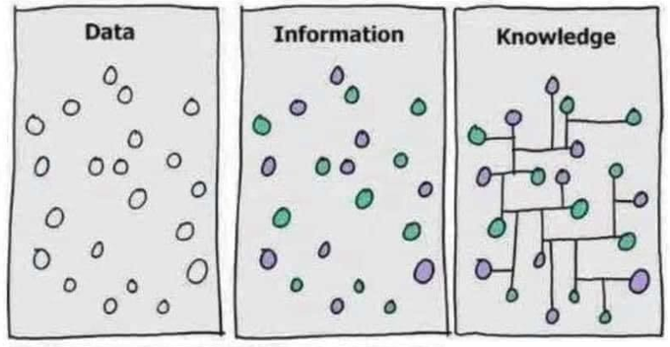
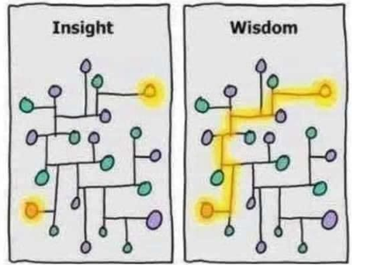

Slide 3
Wisdom Is…
A Provider
3:2 “For length of days and years of life
And peace they will add to you.”
3:10 “So your barns will be filled with plenty
And your vats will overflow with new wine.”
3:14-15 “For her profit is better than the profit of silver
And her gain better than fine gold.
¹⁵ She is more precious than jewels; And nothing you desire compares with her.”

Slide 4
Wisdom Is…
A Provider
A Protector
3:8 “It will be healing to your body
And refreshment to your bones.”
3:21-25 ²¹ My son, let them not vanish from your sight;
Keep sound wisdom and discretion, ²² So they will be life to your soul And adornment to your neck. ²³ Then you will walk in your way securely And your foot will not stumble. ²⁴ When you lie down, you will not be afraid; When you lie down, your sleep will be sweet. ²⁵ Do not be afraid of sudden fear Nor of the onslaught of the wicked when it comes

Slide 5
Wisdom Is…
A Protector
A Provider
A Creator
3:19-20 ¹⁹ The Lord by wisdom founded the earth,
By understanding He established the heavens. ²⁰ By His knowledge the deeps were broken up And the skies drip with dew
8:30 “master workman”
Ex. 28, 31, 35
Artisans given a “spirit of wisdom” within their craft

Slide 6
Wisdom Is…
A Protector
A Provider
A Creator
A Leader
3:6 In all your ways acknowledge Him,
And He will make your paths straight.
3:17-18 ¹⁷ Her ways are pleasant ways
And all her paths are peace. ¹⁸ She is a tree of life to those who take hold of her And happy are all who hold her fast.

Slide 7
Wisdom Is…
From God
3:5-7 ⁵ Trust in the Lord with all your heart
And do not lean on your own understanding. ⁶ In all your ways acknowledge Him, And He will make your paths straight. ⁷ Do not be wise in your own eyes; Fear the Lord and turn away from evil.
Rom. 11:33-36
³³ Oh, the depth of the riches both of the wisdom and knowledge of God! How unsearchable are His judgments and unfathomable His ways! ³⁴ For who has known the mind of the Lord, or who became His counselor? ³⁵ Or who has first given to Him that it might be paid back to him again? ³⁶ For from Him and through Him and to Him are all things. To Him be the glory forever. Amen.

Slide 8
What about Job?
Prov. 3:7
“Do not be wise in your own eyes;
Fear the Lord and turn away from evil.”
Job 1:8
“Have you considered My servant Job? For there is no one like him on the earth, a blameless and upright man, fearing God and turning away from evil.”

Slide 9
1 Tim. 4:8-10
⁸ for bodily discipline is only of little profit, but godliness is profitable for all things, since it holds promise for the present life and also for the life to come. ⁹ It is a trustworthy statement deserving full acceptance. ¹⁰ For it is for this we labor and strive, because we have fixed our hope on the living God, who is the Savior of all men, especially of believers.

Slide 10
“The life to come…”
riches greater than silver/gold
long life
life to our soul
healing in our bones
peace and security
creation perfected
the tree of life
kept from evil

Slide 11
1 Tim. 4:8-10
⁸ for bodily discipline is only of little profit, but godliness is profitable for all things, since it holds promise for the present life and also for the life to come. ⁹ It is a trustworthy statement deserving full acceptance. ¹⁰ For it is for this we labor and strive, because we have fixed our hope on the living God, who is the Savior of all men, especially of believers.

Slide 12
How Do I Get Wisdom?
Eccl. 12:13-14
¹³ The conclusion, when all has been heard, is: fear God and keep His commandments, because this applies to every person. ¹⁴ For God will bring every act to judgment, everything which is hidden, whether it is good or evil.

Slide 13
How Do I Get Wisdom?
Matt. 22:37-40
“And He said to him, “‘You shall love the Lord your God with all your heart, and with all your soul, and with all your mind.’ ³⁸ This is the great and foremost commandment. ³⁹ The second is like it, ‘You shall love your neighbor as yourself.’ ⁴⁰ On these two commandments depend the whole Law and the Prophets.”

Slide 14
How Do I Get Wisdom?
Job 42:3-4
“…Therefore, I have declared that which I did not understand, Things too wonderful for me, which I did not know.” ⁴ ‘Hear, now, and I will speak; I will ask You, and You instruct me.’”

Slide 15
Profit of Wisdom
Proverbs 3; 1 Timothy 4

