Slide 1
Evolution or Degradation

Slide 2
Definitions
Evolution
A gradual process in which something changes into a different and usually a more complex and better form.
Degradation
A decline to a lower condition, quality or level.
American Heritage Dictionary of the English Language

Slide 3
All things produced by humans evolve.

Slide 4
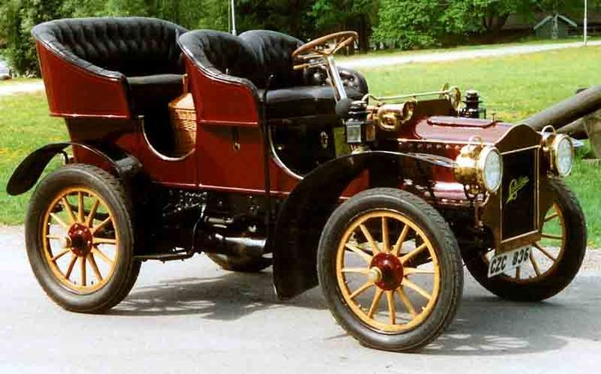
1900 Cadillac
2022 Cadillac

Slide 5
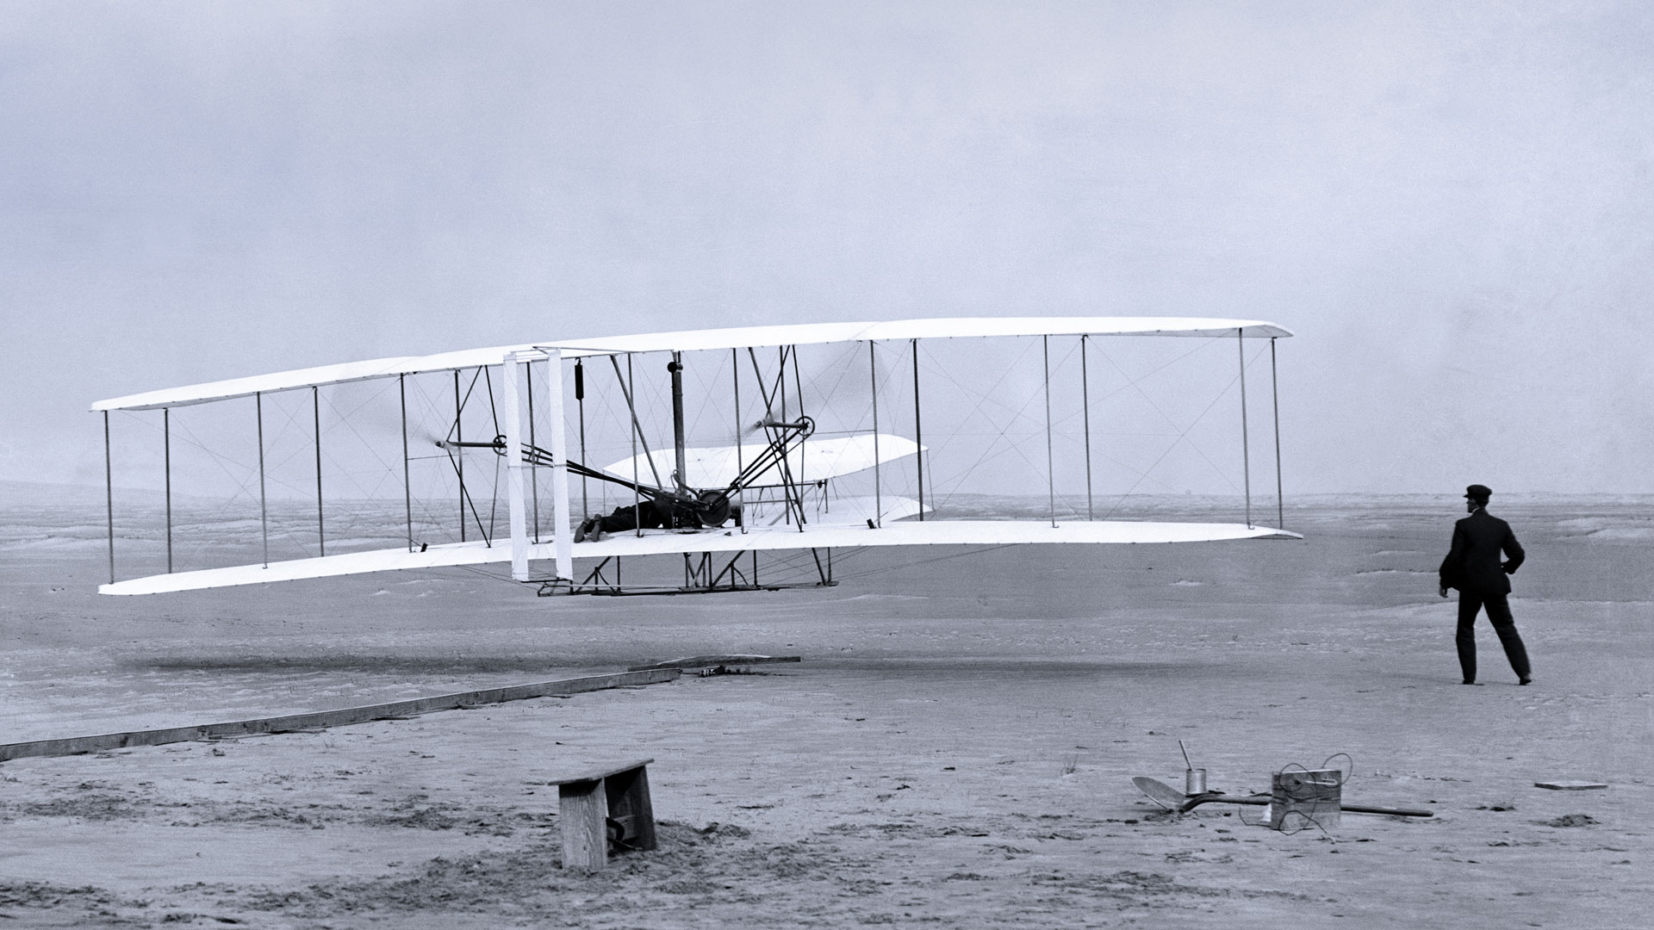
First Airplane
Modern Airliner

Slide 6
Without God, Evolution is the Only Explanation for Life

Slide 7
Evolution of the Horse
Evolution of Humans

Slide 8
“With God, All things are possible.”
God’s creations are perfect in the beginning.
Any change is for the worse.

Slide 9
God’s Creations
As God Made Them:
Effect of Changes
Universe “Good”
Adam and Eve “Very Good” (930 yrs.)
Israel’s Government with God as King
“The universe and everything in it is gradually running down” –Science News January 27, 2010
This “broken World”’
Human King led to decline and captivity

Slide 10
The Church
Built by Jesus (Matthew 16:18)
Under direction of the Apostles (John 20:21)
Apostles guided by the Holy Spirit (John 16:12-15)
N. T. describes the church of 1st Century.
Embry Hills Church is an effort to duplicate the original church.
Many today question the value of this.

Slide 11
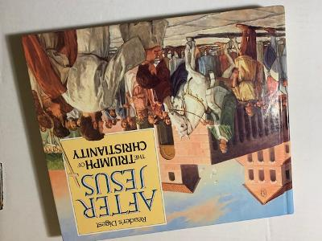
“The writings of the second century reveal the tremendous amount of change and experimentation that was taking place during this period.”
Was this change Evolution of Degradation?

Slide 12
Early Church followed Apostle’s Teaching
In 2nd Century “tremendous amount of change”
Simple Worship
Simple Organization (Elders and Deacons)
Entrance gained by baptism.
“Christian worship evolved into distinctive liturgies.”
“Just as the worship evolved, so did the church’s leadership and organization.”
“Baptism, for example, steadily evolved into a more complex rite.”
“As the church spread to all parts of the empire, the cultures and customs of regional groups exerted a powerful influence on its development.”

Slide 13
Bible Writers foresaw the changes!
They did not call them evolution!
”…men will rise up, speaking perverse things, to draw away the disciples after themselves” (Acts 20:29).
“ the falling away comes first and the man of sin is revealed” (2 Thessalonians 2:3).
“Some will depart from the faith” (1 Timothy 4:1)
“there will be false teachers among you” (2 Peter 2:1)
“The Antichrist is coming…” (1 John 2:18).
Notes:
some will depart from the faith, g

Slide 14
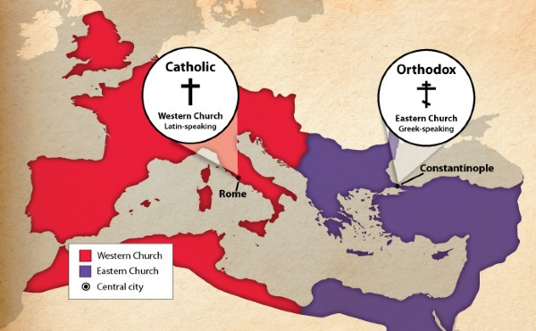
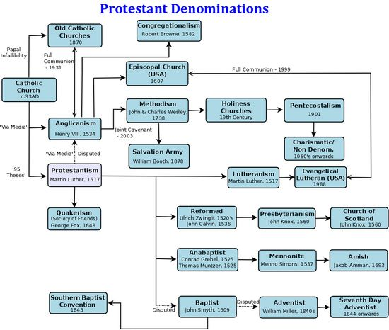
Result of the “Falling Away”
Two Catholic Churches
Hundreds of Protestant Churches
Is this better than the church “in the beginning”?

Slide 15
What did the Apostles Offer as Defense?
“I commend you to God and to the word of His grace…” (Acts 20:32).
““All Scripture is given by inspiration of God, and is profitable for doctrine, for reproof, for correction, for instruction in righteousness, ¹⁷ that the man of God may be complete, thoroughly equipped for every good work. (2 Timothy 3:16-17)
“Preach the word” (2 Timothy 4:2)
“Contend earnestly for the faith which was once for all delivered to the saints” (Jude 3)
Notes:
All Scripture is given by inspiration of God, and is profitable for doctrine, for reproof, for correction, for ^{[a]}instruction in righteousness, ¹⁷ that the man of God may be complete, thoroughly equipped for every good work.

Slide 16
1 John 2:24
“Therefore let that abide in you which you heard from the beginning. If what you heard from the beginning abides in you, you also will abide in the Son and in the Father”
Christ does not change! (Hebrews 13:8)
If the church described in the New Testament was what He wanted in the First Century, it is what He wants now!
Notes:
²⁴ Therefore let that abide in you which you heard from the beginning. If what you heard from the beginning abides in you, you also will abide in the Son and in the Father. ²⁵ And this is the promise that He has promised us—eternal life.

Slide 17
EMBRY HILLS CHURCH has something unique to offer.
We do not claim ----
What is unique is our goal—to be the church as it was in the beginning.
This explains everything about us.
We do not claim perfection in reaching it.
We continue to study to learn more.

Slide 18
2 Corinthians 4:5-6
We do not preach ourselves, but Christ Jesus the Lord, and ourselves your bondservants for Jesus’ sake. For it is the God who commanded light to shine out of darkness, who has shone in our hearts to give the light of the knowledge of the glory of God in the face of Jesus Christ.

Slide 19
One thing is very clear --
What was required to be added to Christ’s church (Acts 2:37-38, 41).
Believers asked, “Men and brethren, what shall we do?”
³⁸ Then Peter said to them, “Repent, and let every one of you be baptized in the name of Jesus Christ for the remission of sins; and you shall receive the gift of the Holy Spirit.
Then those who gladly received his word were baptized; and that day about three thousand souls were added to them.

