Slide 1
Break The Cycle
Notes:
This morning we are going to study from the book of Judges. It’s wonderful that when we preach “the whole counsel of God” we come to books like this that may not be on our immediate reading list, and we discover again how RICH and how HELPFUL every section of Scripture is.
If you’ve ever read even the first 2 chapters of Judges you’ve heard about the “Cycle of the Judges.” It is one of the most dominant themes in the book…. And a quick search online will give you dozens of charts to help follow what is happening…
Let’s read it, and then let me visualize it in a few different of ways…
Two Major Features in This Book…
First is the lack of a national King. Mentioned 4 times…
Second is the downward spiral or idolatry described over and over… The outline is given in ch. 2.

Slide 2
Judges 2:11-19
¹⁶ Then the Lord raised up judges who delivered them from the hands of those who plundered them. ¹⁷ Yet they did not listen to their judges, for they played the harlot after other gods and bowed themselves down to them. They turned aside quickly from the way in which their fathers had walked in obeying the commandments of the Lord; they did not do as their fathers.
¹⁹ But it came about when the judge died, that they would turn back and act more corruptly than their fathers, in following other gods to serve them and bow down to them; they did not abandon their practices or their stubborn ways.
Notes:
Israel Serves The Lord For A Time
Judges 2:10
Israel Falls Into Sin & Idolatry
Judges 2:11-13
Israel Is Enslaved
Judges 2:14-15
Israel Cries Out To God
Judges 2:18
God Raises Up A Judge To Deliver Them
Judges 2:16-18
The Judge Dies & Israel Returns To Idolatry
Judges 2:19-23

Slide 3
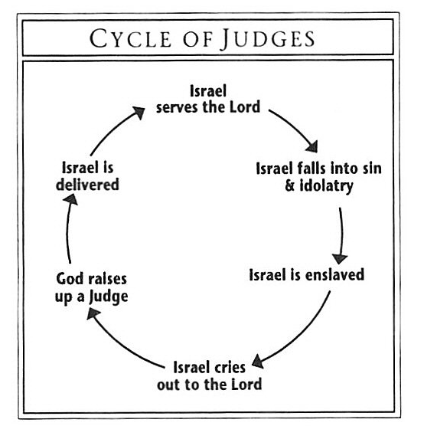
Responsibility
Notes:
I love this one because it emphasizes the Responsibility of Israel and the Grace of God.
THEY made sinful choices. God hasn’t failed. He’s kept all of His promises. But they have abandoned God again and again.
And despite their responsibility – God shows himself so patient and so long-suffering that He keeps rescuing them.

Slide 4
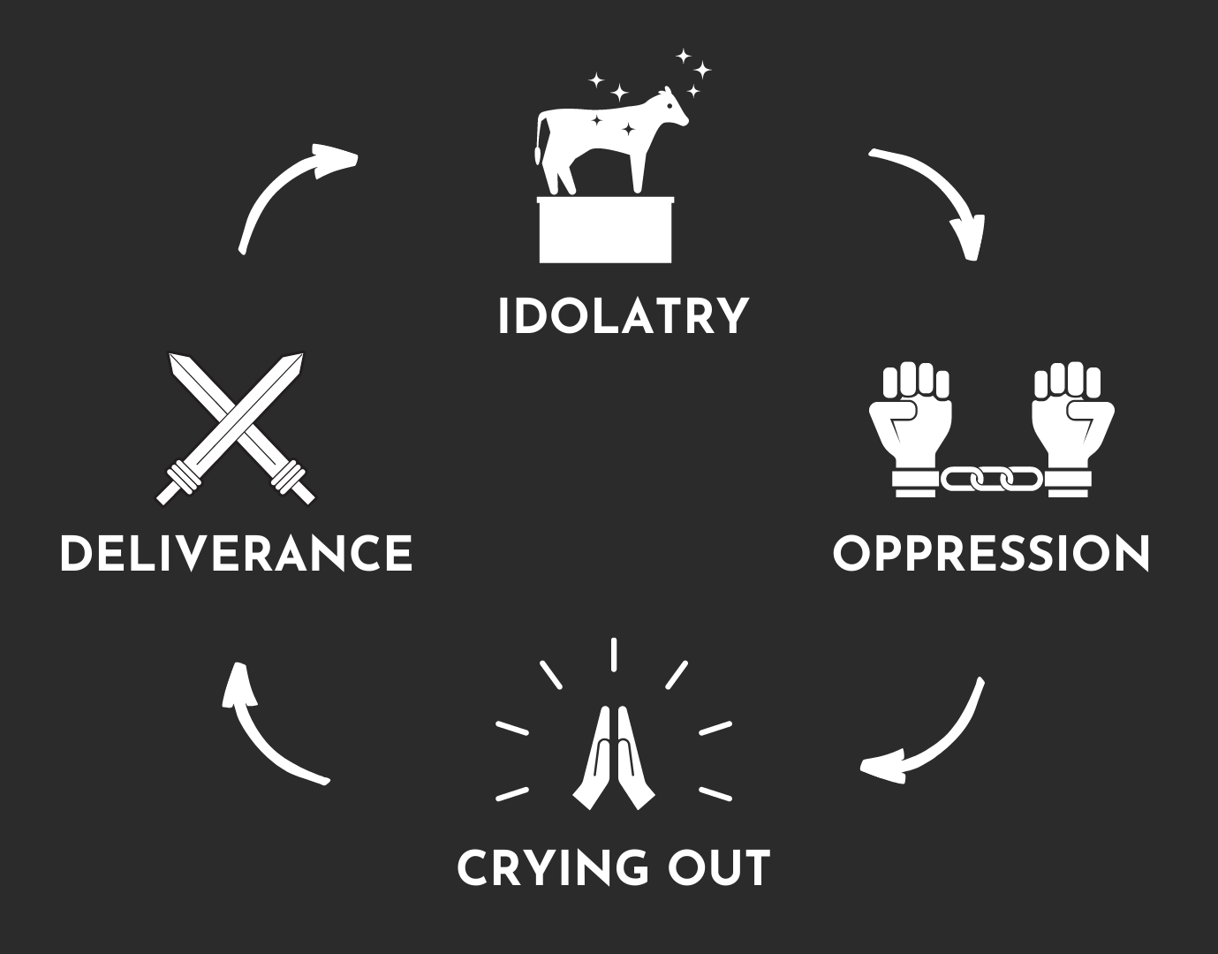
Responsibility
Action
Notes:
I love this one because not only does it look really nice, but notice how it emphasizes the ACTIONS.
The cycle they need to break is the result of their actions and is going to REQUIRE NEW ACTIONS.
This is a book with a lot of BOLD and FAITH- FILLED ACTION…. And I am excited to look at that concept with you even closer.
And while each of the judges have their own weaknesses - and

Slide 5
Responsibility
Action
Leadership
Notes:
And even though this is one ugly chart – notice number 2, 4, 5, and 7. This chart emphasizes the LEADERS…
GOD has every right to be angry at a people who have been given the Promise Land, and who then forsake Him.
When the people cry out – IT IS TO THE LORD (cut off at the bottom). Only God can deliver.
Chosen Judge – GOD picked these servants from Deborah to Samuel to be His messengers.
Judge Dies – the Leadership they provided rarely lasted beyond their lifetimes.
* * All 3 of these qualities are necessary to truly BREAK THE CYCLE… * * *

Slide 6
We Are Still Tested By The Land We Live In.
^{21 “}I also will no longer drive out before them any of the nations which Joshua left when he died, ²² in order to test Israel by them, whether they will keep the way of the Lord to walk in it as their fathers did, or not.” ²³ So the Lord allowed those nations to remain, not driving them out quickly; and He did not give them into the hand of Joshua.”
Notes:
Tested By Idolatry
Tested By Oppression
Tested By Freedom
John 17:15-18 – Jesus makes the same point. We are going OUT into the WORLD….
I hope it is super obvious that we get in cycles too!
Cycles of arguments.
Cycles of rebellion.
Cycles of unhealthy eating.
Cycles of unhealthy thinking!

Slide 7
Cycles Are Broken With The Strength of the Lord.
^{32 “}And what more shall I say? For time will fail me if I tell of Gideon, Barak, Samson, Jephthah, of David and Samuel and the prophets, ³³ who by faith conquered kingdoms, performed acts of righteousness, obtained promises, shut the mouths of lions, ³⁴ quenched the power of fire, escaped the edge of the sword, from weakness were made strong, became mighty in war, put foreign armies to flight.” Hebrews 11:32-34
Notes:
None of the judges would claim that they did this all on their own.
None of the judges would claim to be smart enough, Godly enough, strong enough to win on their own!
Even Samson – the most arrogant, most foolish, most lust driven judge KNEW that the strength was not His OWN!
In every battle, they are counting on the Power of God!
If you are in a cycle of sin, and regret – Please hold tightly to Ephesians 3:20-21 and understand that GOD HAS THE POWER to HELP YOU Break this cycle!
²⁰ Now to Him who is able to do far more abundantly beyond all that we ask or think, according to the power that works within us, ²¹ to Him be the glory in the church and in Christ Jesus to all generations ^{[n]}forever and ever. Amen.
Even today, a big part of what that look like – is raising up a person of action…

Slide 8
Cycles Are Broken By People of Action.
Ready & Willing To Act (Judges 4:4-9)
Take A Small Step (Judges 6:25-27)
Learn As You Go (Judges 7:16-22)
We Have “Judges” Available To Help (1 Cor. 6:4-6)
Notes:
The sin around us is not an oversight on God’s part.
More than good intentions or a good reputation are needed.
There were battles to be fought – and today, when we need to break a bad habit, etc… we must be people of Action.
People of Action have a bias towards accepting the risk and doing something productive.
Gideon – A Judge who takes the action late at night to destroy an idol. There is no going back on this one. Reminds me of a VHS – hit it with a hammer.
Take A Small Step
Avoid Distractions
Learn As You Go – it can be tempting to think you need a master plan – but the truth is we need to FOLLOW the REAL MASTER and trust in HIS PLAN.
Friends, we do this in so many areas of life. In our job, we are learning more and more WHILE DOING. In sports, we learn more in every game we play.
There’s just no substitute for actual practice.
“Learn By Doing”

Slide 9
Cycles Are Broken When The Preferred Future Weighs On Our Hearts.
“Then the sons of Israel cried out to the Lord, saying, “We have sinned against You, for indeed, we have forsaken our God and served the Baals.” Judges 10:10
Notes:
We Need A Long Hard Look At Our Own History!
We Must Be Honest About Where This Cycle Is Leading…
These Truths Drive Us To Sincere Prayers. (3:9, 3:15, 4:3, 6:6-7, 10:10)
The Sins that God Us Here.
The Goodness of God that Never Fails.
Where it is leading…the final chapters of the book are graphic and terrible stories that show just how dark Israel became.

Slide 10
Cycles Are Broken When We Follow Godly Leaders Pointing The Way Forward.
The Judges Pointed People To God. Judges 8:22-23, 11:27
The Judges Were Not Alone. The Role of Parents Is A Prominent Element In The Book. Judges 13:8, 14:3
Notes:
The sin around us is not an oversight on God’s part.
God’s Leaders Want Us To Follow The LORD, Not Themselves.
God send Leaders, Not Lighting Bolts… (But sometimes the leader is called “Lightning” )
Role of Parents – Gideon’s father. Gideon’s limits on his sons. Minor judges – only thing we know is about their children…. Samson’s parents urge their son to make more righteous choices.

Slide 11
But, They Kept Going Back. In Fact, Things Got Worse…
“…and act more corruptly than their fathers…” Judges 2:19

Slide 12
Cycles Remain Broken When We Resist Temptation In Times of Peace.
^{12 “}Therefore let him who thinks he stands take heed that he does not fall. ¹³ No temptation has overtaken you but such as is common to man; and God is faithful, who will not allow you to be tempted beyond what you are able, but with the temptation will provide the way of escape also, so that you will be able to endure it.” 1 Cor. 10:12-13
Notes:
The sin around us is not an oversight on God’s part.
These Times Of Peace Are Times When Our Walk With God Changes our Conditions & Our Character.

Slide 13
Cycles Remain Broken When We Exchange Our Standards For God’s Standards.
“In those days there was no king in Israel; every man did what was right in his own eyes.” Judges 17:6, 18:1, 19:1, 21:25
Notes:
The sin around us is not an oversight on God’s part.

Slide 14
Break The Cycle
Notes:
This morning we are going to study from the book of Judges. It’s wonderful that when we preach “the whole counsel of God” we come to books like this that may not be on our immediate reading list, and we discover again how RICH and how HELPFUL every section of Scripture is.
If you’ve ever read even the first 2 chapters of Judges you’ve heard about the “Cycle of the Judges.” It is one of the most dominant themes in the book…. And a quick search online will give you dozens of charts to help follow what is happening…
Let’s read it, and then let me visualize it in a few different of ways…
Two Major Features in This Book…
First is the lack of a national King. Mentioned 4 times…
Second is the downward spiral or idolatry described over and over… The outline is given in ch. 2.

