Slide 1
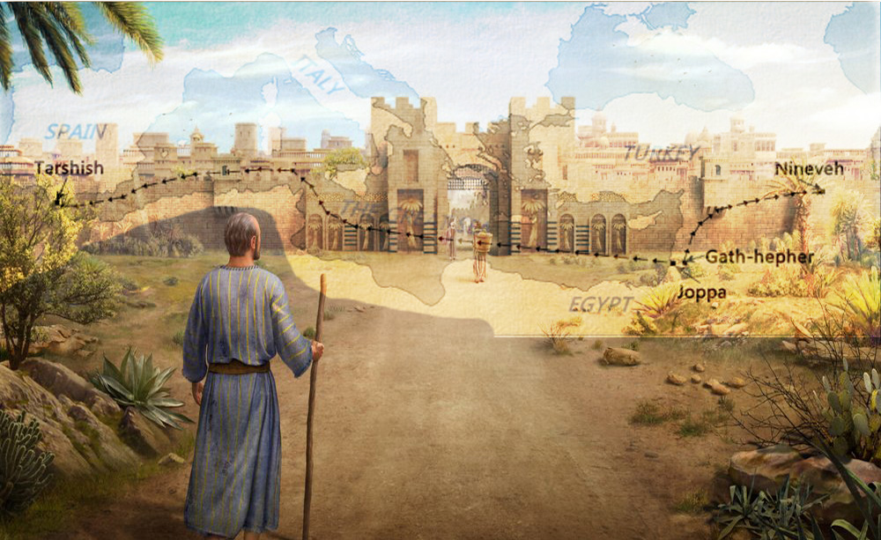
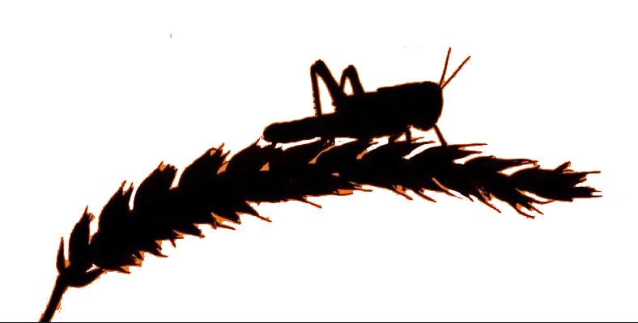
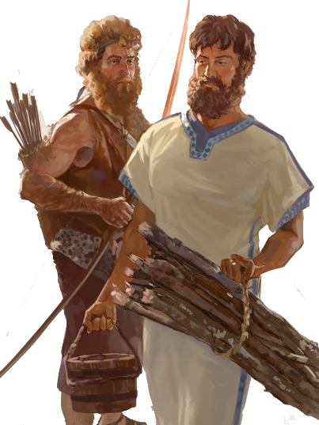
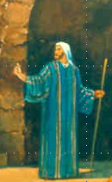

Lesson 7
Joel 1:1 –2:11

Slide 2
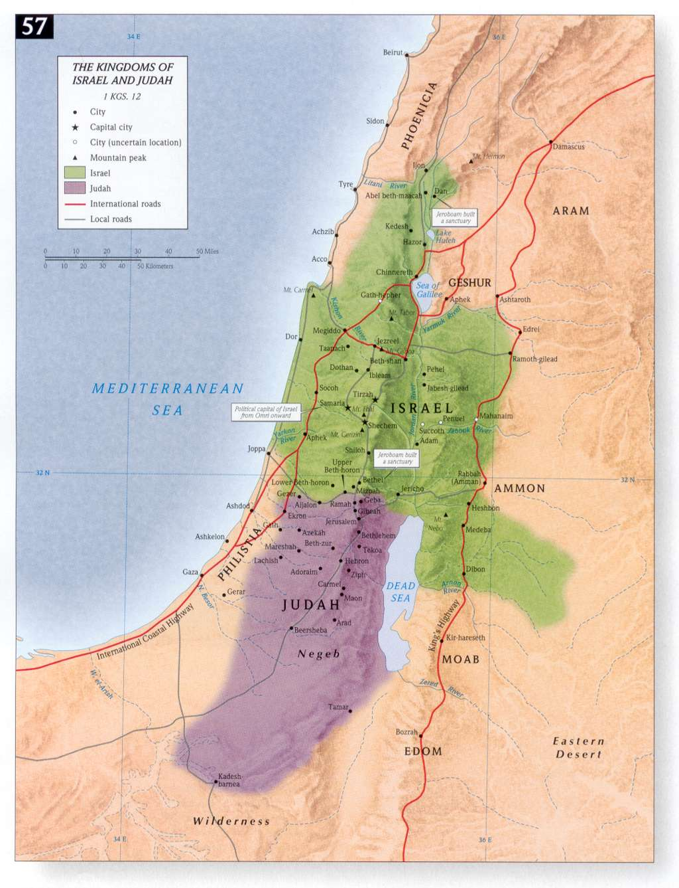
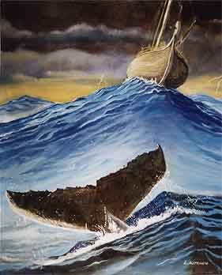
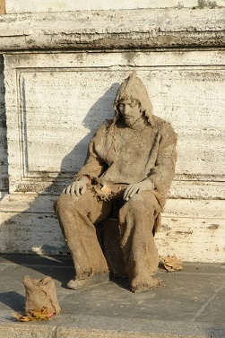

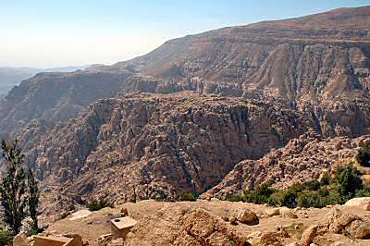
Where are the 4 Prophets?
NINEVEH
Obadiah Edom Punished
Jonah Nineveh repent or
be overthrown in 40 days
Joel Day of the Lord is great and terrible, who can endure
Micah do justly, love mercy & walk
humbly with your God
JONAH
ISRAEL
JOEL
MICAH
EDOM
OBADIAH
JUDAH

Slide 3
Class Objectives
Evidence of the Inspiration of the Scriptures
Learn timeline and events occurring for the prophets
Establish a connection between the Old Testament to the New Testament
Examine what God desires for His people as told us by the prophets
Exercise our Bible Study Skills

Slide 4
The purpose of the prophets was threefold
1
2
3
To warn the nations of the coming judgment.
To explain why the judgment had come upon them.
To give assurance, at least to a remnant, of a hope that lay beyond the judgment.
Notes:
1. The purpose of the prophets was threefold:
a. To warn the nations of the coming judgment.
b. To explain why the judgment had come upon them.
To give assurance, at least to a remnant, of a hope that lay beyond the judgment.

Slide 5
The Role of the Prophets
They are Spokesmen for God, serving as “forthtellers,” speaking what God put in their mouth.
They are Preachers of the Covenant, relating their message to God’s previous promises to the nation of Israel. These covenants were made with or through Abraham, Moses, and David
They are historians, or Interpreters of the Israelites’ History. With out their interpretation God’s people would not know why an event was occurring.

Slide 6
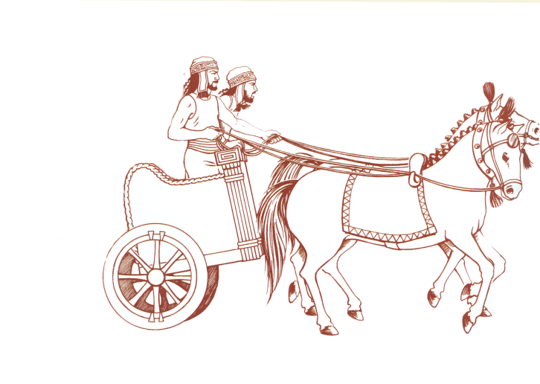


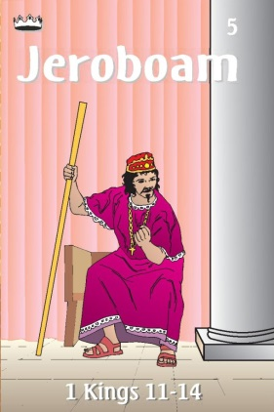

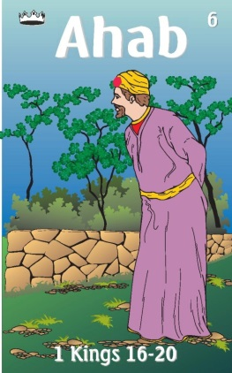
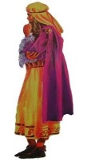
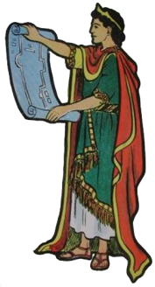

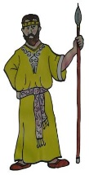
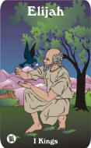
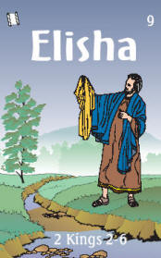

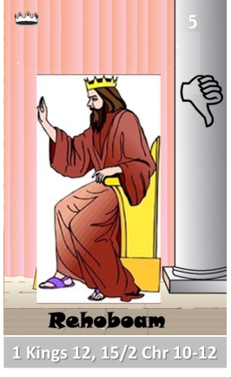
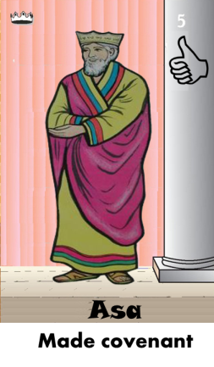
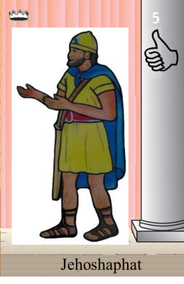
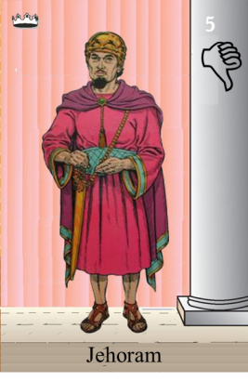
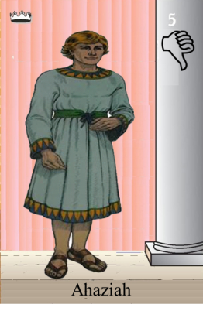
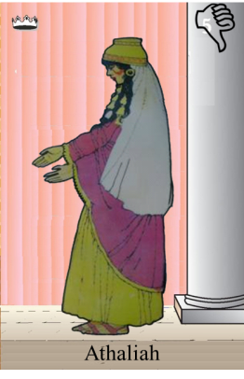
Ahaziah
Jehoram
Killed by Jehu
Baasha
Jehu
Ahijah
Man of God
Rocks for
Mizpah & Geba
Early Kings
Omri Kings
Jehu Kings
Brings in Syria
Obadiah 845-836
Killed by Jehu
Shemaiah
Azariah
Hanani the Seer
Notes:
Jeroboam – not Judha
Baasha & Asa – rocks for fort/Asa turns to Syria not God
Ahab worst King of Israel – God responds – Elijah, troubler of Israel
Elisha – troubles Syria to help Israel God’s compassion
Jehu so well wipes out Ahab’s house – to the fifth king, driving skills with chariot
Obadiah days of Jehoram

Slide 7

Prophetic Waves
Assyrian Threat
Syrian Threat
Babylonian Threat
Romans
Moses
Exodus
Persian
Written
Israel Falls
Abraham
Judah Falls
Judges
Kingdom Divides
Captivity
& Return
United Kingdom
Oral
Daniel
roars
Greeks
2100
1400
1100
1000
900
800
700
600
500
400
100
0
~30
100
605
597
586
538
458
444
722
Christ
Exile
Return
Notes:
Prophet waves –
God tends to give the last gen before day of the Lord a chance to repent – ie lots of prophet activity
Between the Testament ok
400 years of silince not so much, Daniel roars In Between the Testament

Slide 8
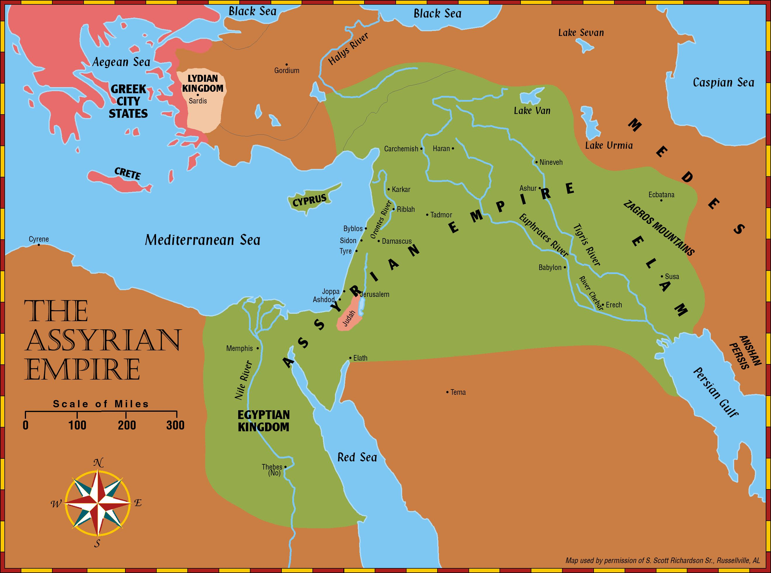
Prophets of the Assyrian Period
Obadiah (~845 BC)
Joel (~830)
Jonah (~780)
Amos (~755)
To Israel
Hosea (750-725)
Isaiah (740-690)
Micah (735-700)
To Israel

Slide 9
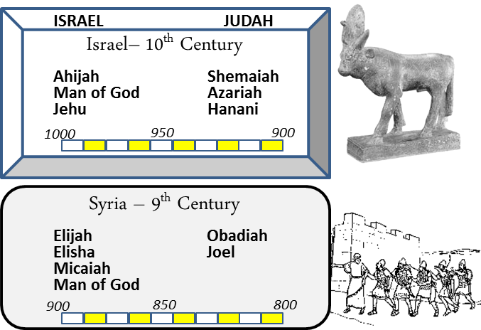
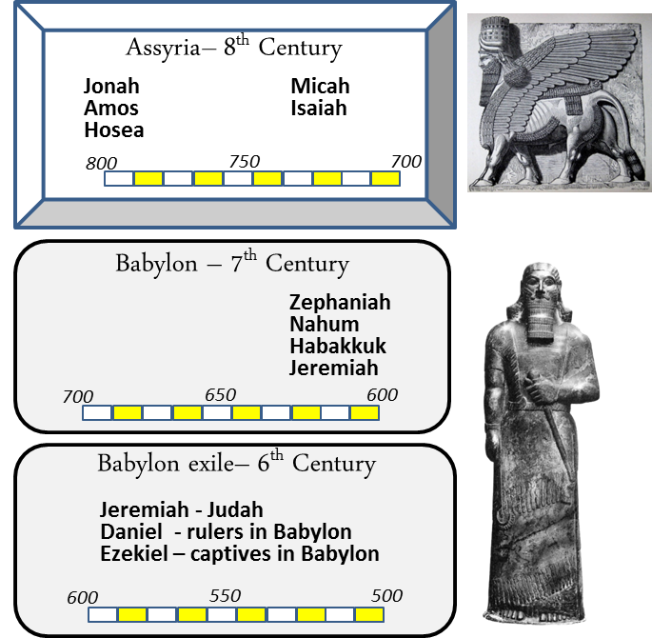
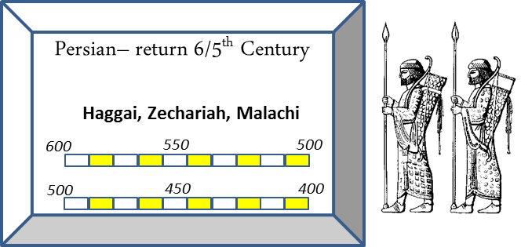
When
Joel
835-817 BC
~100 yrs
Micah
735-700 BC

Slide 10


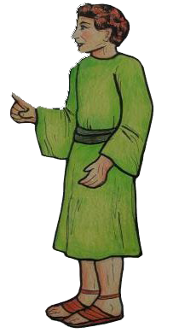

#8 Joash Card
Kings of Israel
Jehu
>did what was right in the eyes of the Lord when Jehoiada the priest lived
> then he abandoned temple and God and served the Asherim and the idols.
835-796
Prophets
crowned at age 7
repaired house of the Lord
Killed Zechariah son of Jehoiada
Fought/wealth to King of Syria
Assassinated
Joel (J)
Jehoiada Made covenant
JEHU DYNASTY

Slide 11

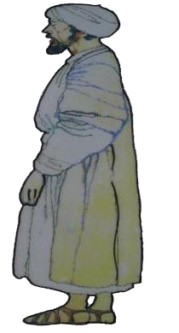

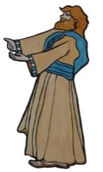
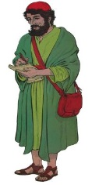
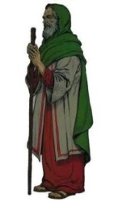
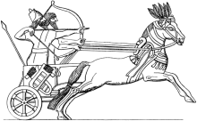



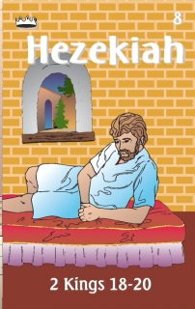

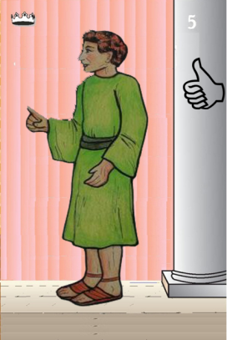
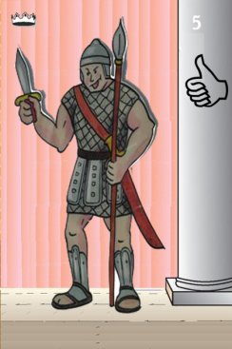
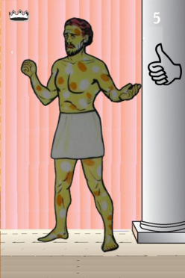
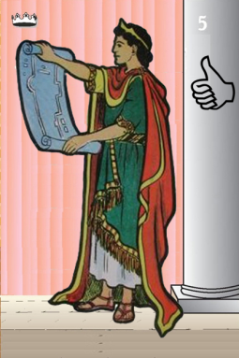
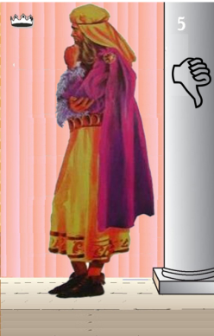
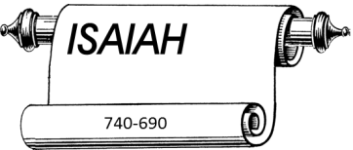

Jehu
841-814
Jehoahaz
Jehoash
Elisha &
the Arrows
Jeroboam II
Zechariah
Tiglath-pileser III
(745–727 b.c.)
793-753
Jehu Kings
Confusing
Brings in Assyria
Joash
Amaziah
Uzziah
Jotham
Ahaz
Jehoiada Made covenant
Notes:
Joel in days dya so f Joash when Jehoiada rules
Jeroboam II – Jonah and Amos
Isaiah – starts in last year of Uzziah
Micah – same time as of Isaiah – days of Ahaz
Ahaz – anybody but God would he turn/worship

Slide 12
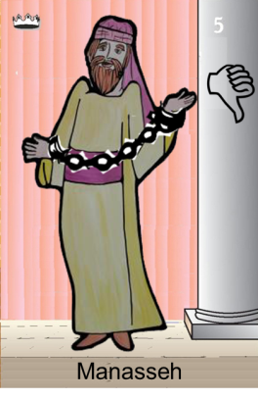
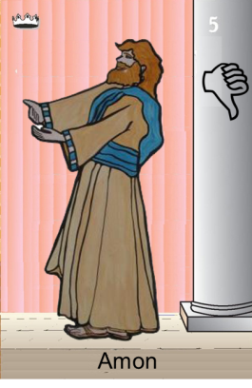
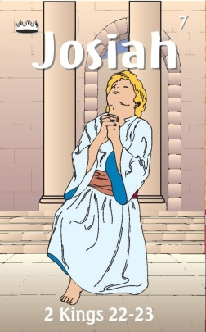

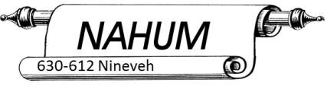


Confusing
Judah Alone
Tiglath-pileser III
(745–727 b.c.)
Revolt of 652 BC
Maybe occasion of Manasseh
Being taken captive
Shallum 752
Menahem 752-742
Pekahiah 742-740
Pekah(752) 740-732
Hoshea 732-722
697-642
640-609
Made covenant
663-
Brings in Aayria
Uzziah
Jotham
Ahaz

Slide 13
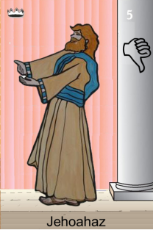

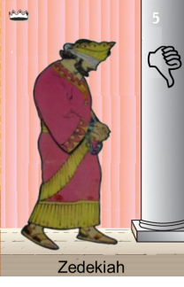
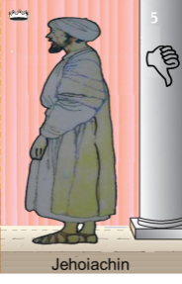
Confusing
Judah Alone
Tiglath-pileser III
(745–727 b.c.)
697-642
640-609
Shallum 752
Menahem 752-742
Pekahiah 742-740
Pekah(752) 740-732
Hoshea 732-722
Made covenant
609
609-597
Egypt
597-586
Babylon
Uzziah
Jotham
Ahaz
597
Babylon
Notes:
Manasseh worse king but repents – born in last 15 years of Hezekiah

Slide 14
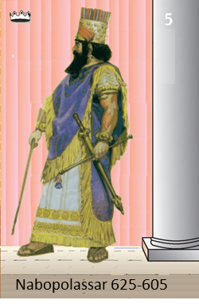
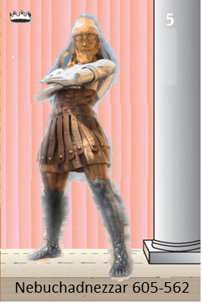
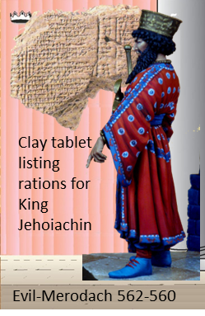
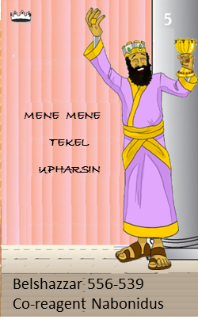





Judah Alone
605-538 BC
Return From Exile
640-609
Babylonian Captivity
538-425?
Daniel
605 BC
597 BC
586 BC

Slide 15














538-425? BC
Return From Exile
640-609
Cyrus Cylinder
Freeing People
537 Rebuild Altar
516 Rebuild Temple

Slide 16

Outline of Joel
Chapter 1
  Locust Invasion (1:1 to 12)
  Call to Repentance (1:13 to 20)
Chapter 2
  Day of the Lord (2:1 to 11)
  Call to Return to the Lord (2:12 to 17)
  Lord’s Mercy (2:18 to 27)
  Lord will Pour Out Spirit (2:28-32)
Chapter 3
  Lord Judges Nation (Philistia/Tyre/Sidon)
  Judah’s Future
Locust Impact on Crops
Actions
Describing Locust Army

Slide 17

List Your Favorite Verse/s

Slide 18

Strange/Peculiar
Words-Phrases

Slide 19
Joel 1:1 (NKJV)
The word of the Lord that came to Joel the son of Pethuel.
Hosea 1:1 (NKJV)
The word of the Lord that came to Hosea the son of Beeri, in the days of Uzziah, Jotham, Ahaz, and Hezekiah, kings of Judah, and in the days of Jeroboam the son of Joash, king of Israel.
Micah 1:1 (NKJV)
The word of the Lord that came to Micah of Moresheth in the days of Jotham, Ahaz, and Hezekiah, kings of Judah, which he saw concerning Samaria and Jerusalem.
Jonah 1:1 (NKJV)
Now the word of the Lord came to Jonah the son of Amittai, saying,
Zephaniah 1:1 (NKJV)
The word of the Lord which came to Zephaniah the son of Cushi, the son of Gedaliah, the son of Amariah, the son of Hezekiah, in the days of Josiah the son of Amon, king of Judah.
Amos 1:2 (NKJV)
And he said:
“The Lord roars from Zion,
And utters His voice from Jerusalem;..
Haggai 1:1–2 (NKJV)
…the word of the Lord came by Haggai the prophet to Zerubbabel…and to Joshua…
2“Thus speaks the Lord of hosts, saying: ‘This people says, “The time has not come, the time that the Lord’s house should be built.” ’ ”
Obadiah 1 (NKJV)
The vision of Obadiah. Thus says the Lord God concerning Edom (We have heard a report from the Lord…
Nahum 1:1 (NKJV)
1The burden against Nineveh. The book of the vision of Nahum the Elkoshite.
Zechariah 1:1 (NKJV)
In the eighth month of the second year of Darius, the word of the Lord came to Zechariah …
Habakkuk 1:1 (NKJV)
The burden which the prophet Habakkuk saw. (vision)
Malachi 1:1 (NKJV)
The burden of the word of the Lord to Israel by Malachi.

Slide 20

Remember the Coming of the Locust Joel 1:2-3
An Invasion of Locusts
² Hear this, you elders;
give ear, all inhabitants of the land!
Has such a thing happened in your days,
or in the days of your fathers?
³ Tell your children of it,
and let your children tell their children,
and their children to another generation
1
2
2
3
3
4
1915 Locust Plague
1945 Children Generation
1975 Children’s Children
2005 Children’s Children’s
2035 Children

Slide 21
Generations
or in the days of your fathers?
Has such a thing happened in your days,
865 BC
Days of Ahab
874-853 BC
Days of Jehosphat
873-848 BC
835 BC
805 BC
your children
your children tell their children,
775 BC
their children to another generation
745 BC
722 BC Fall of Northern Kingdom
715 BC

Slide 22

Prophecy – Near & Far
Within Few years of prophecy
Lifetime
Of prophet
Long
Range
Prophecies
Medium
Range
Prophecies
Messianic
Short
Term
Example
of
Locust
~830 BC
Syria
Assyria
Egypt
Edom
Babylon
“And it shall come
to pass afterward…

Slide 23







Repeated/Reaction People
Actions Commanded
for People to Take
The Prophet Joel commands the people/priest, etc to carry out several different actions. List who is to take these actions.
Tell – 1:2
Wail/Weep – 1:5, 1:13, 2:17
Lament - 1:8, 1:13
Mourn - 1:9, 1:10
Be Ashamed – 1:11
Call a sacred assembly – 1:14, 2:15-16
Cry Out 1:14, 1:19, 1:20
Blow the Trumpet – 2:1, 2:15
Sound the Alarm – 2:1
Rejoice in the Lord – 2:25
Elders
Inhabitants
Farmers/Vinedressers
1: 1 Hear this, you elders
1:14 Cry out to the Lord
1:1 And give ear
1:3 tell your children etc
1:14 Cry out to the Lord
2:1 sound the alarm, tremble
2:6 writhe in pain/faces drained
1:11 Be ashamed, you farmers,
Wail, you vinedressers,
Animals/Beasts
1:18 groan, restless, suffer
1:20 cry out to you
Priests
Virgin
you drunkards
all you drinkers of wine
1:9 mourn
1:13 Gird, Lament, Wail, Sackcloth
Consecrate a fast
Call a sacred assembly
1:12 Lament like a virgin (in sackcloth) for the husband of her youth.
1:5 awake, weep, wail

Slide 24



Rather than rent their clothes, what does God request instead in 1:8?
8 Lament like a virgin wearing sackcloth
for the bridegroom of her youth.
The Holy Bible: English Standard Version. (2016). (Joe 1:8). Wheaton, IL: Crossway Bibles.

Slide 25



Vegetation Description
Vineyard
Fig/Olive (oil) Trees
Grain/Wheat/Barley
Laid Waste
Ruined
Stripped Bare
1:7
Drink Offering Cut off
Grain Offering Cut off
1:9
Dried up
Fails
ruined
Field wasted/land mourns
1:10
Perished
1:11
Withered
All the trees
Surely joy has Withered
Dried up
1:12
Seeds shrivels
Storehouse shambles/barn broken
1:17
Burned all the trees
1:19
Notes:
Joel 1:7 (NKJV)
He has laid waste My vine,
And ruined My fig tree;
He has stripped it bare and thrown it away;
Its branches are made white.
The field is wasted,
The land mourns;
(Joe 1:10). (1982). Thomas Nelson.
The New King James Version (Joe 1:10). (1982). Thomas Nelson.
Joel 1:17 (NKJV)
17The seed shrivels under the clods, Storehouses are in shambles; Barns are broken down, For the grain has withered.
Joel 1:19 (NKJV)
19O Lord, to You I cry out; For fire has devoured the open pastures, And a flame has burned all the trees of the field.

Slide 26

Locust Cycle
Joel likely uses these terms as names for one kind of locust (perhaps in successive swarms), rather than four different types, in order to emphasize the totality of destruction
Joel 1 ESV
⁴ What the cutting locust left, the swarming locust has eaten. What the swarming locust left, the hopping locust has eaten, and what the hopping locust left, the destroying locust has eaten.
Joel 1 NKJV
⁴ What
the chewing locust left,
the swarming locust has eaten;
What the swarming locust left,
the crawling locust has eaten;
And what the crawling locust left,
the consuming locust has eaten.
egg
Joel 1 NIV
⁴What the locust swarm has left
the great locusts have eaten; what the great locusts have left
the young locusts have eaten; what the young locusts have left other locusts have eaten.
crawling
flying
Joel 2 NKJV
²⁵ “So I will restore to you the years that the swarming locust has eaten,
The crawling locust,
The consuming locust,
And the chewing locust
hopping

Slide 27

Smith, J. E. (1994). The Minor Prophets
Notes:
Scholars debate whether the prophet was thinking in terms of four waves of locusts, four species of locusts, or four stages of locusts’ development. Modern scholarship prefers the latter interpretation. Though the precise meaning of the four Hebrew terms used here is uncertain, the NASB attempts to bring out the connotation of the original: (1) gnawing locust, (2) swarming locust, (3) creeping locust, and (4) stripping locust. Three times Joel states that even the leftovers had been “devoured.” The main point is that the locusts have left the land barren (1:4).
Smith, J. E. (1994). (pp. 6263). College Press.
Smith, J. E. (1994). The Minor Prophets (pp. 62–63). College Press.

Slide 28



Life Cycle of a Locust
Young Locust in Larva Stage – no wings
Locust in Pupa Stage
Locust in Adult Stage
With wings

Slide 29


Series of locust egg pouches in ground, 15 cm deep
“Early in the spring the locusts appeared in considerable numbers along the sea-coast and on the lower spurs of the mountains. They did no great injury at the time, and, having laid their eggs, immediately disappeared.
first of June we had heard that thousands of young locusts were on their march up the valley towards our village, and at length I was told that they had reached the lower part of it” (Thomson 1882: 296).
“It is estimated by competent authorities that as many as 65,000 to 75,000 locust eggs are concentrated in a square meter of soil, and allowing for a loss of 30 per cent in hatching, some 60,000 destroyers can emerge from a space 39 inches square” (Whiting 1915: 521).
Series of locust egg pouches in ground, 15 cm deep
Notes:
“The eggs require a certain amount of moisture, for once dried or exposed to air they never hatch, which no doubt accounts for the depth to which the mother parent at times deposits them into the ground” (Whiting 1915: 516).
Date of photograph: 1930
mat02926

Slide 30




How are the invaders described in Joel 1:6?
Strong, and without number;

Slide 31


Stripped Fig Branch
Joel 1
⁶ For a nation has come up against my land, powerful and beyond number;
its teeth are lions’ teeth, and it has the fangs of a lioness.
⁷ It has laid waste my vine and splintered my fig tree; it has stripped off their bark and thrown it down; their branches are made white.

Slide 32


Attack on a Fig Tree

Slide 33

Locust plague of 1915, close view of barked fig tree
Locust plague of 1915, close view of barked fig tree
Notes:
“He hath laid my vine waste, and barked my fig tree: he hath made it clean bare, and cast it away; the branches thereof are made white” (Joel 1:7).
"The locusts at once strip the vines of every leaf and cluster of grapes, and of every green twig. I also saw many large fig-orchards "clean bare," not a leaf remaining; and as the bark of the fig-tree is of a silvery-whiteness, the whole orchards, thus rifled of their green leaves, spread abroad their braches "made white" in melancholy nakedness to the burning sun" (Thomson 1882: 298).
"Not only large vineyards loaded with young grapes, but whole fields of corn disappear, and olive, fig, and mulberry trees are stripped of their leaves as if by magic, and the hope of the husbandman vanishes like smoke" (Thomson 1882: 299).
Date of photograph: 1915
mat01904

Slide 34



How are the invaders described in Joel 1:6?
His teeth are the teeth of a lion,
And he has the fangs of a fierce lion.

Slide 35



Attack on a Fig Tree
⁷ He has laid waste My vine,
And ruined My fig tree;
He has stripped it bare and thrown it away;
Its branches are made white.
A fig tree photographed just before and after the locusts attacked is graphic proof of the destruction wrought by the insect invasion.
Notes:
*

Slide 36
Actions of Joel 1
Gird Yourselves Up (13)
Wail/lie in sackcloth (humble) (13)
Consecrate a fast (14)
Call a sacred assembly (14)
Gather all into House of the Lord (14)
For Day of Lord is at Hand – it shall come as destruction (15)
Cry out to the Lord (19)

Slide 37

Locust plague of 1915, stripped vineyard
“The meat offering and the drink offering is cut off from the house of the LORD; the priests, the LORD's ministers, mourn” (Joel 1:9).
Locust plague of 1915, stripped vineyard
Notes:
“One bright spot, the only silver lining to the cloud yet seen, was indirectly caused by the annihilation of the grape crop, viz., already ‘drinks’ have doubled in price; so that it is unnecessary with Joel to say, ‘Awake, ye drunkards, and weep; and howl, all ye drinkers of wine,’ because they are already doing it (Joel 1:5)” (Whiting 1915: 543).
“The meat offering and the drink offering is cut off from the house of the LORD; the priests, the LORD's ministers, mourn” (Joel 1:9).
Date of photograph: 1915
mat01908

Slide 38



Attack on a Fig Tree
Joel 2:3 (ESV)
Fire devours before them,
and behind them a flame burns.
The land is like the garden of Eden before them,
but behind them a desolate wilderness,
and nothing escapes them.
A fig tree photographed just before and after the locusts attacked is graphic proof of the destruction wrought by the insect invasion.
Notes:
Locust Album
The Colony created the "locust album" that documented the course of the plague of 1915 at the request of Djemal Pasha. On these pages, a fig tree photographed just before and after the locusts attacked is graphic proof of the destruction wrought by the insect invasion. In his account of the devastation in The National Geographic, Colony member John Whiting wrote that the locusts were so voracious and numerous that they could swarm over an unguarded infant and devour its eyes within a few minutes.

Slide 39


Joel 2:4 (NKJV)
⁴ Their appearance is like the appearance of horses;
And like swift steeds, so they run.

Slide 40

Joel 2:5 (NKJV)
⁵ With a noise like chariots
Over mountaintops they leap,
Like the noise of a flaming fire that devours the stubble,
Like a strong people set in battle array.

Slide 41

Joel 2:7 (NKJV)
⁷ They run like mighty men,
They climb the wall like men of war;
Every one marches in formation,
And they do not break ranks.

Slide 42

Joel 2:7 (NKJV)
⁷ They run like mighty men,
They climb the wall like men of war;
Every one marches in formation,
And they do not break ranks.

Slide 43

Joel 2:7 (NKJV)
⁷ They run like mighty men,
They climb the wall like men of war;
Every one marches in formation,
And they do not break ranks.

Slide 44

Joel 2:8 (NKJV)
They do not push one another;
Every one marches in his own column.
Though they lunge between the weapons,
They are not cut down.
Notes:
http://www.old-picture.com/middle-east/locust-plague-The-001.htm

Slide 45


Joel 2:9 (NKJV)
They climb into the houses,
They enter at the windows like a thief.

Slide 46
Joel 2:10 (NKJV)
The earth quakes before them,
The heavens tremble;
The sun and moon grow dark,
And the stars diminish their brightness.
Amos 8:9 (NKJV)
“And it shall come to pass in that day,” says the Lord God,
“That I will make the sun go down at noon,
And I will darken the earth in broad daylight;
Isaiah 13:9–10 (NKJV)
Behold, the day of the Lord comes,
Cruel, with both wrath and fierce anger,
To lay the land desolate;
And He will destroy its sinners from it.
For the stars of heaven and their constellations
Will not give their light;
The sun will be darkened in its going forth,
And the moon will not cause its light to shine.

Slide 47

Repeated/Reaction People
Actions Commanded
for People to Take
The Prophet Joel commands the people/priest, etc to carry out several different actions. List who is to take these actions.
Tell – 1:2
Wail/Weep – 1:5, 1:13, 2:17
Lament - 1:8, 1:13
Mourn - 1:9, 1:10
Be Ashamed – 1:11
Call a sacred assembly – 1:14, 2:15-16
Cry Out 1:14, 1:19, 1:20
Blow the Trumpet – 2:1, 2:15
Sound the Alarm – 2:1
Rejoice in the Lord – 2:25
Elders
you drunkards
all you drinkers of wine
1: 1 Hear this, you elders
1:14 Cry out to the Lord
Inhabitants
1:1 And give ear
1:3 tell your children etc
1:14 Cry out to the Lord
2:1 sound the alarm, tremble
2:6 writhe in pain/faces drained
1:5 awake, weep, wail
2:2 a people come
1:11 Be ashamed, you farmers,
Wail, you vinedressers,
Joel 2:11 (NKJV)
The Lord gives voice before His army,
For His camp is very great;
For strong is the One who executes His word.
For the day of the Lord is great and very terrible;
Who can endure it?
Priests
Farmers/Vinedressers
Animals/Beasts
1:9 mourn
1:13 Gird, Lament, Wail, Sackcloth
Consecrate a fast
Call a sacred assembly
1:18 groan, restless, suffer
1:20 cry out to you
Virgin
1:12 Lament like a virgin (in sackcloth) for the husband of her youth.

Slide 48
Book of Joel Paradigm-2A
Prophetic Element | Summarize Verses
In Control –thus says Joel 2:12
Chosen people Joel 2:17 Joel 2:26-27 Joel 3:2 Joel 3:16
Rebellion – Drunk? | Lacking –points to when Joash is young & under guidance of Jehoiada
Judgment to come Joel 1:15 Joel 2:1 Joel 2:11 Joel 3:2 Joel 3:4-6
Compassion Joel 2:13-14 Joel 2:18-19 Joel 2:20
Call to repentance Joel 2:12-13
Restore in future Joel 2:21-22 Joel 2:25-26
Kingdom for all Joel 2:32 Joel 3:11-12 Joel 3:17
Looking for -
Joel
A
God is Lord Of History
Lord Says
1:1 The word of the LORD that came to Joel the son of Pethuel.

Slide 49
Book of Joel Paradigm-2B
Looking for -
Joel
Prophetic Element | Summarize Verses
In Control –thus says Joel 2:12
Chosen people Joel 2:17 Joel 2:26-27 Joel 3:2 Joel 3:16
Rebellion – Drunk? | Lacking –points to when Joash is young & under guidance of Jehoiada
Judgment to come Joel 1:15 Joel 2:1 Joel 2:11 Joel 3:2 Joel 3:4-6
Compassion Joel 2:13-14 Joel 2:18-19 Joel 2:20
Call to repentance Joel 2:12-13
Restore in future Joel 2:21-22 Joel 2:25-26
Kingdom for all Joel 2:32 Joel 3:11-12 Joel 3:17
B
Election of Israel
Joel 2:1 (NKJV) The Day of the LORD
Blow the trumpet in Zion,
And sound an alarm in My holy mountain!
Let all the inhabitants of the land tremble;
For the day of the LORD is coming,
For it is at hand:

Slide 50
Book of Joel Paradigm -2C
C
Rebellion of Israel
Joel 1:5 (NKJV)
Awake, you drunkards, and weep;
And wail, all you drinkers of wine,
Because of the new wine,
For it has been cut off from your mouth.
Prophetic Element | Summarize Verses
In Control –thus says Joel 2:12
Chosen people Joel 2:17 Joel 2:26-27 Joel 3:2 Joel 3:16
Rebellion – Drunk? | Lacking –points to when Joash is young & under guidance of Jehoiada
Judgment to come Joel 1:15 Joel 2:1 Joel 2:11 Joel 3:2 Joel 3:4-6
Compassion Joel 2:13-14 Joel 2:18-19 Joel 2:20
Call to repentance Joel 2:12-13
Restore in future Joel 2:21-22 Joel 2:25-26
Kingdom for all Joel 2:32 Joel 3:11-12 Joel 3:17
D
E

Slide 51
Book of Joel Paradigm -2D
Joel 1:2 (NKJV) The Land Laid Waste
Hear this, you elders,
And give ear, all you inhabitants of the land!
Has anything like this happened in your days,
Or even in the days of your fathers?
Joel 1:6 (NKJV)
For a nation has come up against My land,
Strong, and without number;
His teeth are the teeth of a lion,
And he has the fangs of a fierce lion.
Prophetic Element | Summarize Verses
In Control –thus says Joel 2:12
Chosen people Joel 2:17 Joel 2:26-27 Joel 3:2 Joel 3:16
Rebellion – Drunk? | Lacking –points to when Joash is young & under guidance of Jehoiada
Judgment to come Joel 1:15 Joel 2:1 Joel 2:11 Joel 3:2 Joel 3:4-6
Compassion Joel 2:13-14 Joel 2:18-19 Joel 2:20
Call to repentance Joel 2:12-13
Restore in future Joel 2:21-22 Joel 2:25-26
Kingdom for all Joel 2:32 Joel 3:11-12 Joel 3:17
Joel 1:15–16 (NKJV)
Alas for the day!
For the day of the Lord is at hand;
It shall come as destruction from the Almighty.
Is not the food cut off before our eyes,
Joy and gladness from the house of our God?
D
Judgment of God
Joel 2:1 (NKJV) The Day of the LORD
Blow the trumpet in Zion,
And sound an alarm in My holy mountain!
Let all the inhabitants of the land tremble;
For the day of the LORD is coming,
For it is at hand:
Joel 2:11 (NKJV)
The Lord gives voice before His army,
For His camp is very great;
For strong is the One who executes His word.
For the day of the Lord is great and very terrible;
Who can endure it?

Slide 52

The Day of the Lord
Joel 1:15
Alas for the day!
For the day of the Lord is near,
And it will come as destruction
from the Almighty.
Joel 2:1
Blow a trumpet in Zion,
And sound an alarm on My holy
mountain!
Let all the inhabitants of the land
tremble,
For the day of the Lord is coming;
Surely it is near,
Joel 2:11
The Lord utters His voice before His
army;
Surely His camp is very great,
For strong is he who carries out His
word.
The day of the Lord is indeed great
and very awesome,
And who can endure it?
Joel 2:31
The sun will be turned into
darkness
And the moon into blood
Before the great and awesome day
of the Lord comes.

Slide 53
Book of Joel Paradigm -2E
Prophetic Element | Summarize Verses
In Control –thus says Joel 2:12
Chosen people Joel 2:17 Joel 2:26-27 Joel 3:2 Joel 3:16
Rebellion – Drunk? | Lacking –points to when Joash is young & under guidance of Jehoiada
Judgment to come Joel 1:15 Joel 2:1 Joel 2:11 Joel 3:2 Joel 3:4-6
Compassion Joel 2:13-14 Joel 2:18-19 Joel 2:20
Call to repentance Joel 2:12-13
Restore in future Joel 2:21-22 Joel 2:25-26
Kingdom for all Joel 2:32 Joel 3:11-12 Joel 3:17
E
Divine Compassion of God

Slide 54
Book of Joel Paradigm –2F
Prophetic Element | Summarize Verses
In Control –thus says Joel 2:12
Chosen people Joel 2:17 Joel 2:26-27 Joel 3:2 Joel 3:16
Rebellion – Drunk? | Lacking –points to when Joash is young & under guidance of Jehoiada
Judgment to come Joel 1:15 Joel 2:1 Joel 2:11 Joel 3:2 Joel 3:4-6
Compassion Joel 2:13-14 Joel 2:18-19 Joel 2:20
Call to repentance Joel 2:12-13
Restore in future Joel 2:21-22 Joel 2:25-26
Kingdom for all Joel 2:32 Joel 3:11-12 Joel 3:17
F
Call to Repentance
Joel 1:14 (NKJV)
Consecrate a fast,
Call a sacred assembly;
Gather the elders
And all the inhabitants of the land
Into the house of the Lord your God,
And cry out to the Lord.

Slide 55
Book of Joel Paradigm –2G
Prophetic Element | Summarize Verses
In Control –thus says Joel 2:12
Chosen people Joel 2:17 Joel 2:26-27 Joel 3:2 Joel 3:16
Rebellion – Drunk? | Lacking –points to when Joash is young & under guidance of Jehoiada
Judgment to come Joel 1:15 Joel 2:1 Joel 2:11 Joel 3:2 Joel 3:4-6
Compassion Joel 2:13-14 Joel 2:18-19 Joel 2:20
Call to repentance Joel 2:12-13
Restore in future Joel 2:21-22 Joel 2:25-26
Kingdom for all Joel 2:32 Joel 3:11-12 Joel 3:17
G
Redemption & Restoration

Slide 56
Book of Joel Paradigm –2H
Prophetic Element | Summarize Verses
In Control –thus says Joel 2:12
Chosen people Joel 2:17 Joel 2:26-27 Joel 3:2 Joel 3:16
Rebellion – Drunk? | Lacking –points to when Joash is young & under guidance of Jehoiada
Judgment to come Joel 1:15 Joel 2:1 Joel 2:11 Joel 3:2 Joel 3:4-6
Compassion Joel 2:13-14 Joel 2:18-19 Joel 2:20
Call to repentance Joel 2:12-13
Restore in future Joel 2:21-22 Joel 2:25-26
Kingdom for all Joel 2:32 Joel 3:11-12 Joel 3:17
H
Kingdom of God

Slide 57
Prophecy – Near & Far
Within Few years of prophecy
Lifetime
Of prophet
Long
Range
Prophecies
Medium
Range
Prophecies
Messianic
Short
Term
Example
of
Locust
~830 BC
Syria
Assyria
Egypt
Edom
Babylon
“And it shall come
to pass afterward…

Slide 58
Prophecy – Near & Far
Few years of prophecy
Lifetime
Of prophet
Long
Range
Prophecies
Medium
Range
Prophecies
Messianic
Short
Term
Example
of
Locust
~830 BC
“And it shall come
to pass afterward…
Joel 2:29
And also on My menservants and on My maidservants
I will pour out My Spirit in those days.
Acts 2
¹⁴But Peter, standing with the eleven, lifted up his voice and addressed them, “Men of Judea and all who dwell in Jerusalem, let this be known to you, and give ear to my words.
¹⁵For these men are not drunk, as you suppose, since it is only the third hour of the day.
¹⁶But this is what was uttered through the prophet Joel:

Slide 59



Joel 3 Timeline
Final
Messianic
Joel 2:28
“And it shall come to pass afterward That I will pour out My Spirit on all flesh;
Joel 3:1-2
¹ “For behold, in those days and at that time,
When I bring back the
captives of Judah and
Jerusalem,
² I will also gather all nations,
And bring them down to the Valley of Jehoshaphat;
And I will enter into judgment with them there
Joel 3:14-15
¹⁴ Multitudes, multitudes in the valley of decision!
For the day of the Lord is near in the valley of decision.
¹⁵ The sun and moon will grow dark,
And the stars will diminish their brightness.
Joel 3:17-18
¹⁷ “So you shall know that I am the Lord your God,
Dwelling in Zion My holy mountain.
Then Jerusalem shall be holy, And no aliens shall ever pass through her again.”
¹⁸And it will come to pass in that day…
A fountain shall flow from the house of the Lord
Joel 2:32
For in Mount Zion and in Jerusalem there shall be deliverance,
As the Lord has said,
Among the remnant whom the Lord calls.

Slide 60

The Day of the Lord in the Prophets

