Slide 1
Hebrews
Lesson Three: Christ, Moses, and Joshua

Slide 2
Riley had a happy life in Minnesota
Great family, great house, great yard, great friends, great hockey team
Family moves to San Francisco
Stressed-out family, nasty house, no yard, no friends, broccoli pizza
Her endurance breaks down at school
Anger’s Idea: Go back to Minnesota, where we were happy!

Slide 3
Riley had a happy life in Minnesota
Great family, great house, great yard, great friends, great hockey team
Family moves to San Francisco
Stressed-out family, nasty house, no yard, no friends, broccoli pizza
Her endurance breaks down at school
Anger’s Idea: Go back to Minnesota, where we were happy!
The Hebrews had a great life
Serving God via Moses and the Law at a beautiful Temple in Jerusalem
Then these Jews accepted Christ
Suffered persecution, financial losses, prison, social isolation
Their endurance was breaking down
They were thinking: Why not go back to Judaism?

Slide 4
Lest we drift
Straighten
Pay Attention
Angels
1:4-2:15
Joy set before Him
God speaks
1:1-3
In his son
Sorrowful
Why Lower?
Strengthen
Pursue Peace
Endured Cross
Enduring foR
12:4-11
Discipline
Prepare
12:12-17
to Endure
Purification
Right Hand
Despising Shame
Short of Grace
Righteousness
Bitterness
Encourage
Looking to Jesus
12:2-3
Hold Firm
Run with Endurance
Esau
No Evil Hearts
2:17-18
Moses
Joshua
3-4
Be Diligent
JESUS IS OUR
7-10:18
GREAT HIGH PRIEST
Have Faith
Miss Rest
God’s Word
Cloud of
Witnesses
10:32-12:1
Hold Fast
Throw Away
Need Endurance
Shaking
4:14-16
Sinai
12:18-29
AND Zion
Gratitude & Service
Reveremce & Awe
Draw Near
Consuming Fire
Immaturity
Suffering of Christ
Falling Away
Aaron
5:1-10
Melchizidek
Judgment
Draw Near
Vengeance
Hold Fast
SINCE Therefore
10:19-25
LET US
For if we go
10:26-31
on sinning
Stir Up
Faith & Patience
Anchor of Hope
Encourage
Fury of Fire
Terrifying
Closing
13
exhortations
Hebrews

Slide 5
Lest we drift
Pay Attention
Angels
1:4-2:15
God speaks
1:1-3
In his son
Christ is Divine
Why Lower?
More Excellent Name
Purification
Right Hand
God’s Son
Encourage
Angels Worship Him
Hold Firm
No Evil Hearts
2:17-18
Be Diligent
Angels Are Created
Moses
Joshua
3-4
JESUS IS OUR
7-10:18
GREAT HIGH PRIEST
Christ is Eternal
Miss Rest
God’s Word
Anointed above Angels
Hold Fast
4:14-16
Rules at God’s Right Hand
Draw Near
Angels are Our Servants
Hebrews

Slide 6
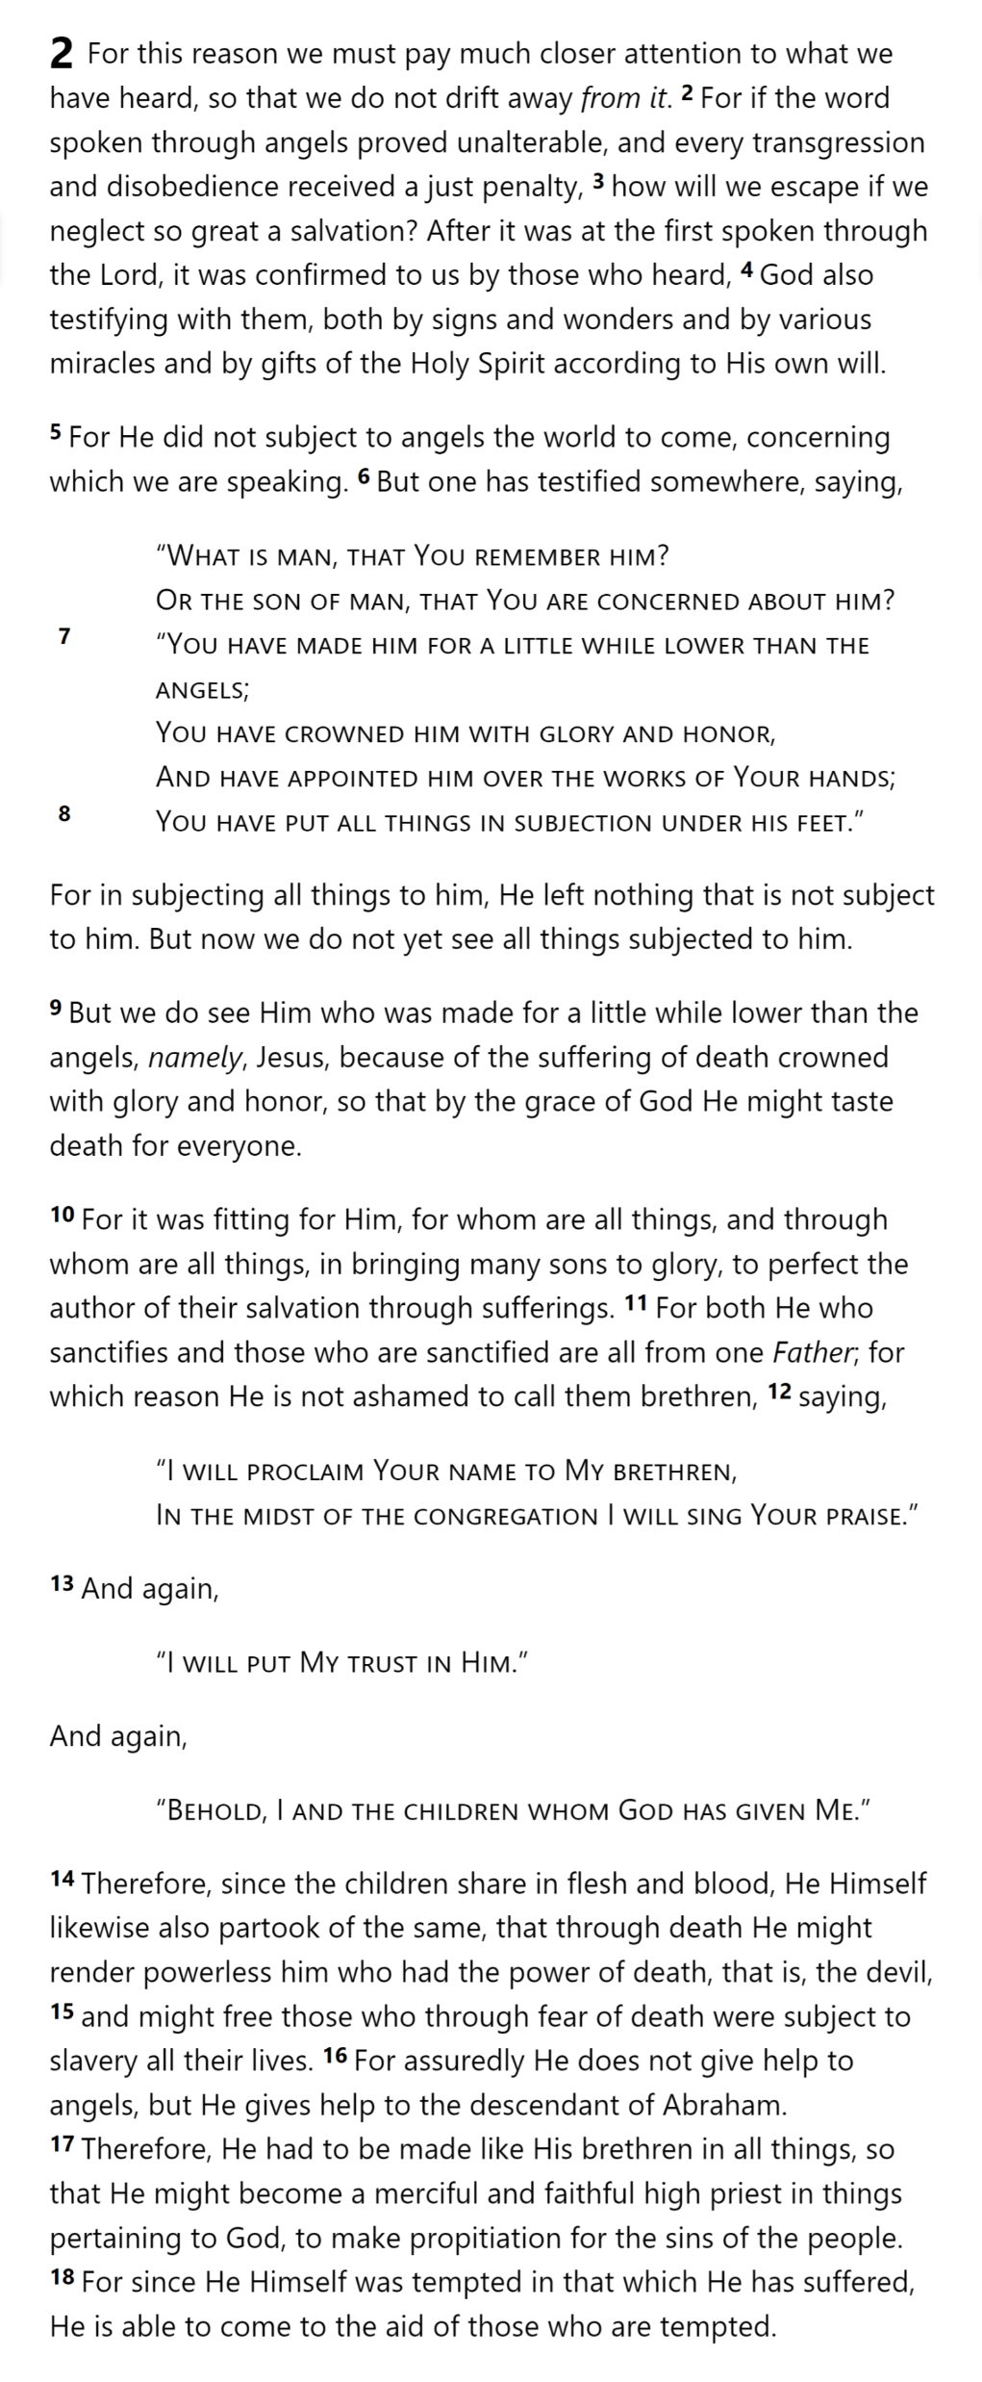
Lest we drift
Pay Attention
Hebrews
Hebrews 2

Slide 7
Why Lower?
Hebrews
Hebrews 2

Slide 8
Why Lower?
To achieve the unfulfilled destiny of man as over all creation
Hebrews
Hebrews 2

Slide 9
Why Lower?
To achieve the unfulfilled destiny of man as over all creation
To “bring many sons to glory” through His suffering
Hebrews
Hebrews 2

Slide 10
Why Lower?
To achieve the unfulfilled destiny of man as over all creation
To “bring many sons to glory” through His suffering
To allow us to become part of God’s family
Hebrews
Hebrews 2

Slide 11
Why Lower?
To achieve the unfulfilled destiny of man as over all creation
To “bring many sons to glory” through His suffering
To allow us to become part of God’s family
To partake of death to render the devil powerless and to free us from fear of death
To share in our experience of suffering and temptation
To become our high priest so He could come to our aid in temptation
Hebrews
Hebrews 2

Slide 12
To achieve the unfulfilled destiny of man as over all creation
Lest we drift
Pay Attention
Angels
1:4-2:15
God speaks
1:1-3
In his son
Why Lower?
To “bring many sons to glory” through His suffering
Purification
Right Hand
To allow us to become part of God’s family
Encourage
Hold Firm
To partake of death to render the devil powerless and to free us from fear of death
No Evil Hearts
2:17-18
Be Diligent
Moses
Joshua
3-4
JESUS IS OUR
7-10:18
GREAT HIGH PRIEST
Miss Rest
To share in our experience of suffering and temptation
God’s Word
Hold Fast
4:14-16
To become our high priest so He could come to our aid in temptation
Draw Near
Hebrews

Slide 13
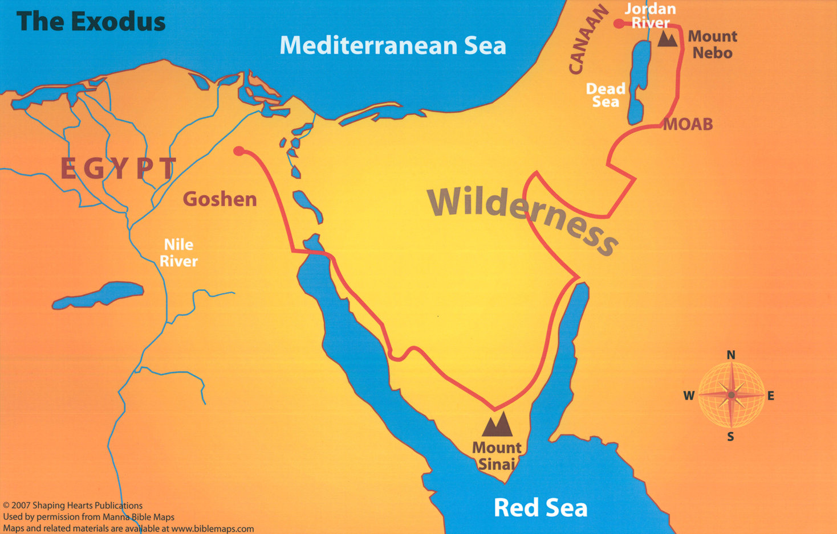
How were the Hebrew Christians in a similar position as the Israelites?
Grumbled about Food & Water
Refused to Enter the Promised Land
Witnessed God’s Power
Delivered from Bondage under Moses
Entered into Covenant with God
Worshipped the Golden Calf

Slide 14
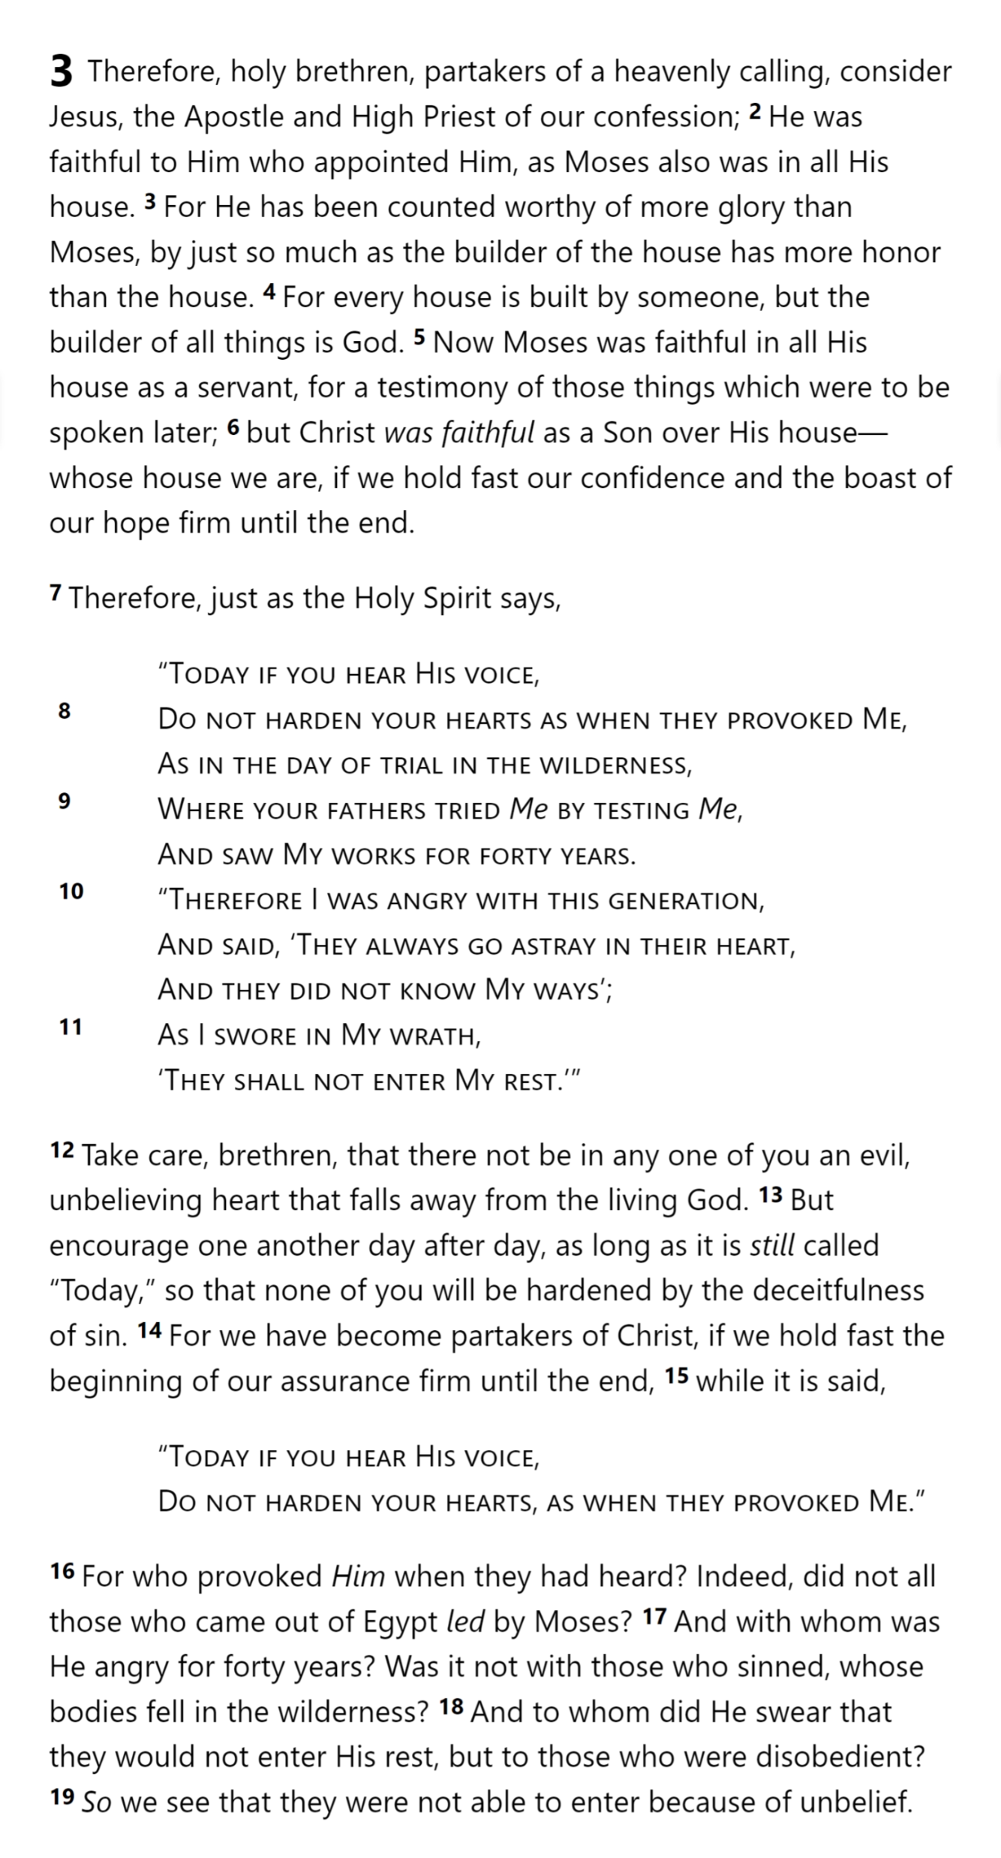
Jesus & Moses:
Both Faithful
Jesus: More
Glory & Honor
3:14 For we have become partakers of Christ, if we hold fast the beginning of our assurance firm until the end,
¹⁵ The Lord your God will raise up for you a prophet like me from among you, from your countrymen, you shall listen to him … ¹⁷ The Lord said to me, “… I will put My words in his mouth, and he shall speak to them all that I command him.”
Deuteronomy 18:15-18
Moses (3:1-4:13)
Aaron (4:14-7:28)
Jesus: Builder of the House => God
Moses: A Servant
Jesus: A Son
Moses: Testified of things to be spoken
Hebrews
Hebrews 3

Slide 15
Psalm 95:7b-11
“as at Meribah, as in the day of Massah”
What was the core problem with the Israelites?
Hebrews
Hebrews 3

Slide 16
The Hebrews were at risk of the same “heart problem” …
And so is every believer of any time
We must be diligent and help each other
A good beginning is not enough; we must stick with it to the end, no matter what comes
Hebrews
Hebrews 3

Slide 17
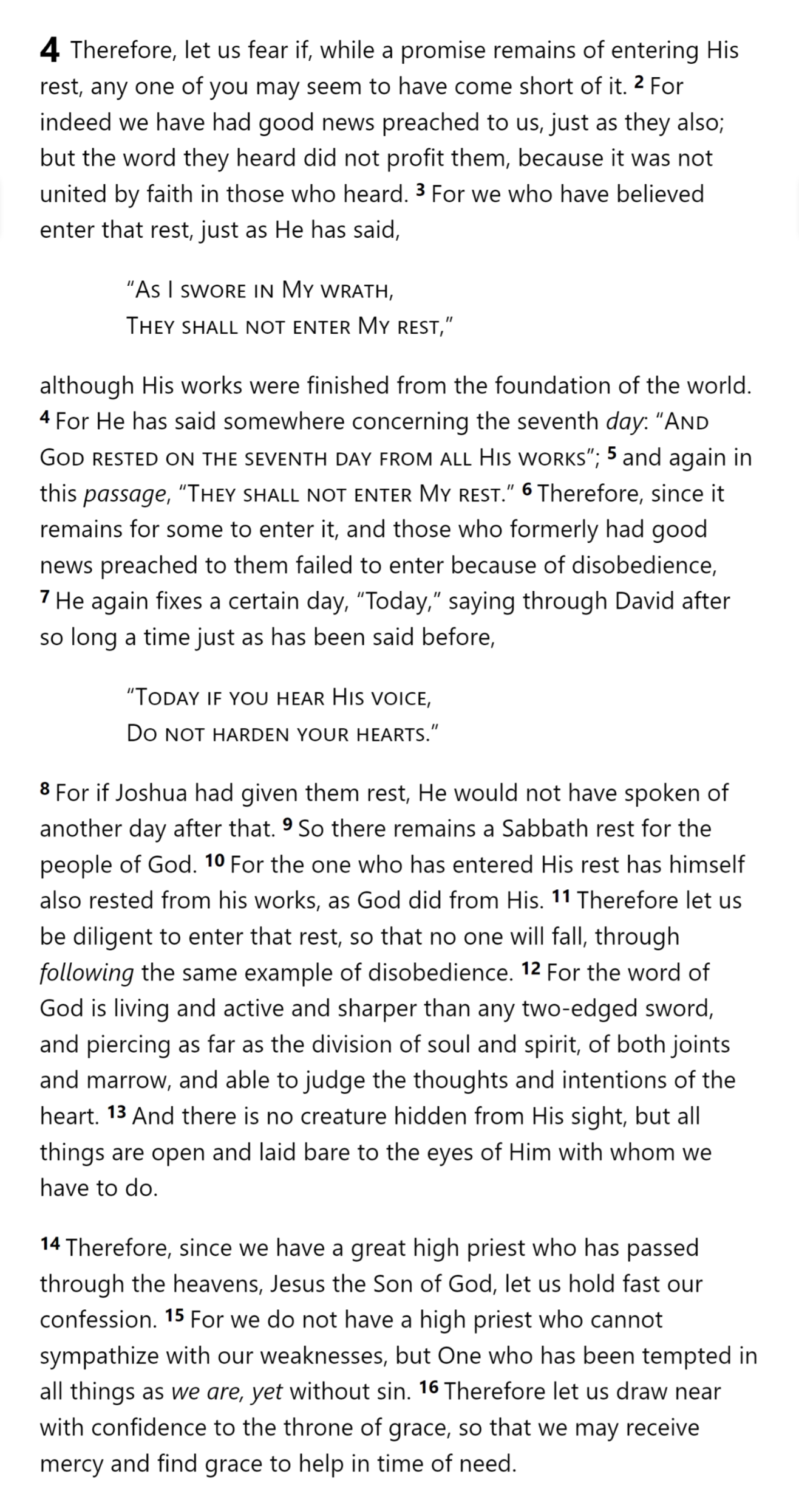
Hebrews
Hebrews 3

Slide 18
Hebrews
Hebrews 3

Slide 19
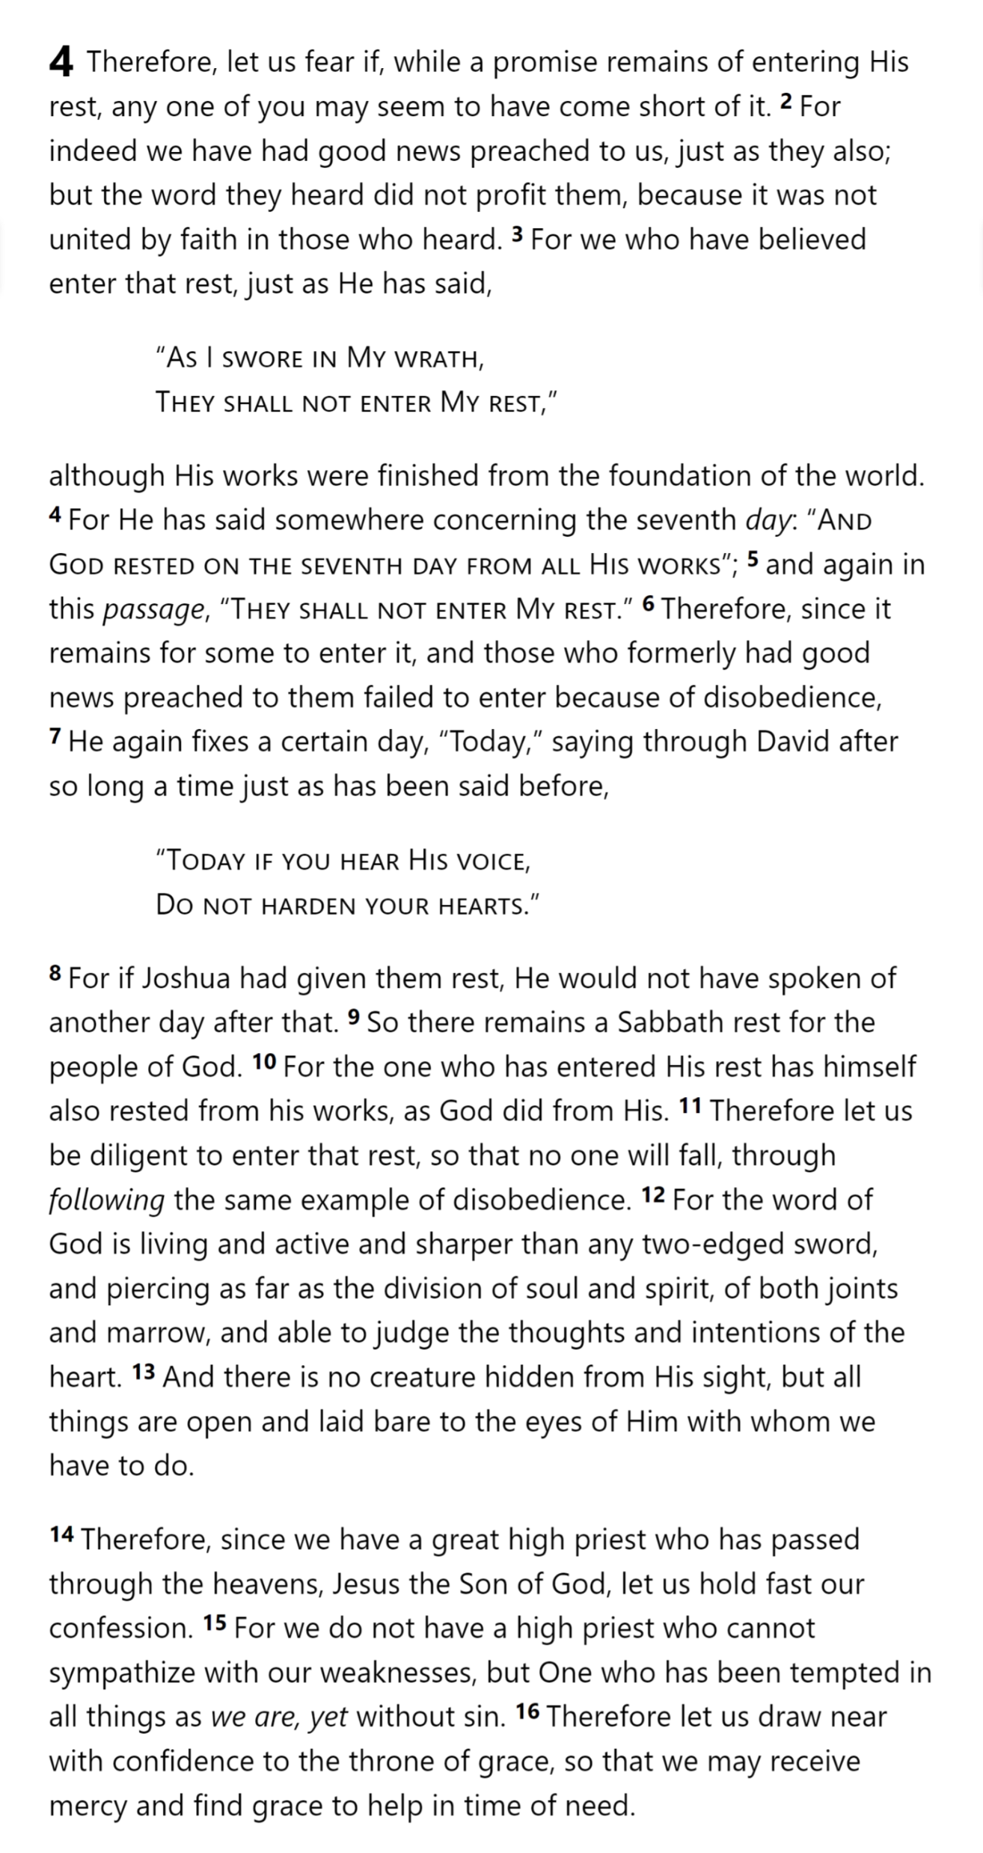
Hebrews
Hebrews 4

Slide 20
Hebrews
Hebrews 3

Slide 21
And God rested on the seventh day from all His works
Today if you hear His voice, Do not harden your hearts
Today if you hear His voice, Do not harden your hearts
Creation
Wanderings
David
Christ
Hebrews
Today
God’s Rest
They shall not enter My rest
as long as it is still called “Today” (3:13)
“So there remains a Sabbath rest for the people of God”
Hebrews 4:9
Hebrews

Slide 22
Hebrews
Hebrews 3

Slide 23
Hebrews
Hebrews 4

Slide 24
1 God … ² in these last days has spoken to us in His Son
4:2 For indeed we have had good news preached to us, just as they also; but the word they heard did not profit them, because it was not united by faith in those who heard.
¹² For the word of God is living and active and sharper than any two-edged sword, and piercing as far as the division of soul and spirit, of both joints and marrow, and able to judge the thoughts and intentions of the heart. ¹³ And there is no creature hidden from His sight, but all things are open and laid bare to the eyes of Him with whom we have to do.
2 For this reason we must pay much closer attention to what we have heard, so that we do not drift away from it … After it was at the first spoken through the Lord, it was confirmed to us by those who heard …
3:5 Moses … [testified] of those things which were to be spoken later
⁶ … those who formerly had good news preached to them failed to enter because of disobedience,
3:7 “Today if you hear His voice, ⁸ Do not harden your hearts

