Slide 1
Hebrews
Lesson Five: Convinced of Better Things

Slide 2
Riley had a happy life in Minnesota
Great family, great house, great yard, great friends, great hockey team
Family moves to San Francisco
Stressed-out family, nasty house, no yard, no friends, broccoli pizza
Her endurance breaks down at school
Anger’s Idea: Go back to Minnesota, where we were happy!

Slide 3
Riley had a happy life in Minnesota
Great family, great house, great yard, great friends, great hockey team
Family moves to San Francisco
Stressed-out family, nasty house, no yard, no friends, broccoli pizza
Her endurance breaks down at school
Anger’s Idea: Go back to Minnesota, where we were happy!
The Hebrews had a great life
Serving God via Moses and the Law at a beautiful Temple in Jerusalem
Then these Jews accepted Christ
Suffered persecution, financial losses, prison, social isolation
Their endurance was breaking down
They were thinking: Why not go back to Judaism?

Slide 4
Lest we drift
Straighten
Pay Attention
Angels
1:4-2:15
Joy set before Him
God speaks
1:1-3
In his son
Sorrowful
Why Lower?
Strengthen
Pursue Peace
Endured Cross
Enduring foR
12:4-11
Discipline
Prepare
12:12-17
to Endure
Purification
Right Hand
Despising Shame
Short of Grace
Righteousness
Bitterness
Encourage
Looking to Jesus
12:2-3
Hold Firm
Run with Endurance
Esau
No Evil Hearts
2:17-18
Moses
Joshua
3-4
Be Diligent
JESUS IS OUR
7-10:18
GREAT HIGH PRIEST
Have Faith
Miss Rest
God’s Word
Cloud of
Witnesses
10:32-12:1
Hold Fast
Throw Away
Need Endurance
Shaking
4:14-16
Sinai
12:18-29
AND Zion
Gratitude & Service
Reveremce & Awe
Draw Near
Consuming Fire
Immaturity
Suffering of Christ
Falling Away
Aaron
5:1-10
MelchizEdek
Judgment
Draw Near
Vengeance
Hold Fast
SINCE Therefore
10:19-25
LET US
For if we go
10:26-31
on sinning
Stir Up
Faith & Patience
Anchor of Hope
Encourage
Fury of Fire
Terrifying
Closing
13
exhortations
Hebrews

Slide 5
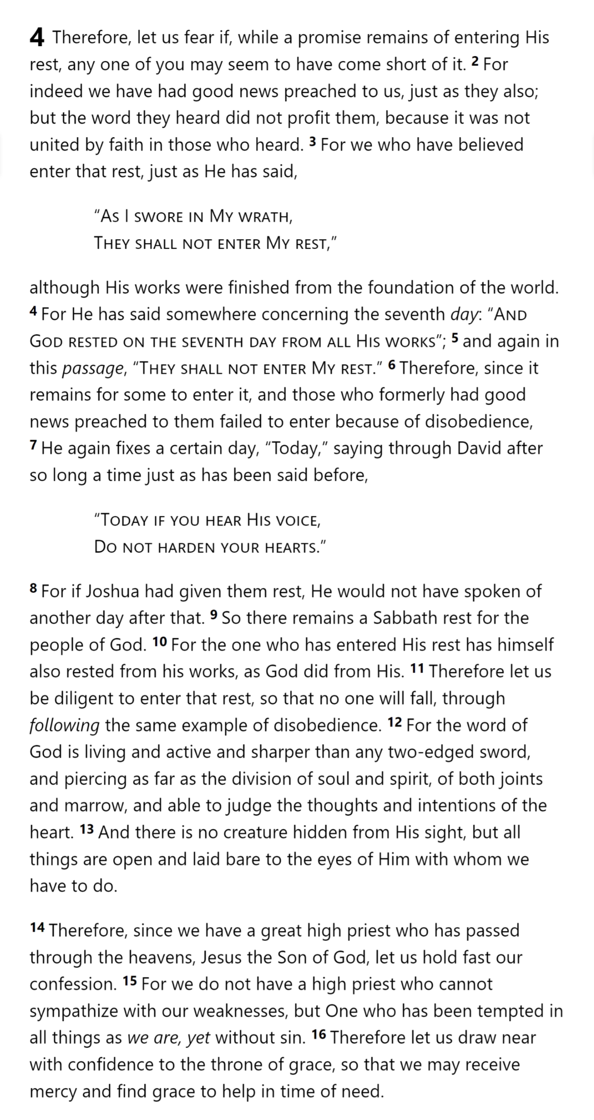
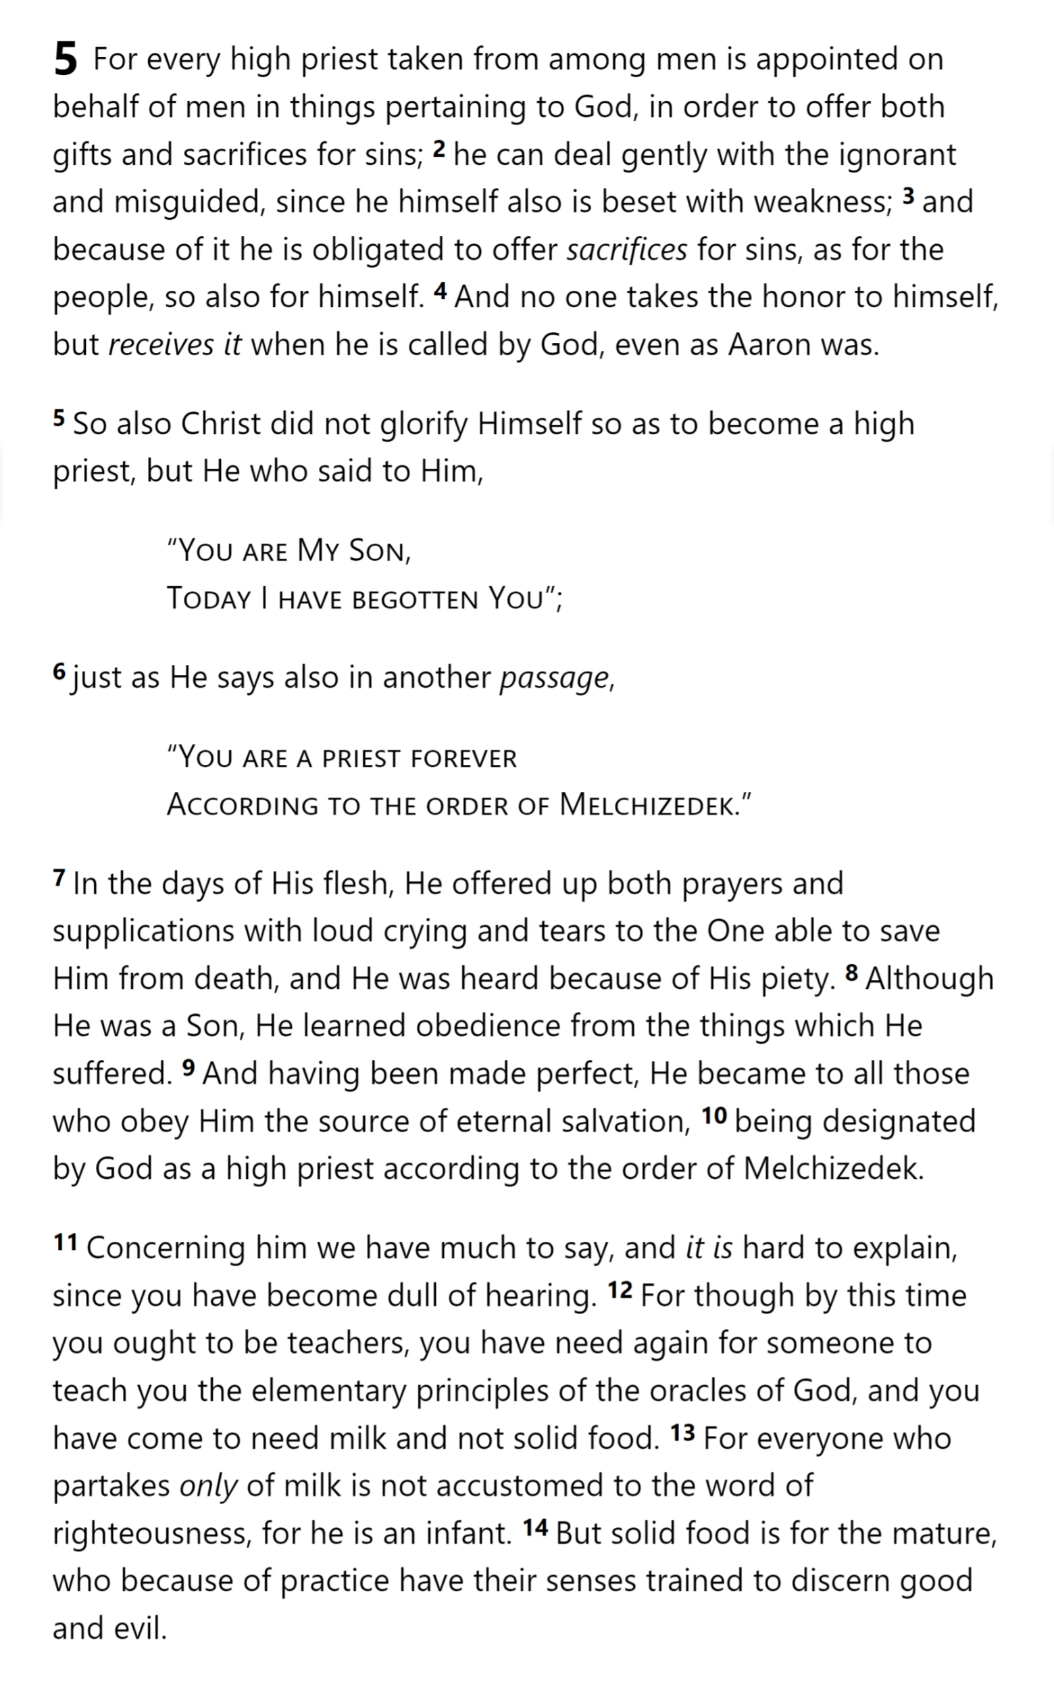
Hold Fast
4:14-16
Draw Near
Hebrews
Hebrews 4

Slide 6
Aaron
5:1-10
His role is to be the “interface” between men and their God.
His understanding of man’s plight enables him to treat men kindly when they make mistakes.
He must be appointed by God, not himself.
Offering sacrifices to God is his main job.
He must be a member of the group he represents (he must be a man).
He offers the sacrifices to deal with the sin of the people he represents.
He must know from experience the problems that men face.
He himself must appear before God without sin.
Hebrews 4

Slide 7
His role is to be the “interface” between men and their God.
He must be appointed by God, not himself.
He must be a member of the group he represents (he must be a man).
Offering sacrifices to God is his main job.
He offers the sacrifices to deal with the sin of the people he represents.
He must know from experience the problems that men face.
His understanding of man’s plight enables him to treat men kindly when they make mistakes.
He himself must appear before God without sin.
Hebrews 5

Slide 8
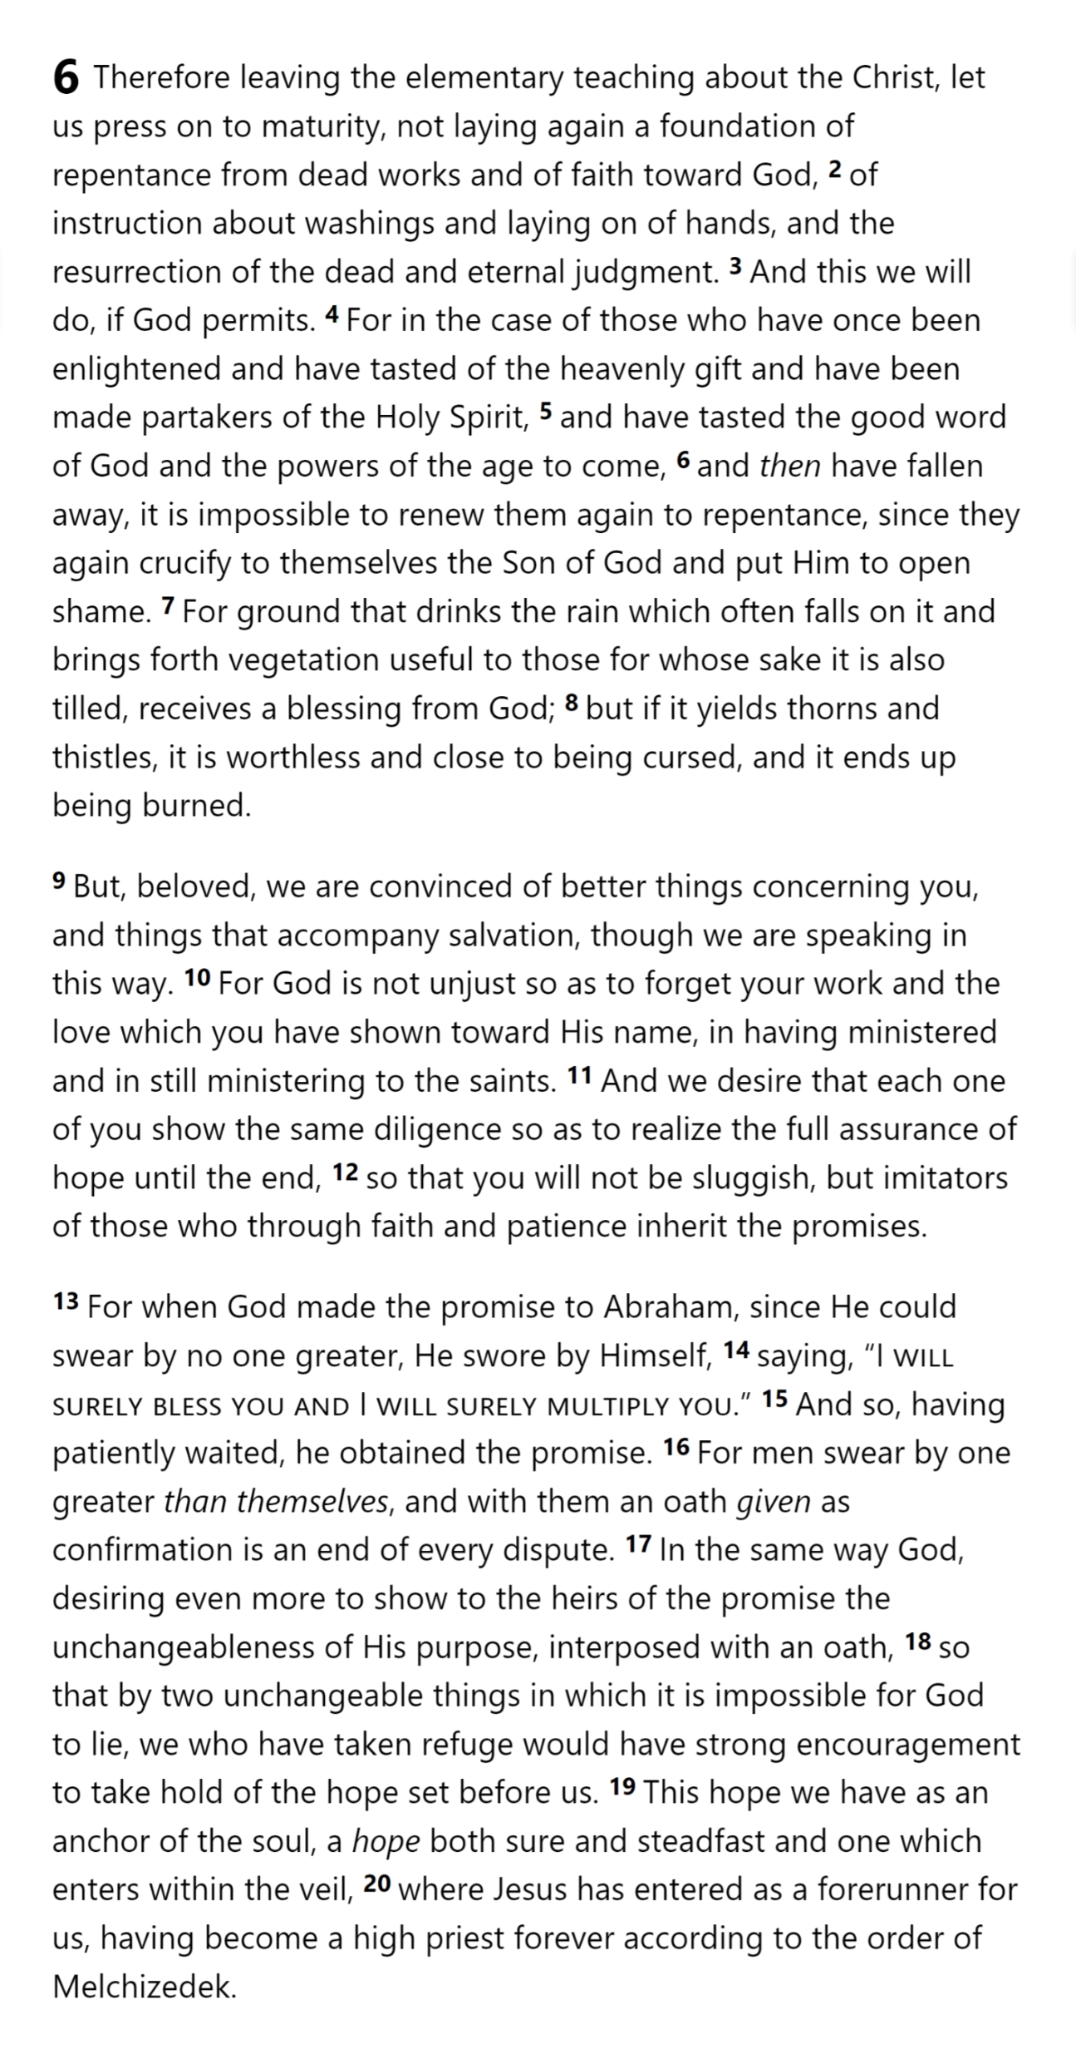
His role is to be the “interface” between men and their God.
He must be appointed by God, not himself.
He must be a member of the group he represents (he must be a man).
Offering sacrifices to God is his main job.
He offers the sacrifices to deal with the sin of the people he represents.
He must know from experience the problems that men face.
His understanding of man’s plight enables him to treat men kindly when they make mistakes.
He himself must appear before God without sin.
Hebrews 5

Slide 9
Immaturity
Hebrews
Hebrews 5

Slide 10
Immaturity
Hebrews
Hebrews 6

Slide 11
Falling Away
Hebrews
Hebrews 6

Slide 12
Falling Away
Hebrews
Hebrews 6

Slide 13
Faith & Patience
Hebrews
Hebrews 6

Slide 14
Faith & Patience
Hebrews
Hebrews 6

Slide 15
Faith & Patience
Anchor of Hope
Hebrews
Hebrews 6

Slide 16
Hold Fast
4:14-16
Draw Near
Immaturity
Suffering of Christ
Falling Away
Aaron
5:1-10
Melchizedek
Faith & Patience
Anchor of Hope
Hebrews
Hebrews 6

