Slide 1
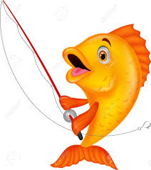
Fish to fishers
A Survey of the Evangelists in Mark 1-4

Slide 2
In mark…
The first subject is the gospel
The first character (John) is a preacher
The first thing Jesus does in his ministry is preach
The first thing he calls his first followers to do is preach
The first parable he teaches is about preaching

Slide 3
The beginning of the gospel of Jesus Christ, the Son of God. 1:1
Good news! A Savior.
Questions:
What does he save us from?
What is he like?
How does he save us?

Slide 4
John the baptist
The mission of the preacher (2)
The character of the preacher (3)
The message of the preacher (4, 7):
John appeared, baptizing in the wilderness and proclaiming a baptism of repentance for the forgiveness of sins.”
And he preached, saying, “After me comes he who is mightier than I, the strap of whose sandals I am not worthy to stoop down and untie. (7)

Slide 5
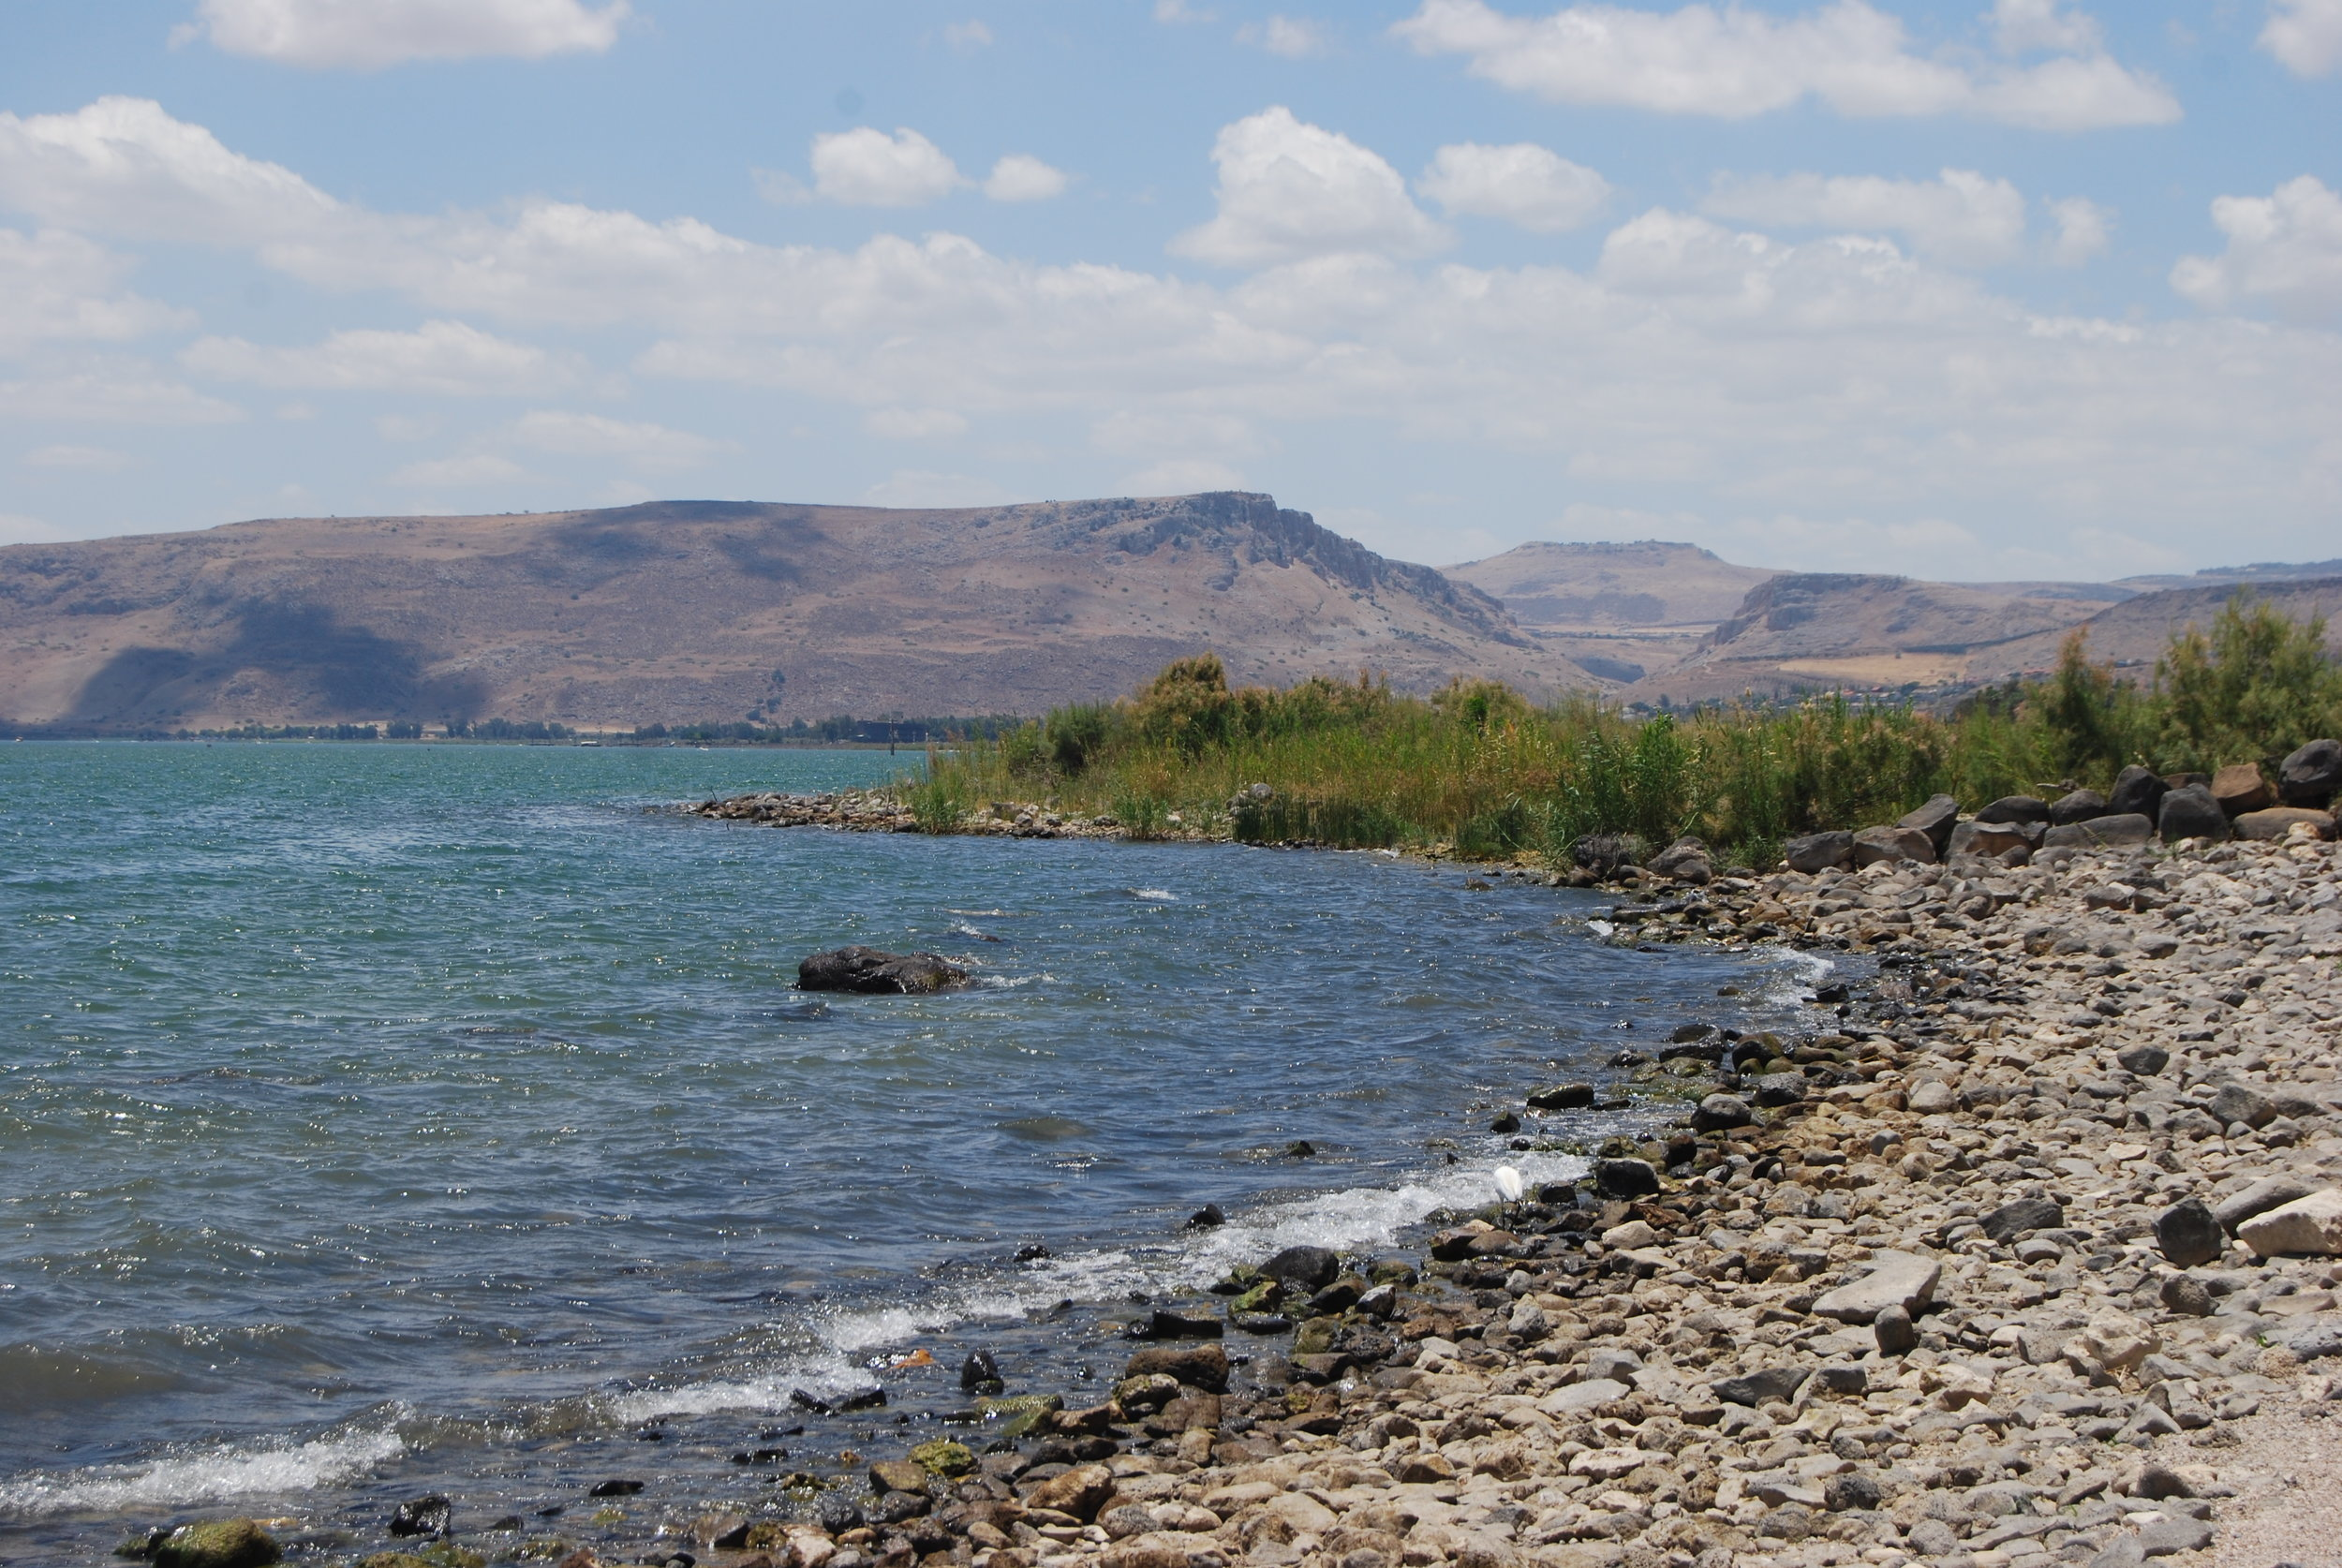
JESUS
The Preacher (1:14, 38)
The Source of authority (1:27)
The Savior (2:10)
The Seeker (2:16-17)

Slide 6
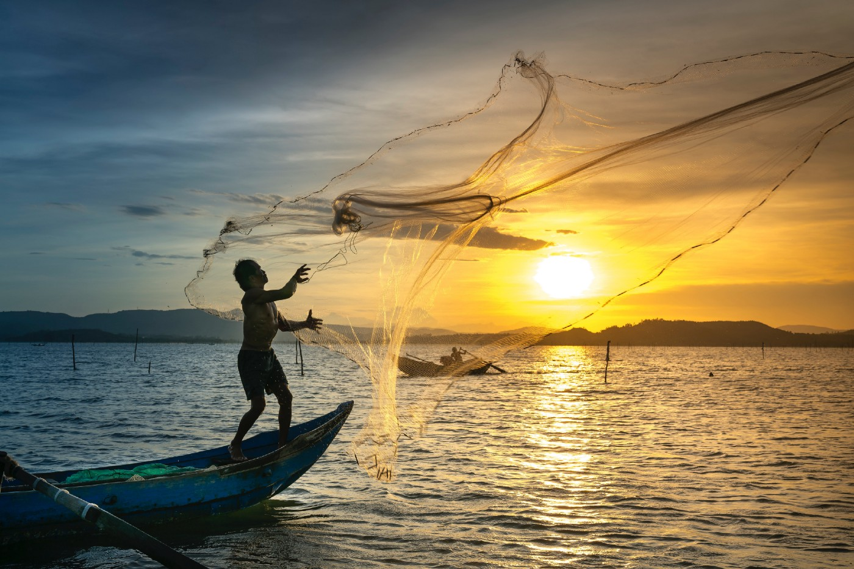
THE FISHERMEN (1:16-20)
What qualities did they not have? Have?
What job did Jesus give them?

Slide 7
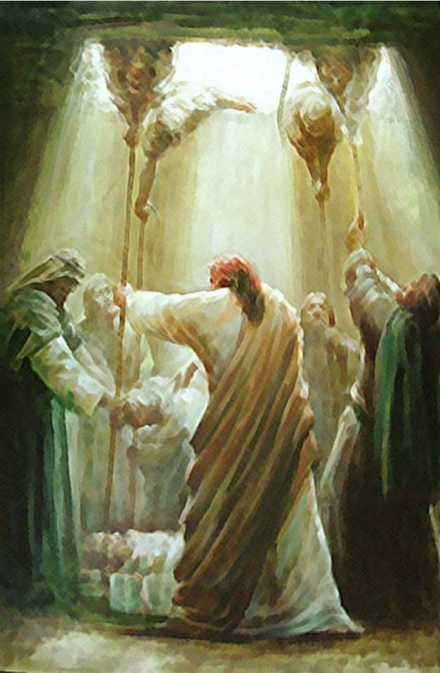
THE FRIENDS (2:1-12)
Faith, compassion, determination
How can we be like them?

Slide 8
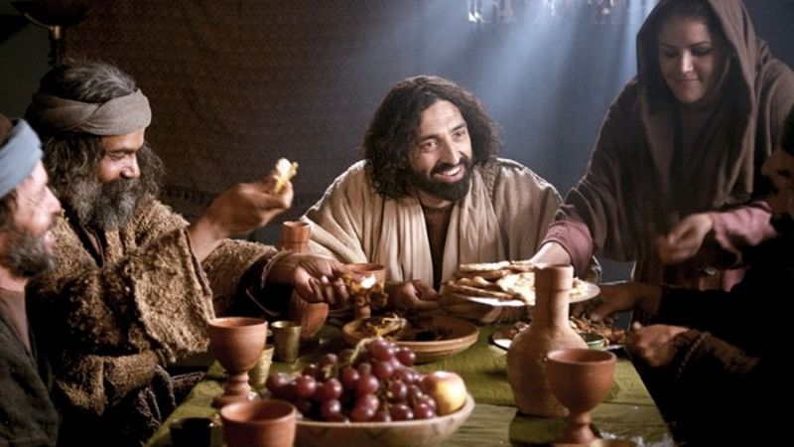
LEVI (2:14-17)
An unexpected disciple. Yet he understands Jesus wants more
How can we be like him?

Slide 9
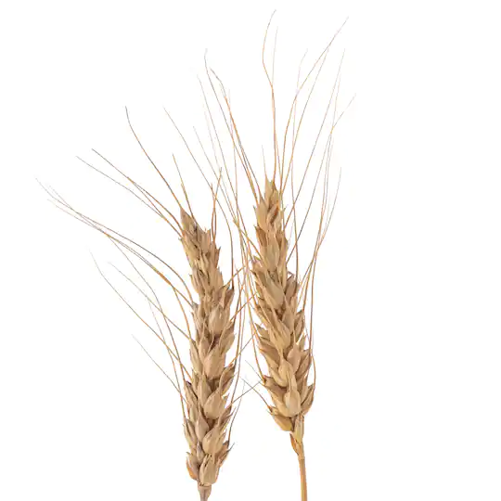
THE SOWER (4:1-20)
The sower sows the word (14). What doesn’t he do? (anything strange?)
We all have a place in this parable as a kind of ground. Can the soils change? How? (1:4, 16)
The Sower has made a sower out of the plant
Following the pattern we are seeing (fishers, Levi, etc.)
What is the fruit? The healthiest plants produce the most. Spread it where you are planted.

Slide 10
TAKE-HOME LESSONS
You have good news. It must be spread
It is more important than physical healing.
It is an essential feature of your discipleship
It doesn’t matter who you are or are not
It is not your job to figure out who will be the most receptive
There will be opposition. There will be hard hearts
There will also be those who recognize you as their best friend because you have done it

