Slide 1
Hebrews
Lesson Ten: The Cloud of Witnesses

Slide 2
Riley had a happy life in Minnesota
Great family, great house, great yard, great friends, great hockey team
Family moves to San Francisco
Stressed-out family, nasty house, no yard, no friends, broccoli pizza
Her endurance breaks down at school
Anger’s Idea: Go back to Minnesota, where we were happy!

Slide 3
Riley had a happy life in Minnesota
Great family, great house, great yard, great friends, great hockey team
Family moves to San Francisco
Stressed-out family, nasty house, no yard, no friends, broccoli pizza
Her endurance breaks down at school
Anger’s Idea: Go back to Minnesota, where we were happy!
The Hebrews had a great life
Serving God via Moses and the Law at a beautiful Temple in Jerusalem
Then these Jews accepted Christ
Suffered persecution, financial losses, prison, social isolation
Their endurance was breaking down
They were thinking: Why not go back to Judaism?

Slide 4
SACRIFICE
ORDER & OATH
TABERNACLE
JESUS IS OUR
7-10:18
GREAT HIGH PRIEST
COVENANT
MINISTRY
PROMISES
Hebrews

Slide 5
Lest we drift
Straighten
Pay Attention
Angels
1:4-2:15
Joy set before Him
God speaks
1:1-3
In his son
Sorrowful
Why Lower?
Strengthen
Pursue Peace
Endured Cross
Enduring foR
12:4-11
Discipline
Prepare
12:12-17
to Endure
Purification
Right Hand
Despising Shame
Short of Grace
Righteousness
Bitterness
Encourage
Looking to Jesus
12:2-3
Hold Firm
Run with Endurance
Esau
No Evil Hearts
2:17-18
Moses
Joshua
3-4
Be Diligent
JESUS IS OUR
7-10:18
GREAT HIGH PRIEST
Have Faith
Miss Rest
God’s Word
Cloud of
Witnesses
10:32-12:1
Hold Fast
Throw Away
Need Endurance
Shaking
4:14-16
Sinai
12:18-29
AND Zion
Gratitude & Service
Reveremce & Awe
Draw Near
Consuming Fire
Immaturity
Suffering of Christ
Falling Away
Aaron
5:1-10
MelchizEdek
Judgment
Draw Near
Vengeance
Hold Fast
SINCE Therefore
10:19-25
LET US
For if we go
10:26-31
on sinning
Stir Up
Faith & Patience
Anchor of Hope
Encourage
Fury of Fire
Terrifying
Closing
13
exhortations
Hebrews

Slide 6
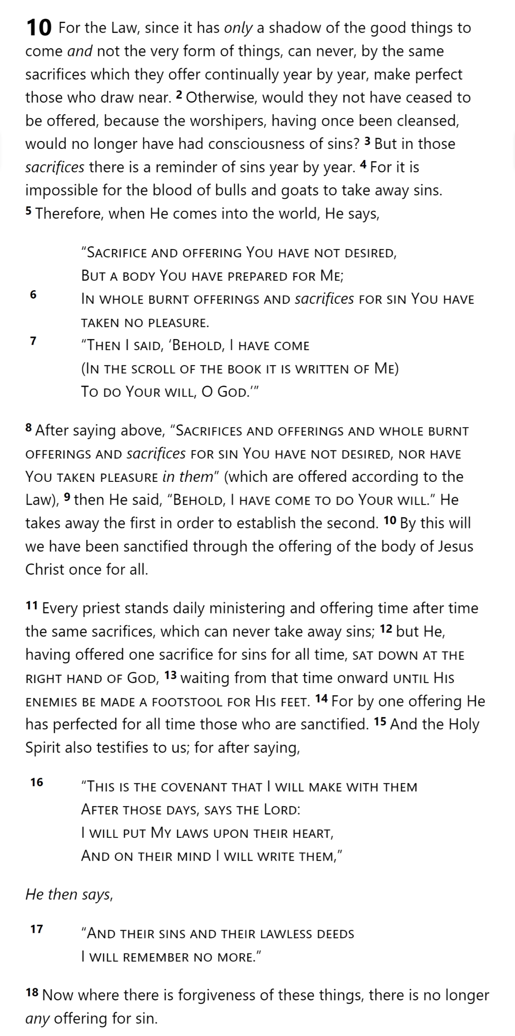
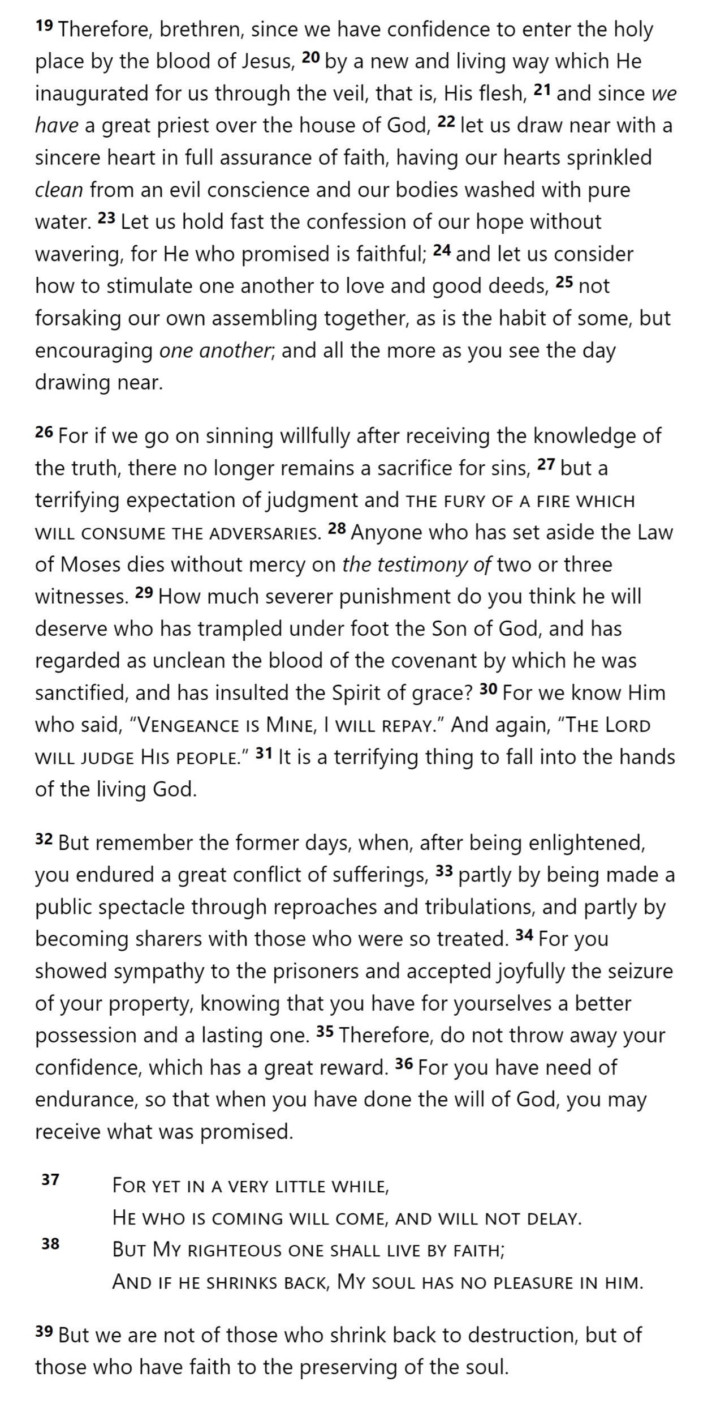
SON
SON
SON
GOD
SON
SON
SON
SON
MAN
MAN
MAN
MAN
MAN
SON
COVENANT
PROMISES
SON
Hebrews 10

Slide 7
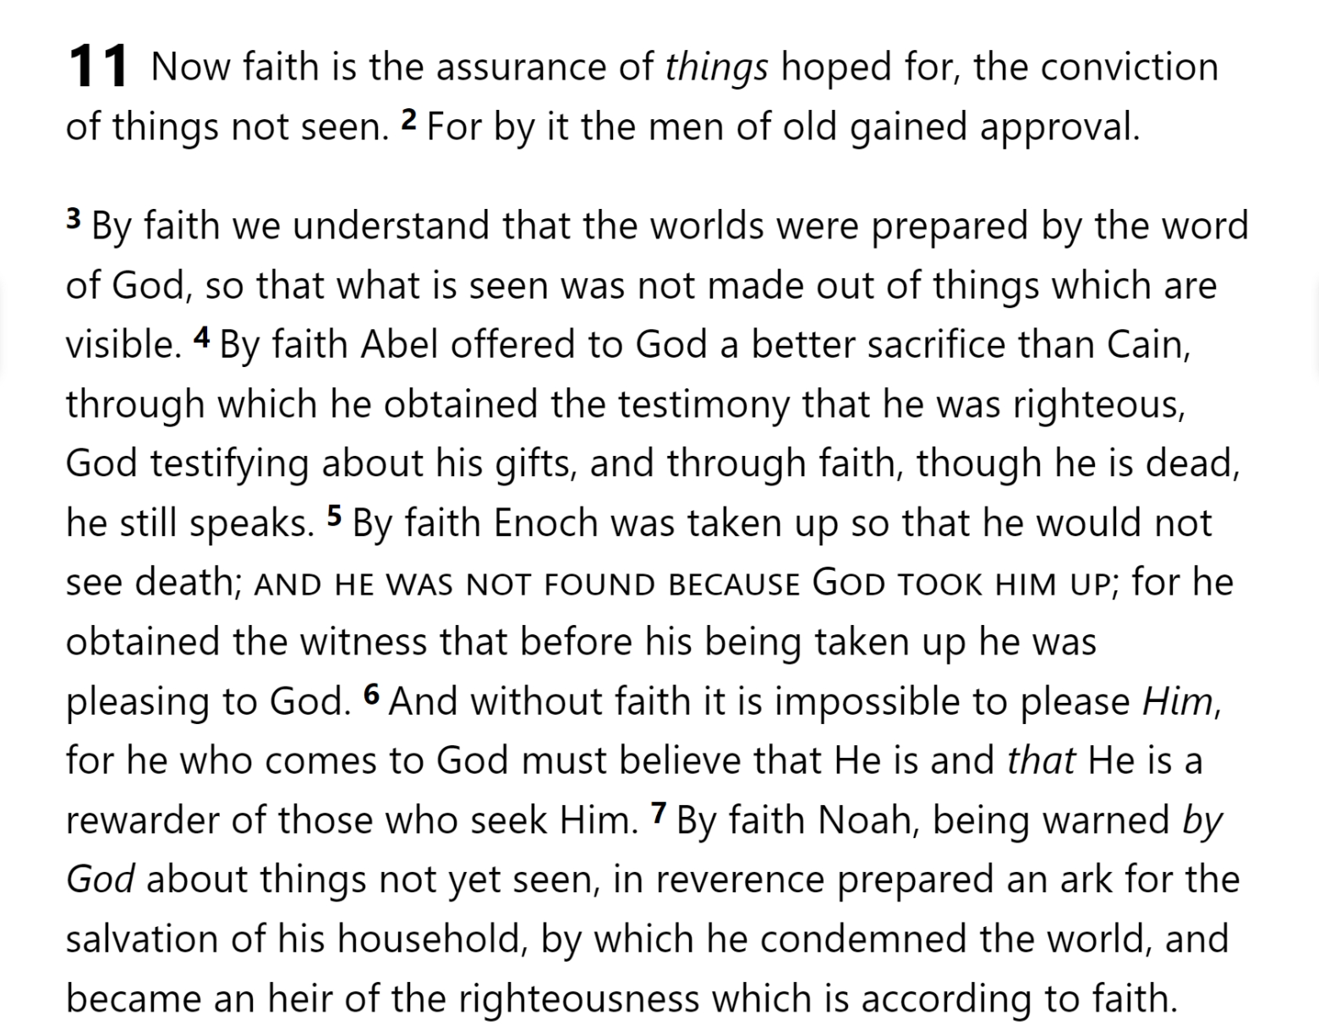
SON
SON
SON
GOD
SON
SON
SON
SON
MAN
MAN
MAN
MAN
MAN
SON
COVENANT
PROMISES
SON
Hebrews 10

Slide 8
SON
SON
SON
GOD
SON
SON
SON
SON
MAN
MAN
MAN
MAN
MAN
SON
COVENANT
PROMISES
SON
Hebrews 10

Slide 9
SON
SON
SON
GOD
SON
SON
SON
SON
MAN
MAN
MAN
MAN
MAN
SON
COVENANT
PROMISES
SON
Hebrews 10

Slide 10
SON
SON
SON
GOD
SON
SON
SON
SON
MAN
MAN
MAN
MAN
MAN
SON
COVENANT
PROMISES
SON
Hebrews 10

Slide 11
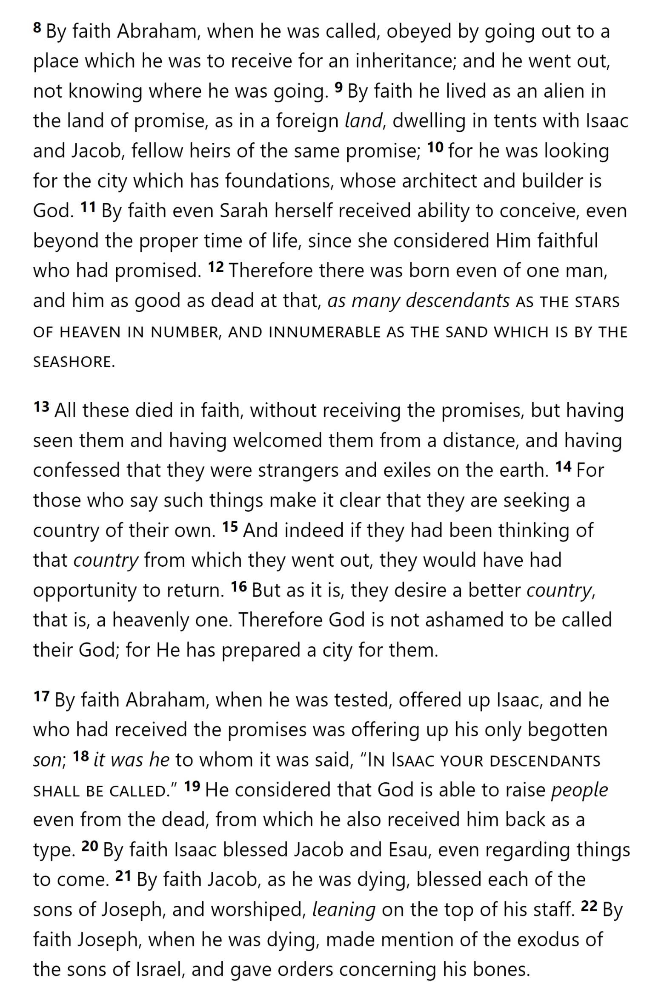
Hebrews 11

Slide 12
Hebrews 11

Slide 13
Hebrews 11

Slide 14
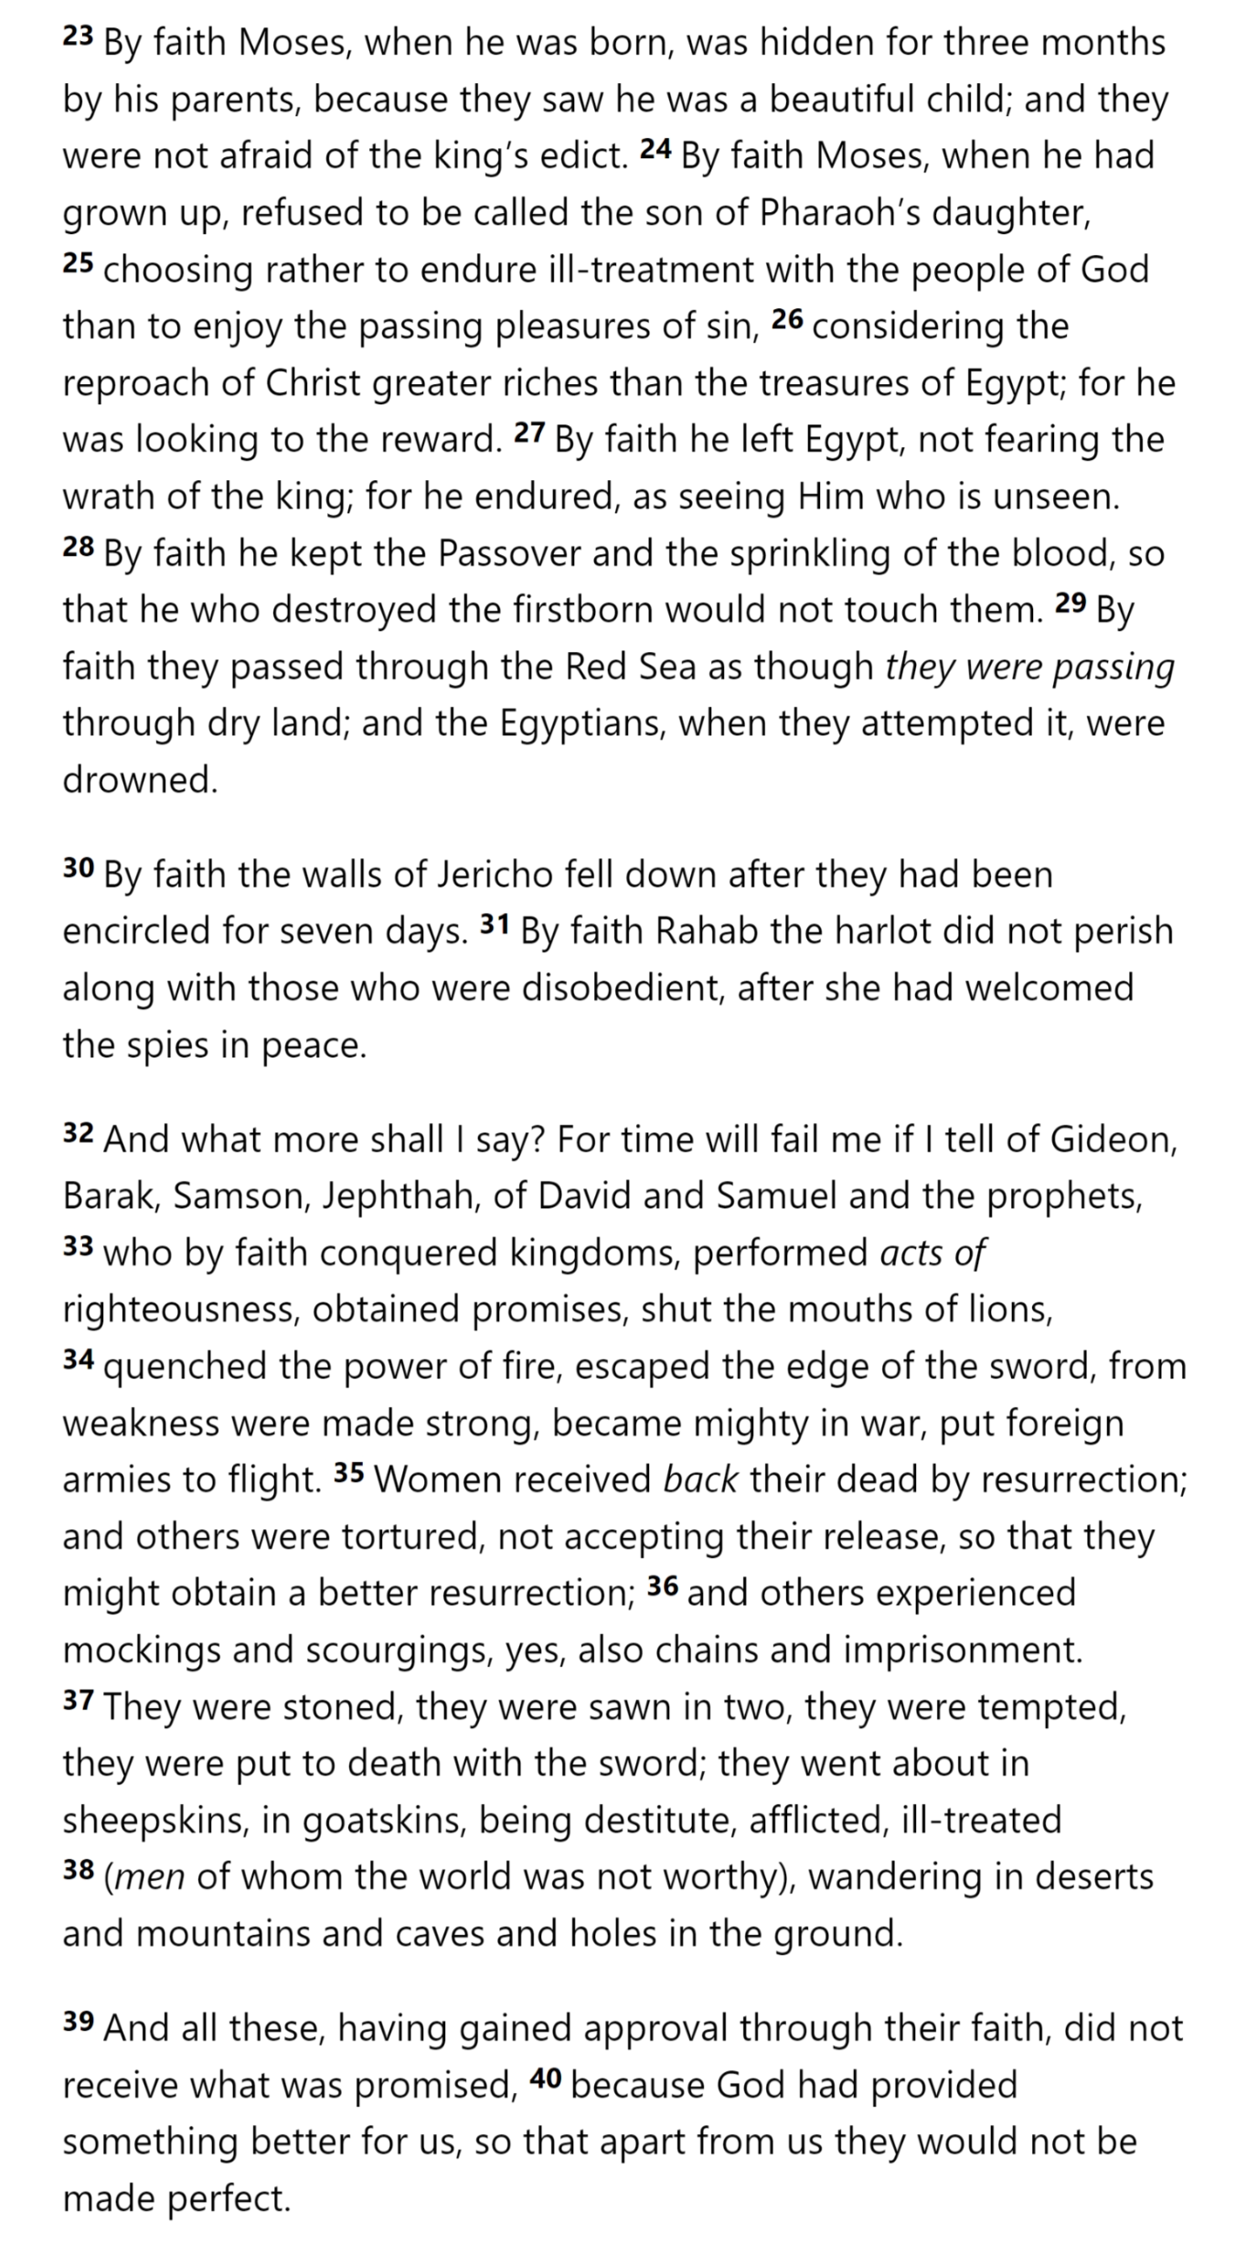
Hebrews 11

Slide 15
Hebrews 11

Slide 16
Hebrews 11

Slide 17
Hebrews 11

Slide 18
Hebrews 11

Slide 19
Hebrews 11

Slide 20
Hebrews 11

Slide 21
Hebrews 11

