Slide 1
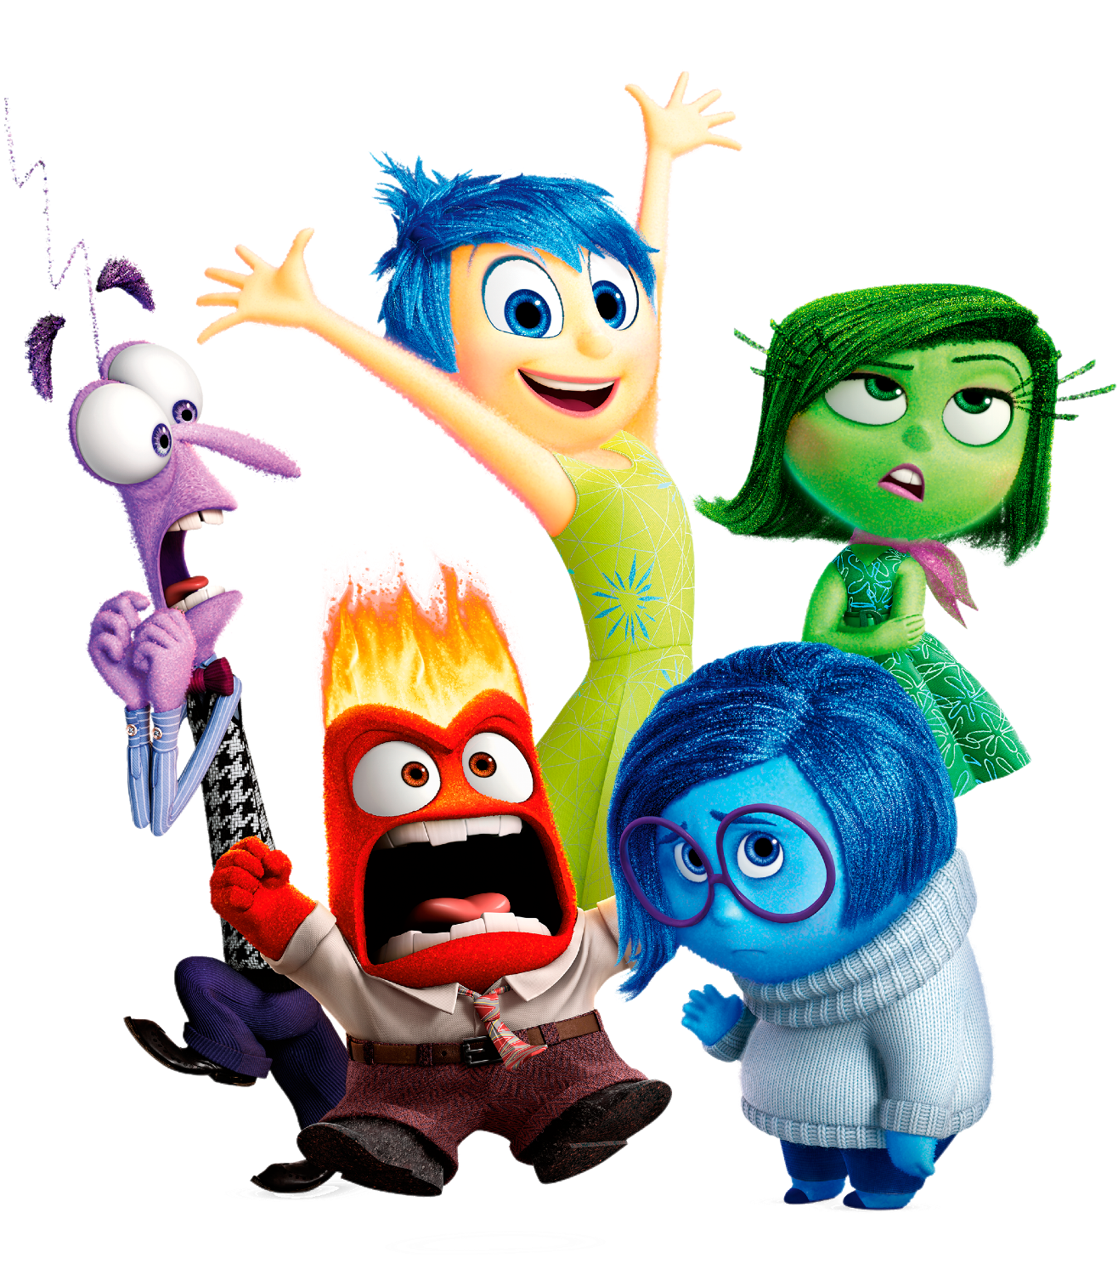
Hebrews
Lesson Twelve: Final Exhortations

Slide 2
Riley had a happy life in Minnesota
Great family, great house, great yard, great friends, great hockey team
Family moves to San Francisco
Stressed-out family, nasty house, no yard, no friends, broccoli pizza
Her endurance breaks down at school
Anger’s Idea: Go back to Minnesota, where we were happy!

Slide 3
Riley had a happy life in Minnesota
Great family, great house, great yard, great friends, great hockey team
Family moves to San Francisco
Stressed-out family, nasty house, no yard, no friends, broccoli pizza
Her endurance breaks down at school
Anger’s Idea: Go back to Minnesota, where we were happy!
The Hebrews had a great life
Serving God via Moses and the Law at a beautiful Temple in Jerusalem
Then these Jews accepted Christ
Suffered persecution, financial losses, prison, social isolation
Their endurance was breaking down
They were thinking: Why not go back to Judaism?

Slide 4
Lest we drift
Straighten
Pay Attention
Angels
1:4-2:15
Joy set before Him
God speaks
1:1-3
In his son
Sorrowful
Why Lower?
Strengthen
Pursue Peace
Endured Cross
Enduring foR
12:4-11
Discipline
Prepare
12:12-17
to Endure
Purification
Right Hand
Despising Shame
Short of Grace
Righteousness
Bitterness
Encourage
Looking to Jesus
12:2-3
Hold Firm
Run with Endurance
Esau
No Evil Hearts
2:17-18
Moses
Joshua
3-4
Be Diligent
JESUS IS OUR
7-10:18
GREAT HIGH PRIEST
Have Faith
Miss Rest
God’s Word
Cloud of
Witnesses
10:32-12:1
Hold Fast
Throw Away
Need Endurance
Shaking
4:14-16
Sinai
12:18-29
AND Zion
Gratitude & Service
Reveremce & Awe
Draw Near
Consuming Fire
Immaturity
Suffering of Christ
Falling Away
Aaron
5:1-10
MelchizEdek
Judgment
Draw Near
Vengeance
Hold Fast
SINCE Therefore
10:19-25
LET US
For if we go
10:26-31
on sinning
Stir Up
Faith & Patience
Anchor of Hope
Encourage
Fury of Fire
Terrifying
Closing
13
exhortations

Slide 5
HEAVEN
JESUS IS OUR
7-10:18
GREAT HIGH PRIEST
SON
GOD
GOD
GOD
MELCHIZEDEK
KING
PRIEST
GOD
SON
AARON
TITHE
BLESSING
TABERNACLE
ABRAHAM
LEVI
LEVI
LEVI
LEVI
ISAAC
BULL
SON
COVENANT
PROMISES
COVENANT
PROMISES
LAND
NATION
SEED
MAN
SON
MAN
MAN
MAN
MAN
MAN
EARTH
MAN
MAN
MAN
MAN

Slide 6
HEAVEN
JESUS IS OUR
7-10:18
GREAT HIGH PRIEST
SON
GOD
GOD
GOD
MELCHIZEDEK
KING
PRIEST
GOD
SON
MAN
MAN
SON
SON
AARON
TITHE
MAN
MAN
BLESSING
SON
SON
MAN
SON
TABERNACLE
ABRAHAM
LEVI
LEVI
LEVI
LEVI
ISAAC
BULL
SON
COVENANT
PROMISES
COVENANT
PROMISES
LAND
NATION
SEED
MAN
MAN
MAN
SON
EARTH
MAN
MAN

Slide 7
HEAVEN
SON
JESUS IS OUR
7-10:18
GREAT HIGH PRIEST
SON
SON
GOD
SON
GOD
GOD
SON
SON
MELCHIZEDEK
KING
PRIEST
GOD
SON
MAN
MAN
AARON
Judgment
Vengeance
Draw Near
Hold Fast
MAN
MAN
TITHE
BLESSING
For if we go
10:26-31
on sinning
SINCE Therefore
10:19-25
LET US
MAN
Stir Up
Fury of Fire
Terrifying
Encourage
TABERNACLE
ABRAHAM
LEVI
LEVI
LEVI
LEVI
ISAAC
BULL
SON
COVENANT
PROMISES
COVENANT
PROMISES
LAND
NATION
SEED
MAN
MAN
MAN
SON
EARTH
MAN
MAN

Slide 8
Lest we drift
Straighten
Pay Attention
Angels
1:4-2:15
Joy set before Him
God speaks
1:1-3
In his son
Sorrowful
Why Lower?
Strengthen
Pursue Peace
Endured Cross
Enduring foR
12:4-11
Discipline
Prepare
12:12-17
to Endure
Purification
Right Hand
Despising Shame
Short of Grace
Righteousness
Bitterness
Encourage
Looking to Jesus
12:2-3
Hold Firm
Run with Endurance
Esau
No Evil Hearts
2:17-18
Moses
Joshua
3-4
Be Diligent
JESUS IS OUR
7-10:18
GREAT HIGH PRIEST
Have Faith
Miss Rest
God’s Word
Cloud of
Witnesses
10:32-12:1
Hold Fast
Throw Away
Need Endurance
Shaking
4:14-16
Sinai
12:18-29
AND Zion
Gratitude & Service
Reveremce & Awe
Draw Near
Consuming Fire
Immaturity
Suffering of Christ
Falling Away
Aaron
5:1-10
MelchizEdek
Judgment
Draw Near
Vengeance
Hold Fast
SINCE Therefore
10:19-25
LET US
For if we go
10:26-31
on sinning
Stir Up
Faith & Patience
Anchor of Hope
Encourage
Fury of Fire
Terrifying
Closing
13
exhortations

Slide 9
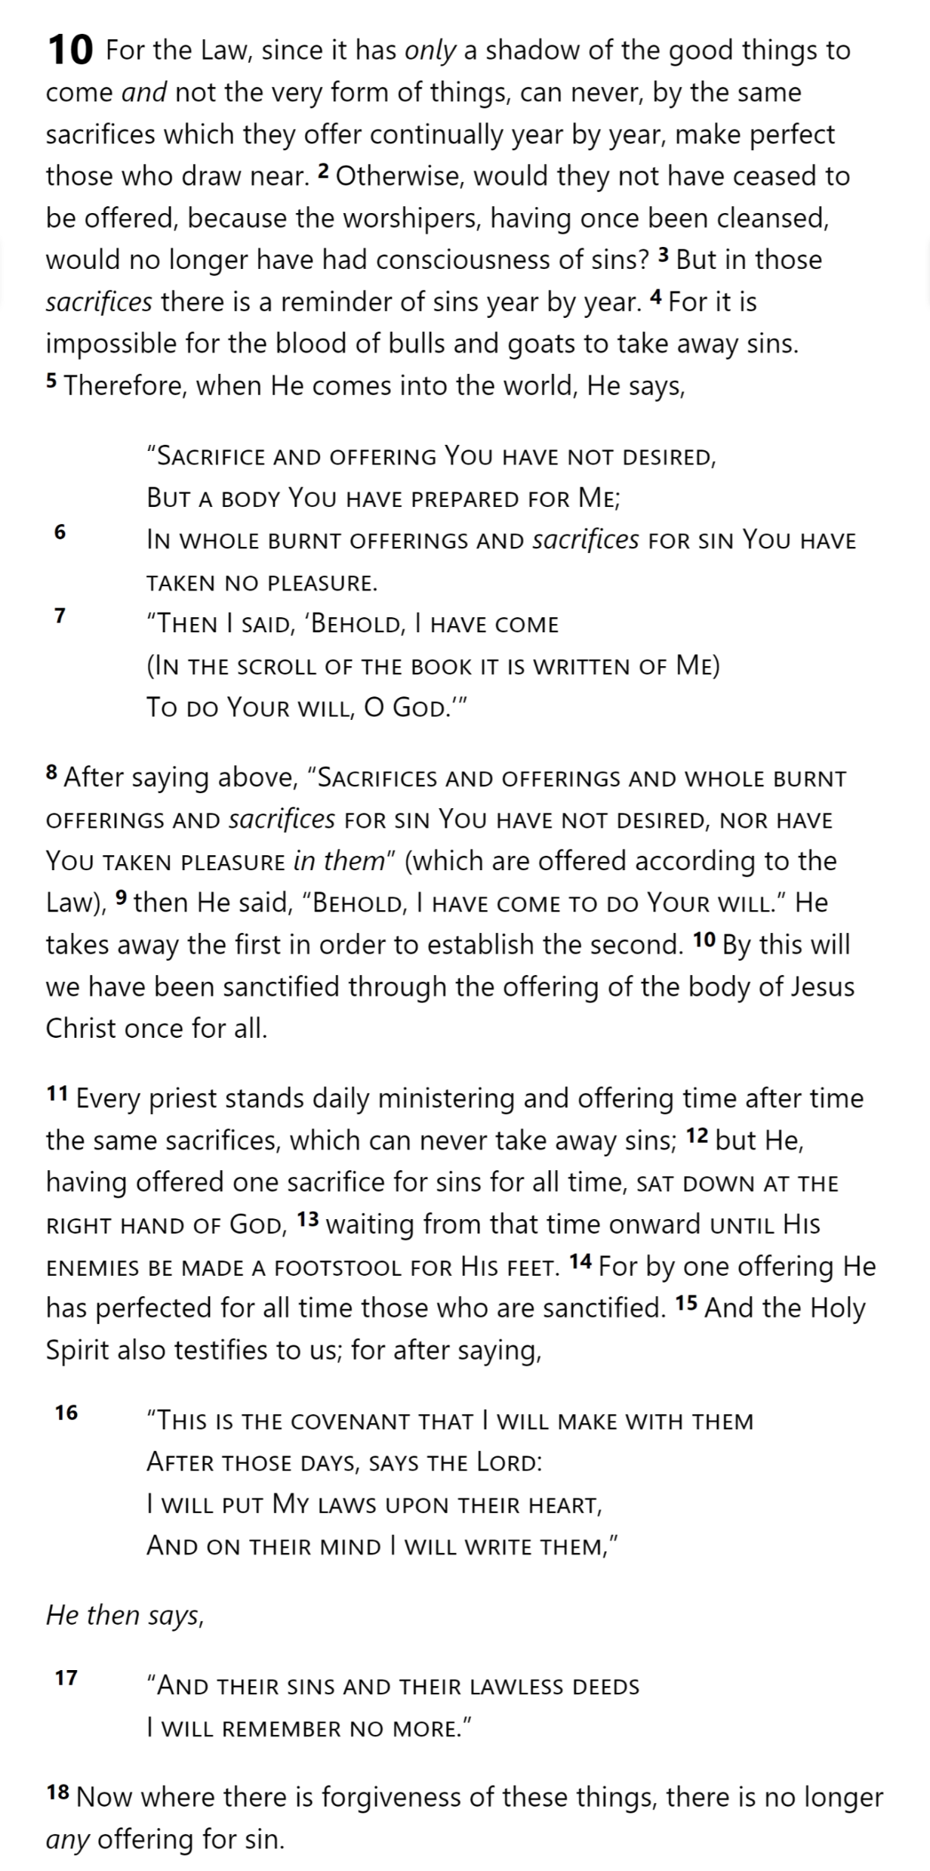
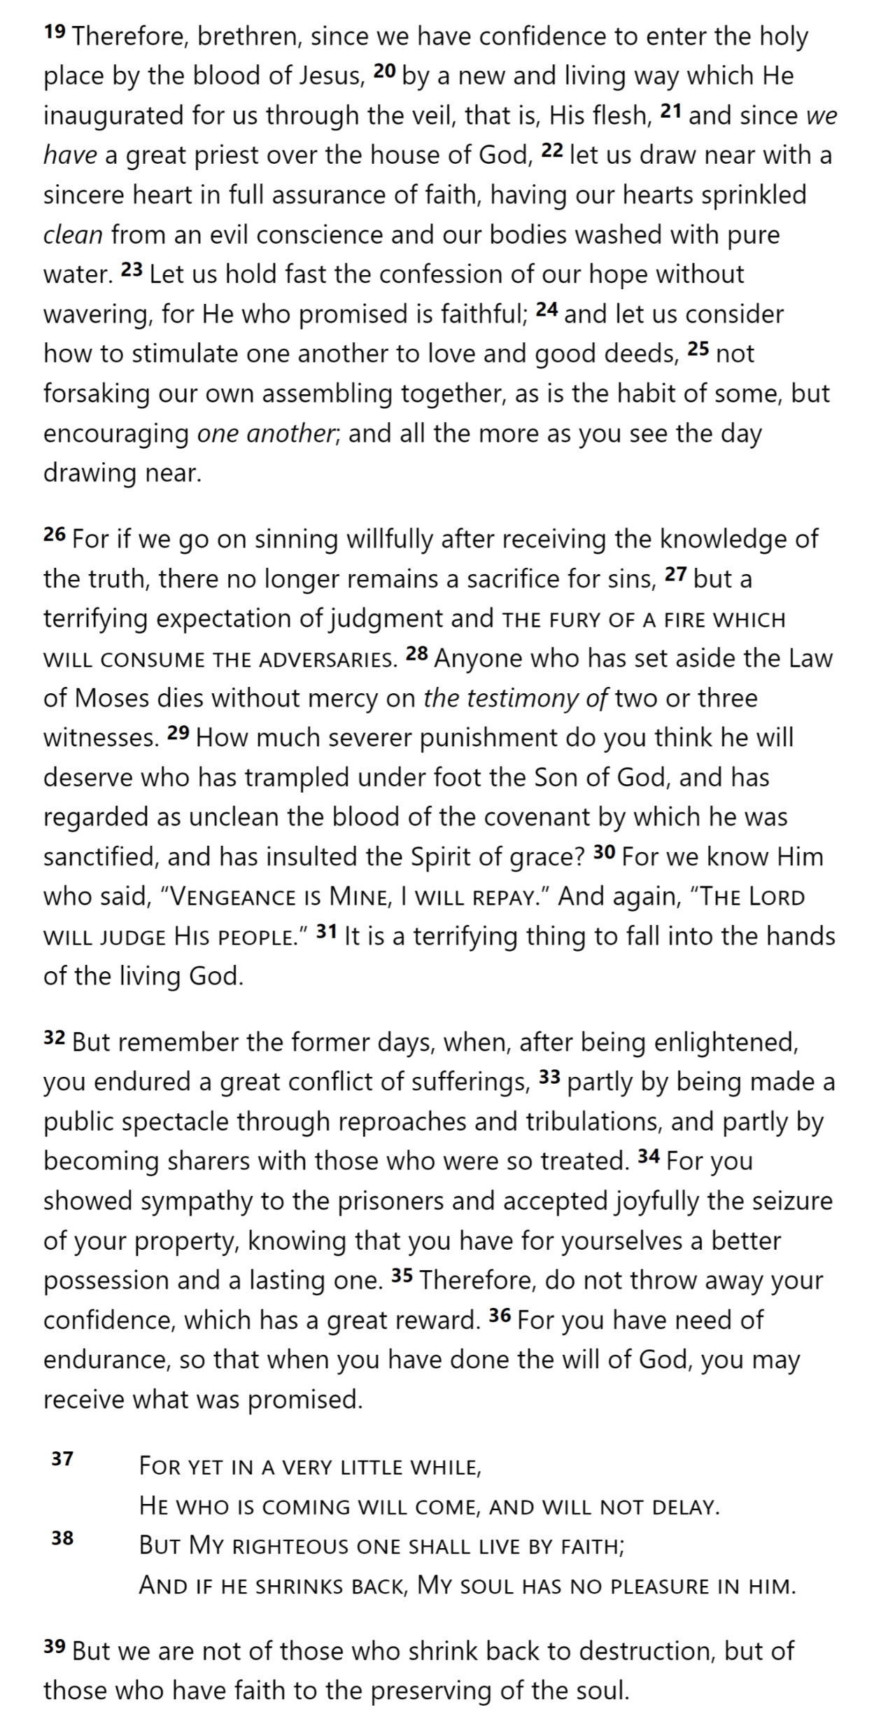
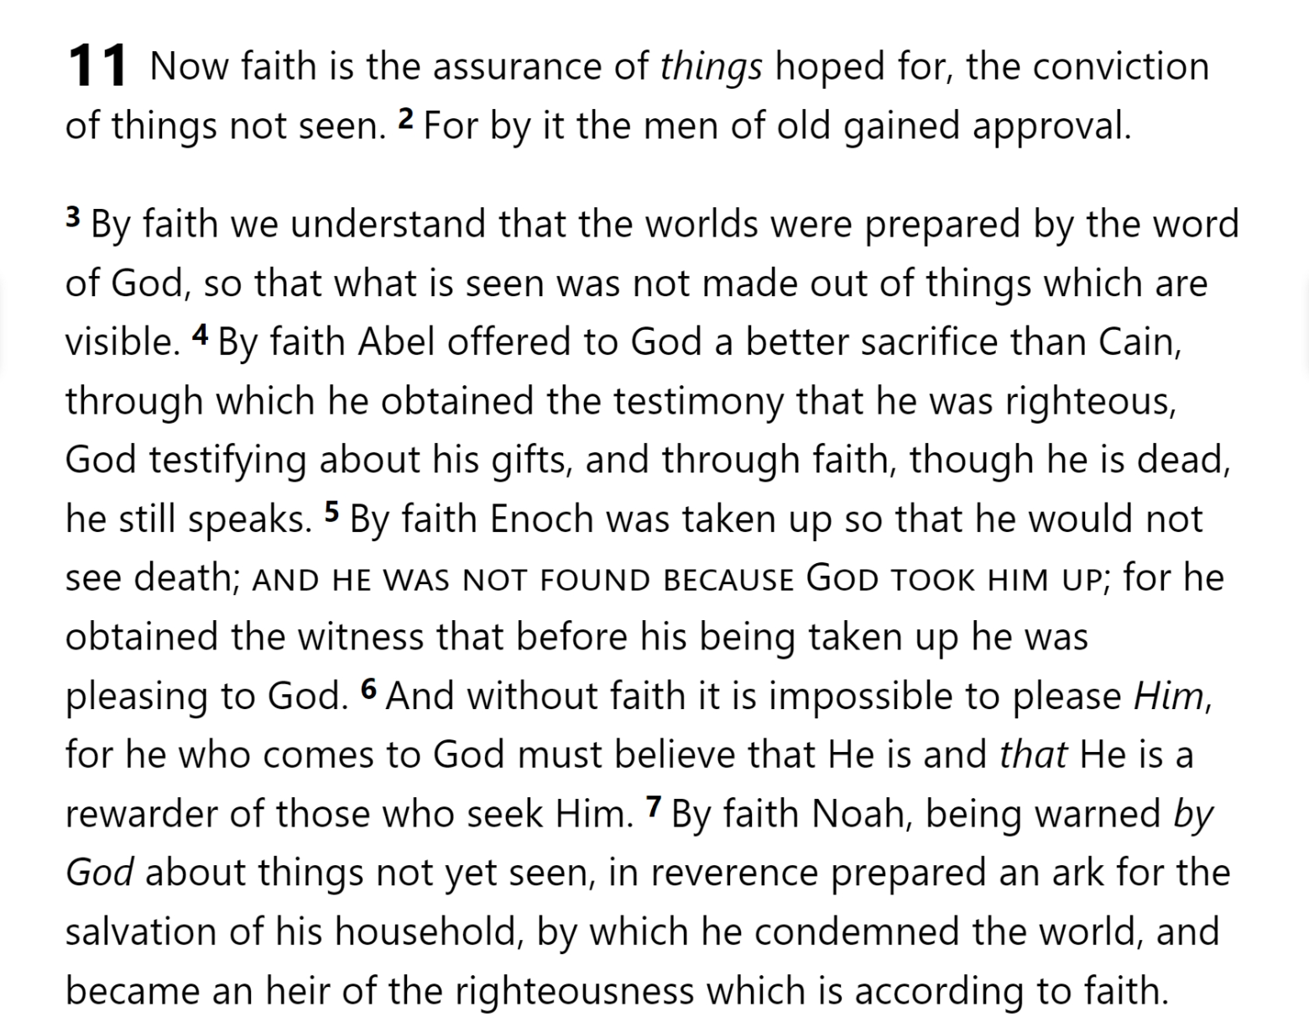
Joy set before Him
Endured Cross
Despising Shame
Looking to Jesus
12:2-3
Run with Endurance
Have Faith
Cloud of
Witnesses
10:32-12:1
Throw Away
Need Endurance
Hebrews 10

Slide 10
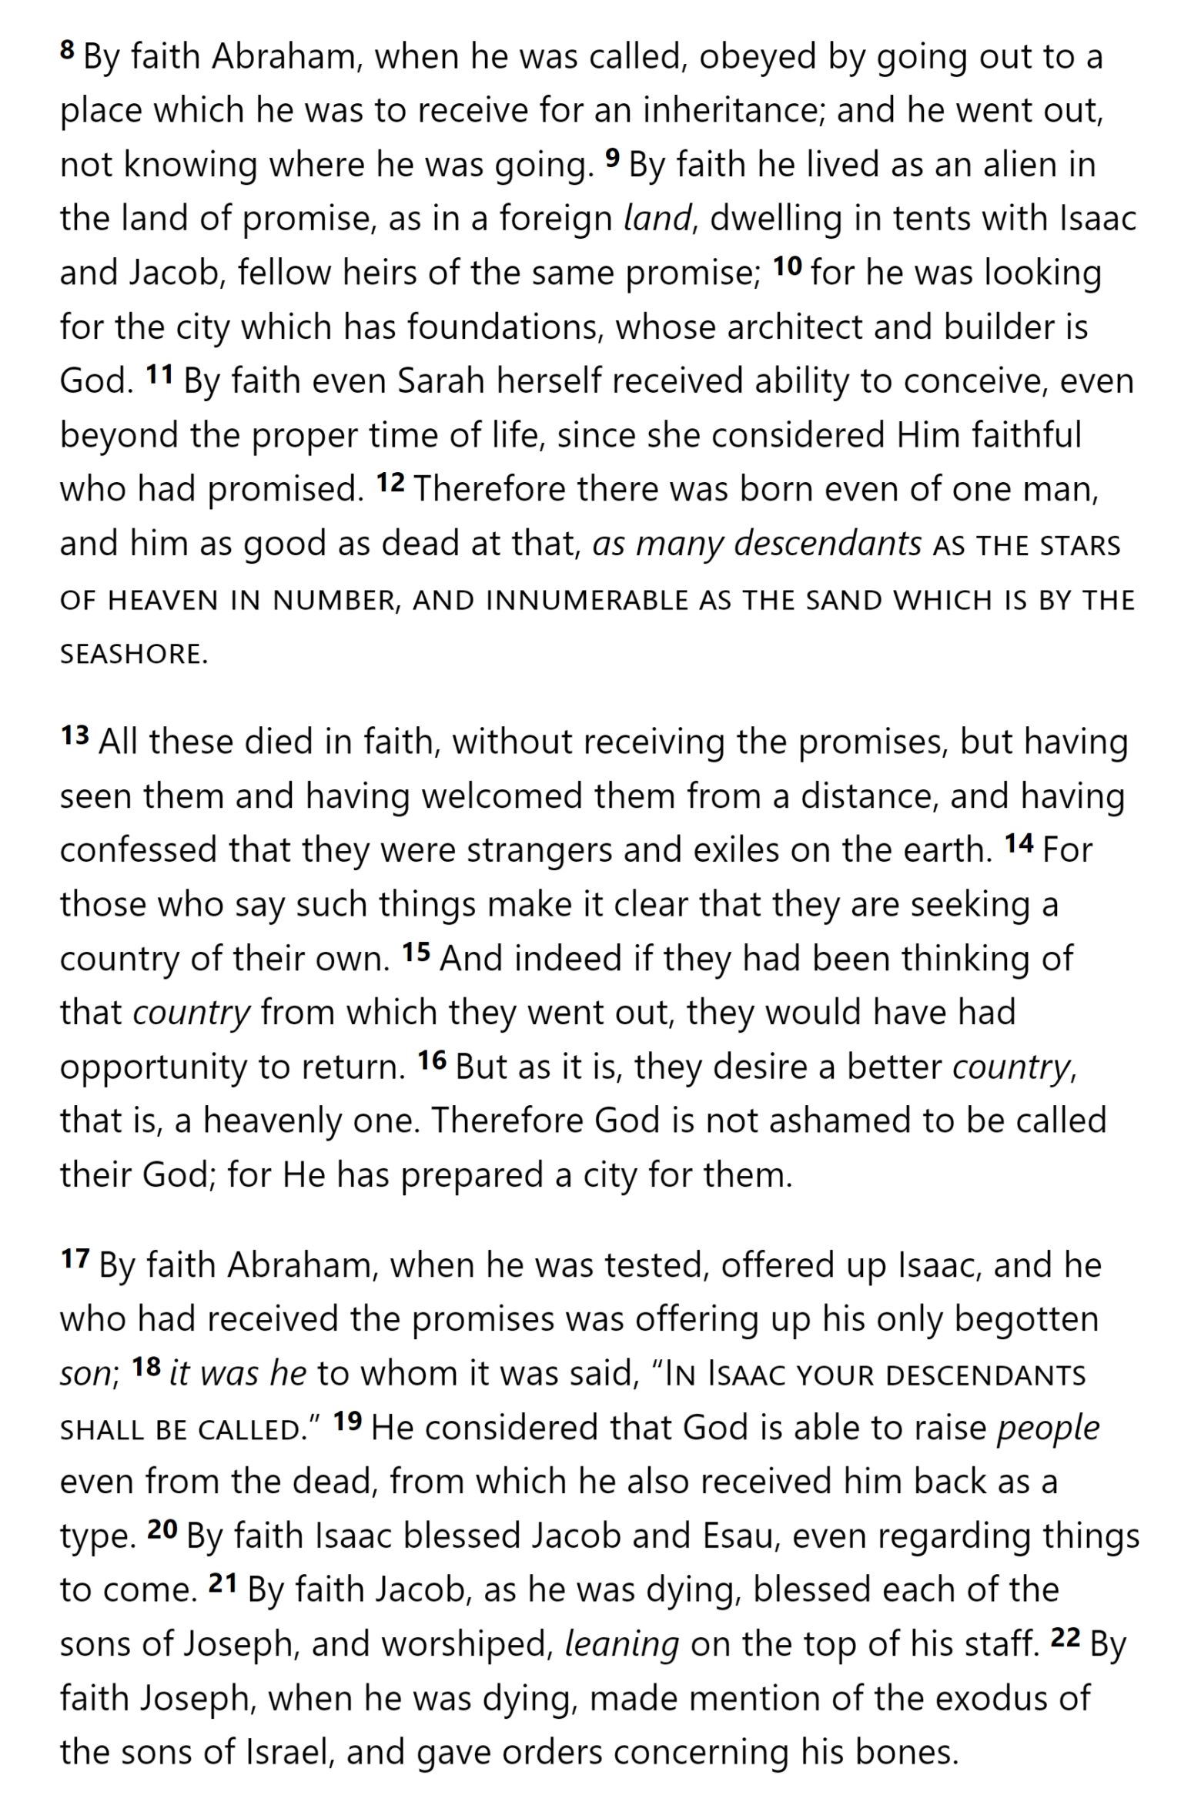
Have Faith
Cloud of
Witnesses
10:32-12:1
Throw Away
Need Endurance
Hebrews 10

Slide 11
Have Faith
Cloud of
Witnesses
10:32-12:1
Throw Away
Need Endurance
Hebrews 11

Slide 12
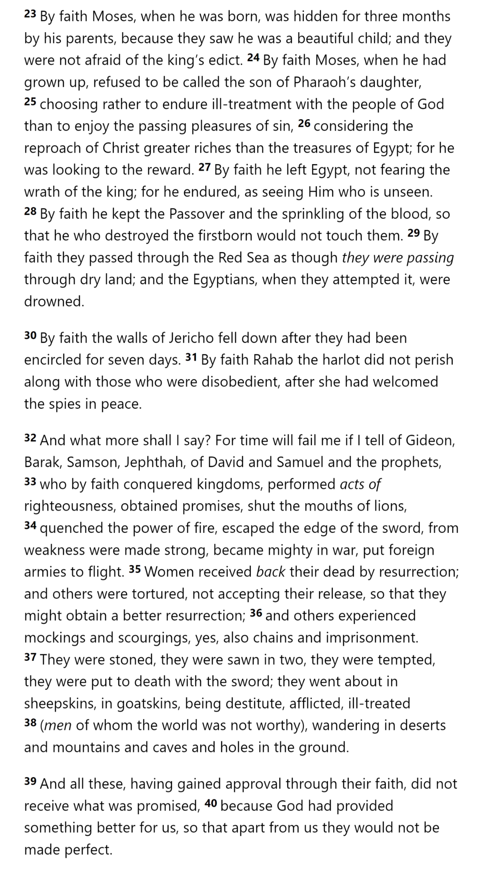
Have Faith
Cloud of
Witnesses
10:32-12:1
Throw Away
Need Endurance
Hebrews 11

Slide 13
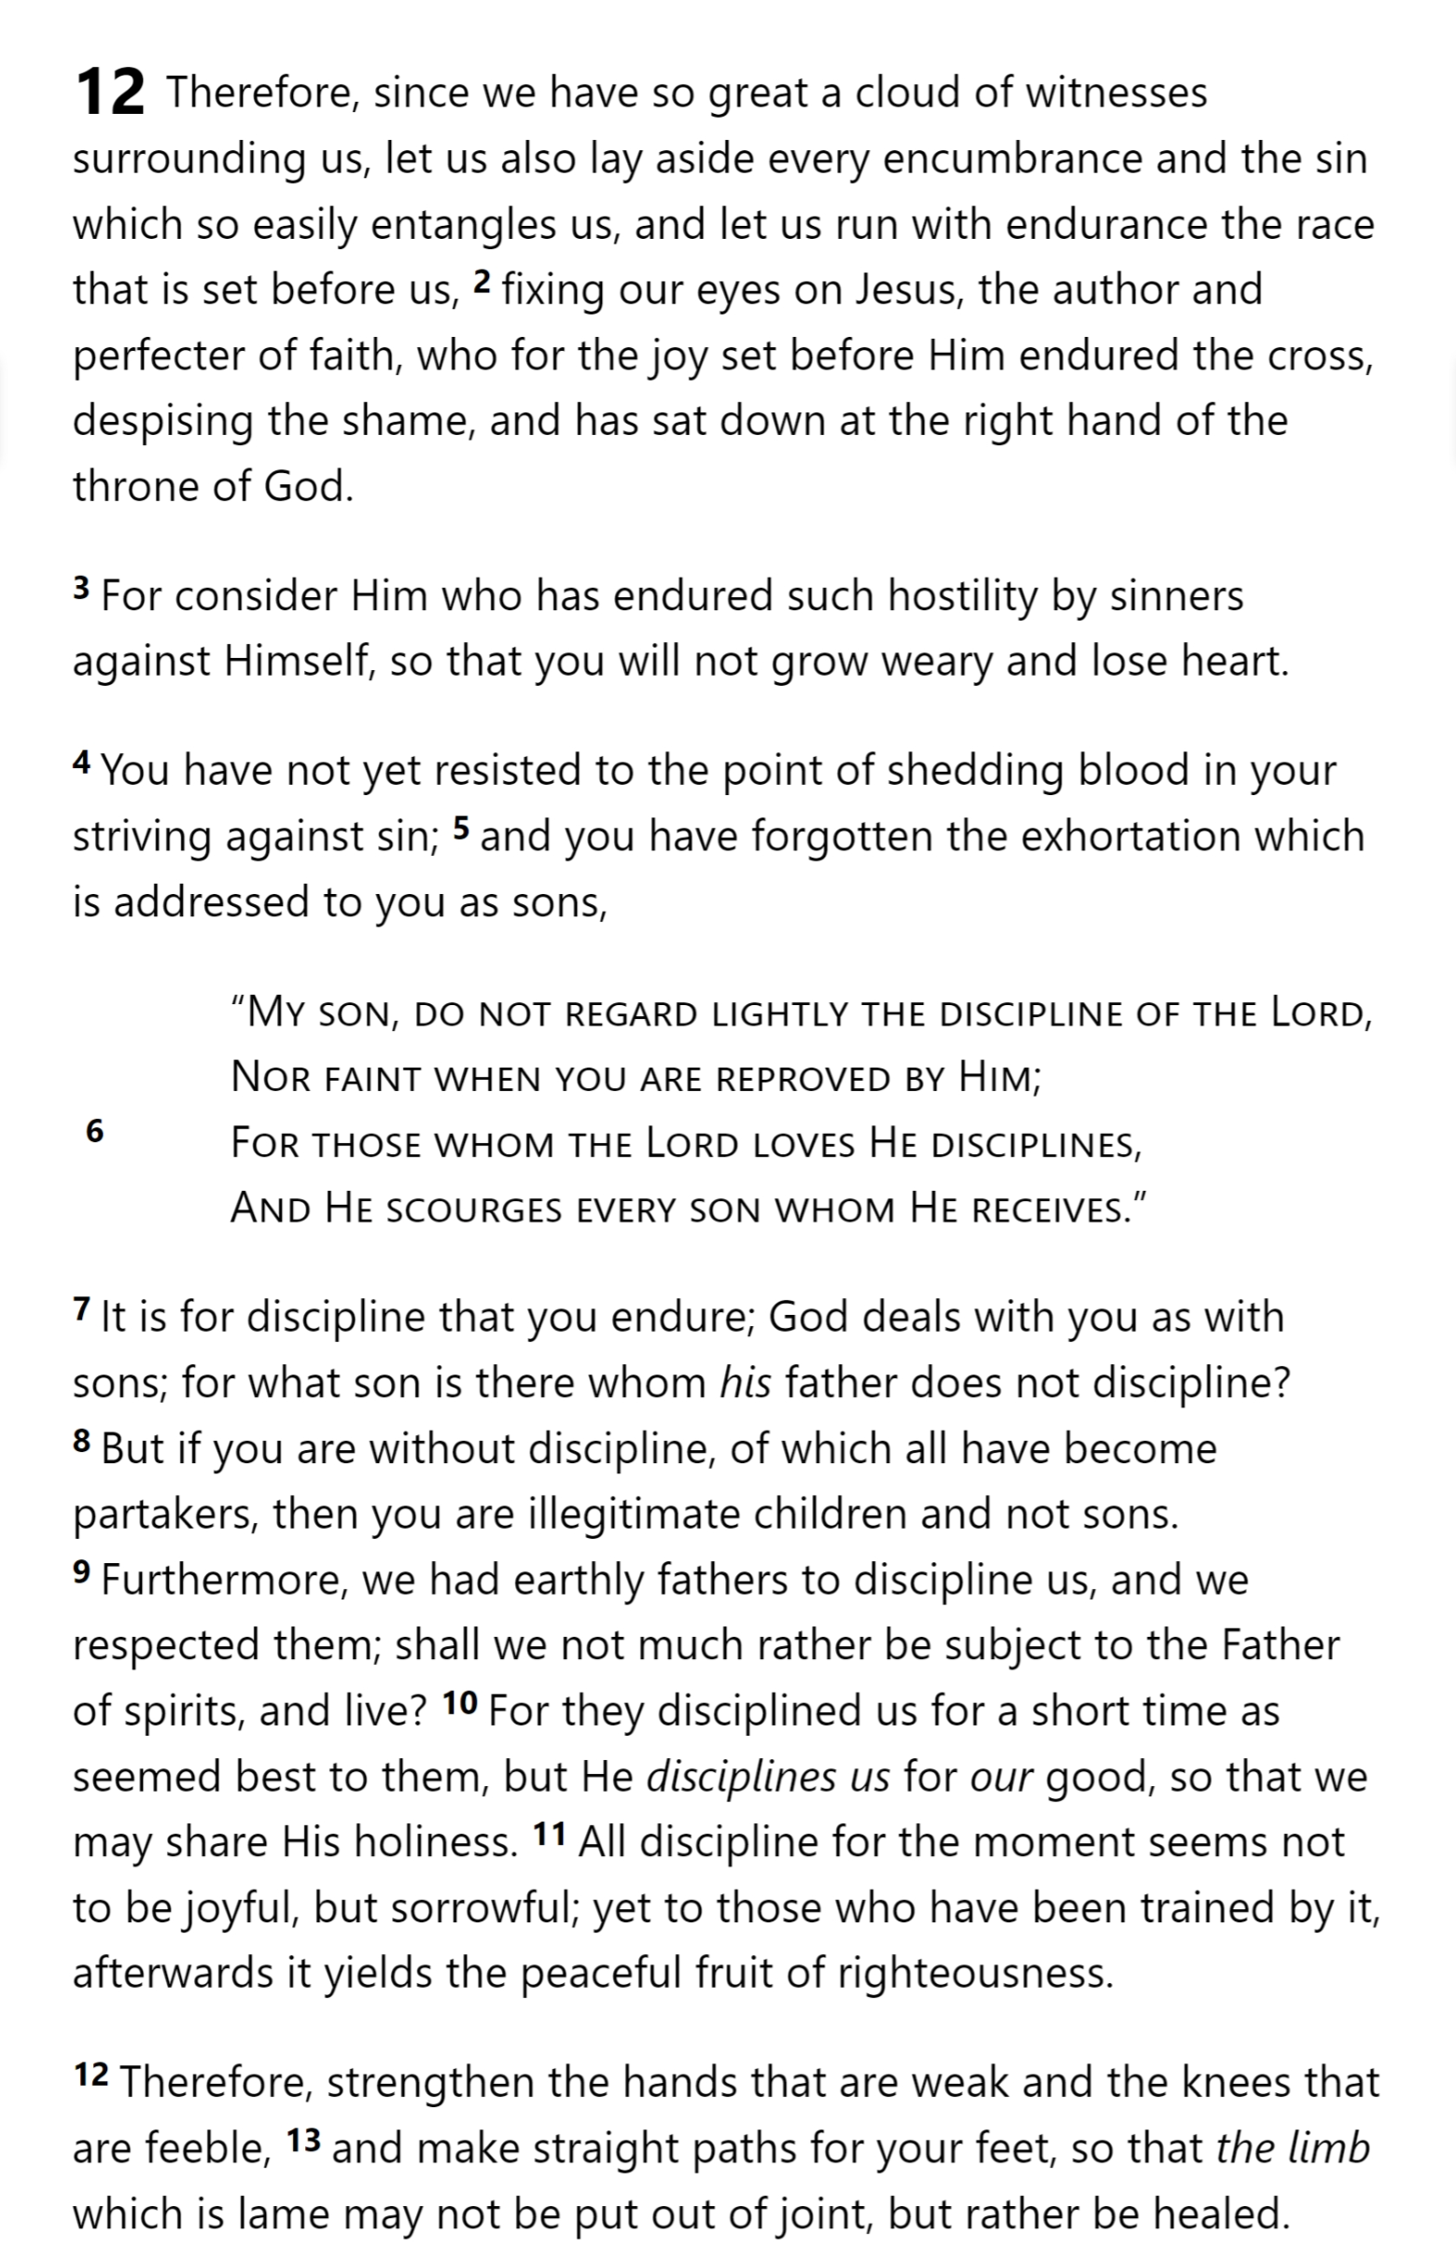
Have Faith
Cloud of
Witnesses
10:32-12:1
Throw Away
Need Endurance
Hebrews 11

Slide 14
Have Faith
Cloud of
Witnesses
10:32-12:1
Throw Away
Need Endurance
Hebrews 11

Slide 15
Joy set before Him
Endured Cross
Despising Shame
Looking to Jesus
12:2-3
Run with Endurance
Have Faith
Cloud of
Witnesses
10:32-12:1
Throw Away
Need Endurance
Hebrews 12
Sorrowful
Enduring foR
12:4-11
Discipline
Righteousness

Slide 16
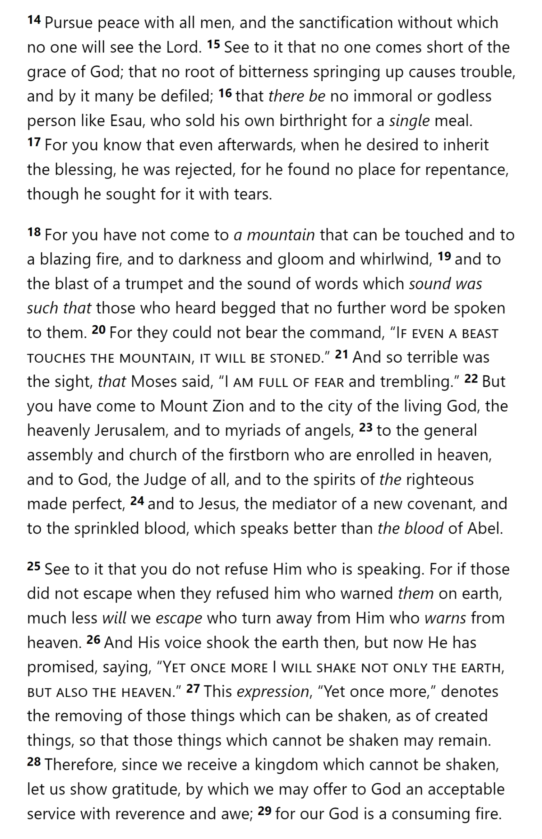
Joy set before Him
Endured Cross
Despising Shame
Looking to Jesus
12:2-3
Run with Endurance
Have Faith
Cloud of
Witnesses
10:32-12:1
Throw Away
Need Endurance
Sorrowful
Enduring foR
12:4-11
Discipline
Righteousness
Hebrews 12

Slide 17
Sorrowful
Enduring foR
12:4-11
Discipline
Righteousness
Straighten
Strengthen
Pursue Peace
Prepare
12:12-17
to Endure
Short of Grace
Bitterness
Esau
Hebrews 12
Sinai
12:18-29
AND Zion

Slide 18
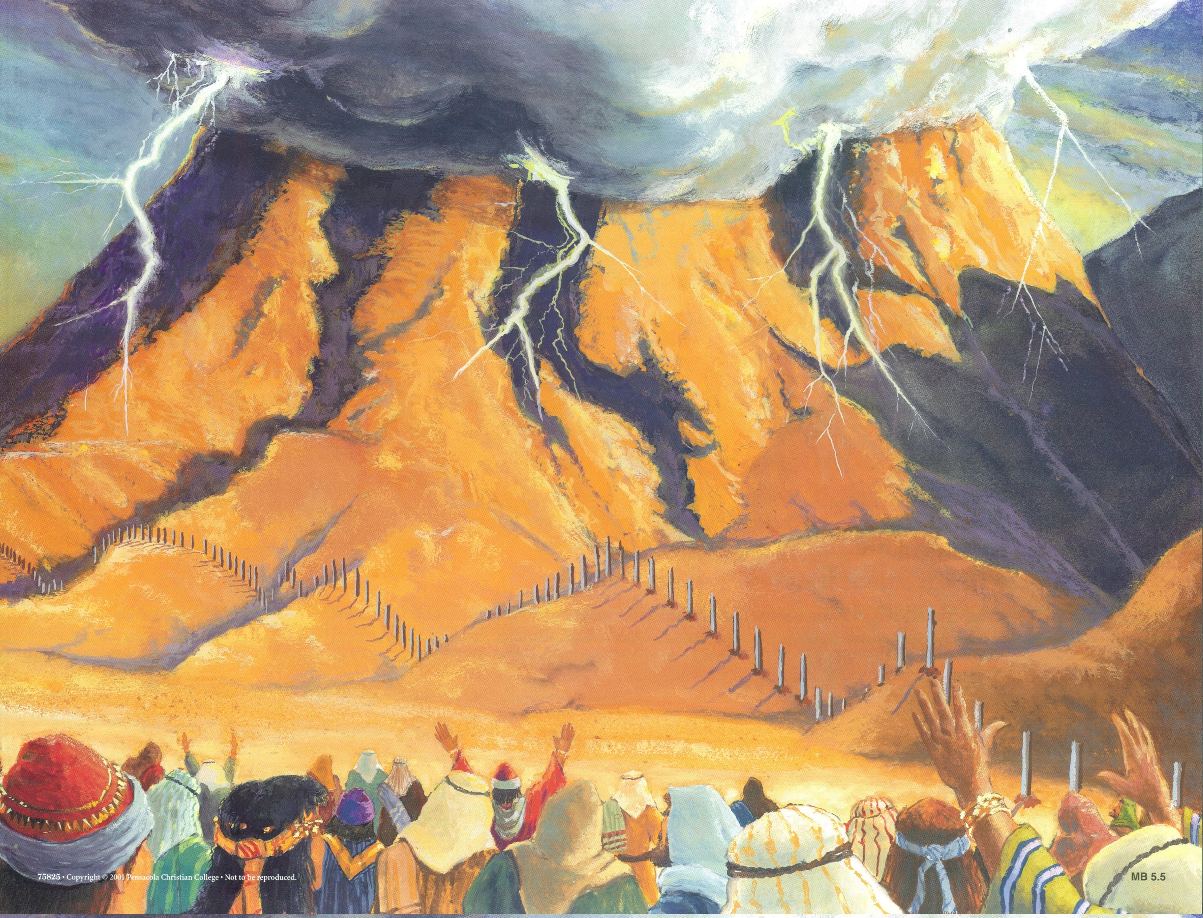
Sorrowful
Enduring foR
12:4-11
Discipline
Righteousness
Straighten
Strengthen
Pursue Peace
Prepare
12:12-17
to Endure
Short of Grace
Bitterness
Esau
Sinai
12:18-29
AND Zion
Hebrews 12

Slide 19
Shaking
Sinai
12:18-29
AND Zion
Gratitude & Service
Reveremce & Awe
Consuming Fire
Hebrews 12

Slide 20
Lest we drift
Straighten
Pay Attention
Angels
1:4-2:15
Joy set before Him
God speaks
1:1-3
In his son
Sorrowful
Why Lower?
Strengthen
Pursue Peace
Endured Cross
Enduring foR
12:4-11
Discipline
Prepare
12:12-17
to Endure
Purification
Right Hand
Despising Shame
Short of Grace
Righteousness
Bitterness
Encourage
Looking to Jesus
12:2-3
Hold Firm
Run with Endurance
Esau
No Evil Hearts
2:17-18
Moses
Joshua
3-4
Be Diligent
JESUS IS OUR
7-10:18
GREAT HIGH PRIEST
Have Faith
Miss Rest
God’s Word
Cloud of
Witnesses
10:32-12:1
Hold Fast
Throw Away
Need Endurance
Shaking
4:14-16
Sinai
12:18-29
AND Zion
Gratitude & Service
Reveremce & Awe
Draw Near
Consuming Fire
Immaturity
Suffering of Christ
Falling Away
Aaron
5:1-10
MelchizEdek
Judgment
Draw Near
Vengeance
Hold Fast
SINCE Therefore
10:19-25
LET US
For if we go
10:26-31
on sinning
Stir Up
Faith & Patience
Anchor of Hope
Encourage
Fury of Fire
Terrifying
Closing
13
exhortations

Slide 21
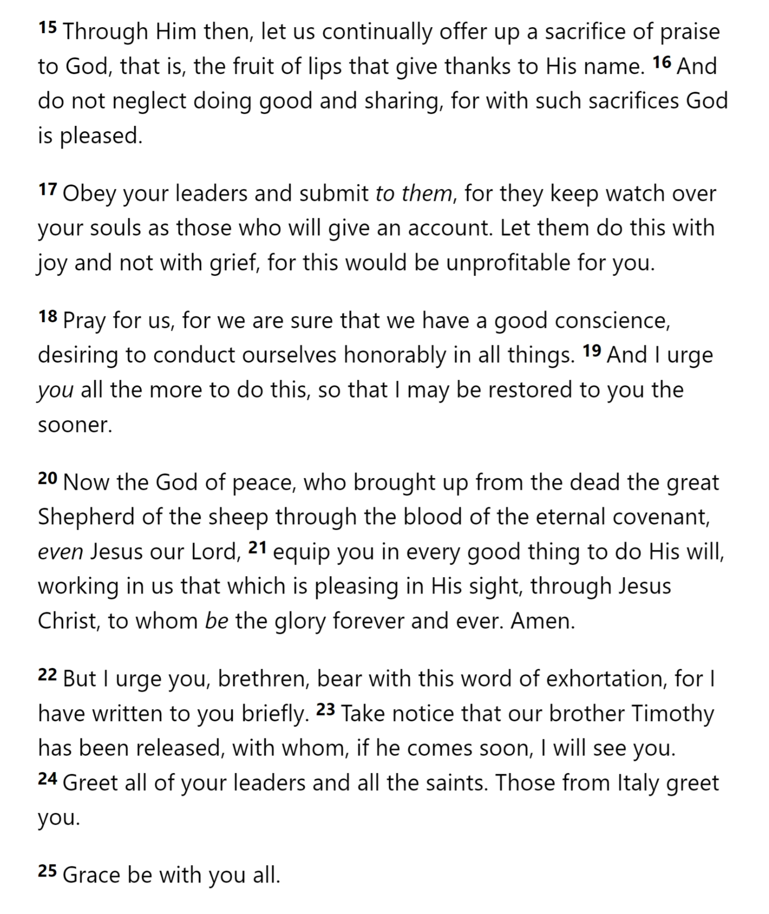
Brotherly Love
Closing
13
exhortations
Hospitality
Victims of Suffering
Sexual Morality
Material Things
Past Leaders
Hebrews 13

Slide 22
Brotherly Love
Closing
13
exhortations
Hospitality
Victims of Suffering
Sexual Morality
Material Things
Past Leaders
False Teaching
Hebrews 13

Slide 23
Brotherly Love
Closing
13
exhortations
Hospitality
Victims of Suffering
Sexual Morality
Material Things
Past Leaders
False Teaching
Sacrifices
Current Leaders
Pray for Teachers
Hebrews 13

Slide 24
Brotherly Love
Closing
13
exhortations
Hospitality
Victims of Suffering
Sexual Morality
Material Things
Past Leaders
False Teaching
Sacrifices
Current Leaders
Pray for Teachers
Hebrews 13

Slide 25
Lest we drift
Straighten
Pay Attention
Angels
1:4-2:15
Joy set before Him
God speaks
1:1-3
In his son
Sorrowful
Why Lower?
Strengthen
Pursue Peace
Endured Cross
Enduring foR
12:4-11
Discipline
Prepare
12:12-17
to Endure
Purification
Right Hand
Despising Shame
Short of Grace
Righteousness
Bitterness
Encourage
Looking to Jesus
12:2-3
Hold Firm
Run with Endurance
Esau
No Evil Hearts
2:17-18
Moses
Joshua
3-4
Be Diligent
JESUS IS OUR
7-10:18
GREAT HIGH PRIEST
Have Faith
Miss Rest
God’s Word
Cloud of
Witnesses
10:32-12:1
Hold Fast
Throw Away
Need Endurance
Shaking
4:14-16
Sinai
12:18-29
AND Zion
Gratitude & Service
Reveremce & Awe
Draw Near
Consuming Fire
Immaturity
Suffering of Christ
Falling Away
Aaron
5:1-10
MelchizEdek
Judgment
Draw Near
Vengeance
Hold Fast
SINCE Therefore
10:19-25
LET US
For if we go
10:26-31
on sinning
Stir Up
Faith & Patience
Anchor of Hope
Encourage
Fury of Fire
Terrifying
Closing
13
exhortations

