Slide 1
Matthew
Chapters
21 – 23
Controversy in Jerusalem
Lesson 10

Slide 2
Class Goals
Know the Kingdom
Know its King
Teach it to others
Harden your resolve
Notes:
In short:
Understand the Kingdom
Recognize the King’s authority
Teach others about it
Harden your resolve/faith

Slide 3
Overview
Jesus has revealed His authority over all things
Jesus has taught the laws of the Kingdom and of the Kingdom citizen
Jesus has prepared His disciples:
To understand
To teach others
For his death
Jesus now enters Jerusalem for His final days on earth
Notes:
Power over disease, distance, time, nature, demons, death
Think of the sermon on the mount, the parables, his responses to the Pharisees

Slide 4
Read 21:1-11
Read 21:12-17
Notes:
We’re covering 3 chapters [today]. We’ll group together most of 22 and 23 into logical sections but we’ll start with several consecutive events and parables that teach a variety of lessons.
Assign chapter 21:
1-11
12-17
18-22
23-27
28-32
33-46
22:1-14
For each, summary and most interesting thing you see.
21:1-11
Image of path
Note the scale, and also the Kidron Valley that is about 400 ft below the peaks of the mountain before
Image of Mount of Olives
This was a mountainous area rising to about 2600 ft above sea level
Think of this as a gateway to Jerusalem
Why do you think Jesus chose to enter the way He did?
To fulfill prophecy (vs 5). What would they be forced to think if he comes in humble, mounted on a donkey?
He’s saying He is that king spoken of in Zechariah 9:9.
That’s a provocative statement to the Pharisees. It’s also, notably, NOT provocative to Roman authorities. This was something He could do without stirring up unnecessary and unwanted attention from Rome…while still making the sharp and pointed statement to the Jewish authorities.
This is the eighth time that Matthew specifically calls out fulfillment of OT prophecy. vs 4 “This took place to fulfill…”.
So remember our goal of hardening our faith…hardening our resolve to remember and follow Jesus. It continues as he enters Jerusalem.
To illustrate the type of king He is.
That the prophecy called for a donkey…and specifies it as “a beast of burden”…is in stark contrast to what they might expect for their king…a war horse. A chariot, a palanquin.
Jesus rides in humbly on a donkey and shows, again, that He is a servant King.
What did the crowd call him?
Hosanna. A term calling for salvation. It was usually understood to mean “save now” or “save, I pray”.
And note also that they call him the Son of David…showing their belief that He is RIGHTFULLY in this position.
I believe in this crowd you probably find many of those who were later baptized at Pentecost in Acts 2.
We tend to focus in Jesus’ last days on all of his opposition. The Pharisees, the false court, the crowds chanting crucify him, crucify him…but remember…Jesus had laid a lot of groundwork over the years. Many of these people had seen, or at least heard of His many miracles. Astounding miracles.
They had heard some of his teaching…the same teaching that at times astounded the listeners. There were people who were ready to follow…and I think that’s why Jesus is entering Jerusalem now…they were as ready as they would ever be.
21:12-17
Summary and thing you found most interesting
This was not the first time Jesus cleansed the temple. John tells us in the first year of his ministry that he made the whip of cords and drove out the money changers and all of the people doing business…this is something that I think deeply bothered Jesus.
And you can see why, what does he say the temple had been made into? [vs 13, a den of robbers]
Though it should be a house of prayer. It would be pretty difficult to pray in what surely looked like a flea market.
What is the temple today? What would be the equivalent?
[The church building]. This is where we go to dedicate ourselves in a special way to God. This building is really just a realization that worshiping God the way we want to benefits from some provisions. Provisions like:
A quiet setting
No wordly distractions
Seating for a large number of people
But what are we doing if we misuse this space in the same way they were in the temple? We’ve got room in this building and on this property to put on a bake sale. I’m positive we could sell ad space on our walls. “Today’s lesson brought to you by Taco Bell”. They know everyone’s hungry after service.
When we do those things, or ANYTHING that isn’t serving the purpose of the church…we are undercutting our ability to have an undefiled relationship with God.
**High School Only**
It’s why some people don’t like to buy things that use the cross as decoration. Like a necklace or a trinket. Or listen to Christian rock. There’s something diluting about mixing regular things, with divine things.
********
We want to keep this place as a place dedicated to one thing, and one thing only. God. There are many things in this world that are good and have their own merit, and should be pursued in their own time…but this is a place for God.
We have a question we always ask our kids when they’re acting up a little here in the building…why are we here?
We’re here to worship God. And when Jesus saw the people using God’s house as a place to do business…and especially…shady business…that’s something he couldn’t tolerate. We see his righteous anger to this.

Slide 5
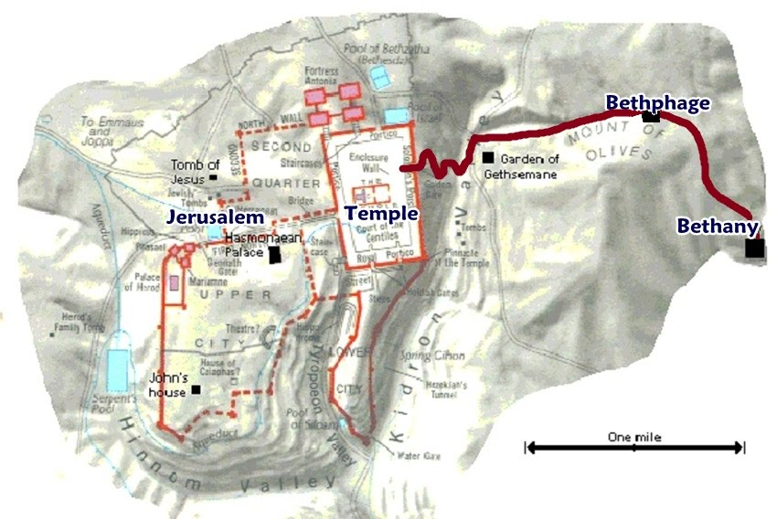

Slide 6
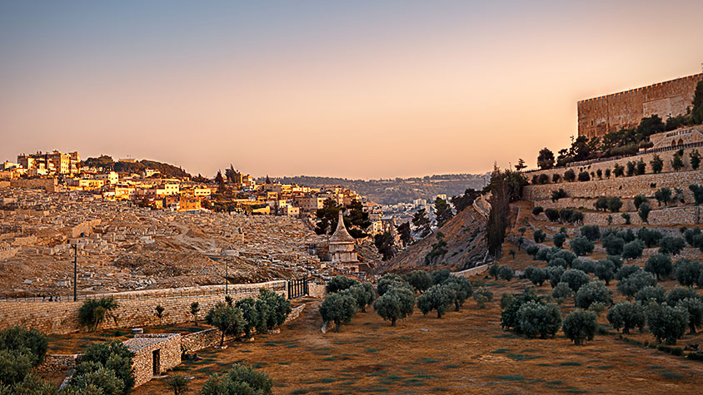

Slide 7
Read 21:1-11
Why did Jesus choose to enter this way?
What did the crowd call Him?
Read 21:12-17
What had the temple been made into?
What is the temple now?
Can the church be misused the same way?

Slide 8
Read 21:18-22
Note: Jesus did not “curse” the fig tree in anger. This miracle, like all of them, had a purpose.
What had John predicted for fruitless trees?
The fig tree represented Israel
Read 21:23-27
Say what you mean and mean what you say
Willingness to listen is a requirement
Notes:
21:18-22
Summary and what you found most interesting
**Read note**
What had John predicted for fruitless trees?
Mat 3:10 “Even now the axe is laid to the root of the trees. Every tree therefore that does not bear good fruit is cut down and thrown into the fire.”
The fig tree represented Israel. These were long established trees, given every opportunity to grow and thrive, but they were not bearing fruit.
And so the conclusion is that they are going to be cut down and discarded. This is a pattern we’ve seen in Jesus’ teaching on the kingdom.
Mat 10:14 “And if anyone will not receive you or listen to your words, shake off the dust from your feet when you leave that house or town”.
Mat 18:17 “And if he refuses to listen even to the church, let him be to you as a Gentile and a tax collector”
Your action AND inaction has consequences. There is a point where you will be judged for these things…and there IS an actual point…it’s not indefinite.
The apostles would stop preaching to some, the church will turn away from some, and here…if you’re not bearing fruit…there will be a time that you’ll be cast into the fire.
What a disappointing lesson to have to teach at this point, for Jesus. Think of Israel’s history…and the love that God has had for them…and to summarize that by killing this fig tree…watching it wither and dry up. It would have been a striking image for the disciples there.
21:23-27
Summary and what you found most interesting
This interaction is interesting to me because of how vividly it exposes the motives behind their questioning. The question itself, by what authority are you doing these things, is a legitimate question.
And it has a legitimate answer. What Jesus discerns, though, is that they were not open to a legitimate answer. Even if Jesus were to give the correct answer, I do this by my own authority, given to me by God the Father….
AND…here’s the proof. I’ve performed these miracles, here is the scripture to back it up, here are the prophecies that have been fulfilled…they would not have listened. They wanted him to say that so they could immediately charge him with blasphemy.
OR…he would say anything else and would show that he didn’t have the authority and they could discredit him. That’s a malicious question, but ONLY because of their not being willing to accept a real answer to it.
Jesus, of course, turns this on its head and say I’ll only answer your question if you’re willing to OWN your beliefs.
I think that’s the root of it. If you don’t think Jesus is the Messiah, SAY IT…and don’t hide behind technicalities in the law, unfounded opinions, or manufactured controversy. Say it and back it up.
This is really Jesus giving us another example of the limitations of our evangelism. The people we evangelize to must be willing to listen. We won’t know that until we try…but once they’ve proven to not have a willing heart to hear…why would I keep answering their empty and provocative questions? Except to everyone’s detriment.
Any other thoughts?

Slide 9
Read 21:28-32
Who were represented by the one who said he would not work?
Who were represented by the one who said he would, but did not?
Read 21:33-46
They pronounce their own judgment
Who will the kingdom be given to?
Read 22:1-14
This is about the kingdom of heaven
What does the wedding garment represent?
The choices, behavior, and actions of those who accept the invitation
Notes:
21:28-32
Summary and what you found most interesting
This follows up the previous teaching perfectly.
Who were represented by the one who said he would not work? [Gentiles]
Who were represented by the one who said he would, but did not? [Jews]
Jesus is saying…Gentiles were not listening, they used to not care…but when righteousness came forward…compelling evidence for God and His coming kingdom…they listened.
You Jews said you were God’s people, but when he sends you his messengers you don’t listen.
The willing heart is what enters the Kingdom of Heaven.
21:33-46
Summary and what you found interesting
The part I found most interesting is when they pronounce their own judgment in vs 41. Jesus tells this parable which describes exactly what the Pharisees and priests and scribes were doing, and he says…what would you do about that?
And they answer correctly, put us to death…I would say spiritual death…and give the kingdom to someone else.
Who would the kingdom be given to? What type of people.
People producing fruit. The people who are actually doing something with this gift that God has given us all…this gift of life, and free will, and guidance towards righteousness, and a chance to be with Him in heaven. What a gift, to have that opportunity. Don’t squander it, especially for the worthlessness of sin and this world.
22:1-14
Summary and what you found interesting
This parable reminds us right off the bat what we’re talking about here, vs 2, the kingdom of heaven.
So we make all of the translations:
The king is God
The wedding feast is this relationship he has formed with the Jewish people
Them not coming to the feast is their rejection of God
He gives them multiple chances and they still reject and openly rebel, treat people poorly…kill
So the King destroys them, which is effectively what happens when you are cut off from God. You may still be alive, you may even be rich and enjoying life…but your soul is destroyed without God.
The people in the streets are you and me, non-Jews…who have been offered this same relationship. And he’s offering it to everyone, vs 10 says good and bad.
And then we get into this sort of parable within a parable starting in vs 11. You may call this part the parable of the wedding garment. What is this garment?
This wedding garment is such an important part of this parable. Had the parable ended in vs 10 you could get this sense that God has simply transitioned “His people” from the Jews to the non-Jews. That us gentiles now have that covenant relationship…and this is important…BY NO CHOICE.
But this wedding garment adds more to it. You’re invited…all of you…but what you do with that invitation is of the utmost important.
The wedding garment represents the choices, behavior, and actions of those who accept the invitation. You may be invited now, but if you don’t participate in the wedding feast, in this relationship that God is offering…
If you show up in ordinary, soiled working clothes and show contempt for the occasion…that is not tolerated…and you’ll be cast out to the same fate as those who already rejected him.
The kingdom of God, again, is the WILLING acceptance of Him in your heart. Your WILLING participation in what he has taught. That’s all he is asking. TRY. Try HARD. Put effort into this….and the reward is eternal…an eternal relationship with God the creator of the universe. That’s the kingdom that Jesus…here in his last few days…is trying so desperately to help them understand.
And thoughts before we move into a structured series of questions from Jesus’ enemies?

Slide 10
Three Captious Questions
Pharisees and Herodians (22:15-22)
Their question?
The answer of Jesus?
The Sadducees (22:23-33)
Their question?
The answer of Jesus?
The Scribes (22:34-40)
Their question?
The answer of Jesus?
Notes:
Starting in vs 15 of chapter 22 we get a series of three consecutive…what we call “captious” questions. This isn’t a word that you hear used very much but it means to find fault in someone, or raise petty objections.
So we’re going to read these three passages and for each..identify the question and answer and make some observations.
Read 22:15-22 about the Pharisees and the Herodians
What was the question? Is it lawful to pay taxes to Caesar, or not?
Jesus answers “render to Caesar the things that are Caesar’s, and to God the things that are God’s”
They really try to butter him up in vs 16 with a lot of hypocritical words…words that if said truthfully would be high praise and would mean that they should be following him, but instead were said with the goal of, vs 15 “entangle him in his words”.
And I think the reason why it says they marveled in vs 22, is that Jesus was able to answer it in a way that was both true…it taught something and was founded on godly principles…AND it was politically savvy. They were NOT able to entangle him in his words.
Okay let’s move on I want to get through all three passages before we make the big observation..
Read 22:23-33
What was the question? In the resurrection, whose wife out of these 7 brothers will she be?
Jesus answers you’re not even asking the right questions.
Sadducees of course we’re very concerned with the resurrection and Jesus is saying…yes there is a resurrection…but it’s not the way you think. Your body dies, and so too do earthly things that support your time on earth…but your spirit lives. God is God of the living, not the dead.
Let’s keep moving.
22:34-40
What was the question? What is the greatest commandment in the law
Jesus answers You shall love the Lord your God with all your heart and with all your soul and with all your mind
This is a question that they hoped would produce any one of a long line of answers that they could have pounced on.
But instead he answers this question straight as an arrow. There actually is a singular answer to this. Love God.
This is easily one of my favorite groups of passages in all of the bible. For many many reasons…
Jesus teaches hard things in an easily understandable and palatable way
He exposes hypocrisy
He shows things of God and things of this world side by side and let’s you see the difference in value
He practices “first principles”, if you remember that lesson about going back to the ORIGINAL design
He scratches that itch we all have, just a little, for JUSTICE. Jesus embarrasses them in their unrighteousness. His answers are a combined, you should be ashamed of yourselves.
He summarizes the ENTIRETY of the kingdom in 3 simple sentences from vs 37-39. I’ve seen that reduced even further on bumper stickers before, “Love God, Love people”…that’s the kingdom. That’s what the law and prophets were all about.
And all of this, teaches this incredibly important lesson of something called “living critically”. This is a term I read in book on Esther by Nathan Ward…that describes this idea of living in a pagan world as a Christian.
That being part of the kingdom means that you are going to be living amongst those who are NOT part of that kingdom…and that you must make critical choices of when to live in unison with that world, and when to separate yourself from it.
The critically accept the parts of our civil government and culture that do not conflict, and sometimes even help in our ability to serve God….and to critically reject the parts that would separate us from God.
Jesus operated within the Roman and Jewish government in all of the ways that he could, but critically rejected them both when they deviated from God’s will.
We have to do the same. And that’s what being a light is about. Being the salt of the earth. Being people who exist in this world as forces of good for everything around us because we are vessels for this Kingdom that God has established through His son. We must live critically.
Any thoughts before we see how Jesus pivots in his teaching here?

Slide 11
Condemnation of Scribes & Pharisees
To the Crowds and His Disciples (23:1-12)
Why would Jesus publicly condemn them?
What reaction could He expect from them?
To Their Face (23:13-33)
What are some things of which He accused them?
To Jerusalem (23:34-39)
What does Jesus predict for His messengers?
Notes:
He goes from defense to offense. From responding to questions to posing questions of his own…and making some strong statements.
He asks the Pharisees a question at the end of chapter 22, that again highlights their focus on the physical rather than the spiritual, with this question of Christ being the Son of David yet David calls him Lord…
And it says at the end no one else dared ask him any more questions. They’ve at least learned that lesson. Don’t try to trip him up on God’s word…you can’t do it.
And so chapter 23 is all about the condemnation of the Scribes and Pharisees. My bible calls it the “Seven Woes to the Scribes and Pharisees”. And this was a very public rebuke. There were crowds present, as well as his disciples.
Why would Jesus publicly condemn them? What would be the purpose of that?
Their hypocrisy needed to be known among the people, and it needed to be laid bare. Jesus is teaching the kingdom, and here are some things that are NOT part of this kingdom.
What kind of reaction do you think he expected from them?
He’s not holding anything back here. He understands that this scathing condemnation will provoke his death. He understands that his time has come. He has said many times before that his time had not yet come. More teaching needed to be done. More time with his disciples…but now is the time. Let them know their folly in full, in front of the crowds.
Give people a chance to hear of their sins, and repent.
Everyone give the chapter a quick scan, and let’s list out in plain terms what Jesus condemns here [write on board]
vs 3 – Works don’t match words
vs 4 – Unwilling to do work they expect of others
vs 5 – Their actions are for show
vs 6 – They love to be honored
vs 7 – They love titles
vs 8-10 – Forgotten true rabbi, father, and instructor
vs 13 – Hypocrites
vs 13 – A barrier to the kingdom of heaven for self and others
vs 14 (if you have it) – Prey on widows and give empty prayers
vs 15 – Teach tradition rather than word of God
vs 16-22 – Misplaced priorities
vs 23 – Elevated tithing over spirituality
vs 24 – Misplaced priorities
vs 25-28 – Present a false image of yourself
Look at this list, and look at how it stacks up to what the kingdom is made up of. (selectively read)
But then there’s one I want everyone to pay attention to in vs 29-36. He says…you all say you wouldn’t have done what your ancestors did, killing the prophets, but you’re doing the same thing right now in rejecting me, and you’ll do the same to my disciples afterwards.
Everyone in here…you are not above these things. In fact, many of us do these things regularly.
The kingdom that Jesus teaches, doesn’t have space for this. We MUST fight against these things…and remember the lessons we learn from the Pharisees…with respect to how close we are to being the same way. We cannot look down on these men as old fools. They are us if we’re not careful.
We’ll move into chapter 24 in the next class.

Slide 12
Woes
Beatitudes
1 – “you shut up the kingdom of heaven” (v 13) | 1 – “theirs is the kingdom of heaven” (5:3)
2 – “devour widows’ houses” (v 14) | 4 – “those who hunger and thirst for righteousness” (v 6)
3 – “a son of hell” (v 15) | 7 – “called sons of God” (v 9)
4 – “blind…blind…blind” (v 16-22) | 6 – “they shall see God” (v 8)
5 – “neglected the weightier matters of the law: justice and mercy and faith” (v 23-24) | 5 – “the merciful…shall obtain mercy” (v 7)
6 – “inside they are full of extortion and self-indulgence” (v 25-26) | 6 – “pure in heart” (v 8)
7 – “inside you are full of hypocrisy and lawlessness (v 27-28) | 6 – “pure in heart” (v 8)
8 – “sons of those who murdered the prophets…” “…on you may come all the righteous blood shed on the earth” (v 29-36) | 8 “those who are persecuted for righteousness’ sake” (v 10-12) 2 – “those who mourn” (v 4) 3 – “they shall inherit the earth” (v 5)

