Slide 1
Worship
Within the Veil
Embry Hills • 2.26.23
Unless otherwise indicated, all Scripture quotations are from The ESV® Bible (The Holy Bible, English Standard Version®),
copyright © 2001 by Crossway, a publishing ministry of Good News Publishers. Used by permission. All rights reserved.

Slide 2
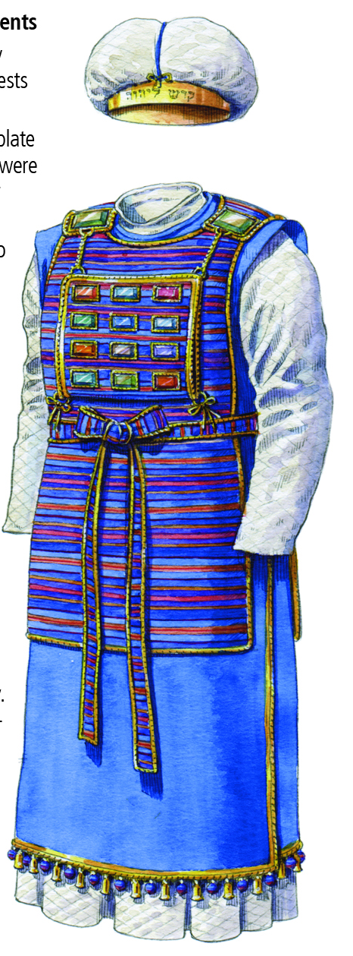
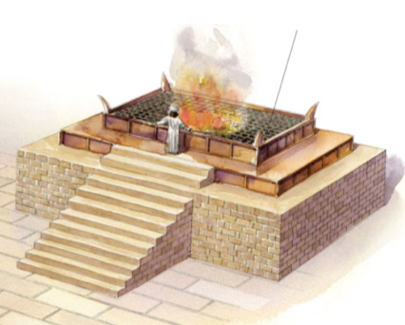
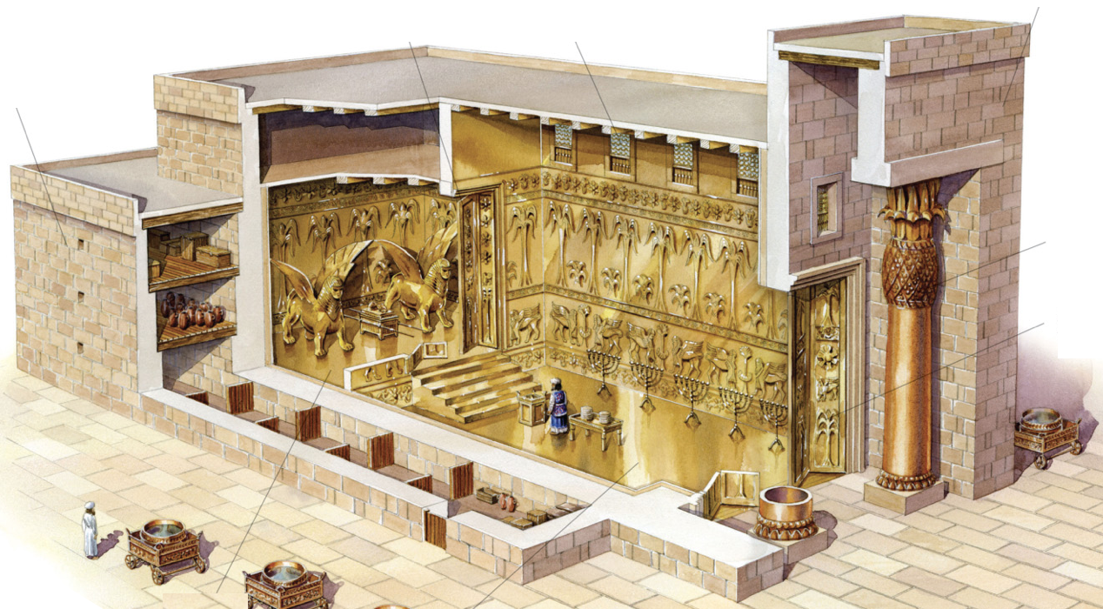
A Kingdom of Priests
If you are a Christian,
you are a priest of God Almighty!
The priesthood: showing what holiness looks like
Exodus 19:6 - Israel: “a kingdom of priests and a holy nation”
1 Peter 2:5,9 - Christians: “a holy priesthood… a royal priesthood”

Slide 3
A Kingdom of Priests
God
The role of priest had 2 dimensions:
Represent the People to God draw near, offer sacrifices, intercede…
Represent God to the People holy clothing, holy conduct, teaching (Lev 10:8ff; Deut 17:8ff)

Slide 4
Approaching God
Ex 25:8 - Lessons from the tabernacle:
I must have clean hands & a pure heart
A death occurred to allow me to come near
I still cannot see God Himself
God
The tabernacle/temple said:
1) God is with you
2) …But keep your distance!

Slide 5
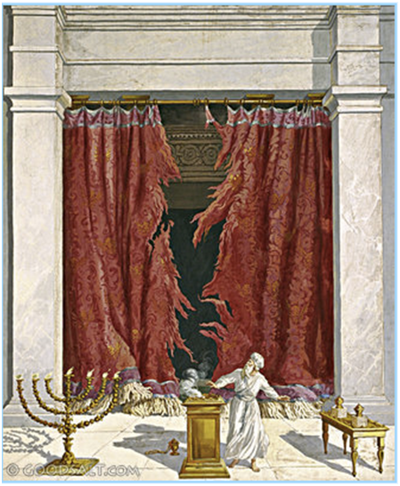
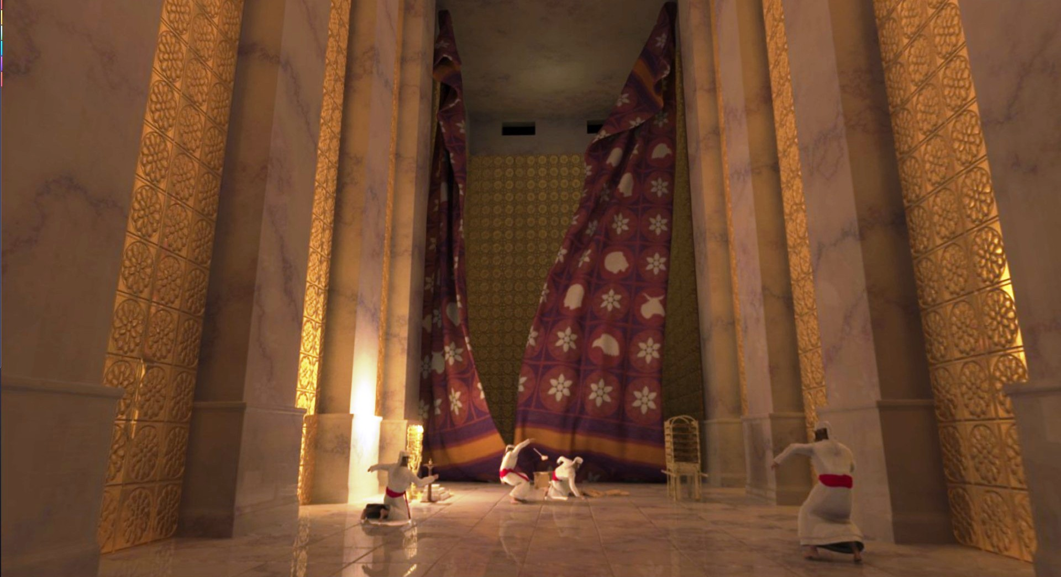

Slide 6
Worship Within the Veil
Mark 15:38 - When Jesus died, the veil was torn open.
Heb 10:19-20 - We now have an unbelievable privilege:
By the blood of Jesus, we can enter the most holy place!
God

Slide 7
Worship Within the Veil
Because we have this incredible privilege, how should we respond?
Heb 10:19-25 - Draw near, hold fast, consider each other
Heb 12:28-29 - Worship with reverence and awe
Heb 13:15 - Offer the sacrifice of praise
God

Slide 8
Offering a Better Sacrifice
What are the biggest obstacles to our worship?
External worship killers?

Slide 9
External Worship Killers
Song itself:
False doctrine
Confusing / unclear words (old language)
Music too difficult
New/unfamiliar
Circumstances:
Distractions: others, kids, talking, noise
Song leader: poor selection, not led well
Pitched too high/low, fast/slow
Lack of energy in worship

Slide 10
Offering a Better Sacrifice
What are the biggest obstacles to our worship?
External worship killers?
Internal worship killers?

Slide 11
Internal Worship Killers
Circumstances:
Lack of sleep/food
Chronic pain
Worry/distraction
Attitude:
Sin in my life
Not my favorite song, too fast/slow
Focused on song leader’s problems
Focused on others’ failure to worship
Laziness / lack of conviction

Slide 12
Offering a Better Sacrifice
What are the biggest obstacles to our worship?
External worship killers?
Internal worship killers?
What practical steps can we take to improve?
As worship leaders? As worshippers?
My sacrifice is my responsibility.

Slide 13
The Sacrifice of Praise
Heb 13:15 - How can I offer a better sacrifice?
Preparation: Get your heart ready
Perspective: Come into God’s presence
Participation: The more you put in, the more you and others benefit
Practice: Make hymns a habit, work at it

