Slide 1
Things Above
Notes:
Bill has set us up to see the problem clearly… The Colossians were being bombarded with empty philosophies…

Slide 2
A New Life
“you have been raised up with Christ”
A New King
“seated at the right hand of God”
A New Home
“things above, not…on earth.”
Notes:
When people are house-hunting sometimes they walk into a house and say “this is the one”. They fall in love with that home, even though they don’t live there yet.
And then they lay awake at night, imagining where the furniture will go, and hoping that nothing gets delayed.
This is Matthew 13! The pearl of great price. When he finds it, then this new pearl is all he can think about. He sells everything to gain what his heart can’t live without.
NEW LIFE: Greek, aorist tense
The AORIST tense always conveys a single, discreet action (i.e. simple aspect). This is the most common tense for referring to action in the past. The IMPERFECT tense always conveys past activity that was more than a single action in some way (i.e. ongoing aspect).
Point: We have been definitively raised up. Therefore “keep seeking…”. When we became a Christian, we decided to seek things above, not just treasures here.
Keep on this journey; don’t let anyone lure you away from it. Remember the transformation you’ve undergone. You have died. When we lived in the world, we were concerned about all of those practices, but we are different people now.
NEW KING… A king who rules out of total love and goodness. A King who defeated demons and the devil, who healed sickness and sadness. A King who conquered over criticism, rejection, and death. A king who endured my punishment so that I could join HIS family! What a KING!!! He has brought us into a NEW COVENANT. Not like the old, but a covenant of the heart.
NEW HOME… A place prepared for us by Jesus. A place prepared where in a resurrected body we can enjoy ETERNAL LIFE with God.
We want to look up and be in awe of God’s glory, of Christ’s pre-eminence, of this new fresh start we have been given – and start to dream about a life that is overflowing with praise to HIM.
New Direction.
New Objectives.
New Hope.
Ch 1: Our Lives Are Devoted To The Greatest King To Ever Exist.
Ch 2: Our Lives Are Guided By The Highest Wisdom The World Will Ever Know.
Ch 3: Our Hearts Are Transformed By The Deepest Love We Can Possibly Receive.
Ch 4: Our Concerns Are Elevated To The Spiritual Consequences Over The Physical.

Slide 3
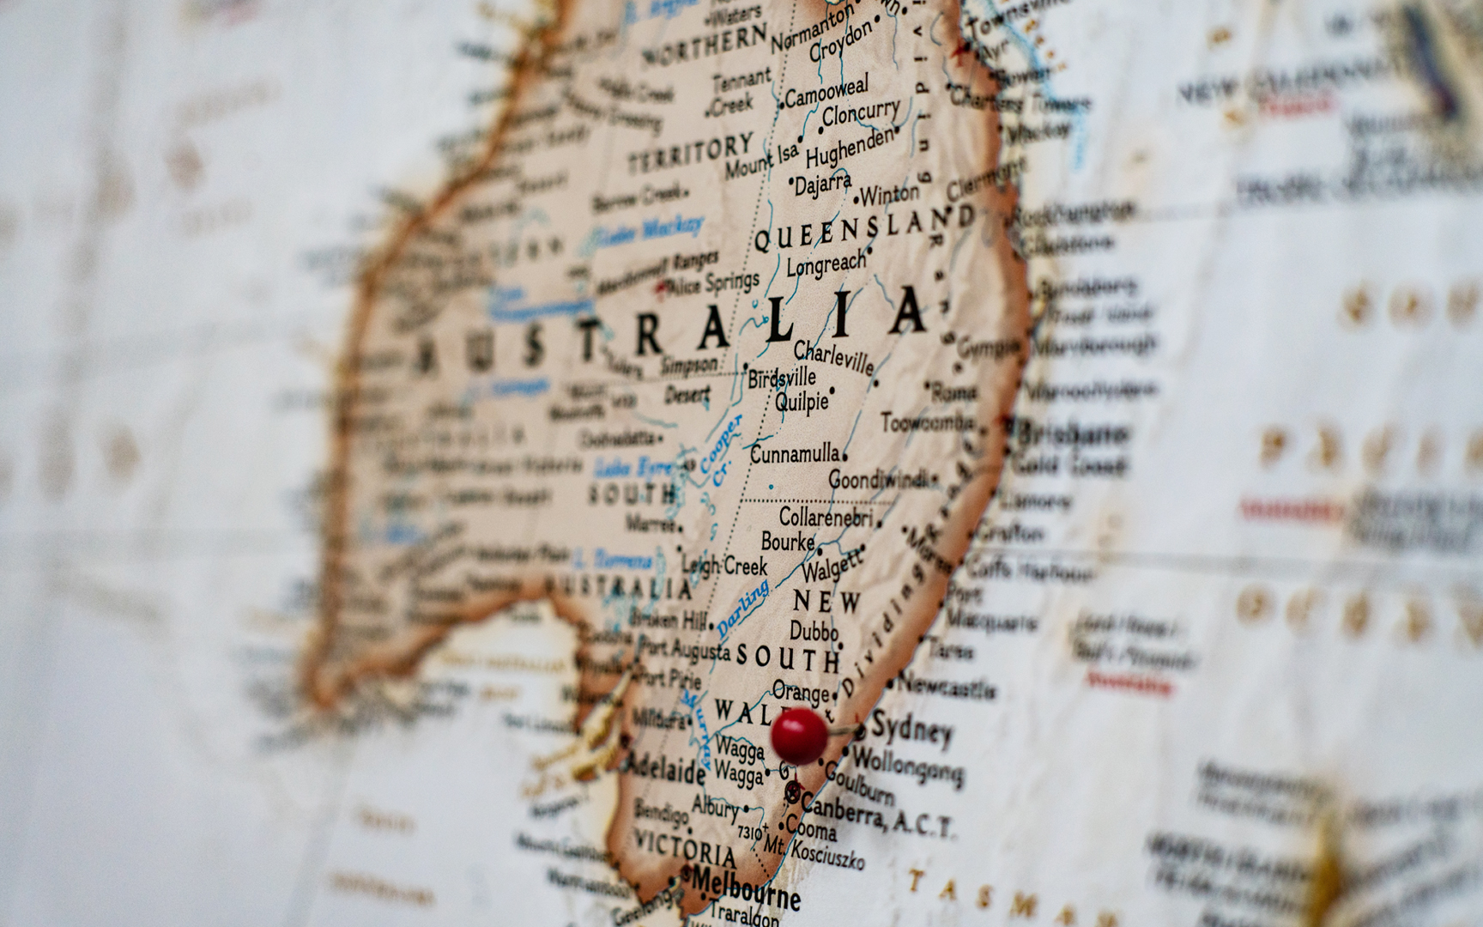
Notes:
I want to help us consider just how ENORMOUS this new life is by imagining…
If we were moving to Australia in 6 weeks, our minds would be LOCKED IN on this upcoming reality.
We’d want to learn everything we could about our new home and the new government we’d be living under.
I have a brand new life! If you moved to Australia, you’d be all about that house, and that food, and those relationships… You’d be building a new life based on your new position.
Likewise: Paul is telling us. We have a whole new life to build. The pursuits and aims of the world don’t even make sense any more. The pursuits and aims of pagan religions have no pull, no sway, for us. We can see them as totally irrelevant.
If we were moving out of state, and our best friend had purchased a beautiful home for us, our family was already there to get settled in, the moving truck had already taken our furniture…and we were just finishing a few jobs and handling the last few boxes. Our mind would be set on that new home.

Slide 4
Notes:
We would expect new sights, sounds, and experiences.
We would anticipate seeing things we’ve never seen before – things that we might read about, but are hard to fully imagine.

Slide 5
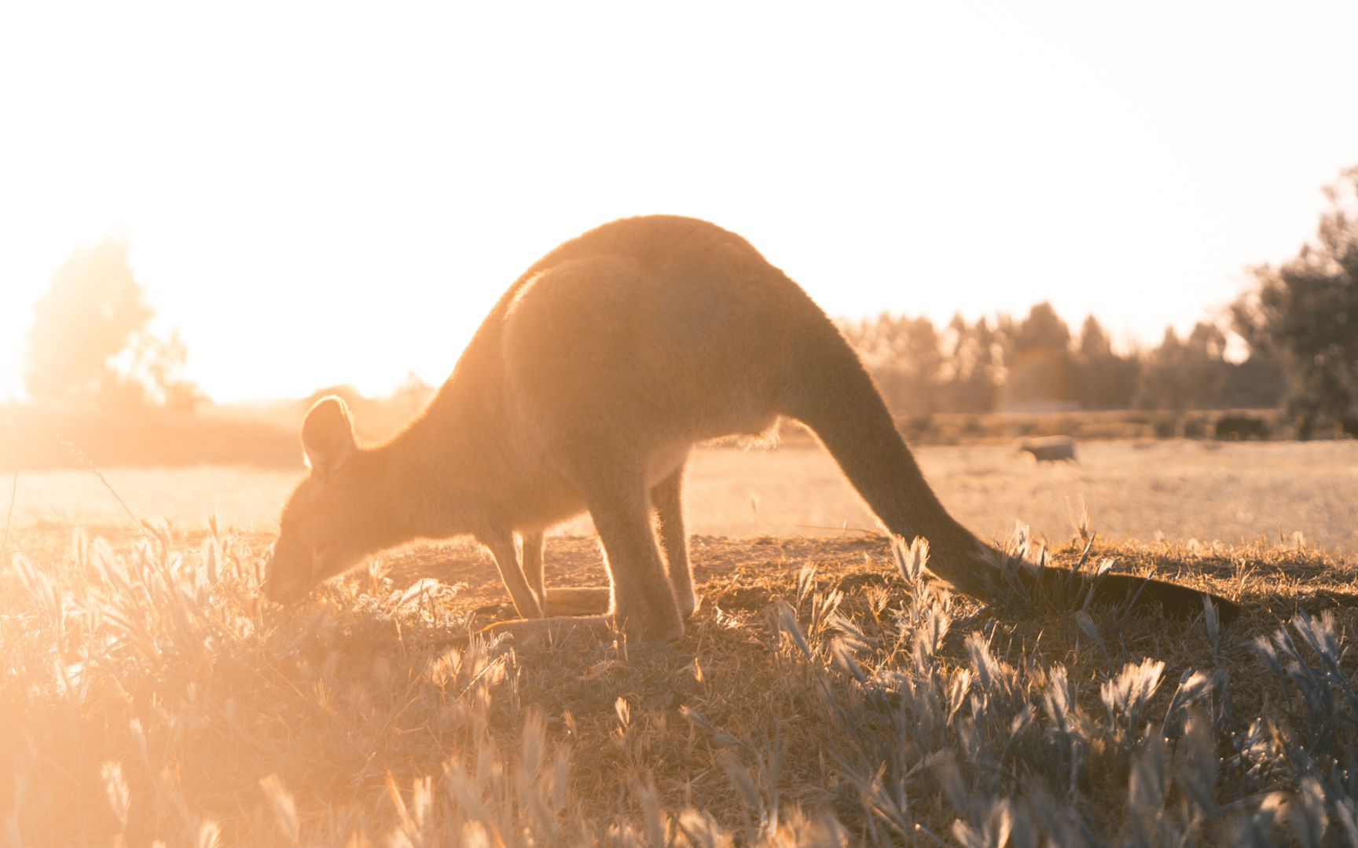
Notes:
As our minds became more and more consumed with our new home, our curiosity would grow for what unexpected adventures await us…
New parts of creation we haven’t really experienced…

Slide 6
Notes:
But not just what activities we might experience in this new place…but all the people who are there.
We think fondly of finally seeing Jesus face to face. Of being in the glory of God.
We think of the reunion with our friends or family who have gone to be with the Lord.
We think of the Great Cloud of Witnesses – heroes of faith – women and men who have run their race…
So we get ready. We prepare.

Slide 7
We think about all of our relationships and responsibilities in a whole new light.
Notes:
I want you to see tonight, that Paul isn’t asking us to IGNORE what’s happening around us.
He’s just asking us to respond to these events, relationships, and concerns in LIGHT of the NEW LIFE we have in CHRIST.
In Christ – I am going to respond with concern for your soul, not just your conditions.
In Christ – I am going to respond according to what is LOVING, not just what is legal.
In Christ – I am going to respond by talking to GOD, not just talking behind your back.
In Christ – I can see how much we have in COMMON, not the things the world says make us different.
In Christ – I am not concerned with what appears religious, but with a heart that loves like Jesus loved.

Slide 8
A mind set on things above replaces worldly thinking with new godly concerns.
The Flesh vs. The Spirit
Temporary vs. Eternal
Appearance vs. Reality
Notes:
Jesus makes this VIVIDLY CLEAR in the parable of the Bigger Barns in Luke 12:16-21…. Here is a man full of worldly thinking! His mind is set only on what he can see, and what he can use for his own purposes.
Like Jesus, Colossians is helping us to GET OUT of that empty way of thinking….
FLESH vs. SPIRIT… (1:21 “hostile in mind” and 3:18 “fleshly mind”)
Physical Appetites vs. Spiritual Appetites. We want to satisfy the hunger of our souls.
Instead of the pursuit of happiness, we are in pursuit of holiness.
Instead of wanting people to serve us, we are looking for ways to serve others.
TEMPORARY vs. ETERNAL: Treasure of the world vs. Treasure in Heaven.
- Instead of working to become wealthy, we are working to become generous.
APPEARANCE vs. REALITY:
Instead of judging things or people based on their appearance, we are concerned with the heart. (3:11)
These 3 SHIFTS in perspective are really well captured in Bill Hall’s little book “Two Men.”
* * This is clear in 2:23… we aren’t interested in things that just “appear” religious. We want an actual walk with God!
* * 1:10-12, the very thing Paul wants for them is to walk worthy, knowing the truth and doing good.
> We Count What We Can’t See… If you ask me to count my blessings, that’s different because I’m a Christian. I ”count” my salvation. I ”count” God’s patience. I “count” God’s promises. I “count” the Holy Spirit. I “count” my church family. I count many things that worldly people can’t count at all.
– we are laying up treasure in heaven.

Slide 9
A mind set on things above carries out earthly tasks with heavenly wisdom.
Our Whole Duty Is Clear
Our Talents Are God-Given
Our Problems Are Smaller
Notes:
I would love to get even more specific on this point, but we will save that for lesson 4 when we do a deep dive into chapter 3 and 4.
But there are some big picture points, I should include tonight….
Setting our minds on things above is NOT quitting our job and moving to a remote island while we wait for Jesus to return.
Setting our minds on things above is APPROACHING our DAILY relationships and responsibilities in a way that pleases and honors God.
I want you to see tonight, that Paul isn’t asking us to IGNORE what’s happening around us.
He’s just asking us to respond to these events, relationships, and concerns in LIGHT of the NEW LIFE we have in CHRIST.
Our Problems Are Smaller.
In Christ – I am going to respond with concern for your soul, not just your conditions.
In Christ – I am going to respond according to what is LOVING, not just what is legal.
In Christ – I am going to respond by talking to GOD, not just talking behind your back.
In Christ – I can see how much we have in COMMON, not the things the world says make us different.
In Christ – I am not concerned with what appears religious, but with a heart that loves like Jesus loved.

Slide 10
Paul’s Mindset…
“For to me, to live is Christ and to die is gain.” Philippians 1:21
“But whatever things were gain to me, those things I have counted as loss for the sake of Christ.” Philippians 3:8
“I press on toward the goal for the prize of the upward call of God in Christ Jesus.” Philippians 3:14
Notes:
1:24, 4:18
I have been on the front lines, suffering and praying for you, because I’m doing everything in my power (by God’s power) to make it possible for you to fully know God’s message.
He’s in prison, but He’s grateful for God’s blessings.
He’s in prison, but He’s serving others in the ways that he can. Writing to those he’s never even met.
He’s in prison, but His mind is set on things above.
When people are house-hunting sometimes they walk into a house and say “this is the one”. They fall in love with that home, even though they don’t live there yet.
And then they lay awake at night, imagining where the furniture will go, and hoping that nothing gets delayed.
This is Matthew 13! The pearl of great price. When he finds it, then this new pearl is all he can think about. He sells everything to gain what his heart can’t live without.
New Direction.
New Objectives.
New Hope.

Slide 11
We Are Citizens of Heaven
“And I heard a loud voice from the throne, saying, “Behold, the tabernacle of God is among men, and He will dwell among them, and they shall be His people, and God Himself will be among them, ⁴and He will wipe away every tear from their eyes; and there will no longer be any death; there will no longer be any mourning, or crying, or pain; the first things have passed away.” Rev. 21:3-4
Notes:
WE MUST… Look with Eyes of Faith At What Truly Lies Ahead. Don’t let the thoughts and ideas of this world crowd out the GLORY of what is to come!

Slide 12
We Will “Set” Our Minds
By being intentional about the things we meditate on.
By asking what would the “old me” do in this situation, and what is the “new me” going to do differently?
By dreaming about the ways we can carry out the Greatest Commandments and the Great Commission.
Notes:
How do we set our minds on things above when there is so much happening all around us?
We are not aiming to just casually think about these ideas every few months.
We are being commanded to LOCK – IN on this mindset. Like when you get a new phone – you set up all your apps and settings just the way you want.
I am SET to know HIM.
Like Locking in our Destination for GPS – we are enroute and are not changing course.
We are going to Know Him, Love Him, Worship Him, Trust Him & Obey Him.
** Point: The very fact that Paul commands this action is evidence that it can be done, but it needs to be done intentionally!
Most general since… this is the term for “be wise” (Homer).
Thinking – Actions – Results.
Paul intentionally addresses their THINKING.
I have a whole new FIELD OF STUDY to master. I want to really know what HE SAYS about this new path. I want to know what HE SAYS about how to respond when someone mistreats me. I want to know what HE DESIRES from ME.
Thinking with Maturity (1 Cor. 13:11)
Thinking with Humility ( Rom 12:3)
Thinking to Determine Our Conviction (Acts 28:22, Phil. 3:15)
Thinking in Agreement ( Phil. 2:2, 4:2)
Thinking to Direct Our Mind To A Subject (Rom 8:5-6, Philippians 2:5, Colossians 3:2)
Thinking with Care For One (Phil. 4:10)
How would the Colossians do this? They Would Have Their Shield Up & Mind Rooted In Truth (To Resist False Teachings.)
MEDITATE: 3:16 – songs help.
OLD ME vs. NEW ME… How can this choice advance God’s kingdom?
What perspective and attitude would Christ bring to this problem?
Is this a fleshly desire or spiritual desire?
DREAMS…
So what does your family imagine as the difference you will make with your lives?
Teens: Set your mind on things above. Don’t dream about the ultimate video game home theatre… Dream about one of your school friends being baptized.
We dream of a day when there is less religious division – because we set aside our opinions and submit to the words of Scripture.
We dream of helping these teens avoid the pain of mistakes from our past.
We dream of supporting men to travel to places near and far where they don’t know about Jesus.
The entire world needs evangelism in EVERY generation.
I dream of being a husband who loves my wife with the selflessness and compassion of JESUS!
I dream of teaching my children with the patience and wisdom that God has exercised toward me!
I dream of doing my job with the gusto, the passion, the quality that surprises others…
I dream of knowing more and more of God’s insights about Himself, and His purposes…than just knowing more about my hobbies.
I dream of spending forever with people from all time and places who put their faith in Jesus.

Slide 13
A New Life
“you have been raised up with Christ”
A New King
“seated at the right hand of God”
A New Home
“things above, not…on earth.”
Notes:
As Christians, we have a new…
Let’s live this week, and all the weeks ahead – with the NEW MINSET of JESUS. Excited about and pursuing the things above, not the temporary things here that are passing away.

Slide 14
Things Above
Notes:
I hope tonight’s lesson has helped you RE-CONNECT with that HEAVEN-CENTERED mindset of Christ and of Paul.
If you want this new Life, and new King and new home to be yours – then don’t wait. Come and be baptized into Christ Jesus for the forgiveness of your sins.

