Slide 1
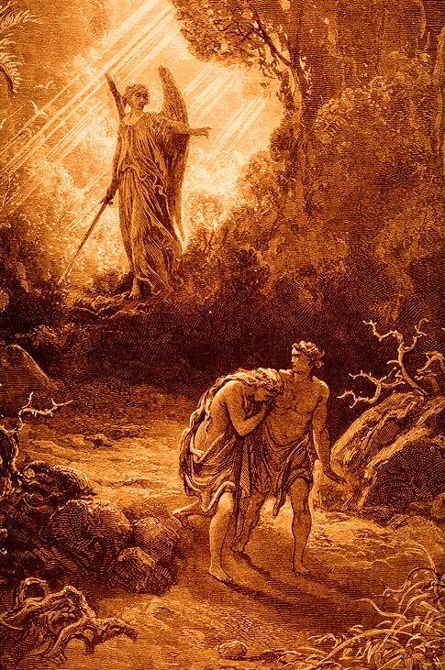
Genesis 1-2
Genesis 3-6
Genesis 6-7
Creation
Rebellion
Destruction

Slide 2
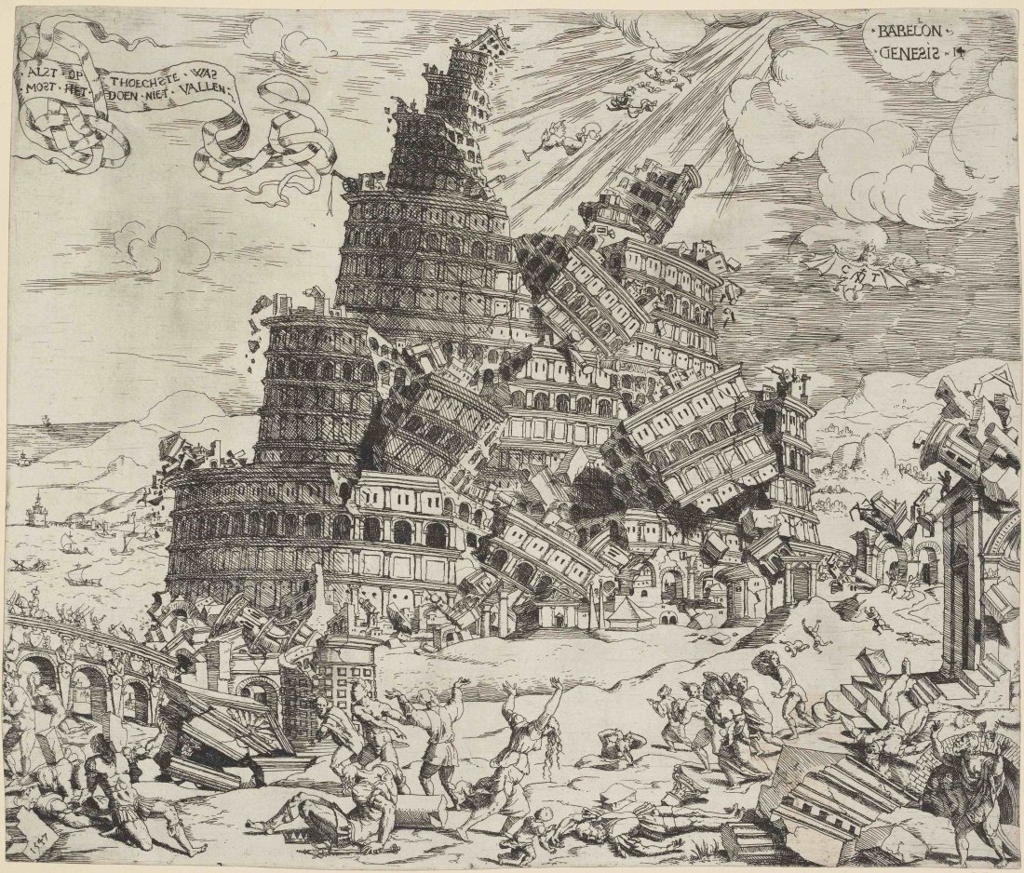
Genesis 8-9
Genesis 9-11
Genesis 11
Creation
Rebellion
Destruction
Destruction

Slide 3
Genesis 12
Israel’s History
Babylonian Exile
Creation
Rebellion
Destruction
Destruction

Slide 4
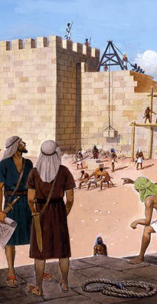
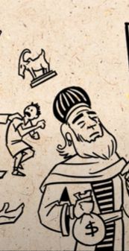
Return from Exile
Malachi
Creation
Rebellion
Destruction

Slide 5
“…all the prophets who have spoken, from Samuel and his successors onward, also announced these days. ²⁵ It is you who are the sons of the prophets and of the covenant which God made with your fathers, saying to Abraham, ‘And in your seed all the families of the earth shall be blessed.’ ²⁶ For you first, God raised up His Servant and sent Him to bless you by turning every one of you from your wicked ways.”
Acts 3:24-26
“Therefore, let all the house of Israel know for certain that God has made Him both Lord and Christ—this Jesus whom you crucified.”
Acts 2:36

Slide 6
¹⁰ By this will we have been sanctified through the offering of the body of Jesus Christ once for all...¹² but He, having offered one sacrifice for sins for all time, sat down at the right hand of God, ¹³ waiting from that time onward until His enemies be made a footstool for His feet. ¹⁴ For by one offering He has perfected for all time those who are sanctified.”
Heb. 10:10, 12-14
“¹…we have peace with God through our Lord Jesus Christ… ¹¹ And not only this, but we also exult in God through our Lord Jesus Christ, through whom we have now received the reconciliation.”
Rom. 5:1, 11

Slide 7
“Wretched man that I am! Who will set me free from the body of this death?
²⁵ Thanks be to God through Jesus Christ our Lord!”
Rom. 7:24-25

Slide 8
We Need Jesus

