Slide 1
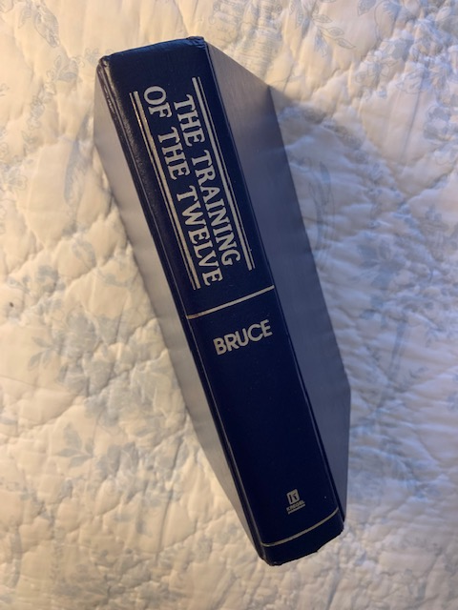
A Major Challenge::
Training the Twelve to Think Spiritually

Slide 2
“Beware of the Leaven of the Pharisees and Sadducees”
^{MATTHEW 16:5} Now when His disciples had come to the other side, they had forgotten to take bread.
⁶ Then Jesus said to them, “Take heed and
And they reasoned among themselves, saying, “It is because we have taken no bread.”

Slide 3
⁸ But Jesus, being aware of it, said to them, “O you of little faith, why do you reason among yourselves because you have brought no bread? ⁹ Do you not yet understand, or remember the five loaves of the five thousand and how many baskets you took up? ¹⁰ Nor the seven loaves of the four thousand and how many large baskets you took up? ¹¹ How is it you do not understand that I did not speak to you concerning bread?—but to beware of the leaven of the Pharisees and Sadducees.”

Slide 4
¹² Then they understood that He did not tell them to beware of the leaven of bread, but of the doctrine of the Pharisees and Sadducees.
Unsound doctrine is a more serious problem than a lack of food!

Slide 5
Four Questions:
Why was their doctrine so dangerous?
Why was false doctrine called leaven?
Do we need to fear false doctrine now?
How can we detect false doctrine?

Slide 6
1. Why was their Doctrine so Dangerous?
They were recognized as spiritual leaders.
They were hypocrites (Luke 12:1; Matt. 7:15).
They taught some truth (Matthew 23:1)
They justified disobedience (Matt. 15:4-6)
They added their traditions (Matt. 15:9)
Would do anything to protect their position.
Sadducees denied resurrection (Acts 23:8)

Slide 7
Four Questions:
Why was their doctrine so dangerous?
Why was false doctrine called leaven?

Slide 8
2. Why was False Doctrine Called Leaven?
Like leaven, it affects everything around it.
It is contagious, spreading to other people.
It leads to other error (Calvinism)
It leads to sin (Genesis 3)
But shun profane and idle babblings, for they will increase to more ungodliness. ¹⁷ And their message will spread like cancer. Hymenaeus and Philetus are of this sort, ¹⁸ who have strayed concerning the truth, saying that the resurrection is already past; and they overthrow the faith of some. (2 Tim. 2:16-18)

Slide 9
Four Questions:
Why was their doctrine so dangerous?
Why was false doctrine called leaven?
Do we need to fear false doctrine now?
24 of the 27 books of the New Testament contain warnings!

Slide 10
2 Peter 2:1-3
2 But there were also false prophets among the people, even as there will be false teachers among you, who will secretly bring in destructive heresies, even denying the Lord who bought them, and bring on themselves swift destruction. ² And many will follow their destructive ways, because of whom the way of truth will be blasphemed. ³ By covetousness they will exploit you with deceptive words; for a long time their judgment has not been idle, and their destruction does not slumber.

Slide 11
Four Questions:
Why was their doctrine so dangerous?
Why was false doctrine called leaven?
Do we need to fear false doctrine now?
How can we detect false doctrine?

Slide 12
1 John
1:1-2 That which was from the beginning, which we have heard, which we have seen with our eyes, which we have looked upon, and our hands have handled, concerning the Word of life— ² the life was manifested, and we have seen, and bear witness, and declare to you that eternal life which was with the Father and was manifested to us—
4:1 Beloved, do not believe every spirit, but test the spirits, whether they are of God; because many false prophets have gone out into the world.
4:6 We are of God. He who knows God hears us; he who is not of God does not hear us. By this we know the spirit of truth and the spirit of error.

Slide 13
2 Timothy 3:16-17
¹⁶ All Scripture is given by inspiration of God, and is profitable for doctrine, for reproof, for correction, for instruction in righteousness, ¹⁷ that the man of God may be complete, thoroughly equipped for every good work.

Slide 14
But what if people don’t want doctrine?
Don’t be surprised!

Slide 15
² Preach the word! Be ready in season and out of season. Convince, rebuke, exhort, with all longsuffering and teaching (doctrine). ³ For the time will come when they will not endure sound doctrine, but according to their own desires, because they have itching ears, they will heap up for themselves teachers; ⁴ and they will turn their ears away from the truth, and be turned aside to fables. ⁵ But you be watchful in all things, endure afflictions, do the work of an evangelist, fulfill your ministry. (2 Timothy 4:2-5)
What are we to do?

Slide 16
Acts 17:11
¹¹ These were more noble than those in Thessalonica, in that they received the word with all readiness of mind, and searched the scriptures daily, whether those things were so.
Unsound doctrine is a more serious problem than a lack of food!

