Slide 1
The Way of Balaam 2 Pedro 2:15-16
El CAMINO DE
2 PEDRO 2:15-16
Notes:
Let’s talk for a moment about a FAITH that doesn’t save.
He knows who God is.
He knows what God commands.
He speaks God’s words.
But He is not loyal to God above all others.
He does not love God more than fame and fortune.
We are inviting you tonight to follow the WAY OF JESUS. The true King. The true Savior.

Slide 2
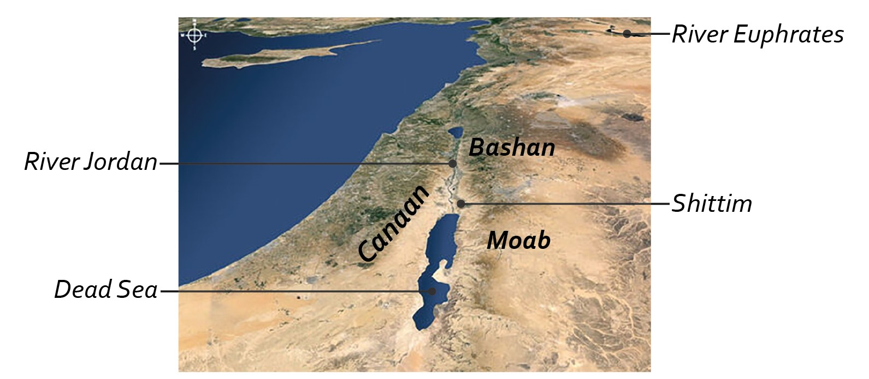
Números 22-24
Río Éufrates
Basán
Río Jordán
Sitim
Mar Muerto
Notes:
After Israel has traveled along the edges of Edom and Moab, they have had to battle two kings.
Balak is so full of fear – that he decides to launch a pre-emptive strike on Israel.
Deut. 23:4 – of Mesopotamia.

Slide 3
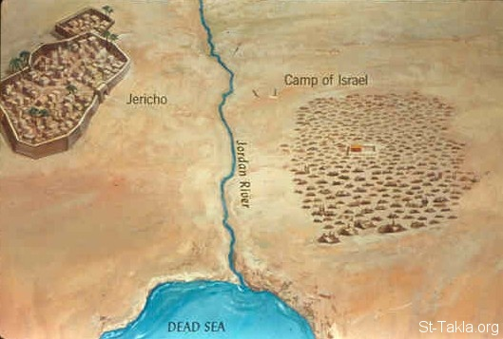
Números 22-24
Campamento de Israel
Jericó
Río Jordán
MAR MUERTO
Notes:
So they are not even in MOAB, and have no plan of attacking Moab, but as we see in the first few verses – the People are terrified because nearly 2 million strangers are camped out.

Slide 4
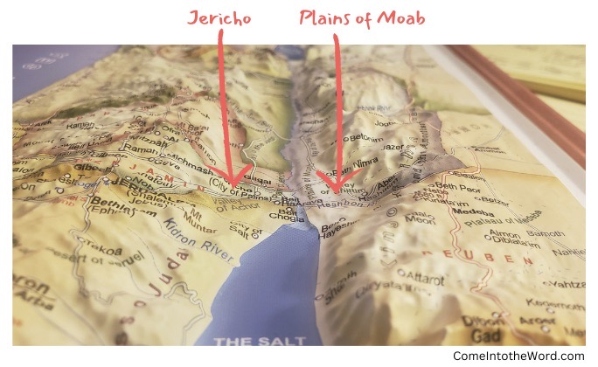
Números 22-24
Jericó
Llanuras de Moab
Notes:
It is also beneficial to think about this being in the PLAINS of Moab, because it helps us understand how Balak selects several positions where from the higher ground he and Balaam can look down and see this mass of people camping in the plains below.

Slide 5
La historia inesperada de Balac y Balaam
Balaam rechaza la invitación de Balac. (Números 22:6-14)
Dios está enojado por el viaje de Balaam. (Números 22:22-35)
Notes:
The Narrative of Números doesn’t actually require these chapters. They could be taken out and you’d still get the message. But this unexpected prophet is given 3 whole chapters – because his life is treated by Scripture as an always relevant, always important warning.
This story unfolds masterfully. A big reason it is so memorable because it has so many Plot Twists… So many unexpected turns that grab our attention and make us wonder WHY these things are unfolding in such a unique way.
Don’t let knowing this story cause you to overlook how many twist and turns this narrative follows.
ODD juxtaposition – how can a prophet of God be wrapped up in superstition and heathenism?
BALAK – declined? The world is often confident in the attractiveness of it’s rewards. As Pedro wrote – they think it strange that we don’t run with them into excesses of sin any longer.
God Both Permits & Is Angry About Balaam’s Journey.

Slide 6
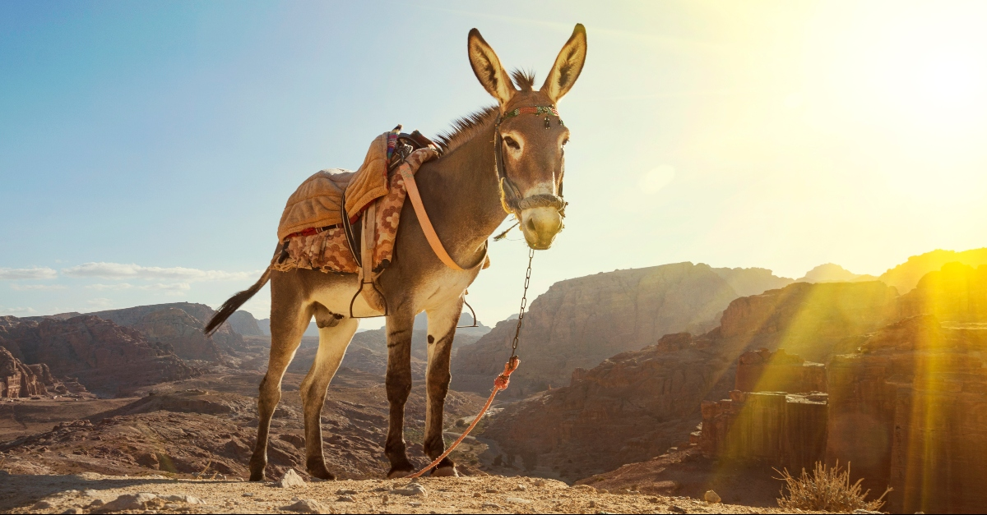
La historia inesperada de Balac y Balaam
Notes:
22:23-35
The Angel and the Donkey are the only one who really honor God here.

Slide 7
La historia inesperada de Balac y Balaam
Balaam rechaza la invitación de Balac. (Números 22:6-14)
Dios está enojado por el viaje de Balaam. (Números 22:22-35)
La maldición de Balaam se vuelve en bendición. (Números 23:8)
Balac multiplica sus malas decisiones. (Núm. 23:20,24, Núm. 24:3-5, Núm. 24:17)
Balaam le enseña a Balac a tentar a Israel con idolatría. (Números 24:14, Números 31:16)
Notes:
The Narrative of Números doesn’t actually require these chapters. They could be taken out and you’d still get the message. But this unexpected prophet is given 3 whole chapters – because his life is treated by Scripture as an always relevant, always important warning.
This story unfolds masterfully. A big reason it is so memorable because it has so many Plot Twists… So many unexpected turns that grab our attention and make us wonder WHY these things are unfolding in such a unique way.
Don’t let knowing this story cause you to overlook how many twist and turns this narrative follows.
ODD juxtaposition – how can a prophet of God be wrapped up in superstition and heathenism?
BALAK – declined? The world is often confident in the attractiveness of it’s rewards. As Pedro wrote – they think it strange that we don’t run with them into excesses of sin any longer.
God Both Permits & Is Angry About Balaam’s Journey.

Slide 8
El “camino de Balaam” es una advertencia permanente para el pueblo de Dios.
Problema triple: extremadamente tentador, engañosamente malo y trágicamente inútil.
2 Pedro 2:15-16, Judas 11, Apocalipsis 2:14
Por favor, no le ruegues a Dios por algo que no es bueno para ti.
Por favor, recuerda que algunos falsos profetas pueden conocer la palabra de Dios, pero sin vivir conforme a ella.
2 Pedro 2:21-22
Notes:
We cannot underestimate how powerful these temptations are!
This is a textbook case of greed
We need to think of Balaam’s Character. Balaam’s Journey. And Balaam’s Fall.
Interesting Side Note: Part of our insight into Balaam’s heart is his cruelty towards animals. When people are cruel and hurtful to animals that are weak and helpless – their own hearts get darker.
Every adult here should be uncomfortable to realize how much we have in common with Balaam. He knew God. He was able to teach others about God. He had a reputation for his relationship with God. And people were patient with him.
Balaam Becomes His Own Worst Enemy! Satan will target the weak spots in our hearts.
Super Obvious, But Also The Downfall of Millions in Every Generation.
He is literally a lesson in a wasted life. In someone who had EVERY ADVANTAGE. Who had everything going for Him. And threw it all away.
False Prophets: He might as well have had a “For Sale” sign in his front yard. He sold his soul for a chance at fame and fortune.

Slide 9
El “camino de Balaam” es una advertencia permanente para el pueblo de Dios.
Balaam es egoísta,
Obsesionado con las riquezas terrenales,
Fácilmente frustrado
Y una peligrosa piedra de tropiezo.
Jesús vive para servir a los demás,
Acumular tesoro en el cielo,
Volver la otra mejilla
Y levantar a otros que han caído.
Notes:
We cannot underestimate how powerful these temptations are!
This is a textbook case of greed
We need to think of Balaam’s Character. Balaam’s Journey. And Balaam’s Fall.
Interesting Side Note: Part of our insight into Balaam’s heart is his cruelty towards animals. When people are cruel and hurtful to animals that are weak and helpless – their own hearts get darker.
Every adult here should be uncomfortable to realize how much we have in common with Balaam. He knew God. He was able to teach others about God. He had a reputation for his relationship with God. And people were patient with him.
Balaam Becomes His Own Worst Enemy! Satan will target the weak spots in our hearts.
Super Obvious, But Also The Downfall of Millions in Every Generation.
He is literally a lesson in a wasted life. In someone who had EVERY ADVANTAGE. Who had everything going for Him. And threw it all away.
False Prophets: He might as well have had a “For Sale” sign in his front yard. He sold his soul for a chance at fame and fortune.

Slide 10
Cuando Dios está por nosotros, no tenemos nada que temer.
⁵ ¡Cuán hermosas son tus tiendas, oh Jacob; Tus moradas, oh Israel!
6 Como valles que se extienden, Como jardines junto al río, Como áloes plantados por el SEÑOR, Como cedros junto a las aguas.
7 Agua correrá de sus baldes, Y su simiente estará junto a muchas aguas; Más grande que Agag será su rey, Y su reino será exaltado. (Números 24:5-7)
Notes:
God’s Words in Balaam’s prophecy shows us how God views HIS people – even after they have sinned in the past.
God’s words in Balaam’s prophecy even point towards the future Kingdom!

Slide 11
Cuando Dios está por nosotros, no tenemos nada que temer.
¹⁶ Oráculo del que escucha las palabras de Dios, Y conoce la sabiduría del Altísimo; Del que ve la visión del Todopoderoso, Caído, pero con los ojos descubiertos.
17 Lo veo, pero no ahora; Lo contemplo, pero no cerca; Una estrella saldrá de Jacob, Y un cetro se levantará de Israel Que aplastará la frente de Moab Y derrumbará a todos los hijos de Set. (Números 24:16-17)
Notes:
God’s Words in Balaam’s prophecy shows us how God views HIS people – even after they have sinned in the past.
God’s words in Balaam’s prophecy even point towards the future Kingdom!

Slide 12
Evitando los pecados de Balaam
¿Qué reputación tengo hoy? (Núm. 22:6, Prov. 22:1)
¿A quiénes realmente me importa impresionar? (Gál. 1:10)
¿Realmente quiero oír el mensaje de Dios? (Gál. 4:16, Núm. 24:10-11)
¿Cómo trato a otros que ven más que yo?
¿Estoy alerta por las piedras de tropiezo por delante? (Rom. 14:13)
¿Llevará mi consejo a otros más cerca de Dios? (Stg. 5:19-20)
¿Cómo seré recordado en el futuro?
Notes:
Trying To Impress The Wrong People Is A Devastating Decision.
> Am I trying to impress people with clothing that is immodest? What a trainwreck.
> Am I trying to impress people who don’t even know God? What a misguided ambition!
Do I Want To Hear.
Regardless of the Messenger?
Regardless of the Message? (Num. 24:10-11)
Beware of flattery! (Proverbs 29:5 - A man who flatters his neighbor spreads a net for his feet.)
Please – DON’T GO – with people who want you to do what you KNOW you can’t do!
Who I want to impress will determine WHERE I want to be and what I want to have.
Num. 31:16 and Rev. 2:14
DO I WANT TO HEAR?
(23:25 – and 24:10-11. He gets so frustrated! He wants Balaam to stop in the middle of the blessings.)
TREAT OTHERS WHO SEE MORE… Humility to listen and accept that they are looking out for me!
Please don’t take that job.
Please don’t rush into that marriage.
Please don’t dwell on that failure.
Please don’t take this lightly.
STUMBLING BLOCKS…
HOW WILL I BE REMEMBERED… Not just that he fell – but that he had been moving that way over the course of many bad decisions, day after day. That he had ignored and rejected his conscience.
Números 23:10 – He wants to die the death of the righteous – but isn’t willing to LIVE the life of a TRUE servant of God.

Slide 13
The Way of Balaam 2 Pedro 2:15-16
El CAMINO DE
2 PEDRO 2:15-16
Notes:
Let’s talk for a moment about a FAITH that doesn’t save.
He knows who God is.
He knows what God commands.
He speaks God’s words.
But He is not loyal to God above all others.
He does not love God more than fame and fortune.
We are inviting you tonight to follow the WAY OF JESUS. The true King. The true Savior.

