Slide 1
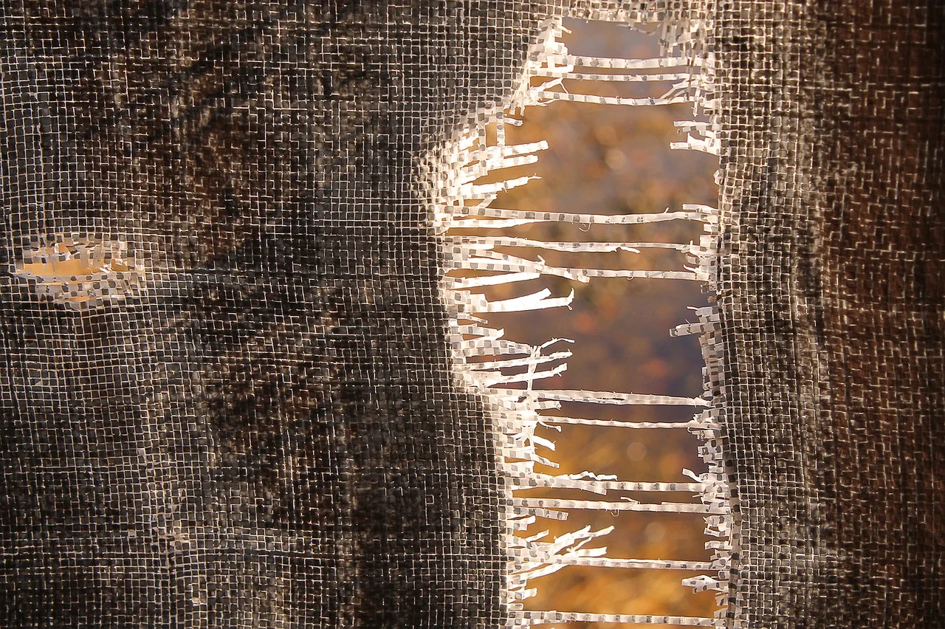
Why Rip Your Robe?

Slide 2
The custom of tearing clothes
Dozens of times in the Bible: scenes of strong emotions
To us, a strange custom
Not suggesting we adopt the practice
Studying the practice in the Bible can bring out some valuable lessons

Slide 3
Sadness and Anguish in our Culture
Flag at half mast
Black clothing
Postings of mourning or R.I.P.

Slide 4
Two examples in the same context
Reuben
Intended to return Joseph to his father (Genesis 37:21-22)
When he found Joseph missing (sold), he tore his garments in anguish (Genesis 37:29-30)
Jacob
Convinced that Joseph was dead (Genesis 37:32-33)
Tore his clothes in mourning (Genesis 37:34)
Wore sackcloth (another custom of mourning)
Ripping robes

Slide 5
Tearing clothes: Other examples
David (2 Samuel 1:11-12)
Ahab (1 Kings 21:27-29)
Elisha (2 Kings 2:11-12)
Mordecai (Esther 4:1)
Job (Job 1:20)
Paul and Barnabas (Acts 14:12-14,18)

Slide 6
Errors: To rip or not to rip?
They should have torn their clothes! (Jeremiah 36:20-26)
Prohibited for high priest to tear his clothes (Levíticus 21:10; 10:6)
Context: holy and uncontaminated (Leviticus 21:11-12)
What about Caiphas? (Matthew 26:65)

Slide 7
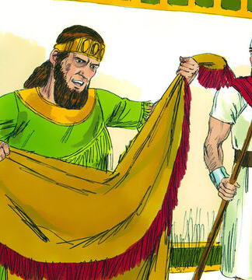
A special case
Naaman came to the king of Israel seeking a cure (2 Kings 5:1-6)
The king ripped his clothes in anguish (2 Kings 5:7)
Elisha asked an interesting question (2 Kings 5:8)
Authorized image use:
Sweet Publishing / FreeBibleimages.org

Slide 8
What do we learn?
Normal to mourn losses
Saddened and anguished when we sin (Joel 2:12-13)
Always respect God´s holiness

Slide 9
Should not rip our robes about things beyond our control
Different roles
Recognize that others have free will
The Lord Himself does not force anyone to repent (Matthew 23:37)
Not to live in worry
What else do we learn?

Slide 10
In practice...
Sadness and anguish have their place
Sin should be our primary reason for anguish
We must never forget that the Almighty God is in control

Slide 11
There is One who wants to take our burdens
“Come to Me, all who are weary and heavy-laden, and I will give you rest. Take My yoke upon you and learn from Me, for I am gentle and humble in heart, and you will find rest for your souls. For My yoke is easy and My burden is light.”
(Matthew 11:28-30)

